Slide 1
DIABETES MELLITUS PREDICTION BASED ON MACHINE LEARNING TECHNIQUES
Presented by,
1. Priyaa L D [810020205064] 2. Saravanadevi M [810020205075] 3. Podhumani M [810020205313]
Under the guidance of,
Dr.S.Sathiya Devi
M.Tech, Ph.D Assistant professor
Department of Information Technology
University College of Engineering, Tiruchirappalli (BIT Campus)

Slide 2
AGENDA:
Introduction
Literature survey
Objective
Flow diagram
Dataset Collection
Dataset Pre-processing
Model Creation
Performance Evaluation
Experiments and results
Reference

Slide 3
INTRODUCTION:
DIABETES (diabetes mellitus) is a group of endocrine disease characterised by sustained high blood sugar level.
Types:
1. Type 1 diabetes(Insulin-dependent Diabetes):
caused when pancreas cannot produce enough Insulin.
2. Type 2 diabetes(Non Insulin-dependent Diabetes):
caused when insulin produced by pancreas can’t be used by cells of the body.
3. Gestational diabetes:
caused due to high blood sugar level during pregnancy.

Slide 4
INTRODUCTION
INSULIN:
The hormone “Insulin” move from blood to cells and instruct cells to consume blood glucose to produce energy in humans.
Insulin range:
usual range→70 to 99 mg/dl.
prediabetic range→100 to 125 mg/dl.
diabetic range→126 mg/dl.

Slide 5
LITERATURE SURVEY
AUTHOR | ALGORITHMS USED | DATASET | ADVANTAGES | DISADVANTAGES
Aishwarya Mujumdar, Dr. vaidehi [1]. | KNN(),DTC(),ETC(),RF(), GaussianNB(),LDA(),SVC(), LinearSVC(), Adaboost(),LR(), Perceptron(),GBC(). | (1)PIMA Indian Diabetes Dataset (PIDD). (2) Synthetic dataset. | Data obtained is more accurate and precise. | Unaware of patients with starting stage of diabetes.
KM Jyoti Rani [2]. | KNN(), LR(),DT(), RandomForest Classifier(), SVM(). | PIMA Indian Diabetes Dataset(PIDD). | 99% accuracy achieved Using Decision Tree. | Records with zero(non null value)are not pre-processed to get more accuracy.
S.Reshmi, S.Kr. Biswas, A.N.Bourah, D.M.Thounaojam, B.Purkayastha [3]. | Decision Tree(), RandomForest Classifier(). | PIMA Indian Diabetes Dataset(PIDD). | Null values are Pre-processed. | Not considered the crucial factors related to gestational diabetes like Dietary Pattern, Metabolic Syndrome.

Slide 6
LITERATURE SURVEY
AUTHOR | ALGORITHMS USED | DATASET | ADVANTAGES | DISADVANTAGES
S.S.Bhat,V.Selvam, G.A.Ansari, M.H.Rahman [4]. | RF(), MLP(), SVM(), GB(), DT(), LR(). | (1) PIMA Indian Diabetes Dataset(PIDD), (2)Clinical dataset. | Duplicate data and irrelevant data are eradicated. | We are unaware of patients with more prone to diabetes who are non-diabetic at present.
M.Soni, Dr.S.Varma [5]. | SVM(), KNN(), DTC(), LR(), RF(), GB(). | PIMA Indian Diabetes Dataset(PIDD). | Data is pre-processed at the initial stage before implementation. | Duplicate data are not cleared.

Slide 7
OBJECTIVE
To predict the Diabetes using various Machine Learning algorithms including K-Nearest Neighbour(KNN), Decision Tree Classifier(DTC), Naïve Bayes(NB), AdaBoost, Random Forest Classifier(RF).

Slide 8
DATA FLOW DIAGRAM
LEVEL 0 DFD:
Machine Learning Algorithms
Input Dataset
Output

Slide 9
DATA FLOW DIAGRAM
LEVEL 1 DFD:
Pre-processing
Classifiers
Input dataset
Pre-processed dataset
Prediction

Slide 10
MODULES
Dataset collection
Dataset pre-processing
Model creation
Performance evaluation
Experimental results

Slide 11
DATASET COLLECTION
The dataset to be used is “PIMA Indian Diabetes Dataset” from National Institute of Diabetes and Digestive and Kidney Diseases[6].
Size of the dataset :- 9 KB
Total number of records :- 768
Total number of attributes :- 9
List of Attributes :-
Input variables:
Pregnancy, BMI, Glucose, BP, Skin Thickness, Age, Insulin, DiabetesPedigreeFunction.
Output variable:
Outcome.

Slide 12
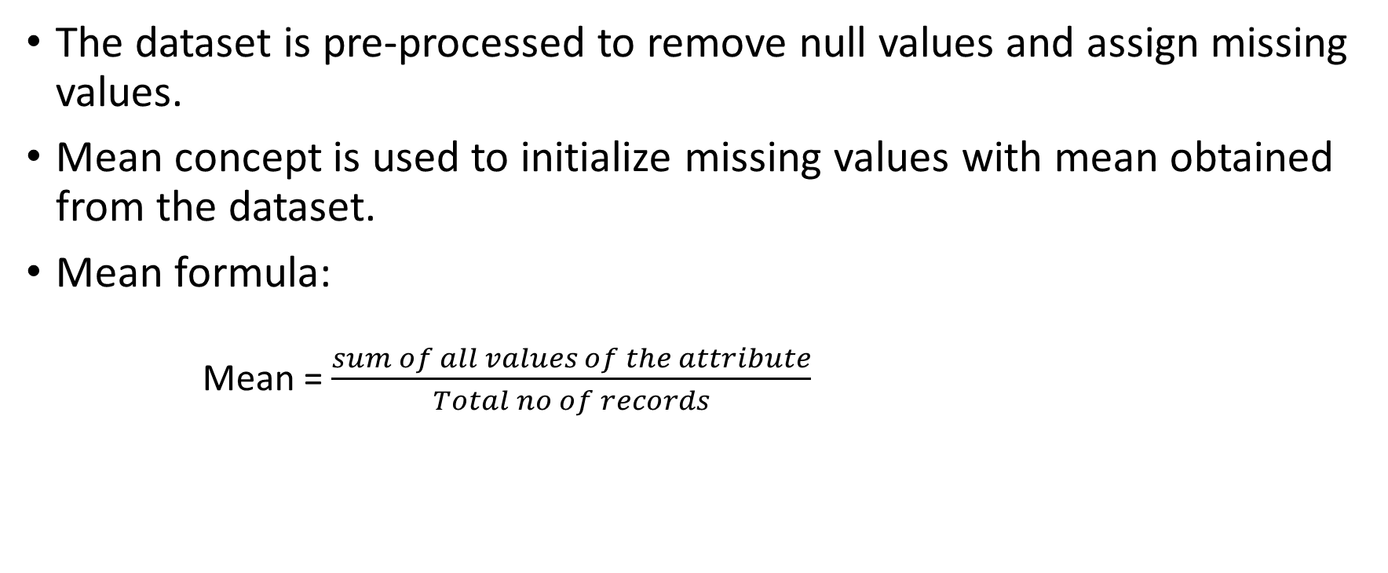
DATA PRE-PROCESSING
The dataset is pre-processed to remove null values and assign missing values.
Mean concept is used to initialize missing values with mean obtained from the dataset.
Mean formula:
Mean = $\frac{sum of all values of the attribute}{Total no of records}$

Slide 13
CLASSIFIERS USED
AdaBoost classifier
Decision Tree Classifier
K-Nearest Neighbor
Naïve Bayes
Random Forest Classifier

Slide 14
AdaBoost
Ensemble machine learning technique.
Classified under ensemble boosting technique.
Adaboost is also known as adaptive boosting.

Slide 15
AdaBoost
Steps involved:
1. Assign equal weight to all the observations.
2. Classify random samples using stumps.
3. Calculate Total Error.
4. Calculate performance of the stump.
5. Update weights.
6. Update weights in iteration.
7. Final prediction.

Slide 16
Decision tree Classifier(DTC)
Supervised machine learning technique.
Steps involved:
1. Determine the Root of the tree.
2. Calculate the Entropy after spilt for the classes.
3. Calculate the Entropy after spilt for each attribute.
4. Calculate information gain for each spilt.
5. Perform the spilt.
6. Perform further splits.
7. Complete the Decision tree.

Slide 17
K-Nearest Neighbour(KNN)
Supervised machine learning technique.
Steps involved:
1. Select the number K of the neighbors.
2. Calculate the Euclidean distance of K number of neighbors.
3. Take the K nearest neighbors as per the calculated distance.
4. Among these k neighbors, count the number of the data points in each category.
5. Assign the new data points to that category for which of the neighbour is maximum.
6. Our model is ready.

Slide 18
Naïve Bayes(NB)
Steps involved:
1. Calculate prior probability for given class labels.
2. Calculate conditional probability with each attribute for each class.
3.Multiply same class conditional probability.
4.Multiply prior probability with step3 probability.
5.See which class has higher probability. Higher probability class belongs to given input set step.

Slide 19
Random Forest Classifier(RF)
Ensemble machine learning technique.
Classified under ensemble bagging technique.
Steps involved:
1. Start with the selection of random samples from a given dataset.
2. This algorithm will construct a decision tree for every sample.Then it will get the prediction result from every decision tree.
3. In this step ,voting will be performed for every predicted result.
4. At last, select the most voted prediction result as the final prediction result.

Slide 20
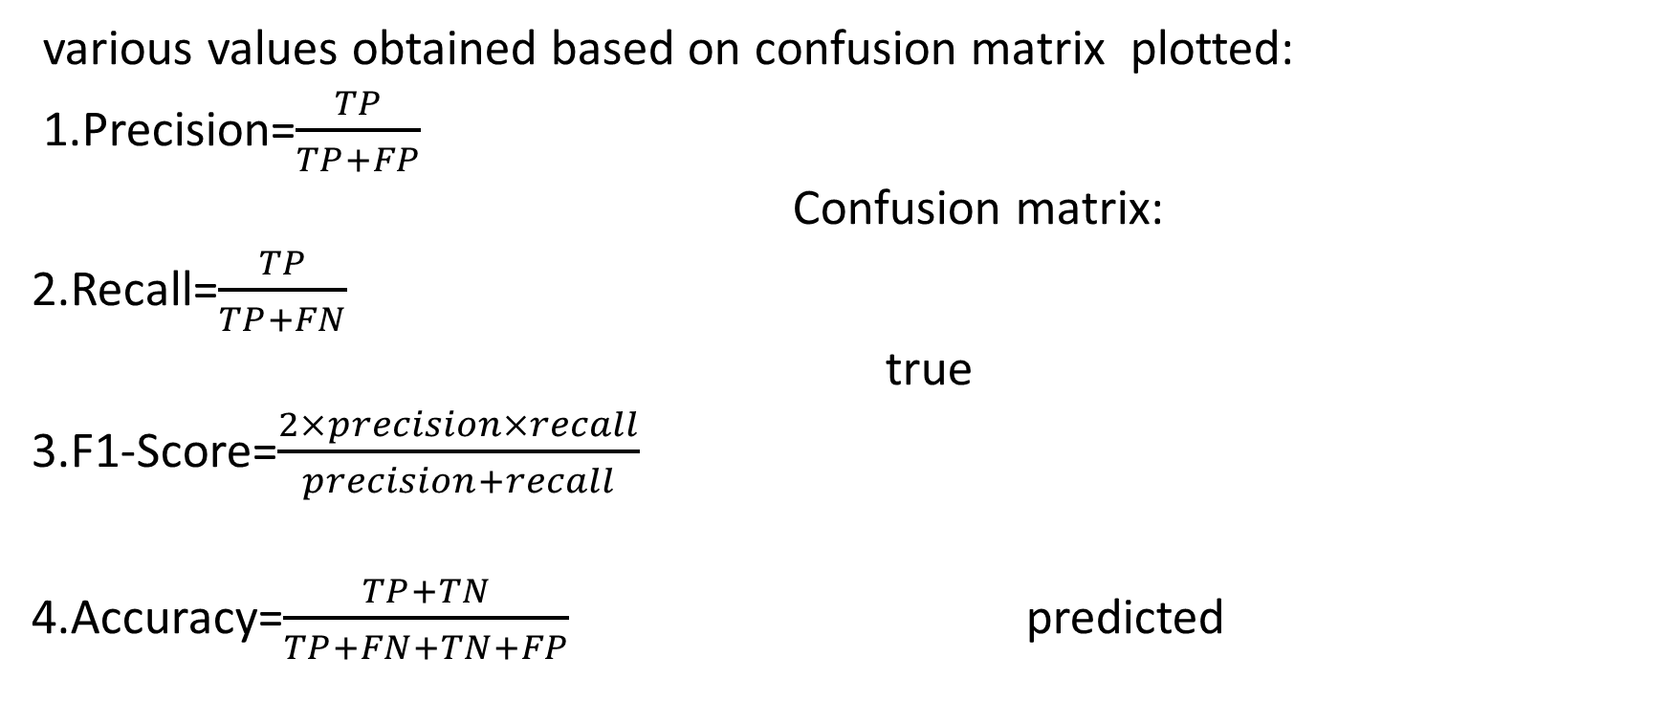
PERFORMANCE EVALUATION
various values obtained based on confusion matrix plotted:
1.Precision=$\frac{TP}{TP+FP}$
Confusion matrix:
2.Recall=$\frac{TP}{TP+FN}$
true
3.F1-Score=$\frac{2×precision×recall}{precision+recall}$
4.Accuracy=$\frac{TP+TN}{TP+FN+TN+FP}$ predicted
TN | FP
FN | TP

Slide 21
TOOLS
SOFTWARE REQUIREMENTS:
Jupyter notebook
IDLE python
Web browser
LIBRARIES AND FRAMEWORK:
Numpy
Pandas
Sklearn
Streamlit
HARDWARE REQUIREMENTS:
Personal computer(PC) with 4GB RAM,i3 Processor,256 SSD

Slide 22
AdaBoost
Parameters tuned:
Parameters used | Assigned value
base_estimator | Decision tree classifier
n_estimator | 100
learning_rate | 1
random_state | 0

Slide 23
Decision tree Classifier(DTC)
Parameters tuned
Parameters used | Assigned values
Criteria | entropy
max_depth | 2
max_features | 8

Slide 24
K-Nearest Neighbour(KNN)
Parameters tuned
Parameters used | Value assigned
n_neighbors | 5

Slide 25
Random Forest Classifier(RF)
Parameters tuned:
Parameters used | Assigned value
n_estimators | 100
criteria | entropy
max_depth | 1
random_state | 0

Slide 26
EXPECTED OUTPUT
The expected output of the Diabetes Prediction System is either one as follows:
Case 1:
0 - NEGATIVE→ The patient is non-diabetic.
Case 2:
1 – POSITIVE→ The patient is diabetic.

Slide 27
EXPERIMENTS AND RESULTS TRAINING DATA
SI.NO | Algorithm | Accuracy | Precision | Recall | F1-Score
1. | Adaboost Classifier | 84.690% | 74.208% | 81.592% | 77.725%
2. | Decision Tree Classifier | 81.107% | 62.443% | 80.701% | 70.408%
3. | K-Nearest neighbor | 78.501% | 61.538% | 74.316% | 67.326%
4. | Naïve Bayes | 75.732% | 61.538% | 68% | 64.608%
5. | Random Forest Classifier | 83.876% | 67.873% | 84.269% | 75.187%

Slide 28
EXPERIMENTS AND RESULTS TESTING DATA
SI.NO | Algorithm | Accuracy | Precision | Recall | F1-score
1. | Adaboost Classifier | 100% | 100% | 100% | 100%
2. | Decision Tree Classifier | 90.259% | 74.468% | 92.105% | 82.352%
3. | K-Nearest neighbor | 82.467% | 70.212% | 71.739% | 70.967%
4. | Naïve Bayes | 79.870% | 63.829% | 68.181% | 65.934%
5. | Random Forest Classifier | 97.402% | 91.489% | 100% | 95.555%

Slide 29
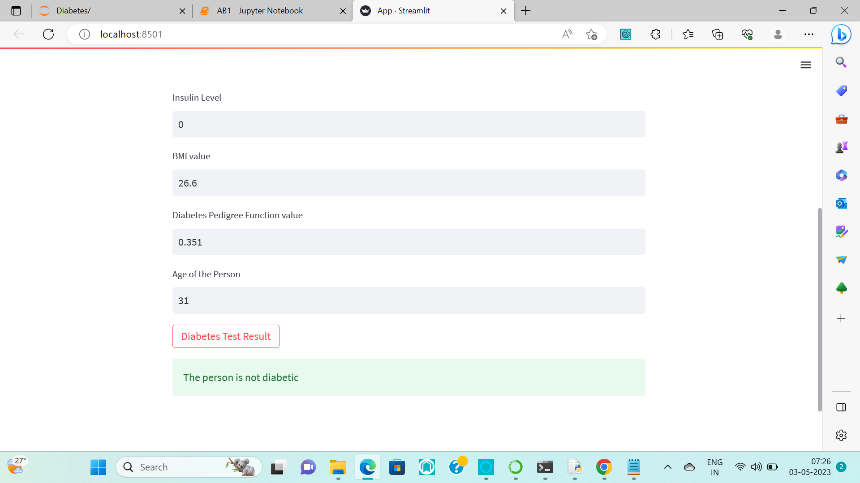
RESULTS

Slide 30
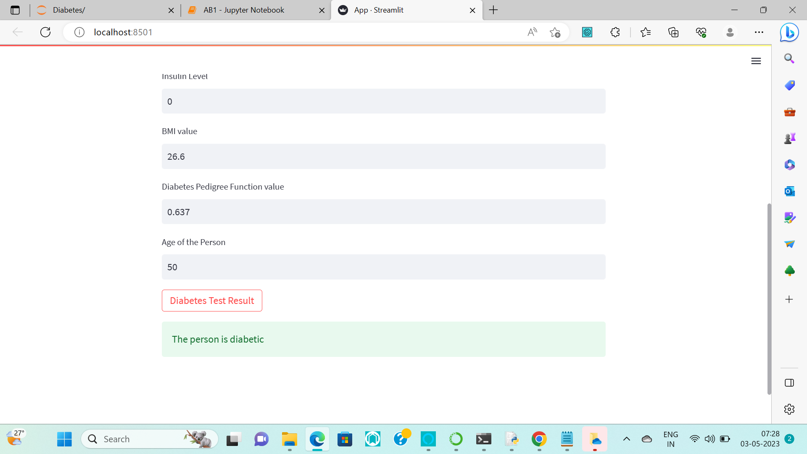
RESULTS

Slide 31
REFERENCE
[1] Aishwarya Mujumdar, Dr.V.Vaidehi,”Diabetes Prediction using Machine Learning Algorithms”, International Conference on Recent Trends in Advanced Computing(ICRTAC)2019, Procedia Computer Science, volume 165, 2019, PP.292-299.
(https://www.sciencedirect.com/science/article/pii/S1877050920300557)
[2]KM Jyoti Rani,” Diabetes Prediction using Machine Learning ”, International Journal of Scientific Research in Computer Science Engineering and Information Technology(IJSRCSE-IT),Volume 6,Issue 4,July-Auguest 2020, PP.294-305.
(https://ijsrcseit.com/paper/CSEIT206463.pdf)
[3]S. Reshmi, Saroj Kr. Biswas, Arpita Nath Boruah, Dalton Meitei Thounaojam, Biswajit Purkayastha, “Diabetes Prediction using Machine Learning Analytics” International Conference on Machine Learning, Big Data, Cloud and Parallel Computing 2022, PP.1-6.
(https://www.researchgate.net/publication/362705860_Diabetes_Prediction_Using_Machine_Learning_Analytics)

Slide 32
REFERENCE
[4] Salliah Shafi Bhat, Venkatesan Selvam, Gufran Ahmad Ansari , Mohd Dilshad Ansari and Md Habibur Rahman, “Prelevance and Early Prediction of Diabetes using Machine Learning in North Kashmir: A case-study of District Bandipora”, Hindawi, Computational Intelligence and Neuroscience, volume 2022, PP.1-12, 4 October 2022.
(https://www.hindawi.com/journals/cin/2022/2789760/)
[5] Mitushi Soni, Dr, Sunita Varma, “Diabetes Prediction using Machine Learning Techniques”, International Journal of Engineering Research and Technology (IJERT), Volume 9, Issue 9,PP.922-925, September 2020.
(https://www.ijert.org/research/diabetes-prediction-using-machine-learning-techniques-IJERTV9IS090496.pdf).
[6]Dataset: PIMA Indian Diabetes Dataset.
(https://www.kaggle.com/datasets/uciml/pima-indians-diabetes-database)

Slide 33
THANK YOU

