Slide 1

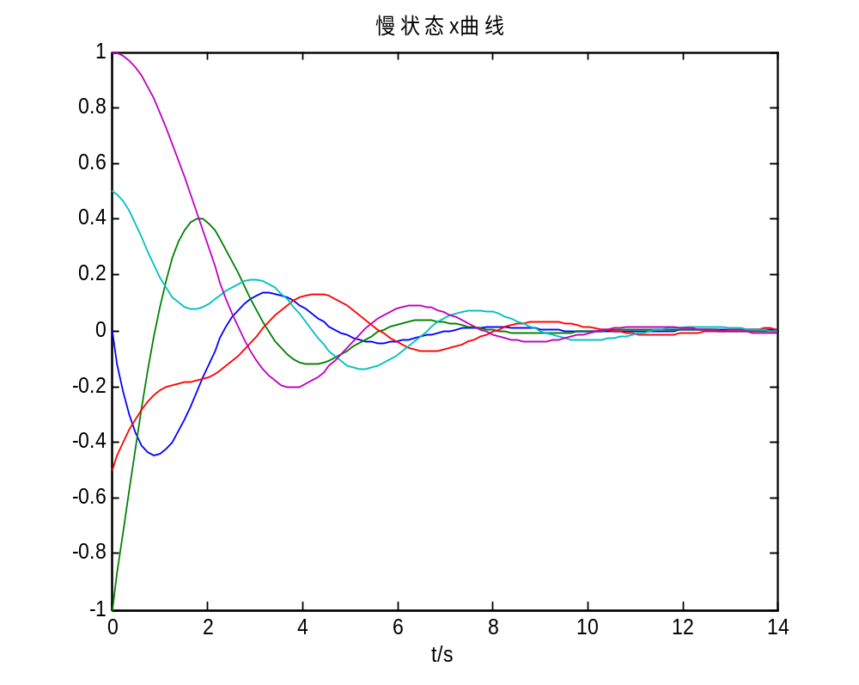
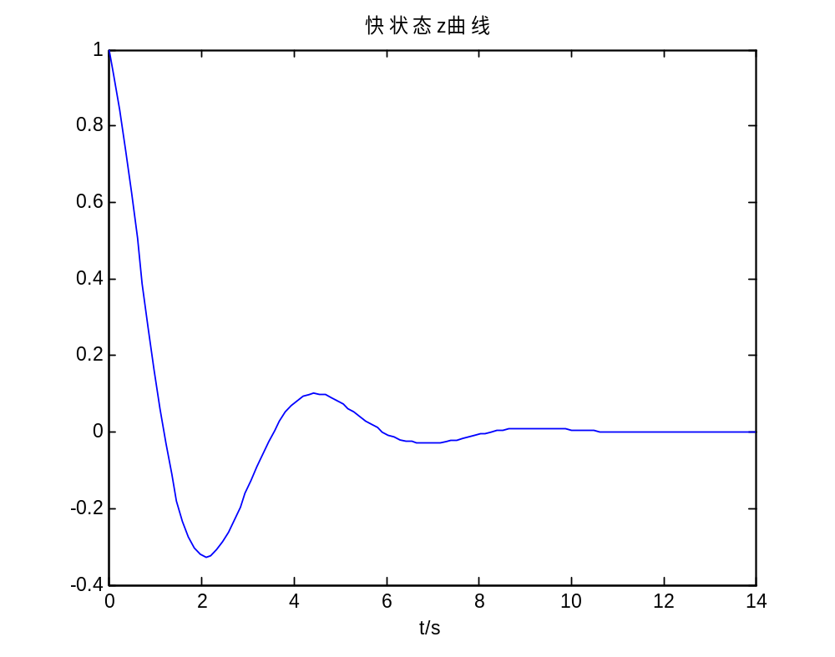

Title of Paper with 54pt Times New Roman Font in Bold Letters
May 28-30, 2017, Chongqing, China
PID: SunAIS-1
Names of the Authors, in bold letters
Author’s Affiliation, Italics, Upper and lower case
1. Introduction
The 2017 Chinese Control and Decision Conference (2017 CCDC) is the 29th of the series and will be held from May 28 to 30, 2017 in Chongqing, China.
We would like to take this opportunity to say congratulations to you for the acceptance of you papers by 2017 CCDC and thank you for choosing 2017 CCDC to present your research results.
Your paper are selected as a poster paper in 2017 CCDC.
In order for your paper to be included in the conference proceedings, and indexed by EI Compendex, please strictly adhere to the format given in this template for 2017 CCDC while preparing your final poster of your paper.
2. General Information
This is the template for preparation of posters for the 2017 CCDC. Please use this document as a sample of the conference poster presentations. The authors of poster papers must produce their poster using this template and submit them with .ppt and .tif form to the 2017 CCDC email box:
Email: ccdcposter@ise.neu.edu.cn
2017 CCDC will produce the final hard copies of all posters in a unified style.
The PowerPoint template to produce your conference posters will be sent to your email box, or is available at
http://www.ccdc.neu.edu.cn/
4. Samples of Figures and Tables
Please follow the samples to prepare your Figures and Tables in the poster. The number of Figures should be no more than four in the poster.
The following is a sample of figure preparation.
Fig. 1. Title of figure, central justified
Do not use vertical lines within the table, use horizontal lines only to separate headings from table entries, which is so-called three-line-table. Table 1 is an example of table preparation.
Table 1. Heading of the table, left justified.
Xxxx | Xxxx | Xxxx | Xxxx | Xxxx
NN | NNN | N | NNNN | N
NN | NNN | NNNN | N | NNN
NN | NNN | NN | NN | NN
NN | NNN | NNN | NNN | N
NN | NNN | N | NNNN | NNN
3. The Guidelines for Poster Preparation
The version of the poster paper is document with ppt. The size of the page is 600mmx800mm. Each paper must be edited in only one page. The PPT page can take about 2500 words. Please take the reference in details as follows.
  The font style is Times New Roman.
  Please do not change the font sizes of the template in your poster.
    The size of the paper title is 54pt in bold letters.
    The size of author names is 44pt in bold letters, and the size of author’s affiliations is 40pt in Italics.
    The size of the section titles is 32pt in bold letters.
    The size of the context is 24pt.
    The size of the titles of figures and tables is 22pt. The font size of the text in figures and/or tables is also 22pt.
  Please leave one clear line between sections.
  The number of figures and tables should be no more than five in total, and each not more than four.
  The corresponding author’s contact email should be placed on the left bottom of the poster.
  The paper ID (XxxXIS-n) should be placed on the top right of the poster.
  Please do not change the width and the horizontal position of the text box. The height of it can be adjusted with the text.
Please send us both the .ppt (for micro adjusting) and .tif (for printing) files.
5. Other Information
The equations should be center placed with serial number in bracket to the right margin.
(1)
Eqn. (1) is an example of the equation which represents a linear system state equation.
If you need to add the subsection, please use 24pt font in bold letters for its title unnumbered.
The Definitions, Theorems, Assumptions, Lemmas, Remarks, etc., should be 24pt font in bold letters, with serial number. The following are two examples.
Definition 1 A poster paper is defined as a paper presented in a poster style in a conference, with the same academic quality as the oral paper.
Remark 1 This template is just for your reference when you prepare your poster.
Please do not change or remove the frame of the template.
Please do your best in preparation of your poster and send it to us in time, in order to guarantee the success of 2017 CCDC and the index of your paper by EI Compendex.
Contact email: ccdcposter@ise.neu.edu.cn

