Slide 1
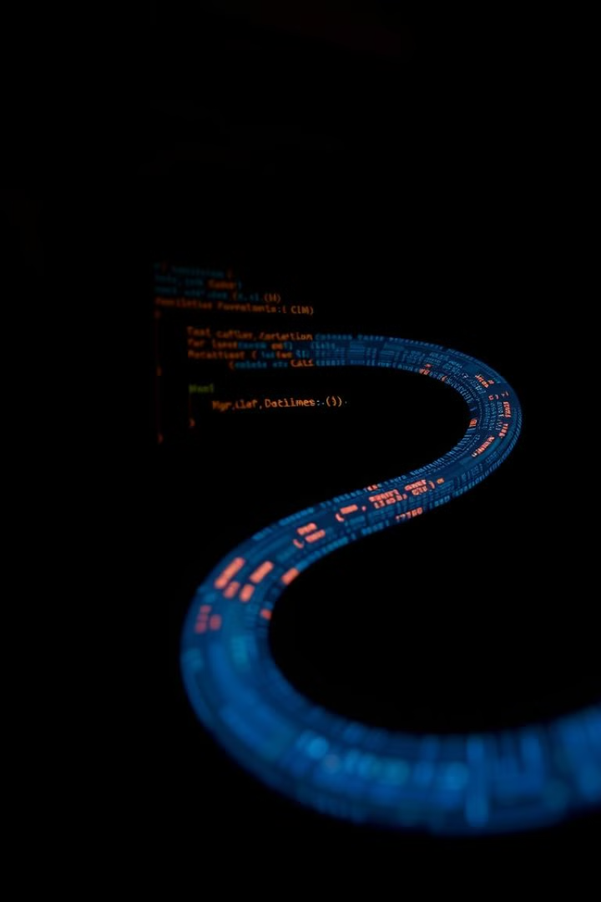
The Morris
Worm:
A Landmark Cyber Attack
The Morris Worm, also known as the Internet Worm, was a self-replicating program that exploited vulnerabilities in Unix systems, infecting thousands of computers in 1988. It's considered a landmark event in cybersecurity, marking the beginning of widespread internet-based malware attacks.

Slide 2

What is the Morris Worm?
The Morris Worm was a self-replicating program designed to spread through interconnected Unix systems. It exploited a vulnerability in the finger daemon, a program that allowed users to get information about other users on the network.
Self-Replication
Exploit Vulnerability
Spread Through Networks
The Morris Worm was capable of copying itself and spreading to other vulnerable systems.
It leveraged a vulnerability in the finger daemon, a common program used to access information about users on a network.
It utilized the internet's infrastructure to propagate, hopping from one connected machine to another.

Slide 3

The Impact of the Morris Worm
The Morris Worm caused significant disruption to the internet and computer networks worldwide. It overloaded systems, making them inaccessible and causing widespread outages.
1
System Overload
The worm replicated uncontrollably, exceeding the capacity of many systems.
2
Network Disruptions
Infected systems became slow or unusable, interrupting critical services.
3
Security Concerns
The worm highlighted the vulnerabilities in internet security and the need for improved defenses.

Slide 4
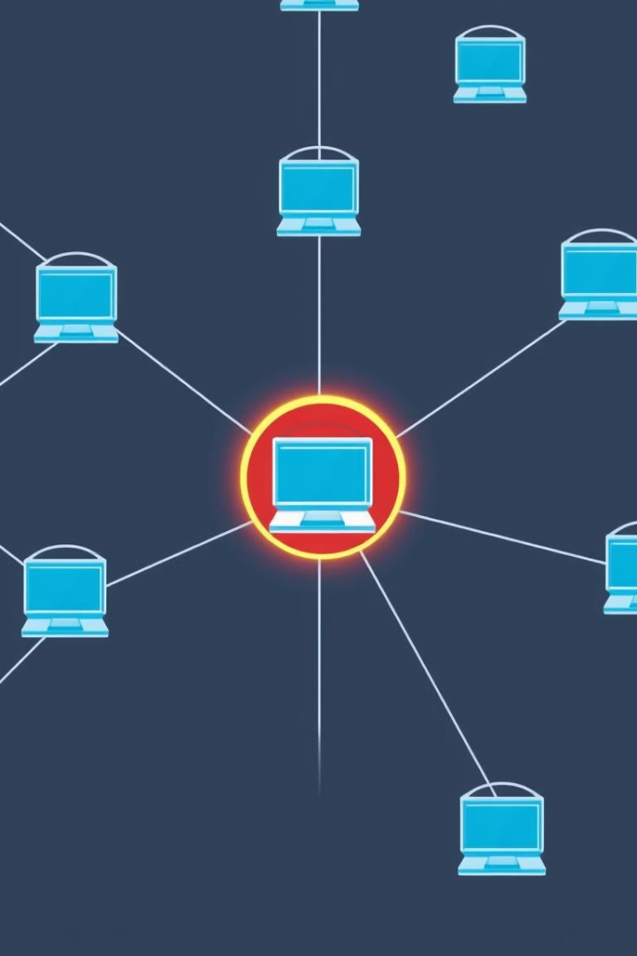



How the Morris Worm Spread
The Morris Worm spread through a combination of techniques, including exploiting vulnerabilities, brute-forcing passwords, and spreading through security holes.
Exploiting Vulnerabilities
The worm targeted a flaw in the finger daemon, allowing it to gain access to systems.
Brute-Force Attacks
It attempted to guess passwords to gain access to systems with weak security.
Security Holes
It leveraged known vulnerabilities in operating systems and software.

Slide 5

Lessons Learned from the Morris Worm
The Morris Worm had lasting impacts on cybersecurity practices and awareness. It led to increased focus on network security, vulnerability management, and user education.
1
Security Patches
2
Password Security
The importance of promptly installing security patches and updates to address vulnerabilities was emphasized.
Strong password policies and user education on password security became essential.
3
Network Segmentation
4
Security Awareness
Segmenting networks to limit the spread of malware became a standard practice.
Awareness about cybersecurity threats and best practices increased significantly.

