Slide 1
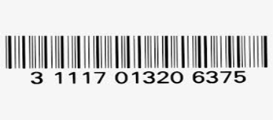
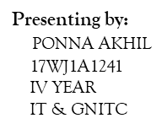
BARCODE

Slide 2
1.WHAT IS A BARCODE
2.HISTORY OF BARCODE
3.WHY USE OF BARCODE
4.TYPES OF BARCODE
5.BARCODE REPRESNTATION
6.BARCODE SCANNER
7.CODE TO GENERATE BARCODES
6.ADVANTAGES
7.DISADVANTAGES
8.APPLICATIONS

Slide 3
WHAT IS A BARCODE ?
It is an automatic identification technology.
It is a predefined format of DARK BARS and WHITE SPACES of varying width
that can be read with an optical barcode scanner.
Structured to contain a specific piece of information.
In the barcode white space is considered as ZERO and black space as ONE.
It allows real time data to be collected accurate and rapidly.

Slide 4
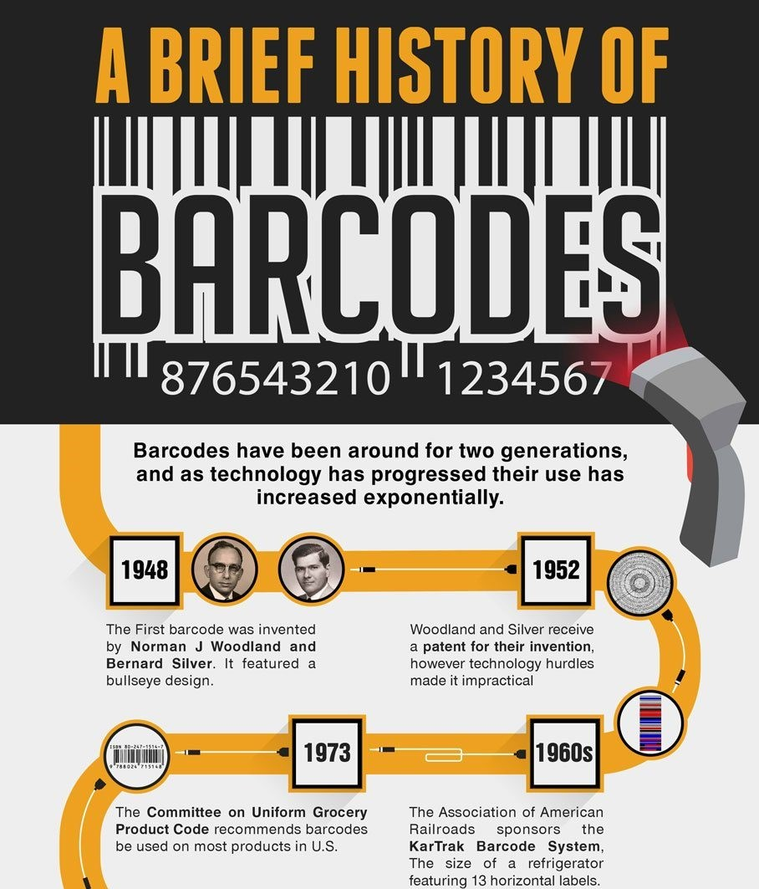

Slide 5
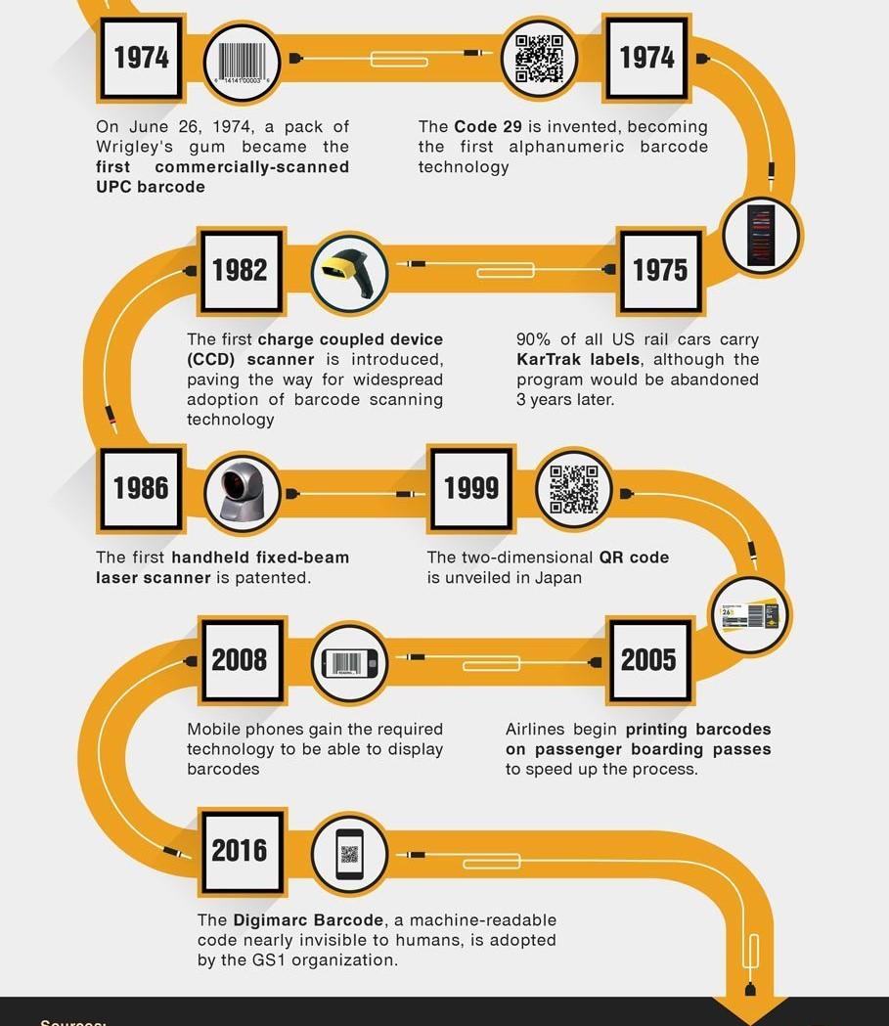

Slide 6
WHY USE OF BARCODE
When barcodes are used in the business process, procedures are automated
To increase productivity and reduce human error.
​ Whenever there is a need to accurately identify or track something ,bar- coding
should be used.
​ For example, in a data entry work environment ,workers may be required
to enter an enormous amount of data into a customer database system.
Instead of manually typing a customer identification number into a database, if
the information is contained in a barcode, a data entry operation may scan it in.
​ Eliminate data entry errors
1)Errors due to bar code: less than 0.001%
2)Coded information errors: 1 every 1CR characters.
3)Manual information errors: 1 every 100 characters.
​ Easy and cheap to produce.

Slide 7
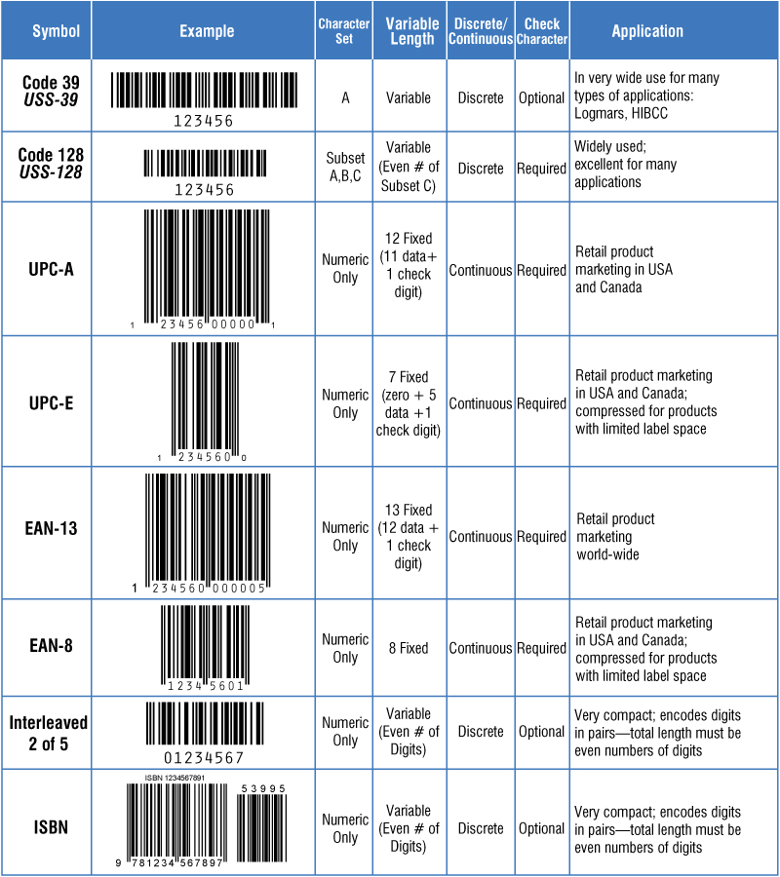
TYPES OF BARCODE : LINEAR

Slide 8
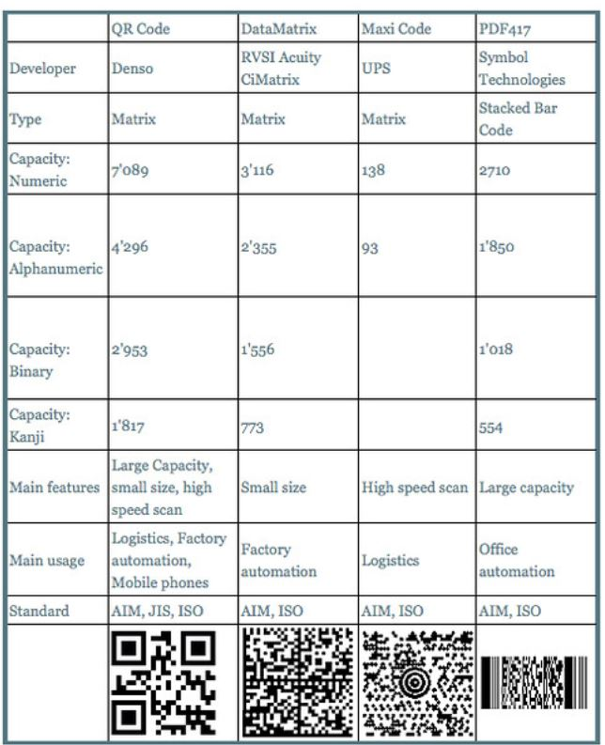
TYPES OF BARCODE : 2D

Slide 9
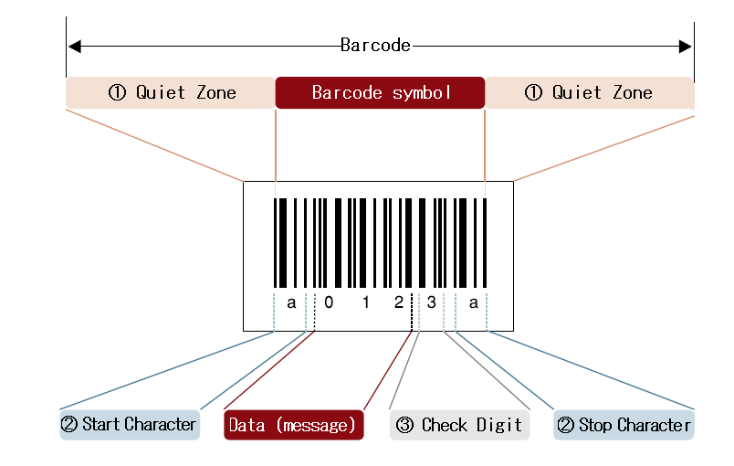
BARCODE REPRESENTATION

Slide 10
Each barcode label have a few different parts:
1)Manufacture's ID
2)Product Item Number
3)Check Digit
Each product have a unique product Item Number.
Check Digit is the final number of the barcode label when scanner reads the
Barcode the digit helps it to verify that the barcode has been read correctly.
This is all done by scanner.
Which pick ups the bars then it transfers the information to the computer.
Then it finds the recordd associated with it.

Slide 11
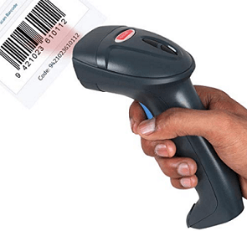
BARCODE SCANNER
These are an electronic device to read printed barcodes.
A barcode scanners uses a PHOTO SENSOR(OPTICAL TECHNIQUE)
To convert the barcode tnto an electric Signal
Types :
1) Pen Style Scanners
2)Slot Based Scanners
3)Charge Coupled Device
4)Camera Based Scanners
5)Leaser Based Scanners

Slide 12
JAVA CODE TO GENERATE BARCODE: IMAGE

Slide 13
import java.awt.image.BufferedImage;
import java.io.ByteArrayOutputStream;
import java.io.FileOutputStream;
import org.krysalis.barcode4j.impl.code128.Code128Bean;
import org.krysalis.barcode4j.output.bitmap.BitmapCanvasProvider;
public class Image {
public static void main(String[] args) {
Image.createImage("Barcode.png", "AKHIL");
System.out.println("finished");
}
public static void createImage(String image_name,String myString) {
try {
Code128Bean code128 = new Code128Bean();
code128.setHeight(15f);
code128.setModuleWidth(0.3);
code128.setQuietZone(10);
code128.doQuietZone(true);
ByteArrayOutputStream baos = new ByteArrayOutputStream();
BitmapCanvasProvider canvas = new BitmapCanvasProvider(baos, "image/x-png", 300, BufferedImage.TYPE_BYTE_BINARY, false, 0);
code128.generateBarcode(canvas, myString);
canvas.finish();
//write to png file
FileOutputStream fos = new FileOutputStream("C:\\Users\\ponna Akhil\\Desktop\\barcode\\"+image_name);
fos.write(baos.toByteArray());
fos.flush();
fos.close();
} catch (Exception e) {
// TODO: handle exception
}
}
}

Slide 14
JAVA CODE TO GENERATE BARCODE: PDF

Slide 15
import java.io.FileOutputStream;
import com.itextpdf.text.Document;
import com.itextpdf.text.DocumentException;
import com.itextpdf.text.Image;
import com.itextpdf.text.PageSize;
import com.itextpdf.text.pdf.Barcode128;
import com.itextpdf.text.pdf.BarcodeEAN;
import com.itextpdf.text.pdf.PdfContentByte;
import com.itextpdf.text.pdf.PdfWriter;
public class PDF {
public static void main(String[] args) {
PDF.createPDF("Barcode.pdf","akhil");
System.out.println("Barcode is created in pdf format");
}
public static void createPDF(String pdfFilename,String myString) {
Document doc = new Document();
PdfWriter docWriter = null;
try {
docWriter = PdfWriter.getInstance(doc, new FileOutputStream("C:\\Users\\ponna Akhil\\Desktop\\barcode\\"+pdfFilename));
doc.addAuthor("jinujawad");
doc.addCreationDate();
doc.addProducer();
doc.addCreator("chillyfacts.com");
doc.addTitle("chillyfacts Barcode test");

Slide 16
doc.setPageSize(PageSize.LETTER);
doc.open();
PdfContentByte cb = docWriter.getDirectContent();
Barcode128 code128 = new Barcode128();
code128.setCode(myString.trim());
code128.setCodeType(Barcode128.CODE128);
Image code128Image = code128.createImageWithBarcode(cb, null, null);
code128Image.setAbsolutePosition(10, 700);
code128Image.scalePercent(125);
doc.add(code128Image);
BarcodeEAN codeEAN = new BarcodeEAN();
codeEAN.setCode(myString.trim());
codeEAN.setCodeType(BarcodeEAN.EAN13);
Image codeEANImage = code128.createImageWithBarcode(cb, null, null);
codeEANImage.setAbsolutePosition(10, 600);
codeEANImage.scalePercent(125);
doc.add(codeEANImage);
} catch (DocumentException dex) {
dex.printStackTrace();
} catch (Exception ex) {
ex.printStackTrace();
} finally {
if (doc != null) {
doc.close();}
if (docWriter != null) {
docWriter.close();
} } } }

Slide 17
JAVA CODE TO GENERATE BARCODE: DBCONNECTION

Slide 18
DATA BASE STEPS:
import java.sql.Connection;
import java.sql.DriverManager;
public class DBConnection {
public Connection getConnection(){
Connection connection=null;
System.out.println("Connection called");
try {
Class.forName("com.mysql.jdbc.Driver");
connection = DriverManager.getConnection("jdbc:mysql://localhost:3306/Barcode","root", "15036244");
} catch (ClassNotFoundException e) {
e.printStackTrace();
} catch (Exception e) {
e.printStackTrace();
}
return connection;
}
}

Slide 19
GENERATING_DYNAMIC_BARCODE :
import java.sql.Connection;
import java.sql.PreparedStatement;
import java.sql.ResultSet;
import DBconnection.DBConnection;
import image.Image;
import Pdf.PDF;
@SuppressWarnings("unused")
public class Generate_Dynamic_Barcode {
public static void main(String[] args) throws ClassNotFoundException {
PreparedStatement ps=null;
Connection connection=null;
DBConnection obj_DBConnection=new DBConnection();
connection=obj_DBConnection.getConnection();
ResultSet rs=null;
try {
String query="select * from user";
ps = connection.prepareStatement(query);
rs=ps.executeQuery();
while(rs.next()){
Image.createImage(rs.getString("Name")+".png", rs.getString("Mobile"));
PDF.createPDF(rs.getString("Name")+".pdf", rs.getString("Name"));
System.out.println("Creating Barcode for "+rs.getString("Mobile")); } }

Slide 20
catch(Exception e){
e.printStackTrace();
}finally{
if(connection!=null){
try {
connection.close();
}
catch (Exception e2) {
e2.printStackTrace();
}
}
if(ps!=null){
try {
ps.close();
}
catch (Exception e2) {
e2.printStackTrace();
}
}
}
}
}

Slide 21
REFERENCE LIBRARIES USED :
BARCODE4J.JAR
ITEXTPDF-5.1.0.JAR
MYSQL-CONNECTOR-JAVA-8.0.23.JAR

Slide 22
ADVANTAGES
Represent unique identity of a product.
Accuracy of data input(Error Free).
More accurate dispatch.
Cost efficient.
Real time data collection.
Measurement of work in progress throughout the factory.
Rapid access to total cost productions.

Slide 23
DISADVANTAGES
System failure may costs more delay
Scratched barcodes may cause problems
Data must be stored in the barcode
In laser scanning cost and durability are the two disadvantages
APPLICATIONS
Departmental stores
Library
Industries
Health agencies
Document tracking

