Slide 1





TNWISE2025
HACKATHON FOR WOMEN IN SCIENCE & ENGINEERING
THEME: ACCESSIBLE DIGITAL EDUCATION AND LEARNING
TITLE: EDUMATE
COLLEGE: KONGU ENGINEERING COLLEGE
TEAM LEADER NAME: THANUSRI M.V

Slide 2

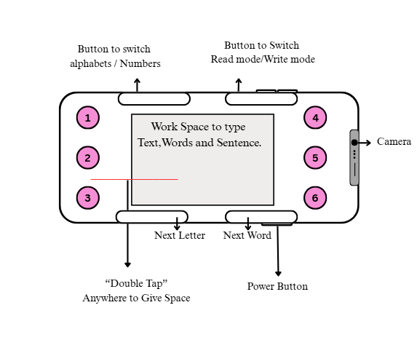
PROBLEM STATEMENT : ACCESSIBLE DIGITAL EDUCATION AND LEARNING
OBJECTIVES OF THE WORK:
Provide inclusive learning tools for blind and deaf users using Braille representation and audio/voice assistance.
Enable accessible interaction through features like volume control, voice-assisted chatbot, and hardware buttons.
Guide users through tutorials on app usage and the Braille system with an interactive learning approach.
Offer a user-friendly interface that supports easy navigation, registration, and clear exit flow.

Slide 3
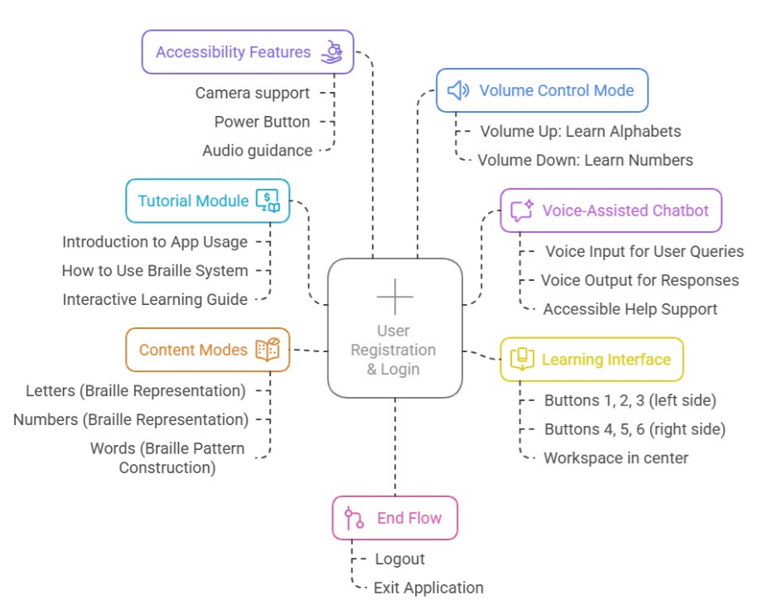


Slide 4
PROJECT DESCRIPTION:
CONCLUSIONS:
The app successfully enhances learning accessibility for blind and deaf users through tailored features like Braille content, audio guidance, and voice interaction.
User-friendly design and intuitive controls improve the overall usability and learning experience.
Interactive tutorials and structured content modes support self-paced learning, helping users understand and use the Braille system effectively.
The integration of assistive technology demonstrates the potential for inclusive digital solutions that bridge communication and learning gaps.
A mobile application designed for blind and deaf users to support inclusive education through Braille and audio-guided learning.
Integrates accessibility features like camera support, power button controls, and voice assistance for enhanced usability.
Includes interactive modules such as tutorials, content modes, and a learning interface for practicing alphabets, numbers, and words.
Provides user-friendly navigation with simple registration/login, voice-assisted chatbot, and easy logout/exit flow.

Slide 5
TEAM MEMBER DETAILS:
TEAM MEMBER 1 :
TEAM MEMBER 2 :
TEAM MEMBER 3 :
NAME: SOWMIYA SREE M
SEMESTER: SECOND
YEAR: 1ST
DEPARTMENT: MCA
NAME: THANUSRI M.V
SEMESTER: SECOND
YEAR: 1ST
DEPARTMENT: MCA
NAME: POOJA E
SEMESTER: SECOND
YEAR: 1ST
DEPARTMENT: MCA
TEAM MENTOR NAME:
NAME: HEMALATHA S
DESIGNATION: MCA., PhD(pursuing) DEPARTMENT: MCA
COLLEGE: KONGU ENGINEERING COLLEGE

