Slide 1
UPI Reliability, Automated Recovery &
Predictive Early-Warning System
Detect → Explain → Recover → Resolve → Analyze → Predict → Prevent → Verify
Second Review
Presented by: Poojitha D Reg. No.: ____________
Guide: ____________________ Department: ____________________

Slide 2
Introduction
1 / 2
▪ UPI is India's main way to pay: 26,746 million payments in Aug 2026 from the top-50 remitter banks alone
▪ Every failed payment is one of two kinds (NPCI classification)
– Business decline (BD) – refused for the payment/account: low balance, wrong PIN, limit, invalid UPI ID
– Technical decline (TD) – a system could not finish it; can happen **after** money is debited
▪ NPCI targets: TD below 1%, BD below 5% (Circular OC-149)
▪ RBI rule (TAT circular, 2019): a failed payment that took money must be reversed by T+1 (transfers) / T+5 (merchants) – else ₹100 per day of delay
▪ NPCI publishes monthly, bank-wise TD/BD data – the base of this project (Jan 2020 – Aug 2026)
UPI Reliability, Automated Recovery & Early-Warning System · Second Review
2

Slide 3
Introduction – Problem Statement
2 / 2
▪ Customers carry the burden: when a failed payment debits money, the customer must notice it, find the reason and raise a complaint
▪ Explanations are missing or technical: error codes and TD/BD terms mean nothing to most users
▪ Banks see only monthly aggregates: no link between a rise in failures and the customers it actually hit
▪ Dashboards stop at “analyze → forecast”: they don't trigger recovery or check whether a fix worked
▪ Problems recur unnoticed: an improvement can quietly reverse months later
▪ Gap addressed: a closed loop connecting customer-level recovery with bank-level reliability intelligence
UPI Reliability, Automated Recovery & Early-Warning System · Second Review
3

Slide 4
Objectives
▪ Detect failed UPI payments that took the customer's money – automatically, from transaction state
▪ Recover without a complaint: auto-create a refund request with the RBI deadline; bank resolves it; customer sees every step
▪ Explain each failure in plain language using RAG over RBI/NPCI guidance – never inventing a cause
▪ Analyze 80 months of NPCI bank data: when reliability changed (change-points) and which banks matter most (volume-weighted risk)
▪ Predict next months' TD/BD per bank and raise early warnings before problems reach customers
▪ Verify fixes: record bank interventions, compare against a counterfactual forecast, and flag recurrence
▪ Keep simulated data honest: demo transactions follow each bank's real NPCI failure mix and are clearly labelled
UPI Reliability, Automated Recovery & Early-Warning System · Second Review
4

Slide 5
Module Names
1 / 2
# | Module | What it does
1 | Data Ingestion & Preprocessing Pipeline | Reads NPCI Excel files, cleans, normalises bank names, detects duplicate/unpublished months, stores in SQLite
2 | Reliability Analytics Engine | Forecasting (Prophet), change-point detection (PELT), volume-weighted risk scoring, cause breakdown
3 | RAG Explanation Engine | Retrieves RBI/NPCI notices & domain knowledge; explains every detected shift with recommended actions
4 | Customer Payments & Recovery | Transaction history, failure + financial-impact detection, automatic refund requests, plain-language guide
5 | Bank Recovery Desk | Ticket queue with priority & RBI-deadline SLA; refund, resolve, reopen, notes, evidence
UPI Reliability, Automated Recovery & Early-Warning System · Second Review
5

Slide 6
Module Names
2 / 2
# | Module | What it does
6 | Reliability Intelligence | Change-point → customer impact, RAG investigation, early warnings, intervention evaluation, recurrence alerts
7 | Bank-Consistent Transaction Simulator | Generates demo payments from each bank's real TD/BD mix and reversal rate; fidelity check
8 | Live Problem Identification | Diagnoses a single failed payment; minute-level incident monitor on a transaction feed
9 | Platform, Security & Deployment | FastAPI web app, roles (User/Admin), OTP login, Docker image, CI/CD, secret scanning
10 | Analytics Dashboard | 3D bank network, trend explorer, risk ranking, Power BI embedding
UPI Reliability, Automated Recovery & Early-Warning System · Second Review
6

Slide 7
Methodology – Closed-Loop Architecture
1 / 2
Detect
Explain
Recover
Resolve
Analyze
Predict
Prevent
Verify
Customer / operational loop
Bank intelligence loop
▪ Data layer: NPCI monthly bank files → cleaned SQLite store → bank-month panel (TD, BD, volume, reversal)
▪ Intelligence layer: forecasting, change-points, risk scoring and RAG run on the panel (batch)
▪ Operational layer: transactions → failure detection → refund request → bank desk → resolution (real time)
▪ Link between layers: each change-point is turned into customer impact; tickets after a fix count as recurrence
▪ One state machine: customer view and bank desk share one database, so every action syncs instantly
UPI Reliability, Automated Recovery & Early-Warning System · Second Review
7

Slide 8
Modeling Plan
2 / 2
Question | Method / model | Output
When did a bank's reliability really change? | PELT change-point detection (+ Binary Segmentation cross-check) | Confirmed shifts per bank & metric
What happens next month? | Prophet on log scale, benchmarked vs naive baseline (3-month backtest) | 2-month forecasts + bounds, early warnings
Which banks hurt most customers? | Impact score = failure rate × share of volume | Monthly risk ranking
How many customers did a shift hit? | Volume × rate; × post-debit share × reversal-failure rate | Failed payments & refunds per month
Did the money leave the account? | Rule engine on status + debit + reversal/refund (+ grace window) | Automatic refund request with RBI SLA
Why did my payment fail? | NPCI code meaning + TF-IDF RAG over RBI/NPCI guidance | Plain-language answer, no invented cause
Did the fix work? Is it back? | Pre/post means + Prophet counterfactual on pre-fix data; recurrence rules | Working / may recur / didn't help
UPI Reliability, Automated Recovery & Early-Warning System · Second Review
8

Slide 9
Data Preprocessing
1 / 3
▪ Source: NPCI “UPI Ecosystem Statistics – Top-50 member performance (Remitter)”, 82 monthly Excel files
▪ Automated pipeline: incoming → validated → processed folder; re-runs only on new files
▪ Cleaning: column names standardised across NPCI format changes; numeric coercion; % and count fields validated
▪ Bank-name normalisation: case/spacing/suffix fixes and merging of truncated name variants into one canonical bank
▪ Duplicate & unpublished-month detection: repeated files and months NPCI never published are flagged, not double-counted
▪ Derived metrics: reversal failure % = 100 − debit-reversal success %; volume share per month
▪ Storage: SQLite (upi_remitter_stats) → bank-month panel of 3,478 rows, 158 banks, 80 months
▪ Synthetic cause split (labelled): real TD/BD split into 12 NPCI response-code causes; verified to add back to the real totals
UPI Reliability, Automated Recovery & Early-Warning System · Second Review
9

Slide 10
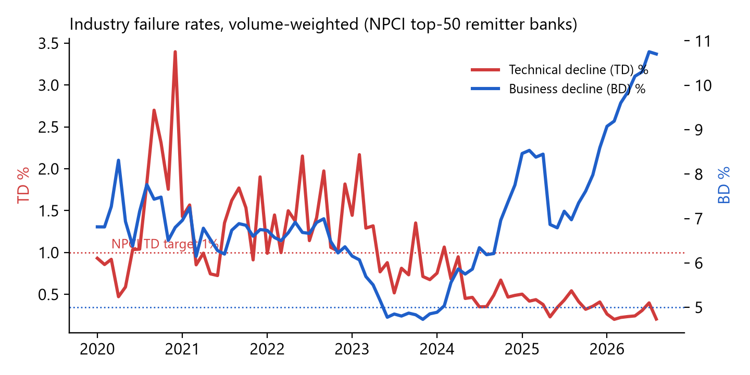
Exploratory Data Analysis – Industry Trend
2 / 3
▪ TD fell sharply: 0.93% (Jan 2020) → 0.21% (Aug 2026)
▪ BD stays high: 6.8% → 10.7% – mostly customer-side (balance, PIN, limits)
▪ Industry now meets the TD target on average, but individual banks still exceed it
▪ Volume grew 24x over the period – the same rate now affects far more people
▪ Seasonal pressure: festive months (Oct–Nov) and FY-end (Mar) show volume-driven spikes
UPI Reliability, Automated Recovery & Early-Warning System · Second Review
10

Slide 11
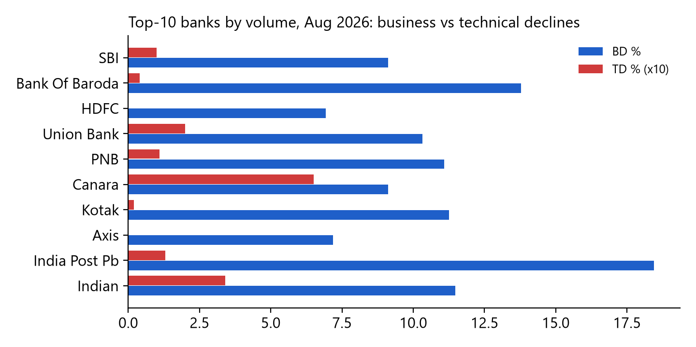
Exploratory Data Analysis – Banks & Data Quality
3 / 3
▪ Highly concentrated: SBI alone ≈26% of top-50 volume
▪ Worst TD (Aug 2026): Baroda U.P. Bank at 2.44% – 2.4x the NPCI target
▪ 1,596 change-points detected across 8 metrics since 2020
▪ Anomalies found: Aug-2026 reversal success 2.9% (Kotak) and 1.7% (ICICI) vs ~95% usual; HDFC/Axis TD 0.00%
▪ Handled by robust profiles: 3-month means and 6-month medians
UPI Reliability, Automated Recovery & Early-Warning System · Second Review
11

Slide 12
Approach & Algorithms – Analytics
1 / 3
▪ PELT change-point detection (ruptures): finds months where the mean failure rate shifts; BinSeg confirms; forecast-based “emerging” shifts flagged early
▪ Prophet forecasting: log-transformed series, changepoint prior 0.1; naive fallback for < 6 months of history
– Benchmarked against a naive “last value” model on a 3-month hold-out (MAPE): Prophet won for 48% of 60 banks – reported honestly per bank
▪ Volume-weighted impact score: rate × volume share → ranks banks by customers affected, not just by rate
▪ Change-point → customer impact: rate shift applied to the old volume isolates the effect of the change itself
▪ Intervention evaluation: before vs after averages + Prophet counterfactual trained only on pre-fix months
▪ Recurrence detection: improvement lost, forecast back to old level, or new worsening after a fix
UPI Reliability, Automated Recovery & Early-Warning System · Second Review
12

Slide 13
Approach & Algorithms – Recovery & RAG
2 / 3
▪ Failure-detection state machine: FAILED + DEBITED + no reversal/refund after a grace window → refund request (pending payments never treated as failures)
▪ SLA & priority: RBI deadline T+1 / T+5, ₹100/day compensation; priority from amount, deadline, repeat customer, bank early warning
▪ Bank-consistent Monte-Carlo simulation: response codes drawn from each bank's NPCI mix; reversal success from its real rate
– Fidelity: 200,000 simulated payments per bank reproduce NPCI TD/BD rates; bank order preserved (rank corr. 0.9999)
▪ RAG: TF-IDF retrieval (cosine, relevance threshold) over RBI/NPCI notices, news and curated guidance
– Bank side: 1,588 change-point explanations; optional LLM polish, rejected if it states a number not in the data
– Customer side: answers separate known / possible / unknown – never an invented cause
▪ Live monitor: Poisson tail test (p < 10⁻⁴) on a rolling window to flag failure spikes
UPI Reliability, Automated Recovery & Early-Warning System · Second Review
13

Slide 14
Tools & Technology Stack
3 / 3
Layer | Tools
Language & data | Python 3.12, pandas, NumPy, SciPy, openpyxl
Modeling | Prophet (cmdstan), ruptures (PELT/BinSeg), scikit-learn (TF-IDF)
RAG & LLM | RBI / NPCI RSS feeds, Google News search, Gemini (optional, number-checked)
Storage | SQLite (NPCI data, RAG store, users, transactions, tickets)
Web application | FastAPI, Jinja2, JavaScript, Chart.js, Three.js; JWT + email OTP login
Dashboards | Built-in analytics pages, Power BI (embedded)
Testing & quality | pytest (63 end-to-end tests), headless-Chrome UI checks
DevOps & security | Docker, GitHub Actions (build, smoke test, secret scan), Render, Netlify
UPI Reliability, Automated Recovery & Early-Warning System · Second Review
14

Slide 15
Project Plan & Milestone Progress
1 / 2
Phase | Milestone | Status
1 | NPCI data pipeline, cleaning, SQLite store (80 months) | ✔ Completed
2 | Forecasting, change-point detection, risk scoring | ✔ Completed
3 | RAG explanations + recommended actions | ✔ Completed
4 | Web platform: roles, OTP login, analytics, live check | ✔ Completed
5 | Customer recovery: simulation, detection, refund requests, guide | ✔ Completed
6 | Bank desk + intelligence: impact, interventions, recurrence | ✔ Completed
7 | Docker image, CI/CD, secret protection | ✔ Completed
8 | Public hosting (Render + Netlify), Power BI report publish | ◐ In progress
9 | SARIMA benchmark, MLflow experiment tracking | ○ Planned
10 | Final evaluation, report & documentation | ○ Planned
UPI Reliability, Automated Recovery & Early-Warning System · Second Review
15

Slide 16
Milestone Progress – Achieved So Far & Next Steps
2 / 2
Achieved
Next steps
▪ 3,478 bank-months cleaned (158 banks, 80 months)
▪ 1,596 change-points detected; 1,588 explained
▪ Forecasts for every bank, benchmarked vs naive
▪ End-to-end recovery loop working: detect → request → refund → customer update
▪ Plain-language UI, verified jargon-free by tests
▪ 60 of 63 automated tests passing; Docker image tested (≈160 MB RAM)
▪ API keys removed from all history; secret scans on every push
▪ Go live on Render + Netlify
▪ Add SARIMA as a second forecasting benchmark
▪ Track model runs and metrics in MLflow
▪ Publish the Power BI report
▪ Persistent database for the hosted version
▪ Recalibrate the live incident monitor (3 tests) on new data
▪ Final evaluation and project report
UPI Reliability, Automated Recovery & Early-Warning System · Second Review
16

Slide 17
Thank you
Questions & suggestions

