Slide 1


Slide 2

SMART LOAN PORTAL WITH
AI MODEL
FOR ELIGIBILITY ANALYSIS
By
Poorna Rathi G

Slide 3
1. What This Project Is
This project is a complete loan application website.
Users can apply for a loan online.
The system uses an AI model to check if the loan will be
- Approved or Rejected
Everything happens automatically with no manual checking.

Slide 4
2. What I Built
I created the full system including:
User login & registration
A loan prediction form
A history page showing past results
An dashboard with details
A machine learning model connected to Django
Clean and simple frontend design

Slide 5
3. The Machine Learning Model
I used a loan dataset with many past records.
I cleaned the data and removed missing values.
I trained the model to learn patterns of people who get loans.
The model becomes smart and predicts with high accuracy.
I saved the model and connected it with Django.

Slide 6
4. Technologies I Used
Frontend: HTML, CSS
Backend: Django (Python)
Database: MySQL
ML Libraries: pandas, numpy, scikit-learn
Tools Used: VS Code

Slide 7
5. Output
Approved when:
High income
Good credit history
Low or reasonable loan amount
Stable job / graduate
Rejected when:
Low income
Weak credit history
Very high loan amount
Unstable profile

Slide 8
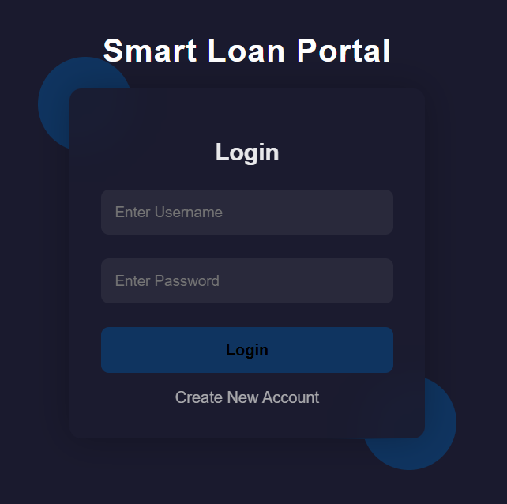
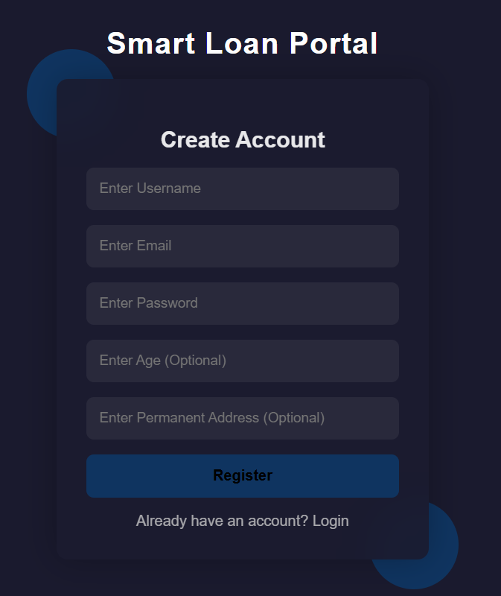
6. Output Screenshot - login , register

Slide 9
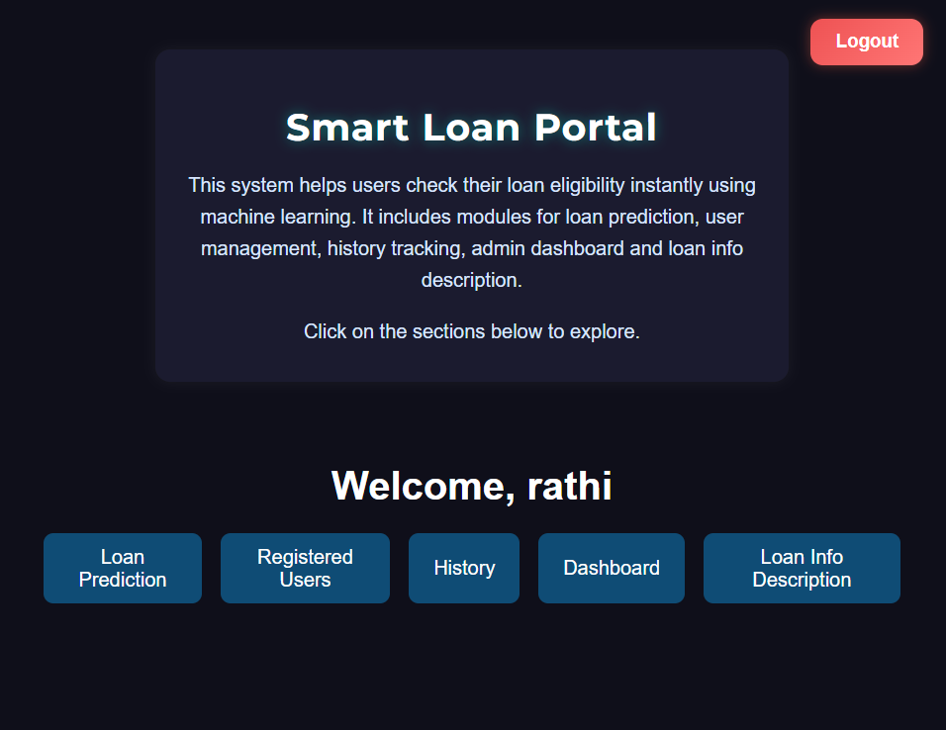
6. Output Screenshot

Slide 10
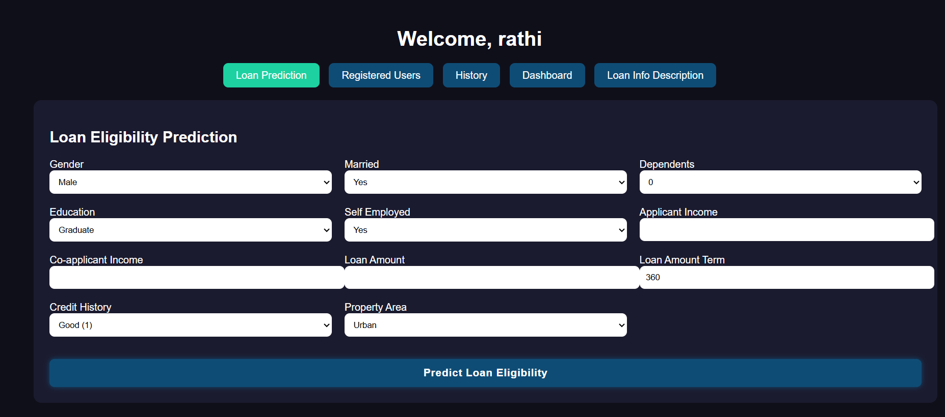
6. Output Screenshot

Slide 11
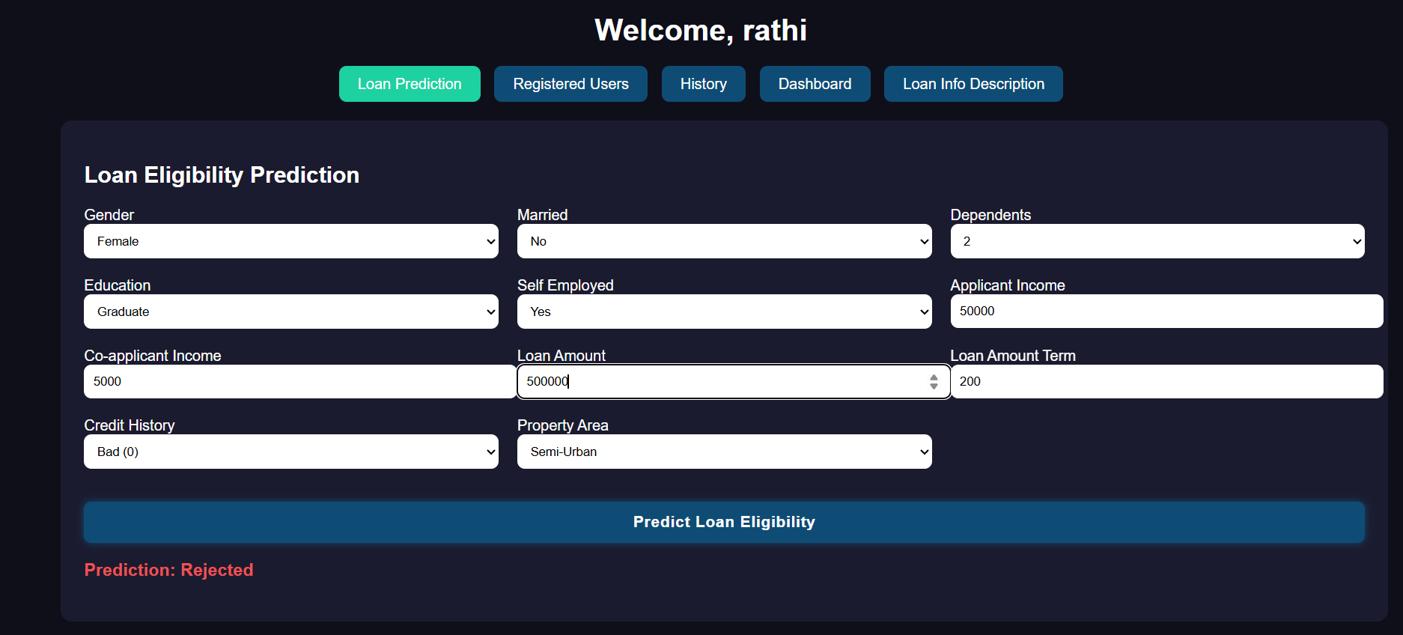
6. Output Screenshot

Slide 12
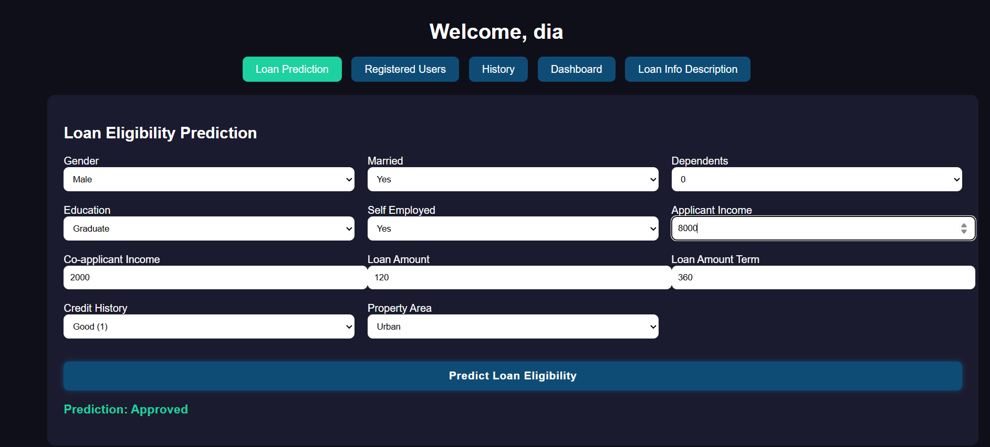
6. Output Screenshot

Slide 13
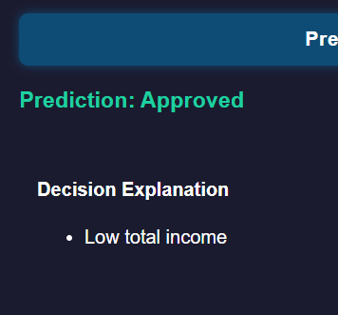
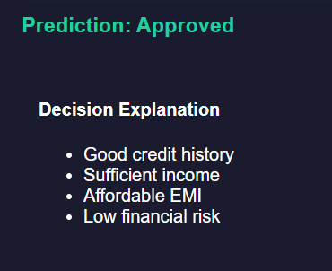
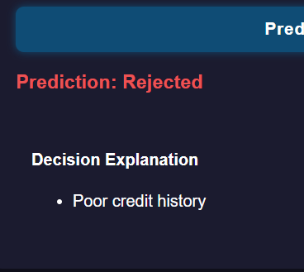
6. Output Screenshot

Slide 14
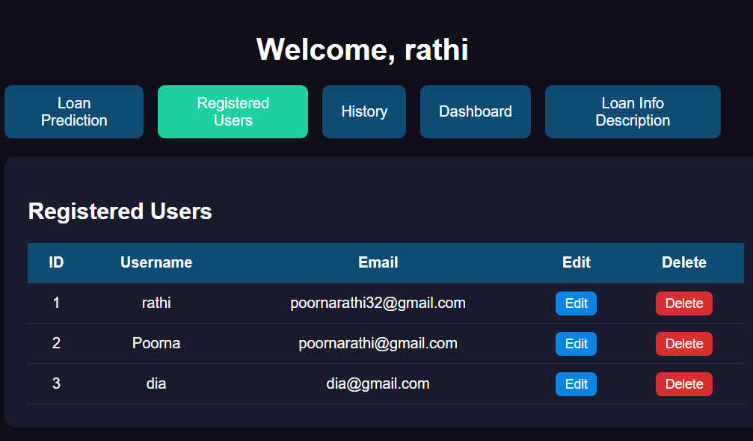
6. Output Screenshot

Slide 15
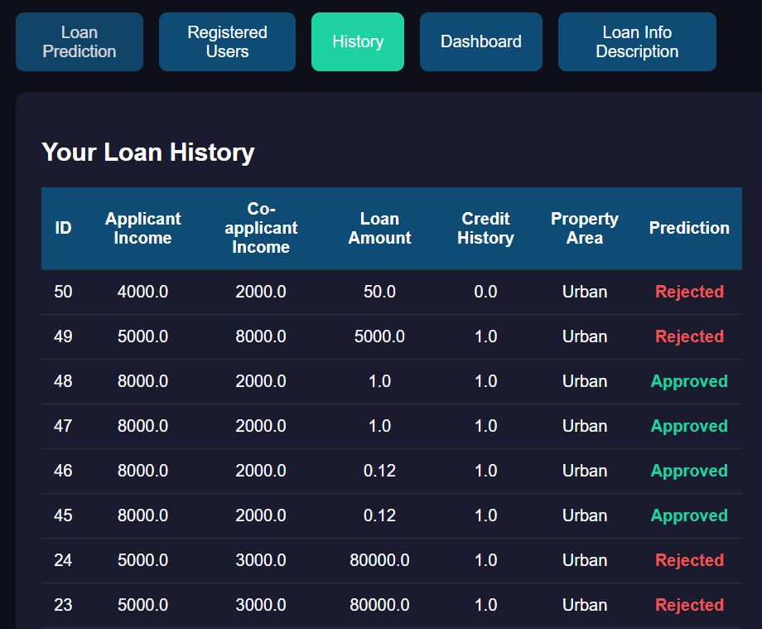
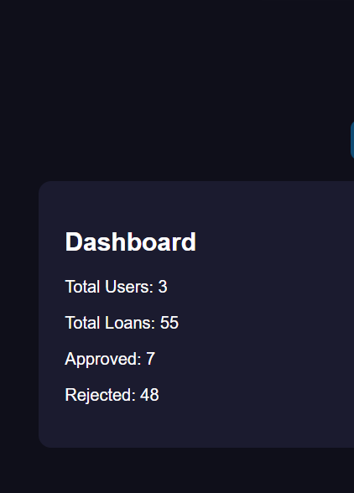
6. Output Screenshot

Slide 16
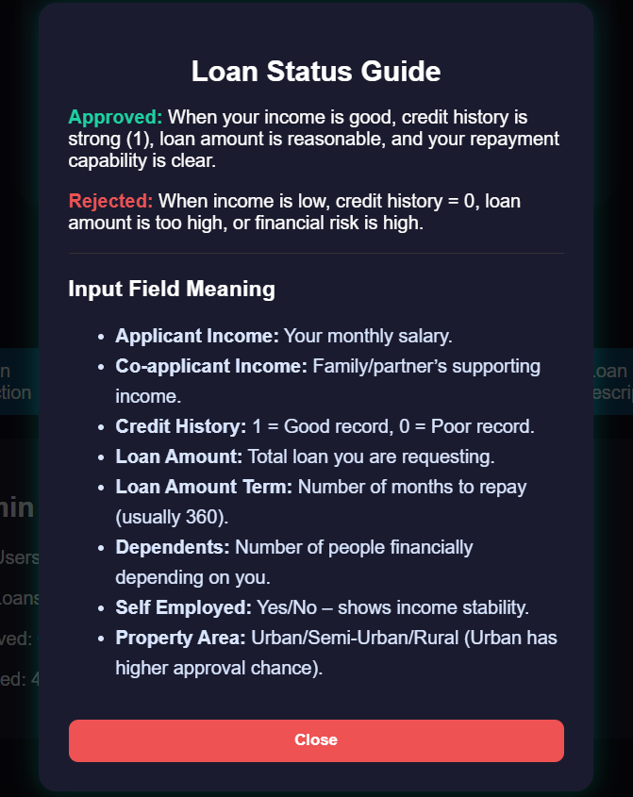
6. Output Screenshot

Slide 17
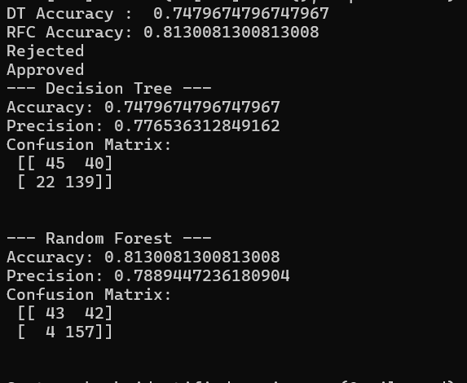
6. Output Screenshot

Slide 18
Thank You

