Slide 1
Adaptive Pricing and Profit Optimization Using Machine Learning with an Iterative Development Model
FINAL YEAR PROJECT PRESENTATION
Guide : Dr. J. Vinoj
(Department of CSE, VFSTR)
BATCH – 052
221FA04150 – POORNA SAI MANNEM
221FA04095 – MANOJ KUMAR GUNTURU

Slide 2
INTRODUCTION:
In today’s highly competitive and data-driven digital economy, pricing has emerged as a critical strategic lever for maximizing revenue and profitability. Traditional static pricing approaches, which rely on fixed price points, often fail to respond effectively to rapidly changing market conditions, customer behavior, and competitive dynamics. As a result, organizations particularly in e-commerce and online services—are increasingly adopting adaptive and dynamic pricing strategies that adjust prices in real time based on demand patterns, customer preferences, and market signals.
With the exponential growth of transactional data and advances in computational capabilities, machine learning (ML) has become a powerful enabler of dynamic pricing systems

Slide 3
Identification of Tools / Equipment / Training Needs
Programming Language:
Python is used as the primary programming language due to its simplicity and strong support for machine learning and data analysis.
Development Environment
Jupyter Notebook / Google Colab is used for writing, testing, and visualizing machine learning models interactively.
Data Analysis Libraries
NumPy: For numerical computations and matrix operations.
Pandas: For data cleaning, preprocessing, and handling structured datasets.

Slide 4
Data Visualization Tools
Matplotlib and Seaborn: Used to visualize trends in pricing, demand, and profit to better understand the dataset.
Machine Learning Libraries
Scikit-learn: Used for building regression and prediction models such as Linear Regression and Random Forest.
XGBoost : Used for improving prediction accuracy in advanced stages.
Dataset Sources
Real-world datasets from platforms such as Kaggle, or synthetically generated pricing and demand datasets.

Slide 5
OBJECTIVES:
The main objective of this project is to develop an intelligent pricing system that adapts dynamically to market conditions in order to maximize profit using machine learning techniques. The specific objectives are as follows:
To analyze historical pricing and demand data to understand the relationship between price and customer demand.
To develop machine learning models capable of predicting product demand based on pricing and other influencing factors.

Slide 6
To design an adaptive pricing mechanism that automatically adjusts product prices to optimize overall profit.
To implement an iterative development model that continuously improves pricing accuracy using feedback from previous iterations.
To evaluate the performance of the proposed model using appropriate statistical and machine learning metrics.
To demonstrate the effectiveness of machine learning-based pricing over traditional static pricing methods.

Slide 7
Basic Methodology
The project follows a structured methodology combined with an Iterative Development Model, allowing continuous refinement of the pricing strategy. The methodology consists of the following stages:
Data Collection
Historical data related to product prices, demand, sales volume, and cost is collected from publicly available datasets or generated synthetically to simulate real-world pricing scenarios.
Data Preprocessing
The collected data is cleaned by handling missing values, removing outliers, and normalizing relevant features to ensure quality input for machine learning models.

Slide 8
Exploratory Data Analysis (EDA)
Data visualization techniques are applied to identify trends, correlations, and patterns between price, demand, and profit.
Feature Engineering
Important features such as seasonal demand, competitor pricing (if available), and cost margins are selected or derived to enhance model performance.
Model Development
Machine learning regression models are trained to predict demand based on input features. Multiple models are tested to identify the most accurate one.
Profit Optimization
Predicted demand values are used to calculate profit at different price points, and the optimal price is selected to maximize profit.
Iterative Model Improvement
The model performance is evaluated, and feedback from results is used to retrain and improve the model in successive iterations.
Performance Evaluation
The final model is evaluated using metrics such as Mean Squared Error (MSE) and R² score to validate accuracy and effectiveness.

Slide 9
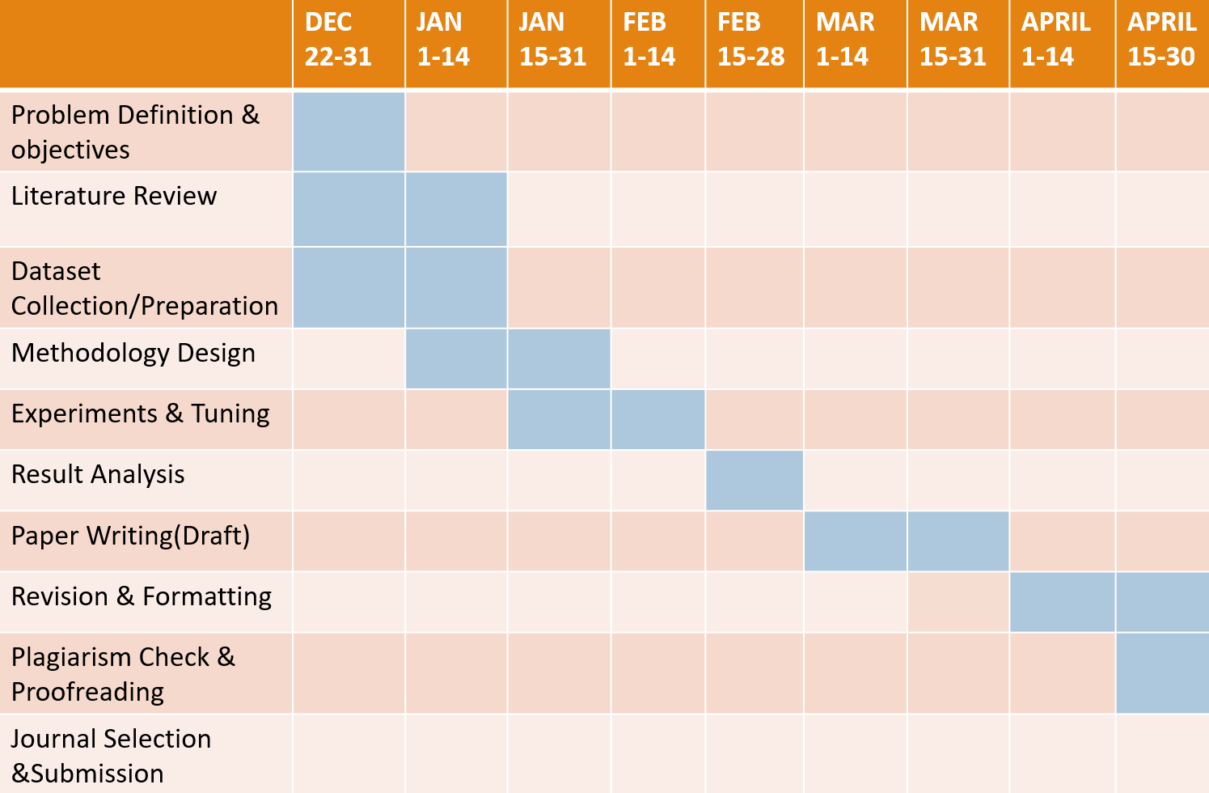
GANTT CHART

Slide 10


