Slide 1
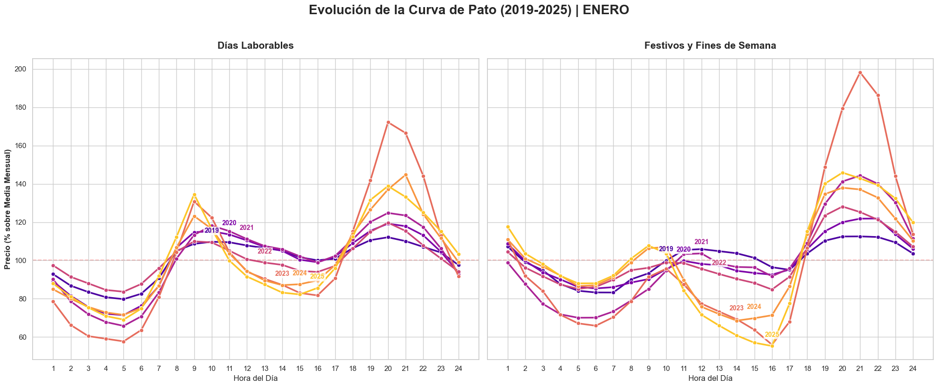

Slide 2
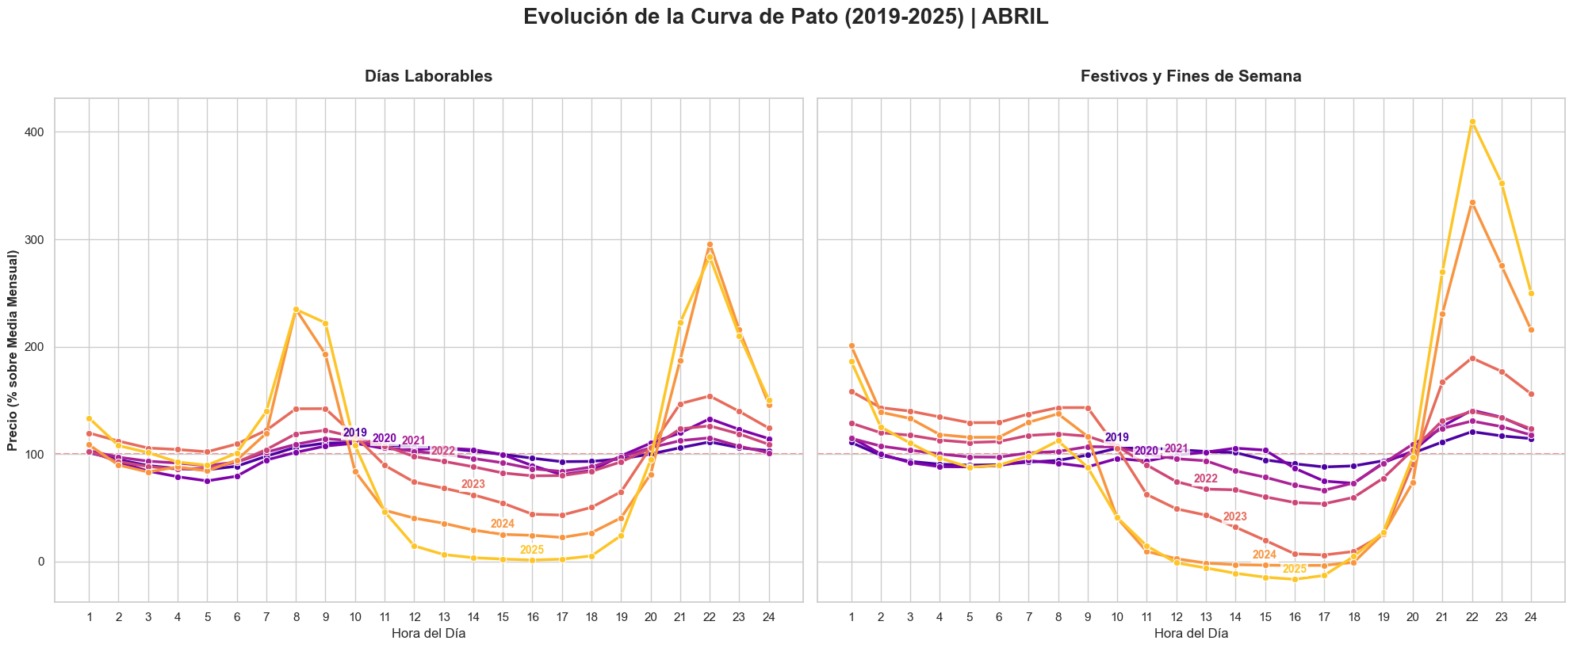

Slide 3
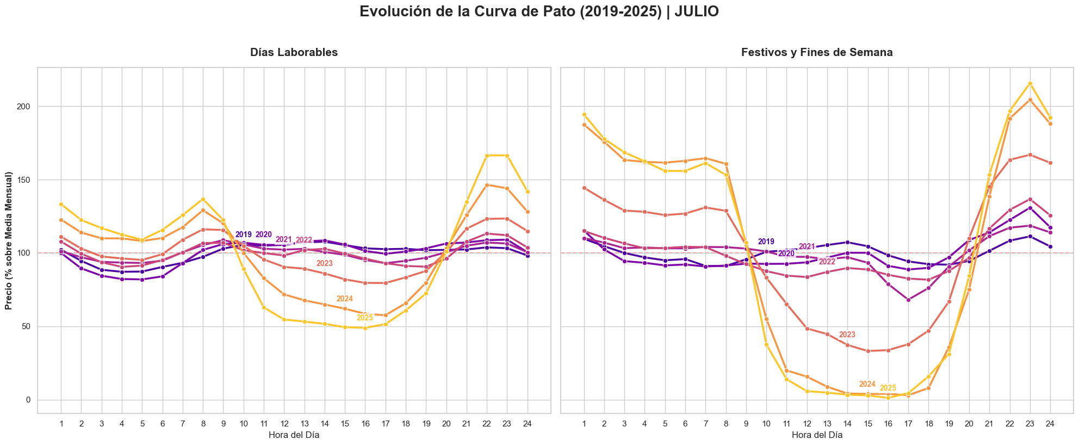

Slide 4
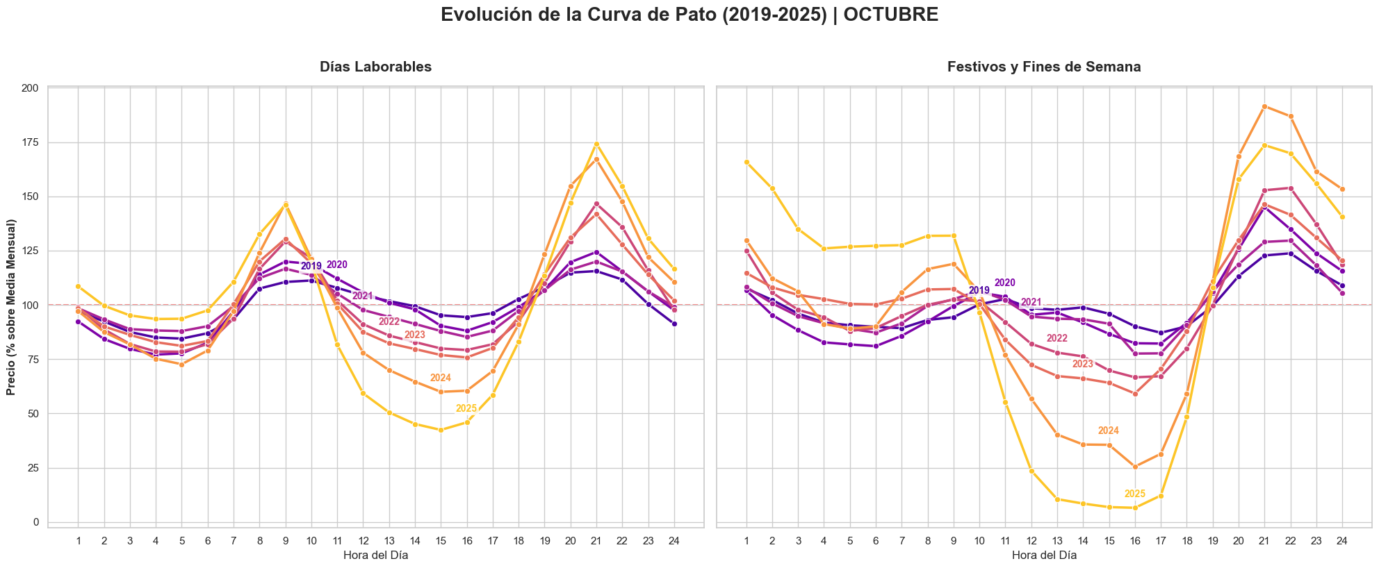

Slide 5
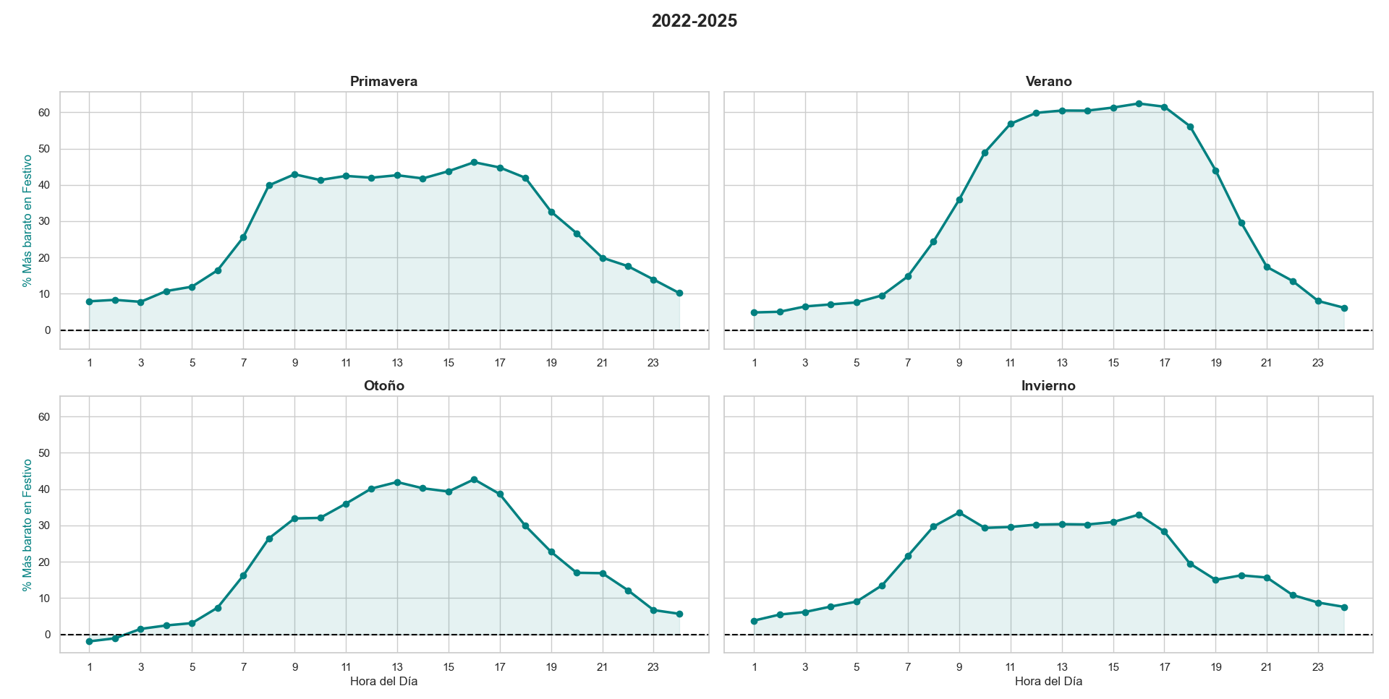

Slide 6
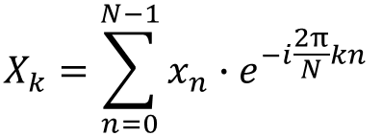
$$X_{k}=\sum_{n=0}^{N−1}{x_{n}∙e^{−i\frac{2π}{N}kn} }$$
Transformada Discreta de Fourier (DTF)

Slide 7
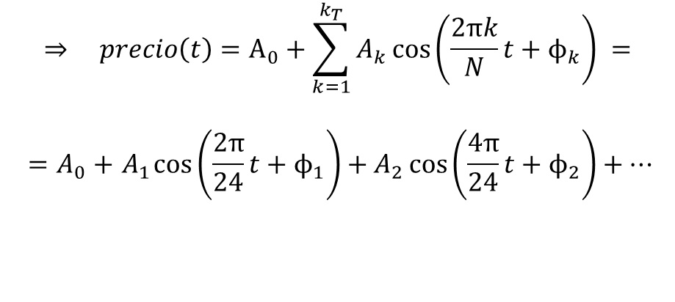
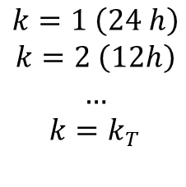
$$X_{k}=\sum_{n=0}^{N−1}{x_{n}∙e^{−i\frac{2π}{N}kn} }$$
$$⇒ precio\left(t\right)=A_{0}+\sum_{k=1}^{k_{T}}{A_{k}\cos\left(\frac{2πk}{N}t+ϕ_{k}\right) =}$$
$${ =A}_{0} +{ A}_{1}\cos\left(\frac{2π}{24}t+ϕ_{1}\right)+A_{2}\cos\left(\frac{4π}{24}t+ϕ_{2}\right)+…$$
$$k=1 \left(24 h\right)$$
$$k=2 \left(12h\right)$$
$$…$$
$$k=k_{T}$$
Transformada Discreta de Fourier (DTF)

Slide 8
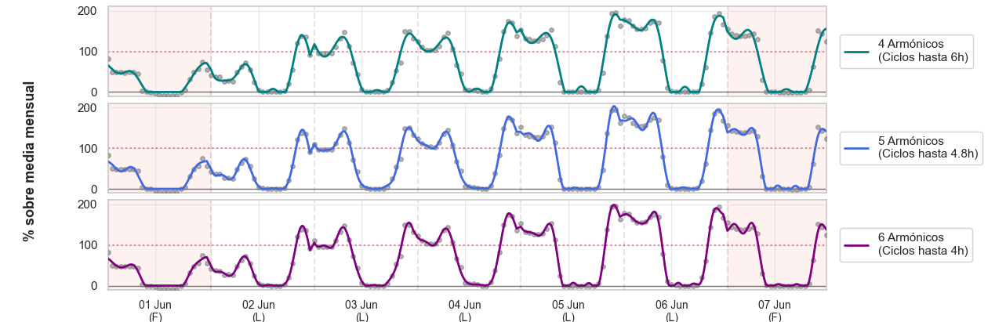
$$X_{k}=\sum_{n=0}^{N−1}{x_{n}∙e^{−i\frac{2π}{N}kn} }$$
$$⇒ precio\left(t\right)=A_{0}+\sum_{k=1}^{k_{T}}{A_{k}\cos\left(\frac{2πk}{N}t+ϕ_{k}\right) =}$$
$${ =A}_{0} +{ A}_{1}\cos\left(\frac{2π}{24}t+ϕ_{1}\right)+A_{2}\cos\left(\frac{4π}{24}t+ϕ_{2}\right)+…$$
$$k=1 \left(24 h\right)$$
$$k=2 \left(12h\right)$$
$$…$$
$$k=k_{T}$$
Transformada Discreta de Fourier (DTF)

Slide 9

$$X_{k}=\sum_{n=0}^{N−1}{x_{n}∙e^{−i\frac{2π}{N}kn} }$$
$$⇒ precio\left(t\right)=A_{0}+\sum_{k=1}^{k_{T}}{A_{k}\cos\left(\frac{2πk}{N}t+ϕ_{k}\right) =}$$
$${ =A}_{0} +{ A}_{1}\cos\left(\frac{2π}{24}t+ϕ_{1}\right)+A_{2}\cos\left(\frac{4π}{24}t+ϕ_{2}\right)+…$$
$$k=1 \left(24 h\right)$$
$$k=2 \left(12h\right)$$
$$…$$
$$k=k_{T}$$
Transformada Discreta de Fourier (DTF)
$$Variables ⇒ A_{0},A_{1},A_{2},A_{3},A_{4},ϕ_{1},ϕ_{2},ϕ_{3},ϕ_{4}$$

Slide 10







$$X_{k}=\sum_{n=0}^{N−1}{x_{n}∙e^{−i\frac{2π}{N}kn} }$$
$$⇒ precio\left(t\right)=A_{0}+\sum_{k=1}^{k_{T}}{A_{k}\cos\left(\frac{2πk}{N}t+ϕ_{k}\right) =}$$
$${ =A}_{0} +{ A}_{1}\cos\left(\frac{2π}{24}t+ϕ_{1}\right)+A_{2}\cos\left(\frac{4π}{24}t+ϕ_{2}\right)+…$$
$$k=1 \left(24 h\right)$$
$$k=2 \left(12h\right)$$
$$…$$
$$k=k_{T}$$
Transformada Discreta de Fourier (DTF)
$$ϕ_{k}$$
$$ϕ_{k}$$
$$ϕ_{k}$$
$$ϕ_{k}$$
$$ϕ_{k}$$
$$ϕ_{k}$$
$$ϕ_{k}$$
$$Variables ⇒ A_{0},A_{1},A_{2},A_{3},A_{4},ϕ_{1},ϕ_{2},ϕ_{3},ϕ_{4}$$

Slide 11

$$X_{k}=\sum_{n=0}^{N−1}{x_{n}∙e^{−i\frac{2π}{N}kn} }$$
$$⇒ precio\left(t\right)=A_{0}+\sum_{k=1}^{k_{T}}{A_{k}\cos\left(\frac{2πk}{N}t+ϕ_{k}\right) =}$$
$${ =A}_{0} +{ A}_{1}\cos\left(\frac{2π}{24}t+ϕ_{1}\right)+A_{2}\cos\left(\frac{4π}{24}t+ϕ_{2}\right)+…$$
$$k=1 \left(24 h\right)$$
$$k=2 \left(12h\right)$$
$$…$$
$$k=k_{T}$$
Transformada Discreta de Fourier (DTF)
$$ϕ_{k}$$
$$ϕ_{k}$$
$$ϕ_{k}$$
$$ϕ_{k}$$
$$ϕ_{k}$$
$$ϕ_{k}$$
$$ϕ_{k}$$
$$Variables ⇒ A_{0},A_{1},A_{2},A_{3},A_{4},ϕ_{1},ϕ_{2},ϕ_{3},ϕ_{4}$$
$$A_{0},A_{1},A_{2},A_{3},A_{4}$$
/ ciclo

Slide 12
Algoritmo machine learning
XGBoost
XGBoost
XGBoost

Slide 13











Algoritmo machine learning
$$t$$
XGBoost
$${\hat{x}}_{n}$$
$$x_{n}$$
$$t+1$$
$$t$$
XGBoost
$${\hat{A}}_{k,t}$$
$$x_{n}$$
$$t+1$$
$$k$$
XGBoost
$${\hat{A}}_{k,k}$$
$$A_{k}$$
$$t+1$$

Slide 14

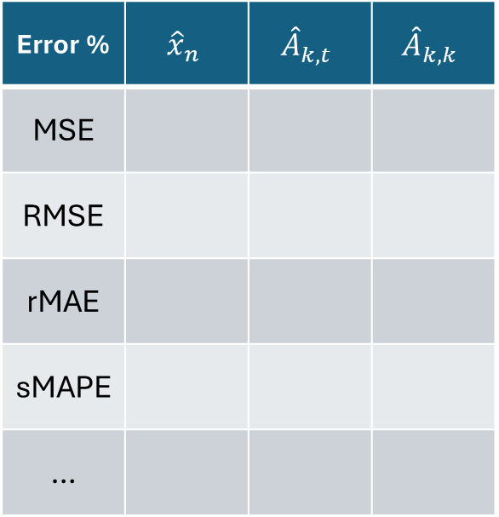
Algoritmo machine learning
$$t$$
XGBoost
$${\hat{x}}_{n}$$
$$x_{n}$$
Error % | $${\hat{x}}_{n}$$ | $${\hat{A}}_{k,t}$$ | $${\hat{A}}_{k,k}$$
MSE
RMSE
rMAE
sMAPE
…
$$t+1$$
$$t$$
XGBoost
$${\hat{A}}_{k,t}$$
$$?$$
$$x_{n}$$
$$t+1$$
$$k$$
XGBoost
$${\hat{A}}_{k,k}$$
$$A_{k}$$
$$t+1$$

