Slide 1
Build It Together, Own It Together
Residents Deck (v0.2) | 2025-09-07
Notes:
60‑sec talk track: You get benefits day one: cheaper pre‑orders, paid roles, creative revenue.
5‑min talk track: Our goal is real income and lower costs; everything is transparent and member‑run.

Slide 2
What You Get Right Away
• Discounted pre‑orders (groceries/services)
• Paid operator roles (home node, media, support)
• Creator pods with on‑chain revenue splits
Notes:
60‑sec talk track: Immediate benefits sell the pilot.
5‑min talk track: Mention weekly office hours for AI help and business setup.

Slide 3
How Money Stays Local
• $CRED community credits redeemable with local vendors
• Pre‑order rails = less waste, lower prices
• Transparent payouts & leaderboards
Notes:
60‑sec talk track: It’s not crypto speculation; it’s store credit you earn and spend locally.
5‑min talk track: We publish weekly reports on payouts and savings.

Slide 4
Pathways & Training
Learner → Operator → Lead
• Short trainings & QA checks
• Matched savings via $CRED
• Weekly office hours (AI, finance, small biz)
Notes:
60‑sec talk track: Explain the pathway ladder.
5‑min talk track: Matched savings make progress visible and build assets.

Slide 5
Home‑Node Program
Run small services at home:
• OCR/RAG for local businesses
• Media transcode/publish for creators
• AI assistant sessions
Get paid weekly by performance
Notes:
60‑sec talk track: Explain proof‑of‑service scoring.
5‑min talk track: Neighbors can try it on basic hardware; we have different tiers.

Slide 6
Creator Guild
• Make music/AI videos/art
• Pre‑orders for drops and shows
• On‑chain splits: instant & transparent
Notes:
60‑sec talk track: Creators get paid and credited automatically.
5‑min talk track: We’ll feature resident talent in events.

Slide 7
Micro‑Business Containers
• Bulk delivery, shuttle, community kitchen
• “Container” playbooks you can replicate
• Vote on what to launch next
Notes:
60‑sec talk track: Invite sign‑ups for first three containers.
5‑min talk track: Explain we start with the services people want most.

Slide 8
Community Wins (5‑Year)
• ~3.25× revenue & ~4.4× profit vs traditional
• ~2.6× more jobs; ~2.8× more households served
• Democratic ownership & voice for residents
Notes:
60‑sec talk track: Show the numbers at a high level.
5‑min talk track: Explain more households served because pre‑orders and credits remove barriers.

Slide 9
How We Decide
Two‑House Votes
• Token House ($CAT) for strategy
• Citizen House ($WORK) for programs & grants
A proposal passes only when both approve
Notes:
60‑sec talk track: Residents’ work earns $WORK voting power.
5‑min talk track: No one can steamroll decisions; both houses must agree.

Slide 10
Join the Pilot
Sign up: Operator, Creator Pod, or Vendor
Bring a neighbor; earn $WORK + $CRED
Community assemblies start next week
Notes:
60‑sec talk track: End with clear invites.
5‑min talk track: We’ll message meeting times and sign‑up forms.

Slide 11
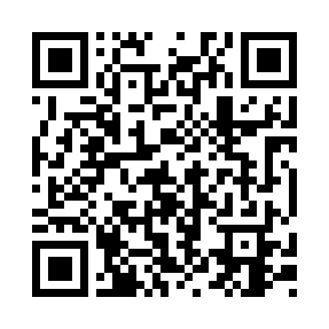
Scan to Join & Access Resources
Drive folder:
https://drive.google.com/drive/folders/REPLACE_WITH_YOUR_LINK
Notes:
60‑sec talk track: If QR is not live yet, use the URL text.
5‑min talk track: We’ll update the QR with the final Drive link.

