Slide 1
LIVE DEMO — FOR COMIC PUBLISHERS
ACBF
PANEL EDITOR
Turning a comic archive into a panel-by-panel reading experience — without redrawing a single page.
.CBZ
/
.CBR
→ editor →
.ACBF

Slide 2
THE IDEA
YOU ALREADY HAVE THE PANELS.
NOW THE READER CAN FIND THEM.
INPUT
EDITOR DRAWS
READER FOLLOWS
Page
Panels
Reading order
One flat raster image, exactly as it sits in the archive today.
→
Each panel becomes its own shape — a rectangle, or any polygon.
→
The sequence you set is exactly the path the reader is guided through.

Slide 3
WHY READERS CARE
A PAGE BUILT FOR PRINT ISN'T BUILT FOR A PALM
●
Small screens, full pages
Shrink a print-lettered page to a phone and the dialogue goes illegible before the art does.
●
Guided, not zoomed
Guided View pans and zooms to every panel automatically, in reading order — no pinching, no hunting for the next line.
●
Runs on their device
No upload, no server round-trip. The reader's copy of the issue never leaves their phone.

Slide 4
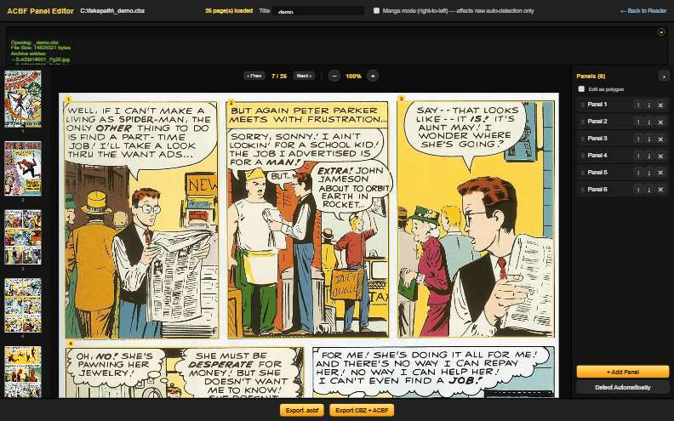
STEP 1 OF 3
DROP IN THE ARCHIVE
1
Open the .cbz or .cbr you already have — nothing to re-export first.
—
An on-device model reads the page and outlines every panel
—
This page: 6 panels found and numbered in under two seconds
—
No file ever leaves the browser

Slide 5
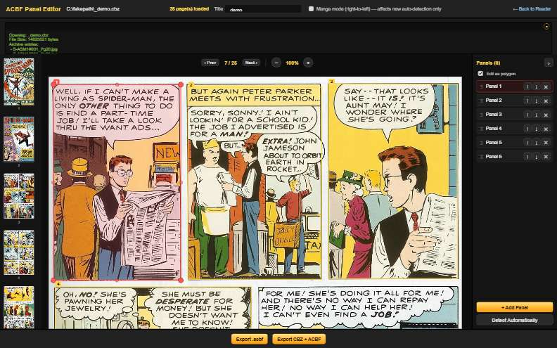
STEP 2 OF 3
CORRECT THE DRAFT
2
Every panel is a shape, not just a box.
—
Drag a corner to resize, an edge to trace an angled border
—
Add, delete, or redraw a panel from scratch
—
Drag panels in the list to fix reading order

Slide 6
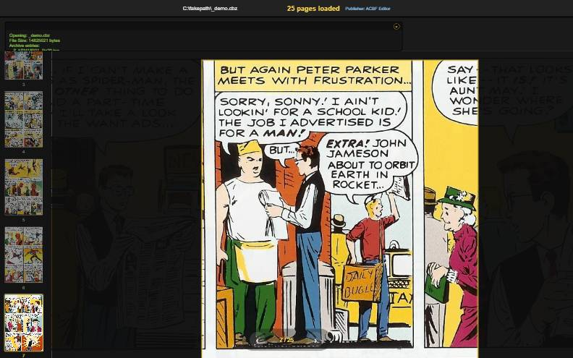
STEP 3 OF 3
THE READER'S VIEW
3
Export, and the reader gets an automatic path through the page.
—
One panel at a time, in the order you set
—
Pan & zoom, fade-to-black, or Cinematic (shown here)
—
Cinematic spotlights the current panel, dims the rest

Slide 7
THE FINE PRINT — READ IT ANYWAY
NOTHING TO LOSE BY TRYING IT
0 UPLOADS
OPEN FORMAT
1 ISSUE
Every archive stays on your own machine, start to finish — the editor never phones home.
ACBF is a public spec, not something locked to this reader or this company.
is enough to try it end to end — no migration, no contract, no commitment.

Slide 8
FOR YOUR ARCHIVE, SPECIFICALLY
WHAT CHANGES ON YOUR END
YOUR ARCHIVE
Works as-is — no re-scanning, no re-lettering, no format change.
YOUR READERS
A phone-native way to read a page that was drawn for print.
YOUR DATA
The panel map is a file you keep — export it, edit it later, or walk away with it.

