Slide 1

Can Complex Collective Behaviour Be Generated Through Randomness, Memory and
a Pinch of Luck?
Introduction to Research
MEFT - 2017
Pedro M. Pereira (N.78889)

Slide 2
Structure of Presentation
Motivation
Setup
Model
Results
Conclusions

Slide 3
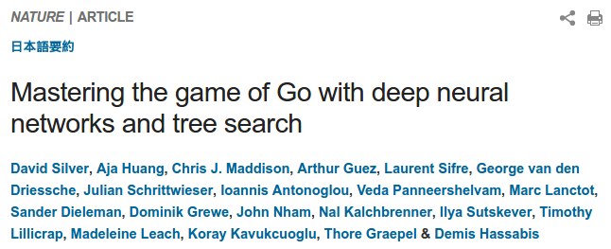
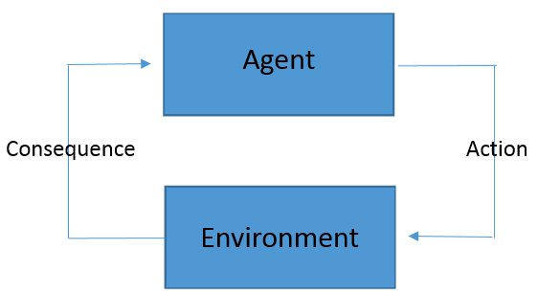
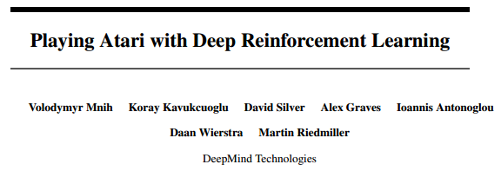
Motivation
Reinforcement Learning
"Evolution forged the entirety of sentient life on this planet using only one tool: the mistake." - Dr. Robert Ford, HBO's Westworld

Slide 4
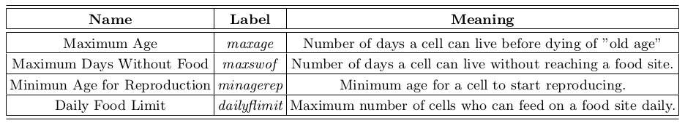
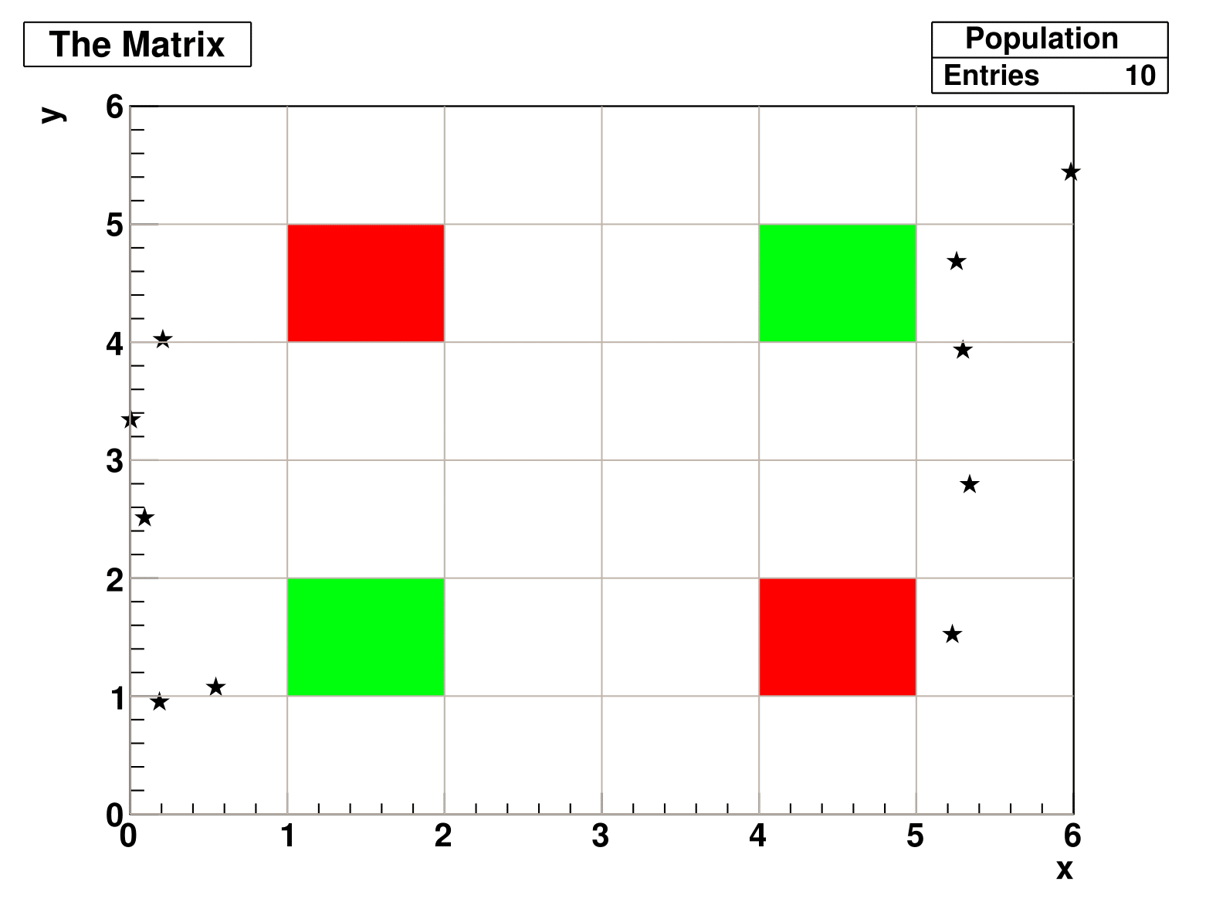
SETUP
L=6
N=10
Symmetric population distribution
symmetric death and food sites distribution

Slide 5
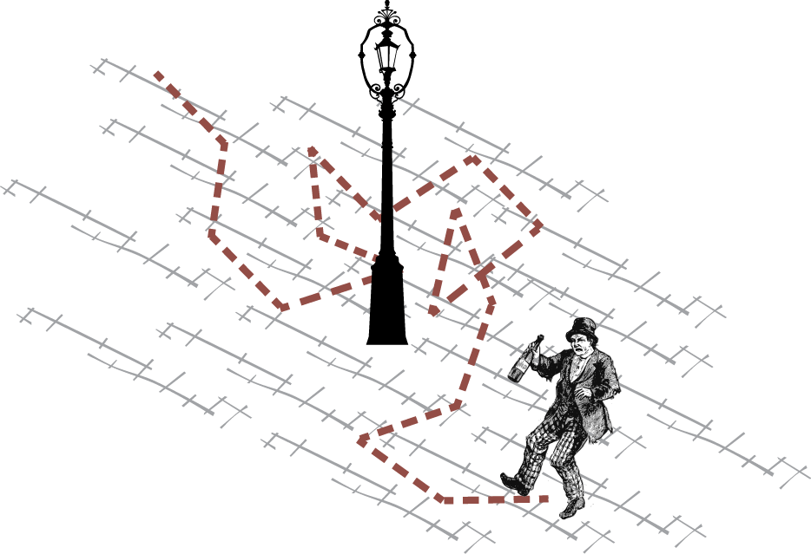
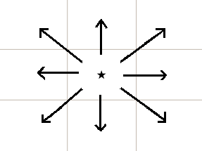
Model
At t=0 :
Random Walker
Possible Moves
Source: Theoretical Systems Biology, Imperial College London

Slide 6

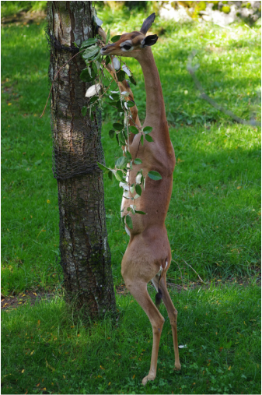
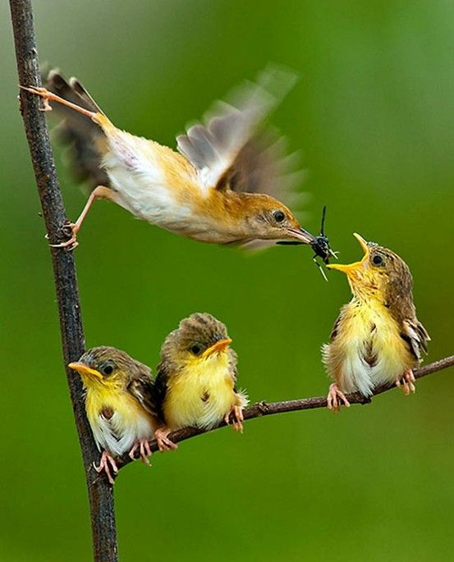
Model
Cells Reproduce
If one cell has many options for reproduction
it will choose at random one of the highest generation
possible.
If many cells are in the same food site, the
ones from higher generations and with lower age have pri-
ority to eat.
Replication of what happens in nature.
Source: National Geographic Magazine

Slide 7
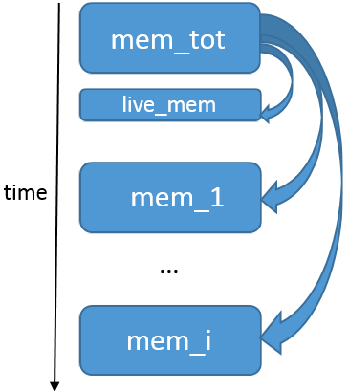
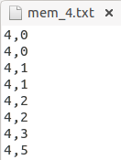
Model
Weights
Death Event in P
6 x P
Feeding Event in P
0 x P
1 x P-1
2 x NOT(P AND P-1)
Part of the memory from a generation 4
Time Evolution of Memory Creation
live_mem
Effect of Communication is not negligible for generation 0

Slide 8
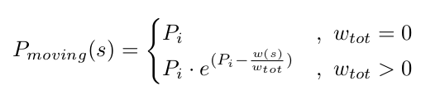
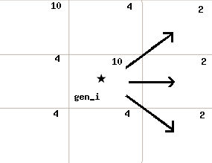
Model
Depends on the ratio of the weight of s with the total sum of weights in the available sites!
Can be bigger than Pi !
Available moves with Memory

Slide 9
Model
Can Somebody die of hunger in a food Site? No... Unless the food site becomes saturated! (because of dailyflimit)
After this happens, different information is stored for a certain food site P' :
Death Event in P'
6 x P'
Feeding Event in P'
0 x P'
2 x P'-1
1 x NOT(P' AND P'-1)
This 'Inversion' occurs when weight of P' equals the weight of the nearby sites - Population reaches Neq (Equilibrium Population Number).
Reverts to the old weights if Population Number gets below the Neq.

Slide 10
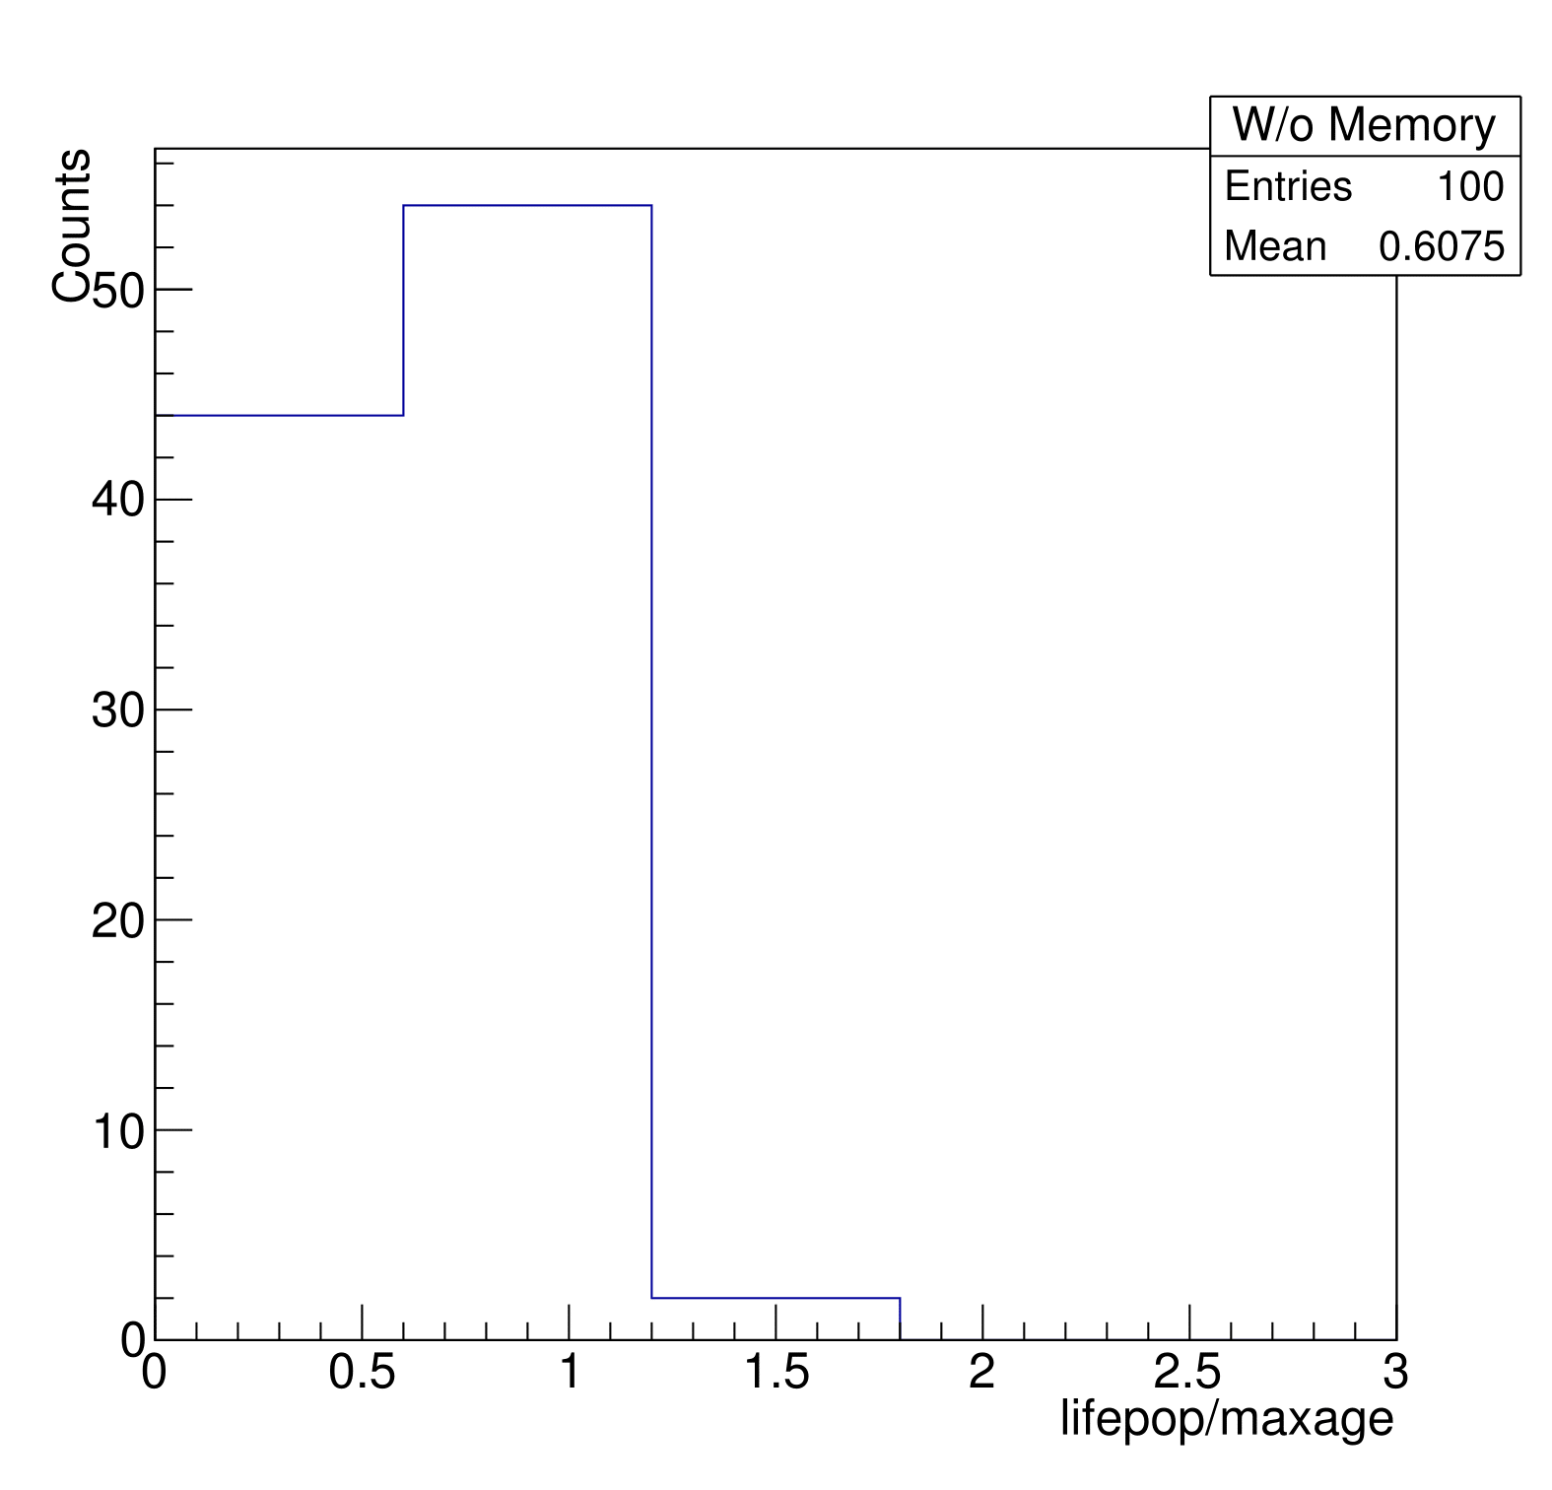
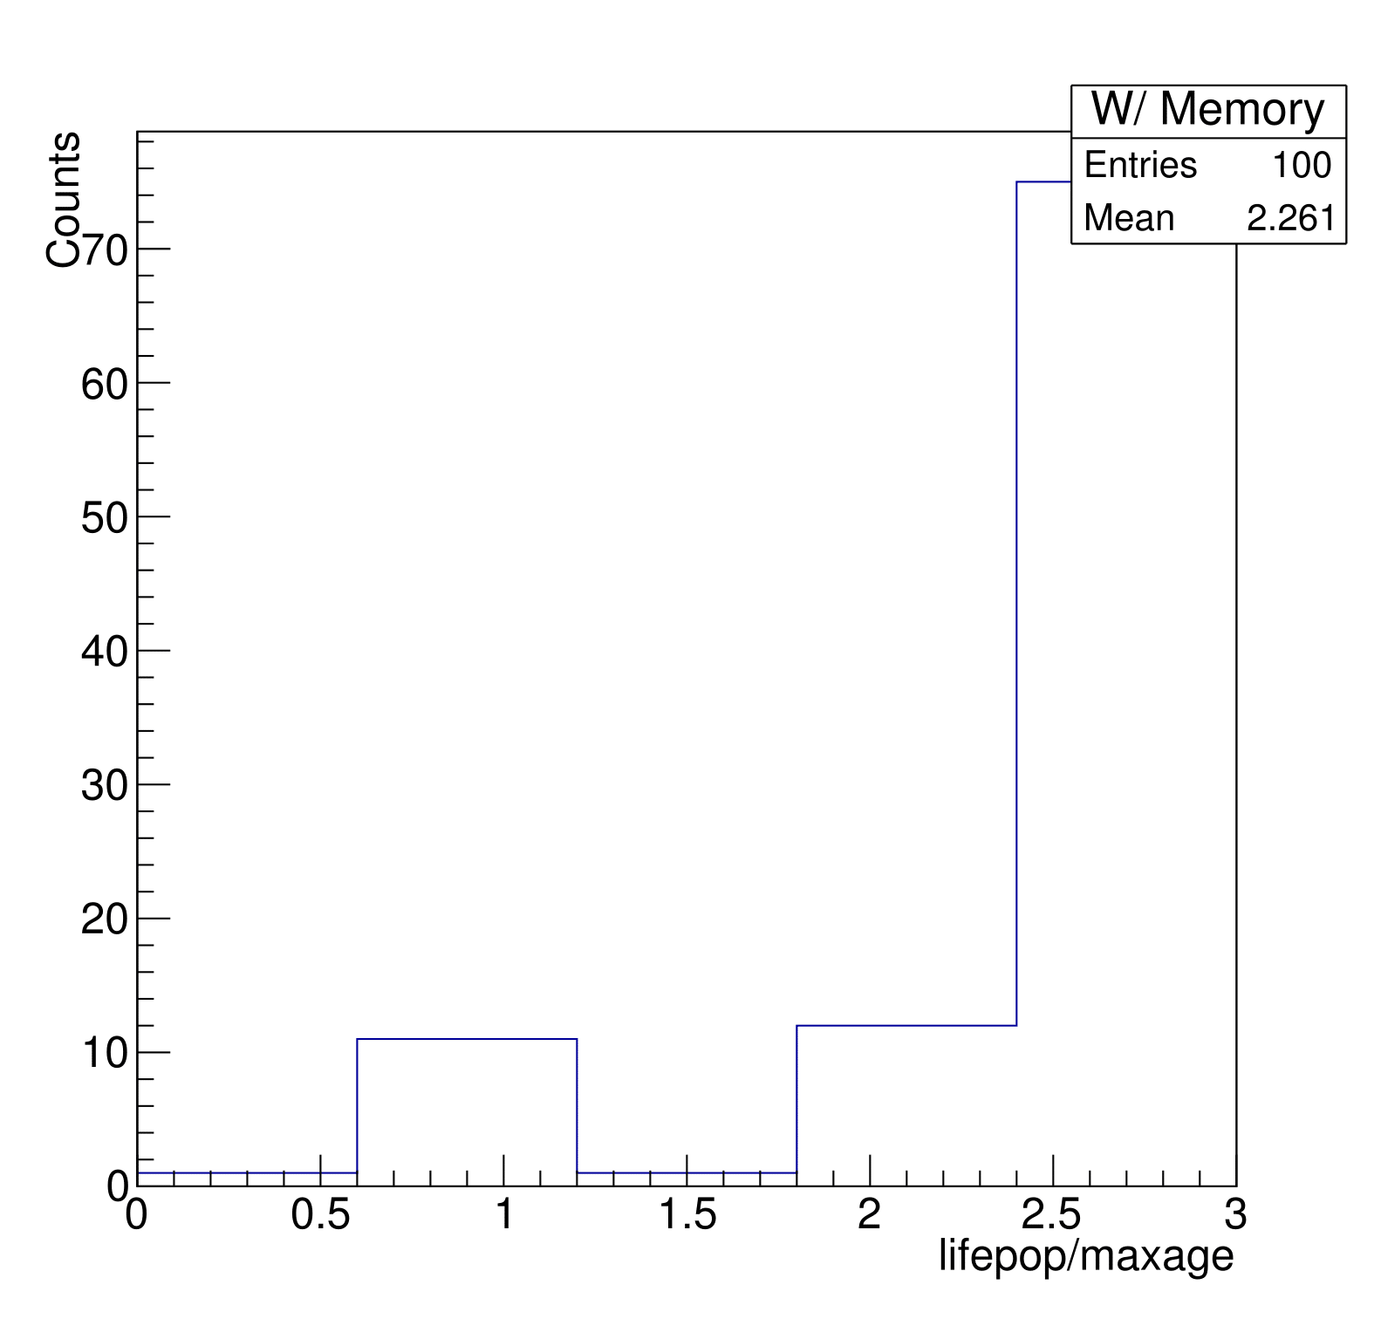
Results
Pure Random Walker
Model With Memory

Slide 11
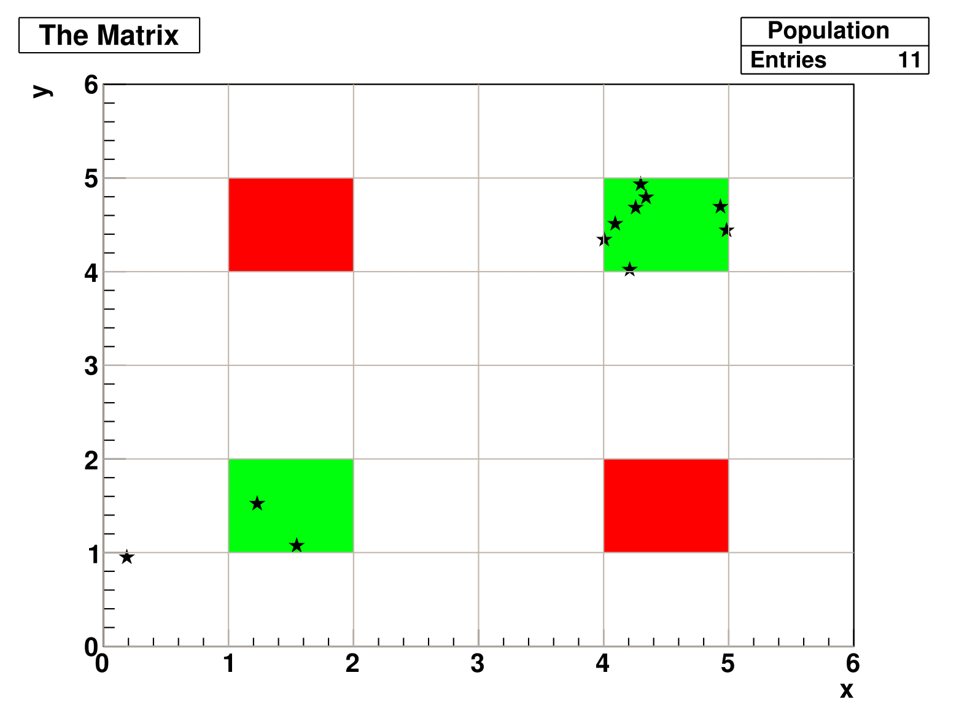
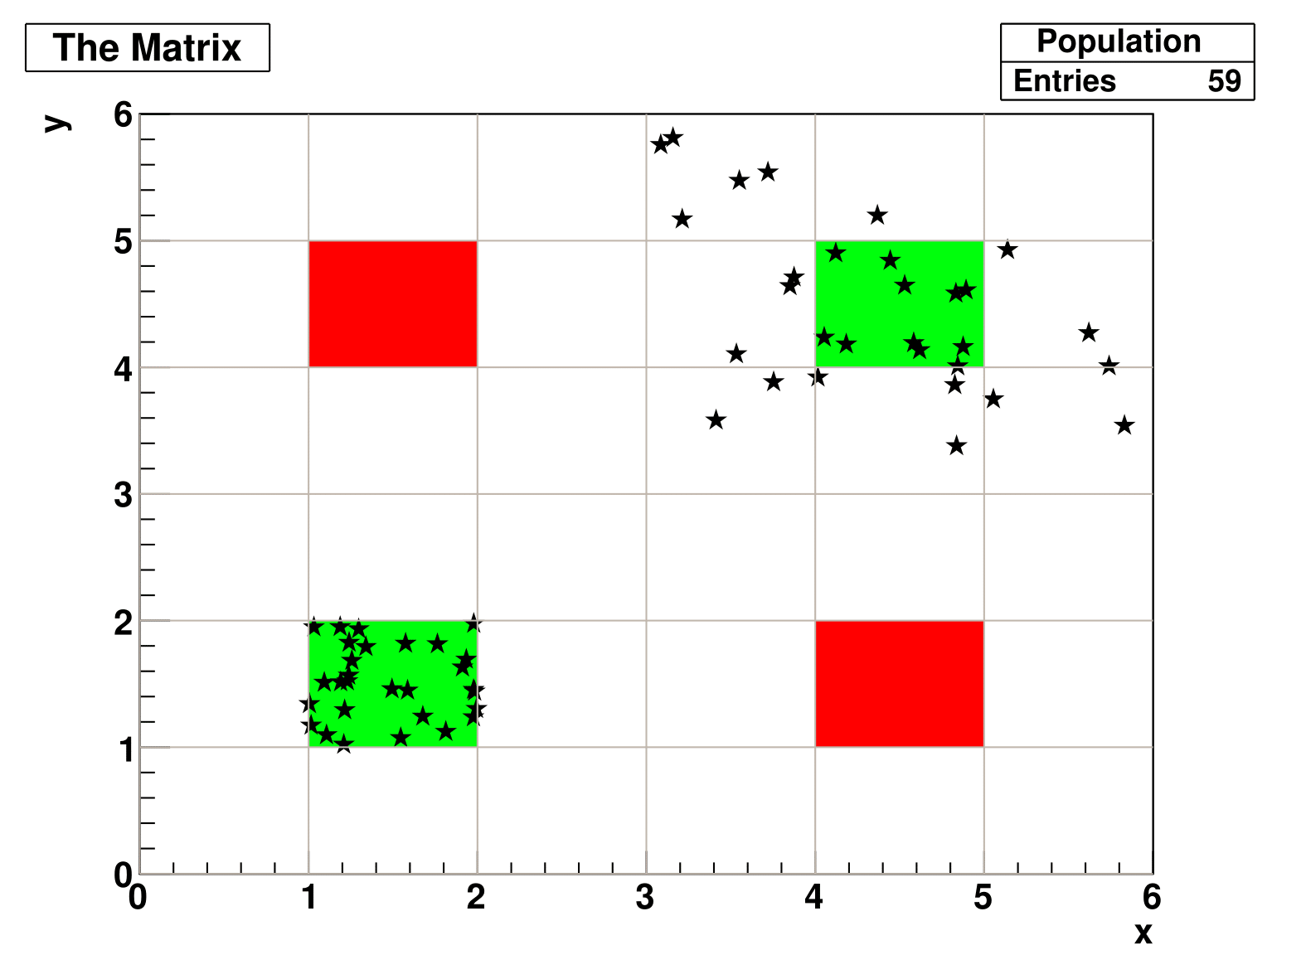
Results – 'Lucky' evolution
Day 5
Day 99

Slide 12
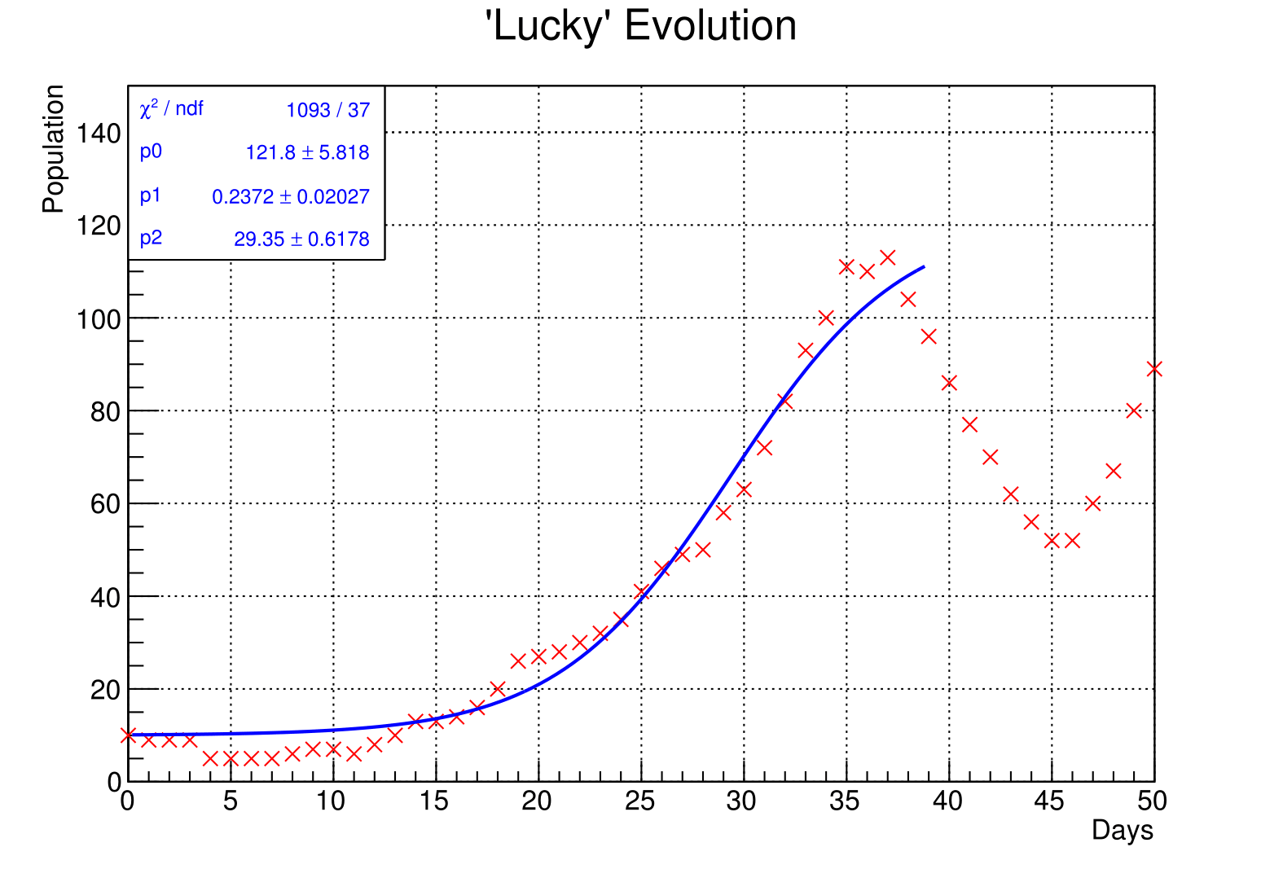

Results – 'Lucky' fit to logistic function
p0=Neq
p1=k
p2=d0

Slide 13
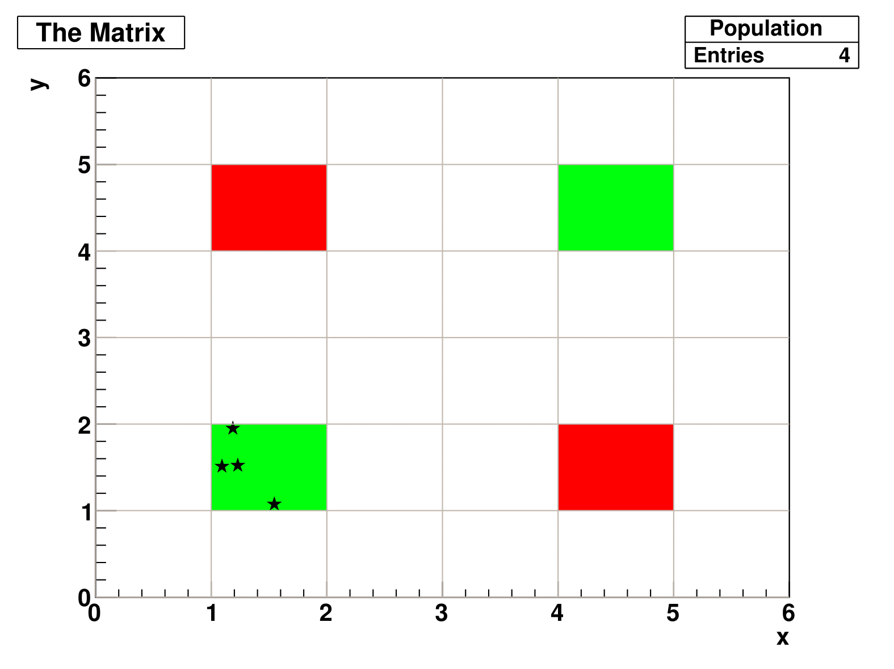
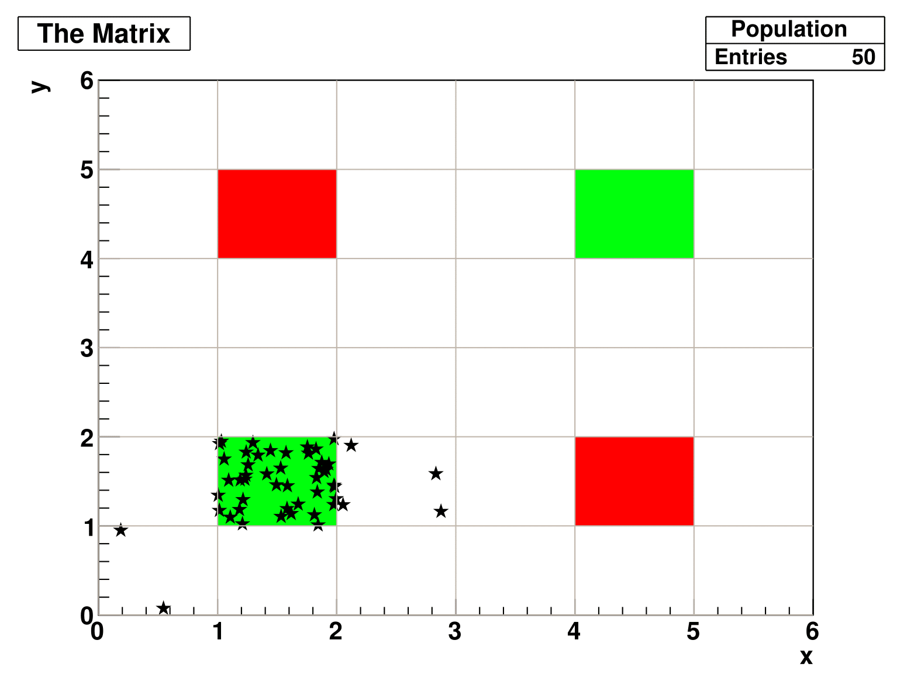
Results – 'Adventurous' evolution I
Day 4
Day 18

Slide 14
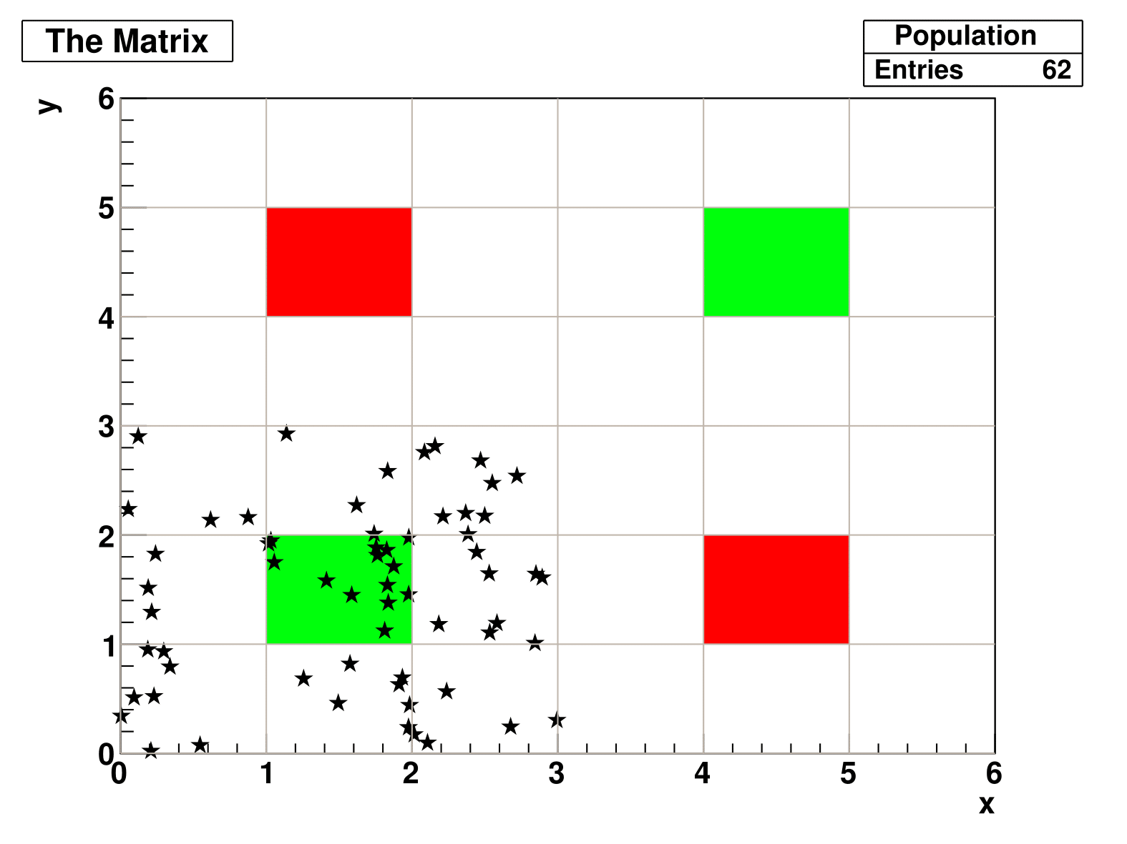
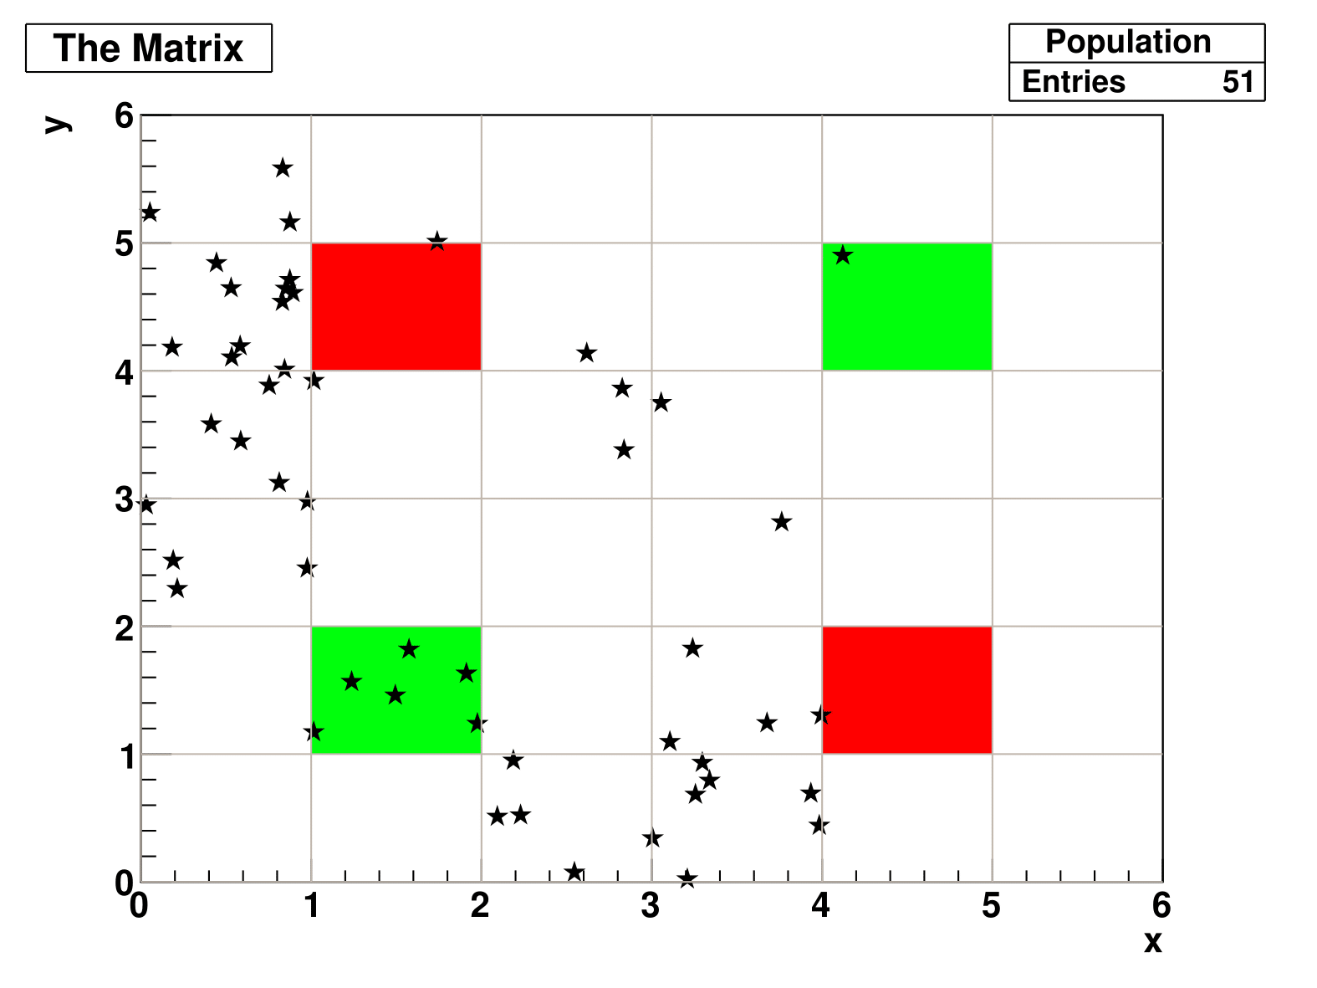
RESULTS – 'ADVENTUROUS' EVOLUTION II
Day 23
Day 45

Slide 15
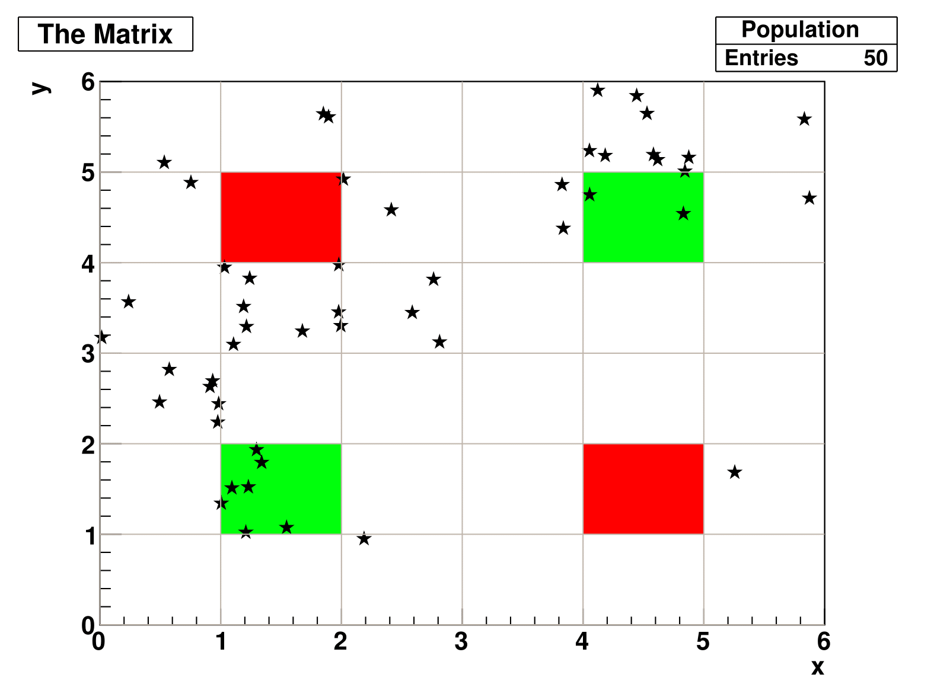
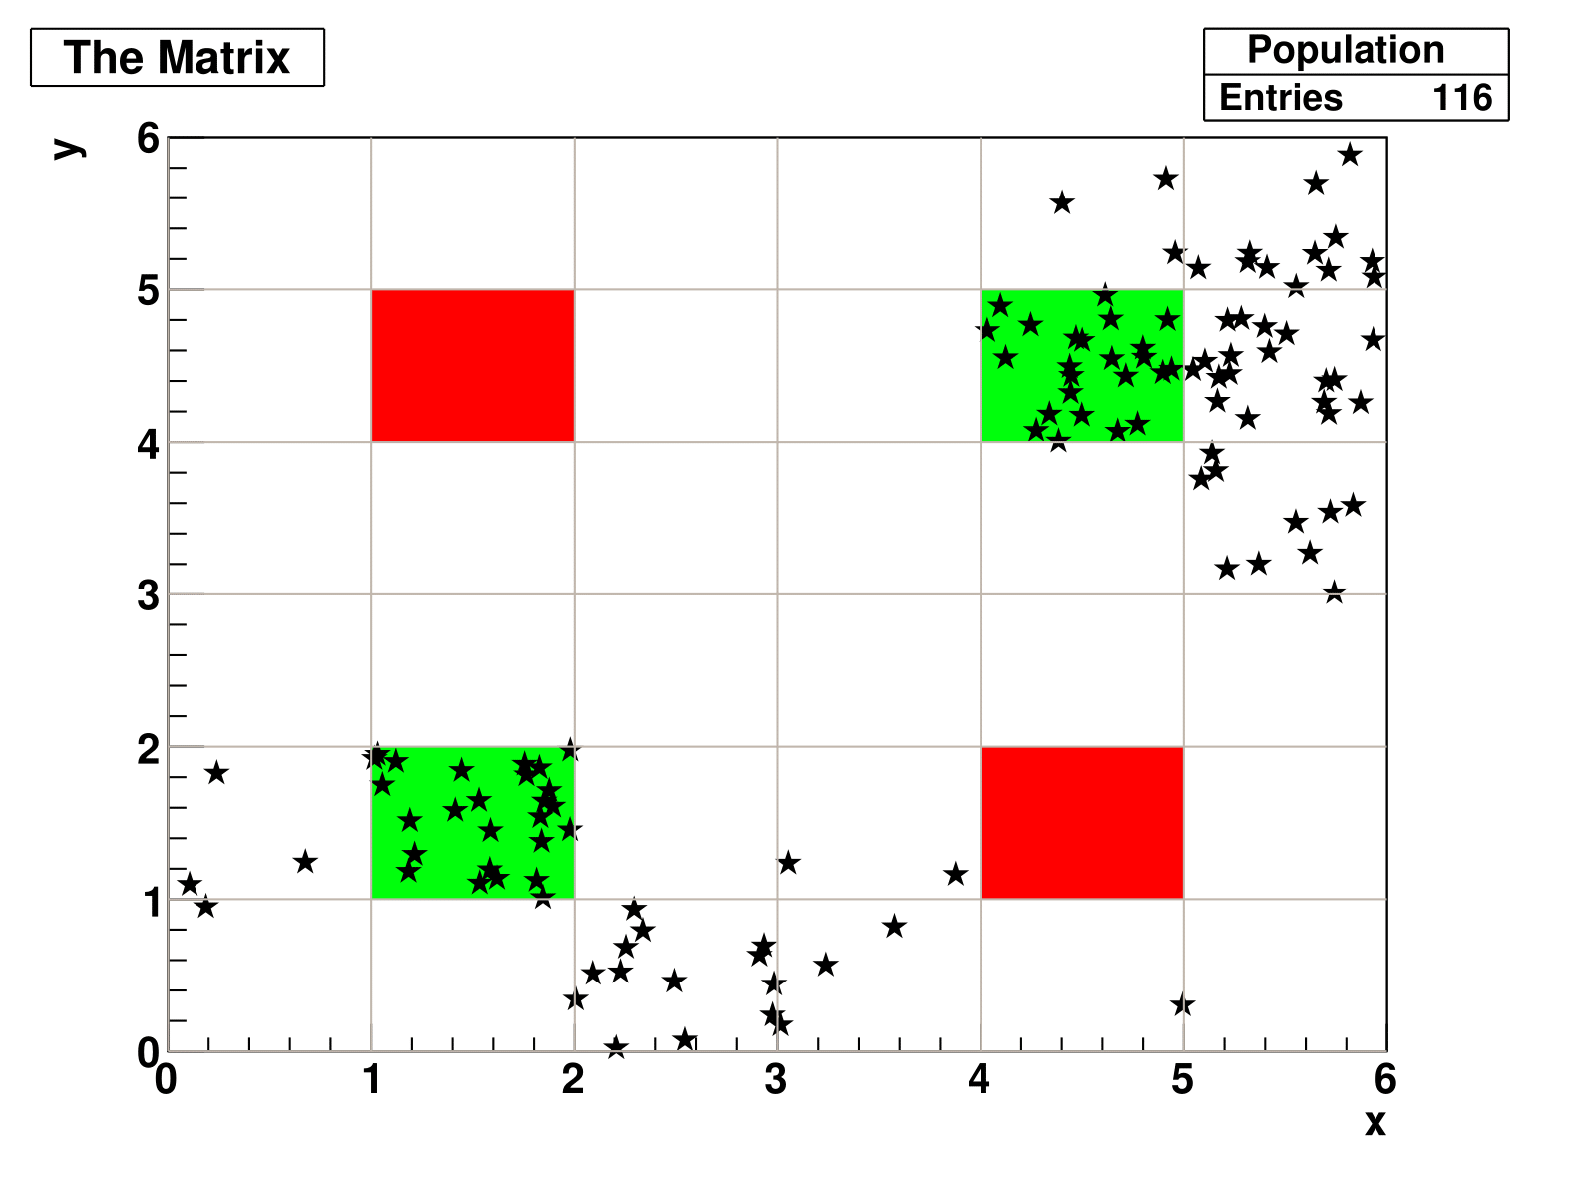
RESULTS – 'ADVENTUROUS' EVOLUTION III
Day 51
Day 70

Slide 16
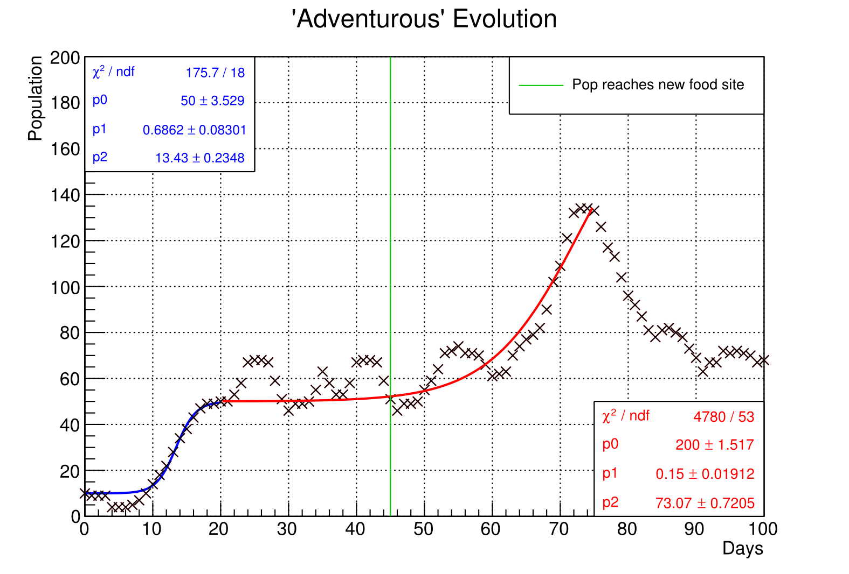
Results – 'Adventurous' fit to logistic function
p0=Neq
p1=k
p2=d0
Ni=10 for Blue
Ni=50 for Red

Slide 17
Conclusions
The model fulfilled its purpose of generating interesting collective behaviour having only three available tools: initial randomness, memory of deaths and good zones and a tuning of the initial conditions.

Slide 18
Conclusions
The breakthroughs that distinguished the memoryless case from the 'intelligent' one were:
The correct definition of the probability distribution;
Gifting generation 0 with a live memory that emulates their only way of sharing information – communication.
Redefinition of the weights given in an eating event when food source saturates.

Slide 19
Conclusions
Obvious improvement: Introducing mutations - randomly generated information added to the memory of some generations that can contribute in a good or bad way to the development.
Interesting test: Introducing a concurrent population with a different mem_tot and observe if both populations tend to merge and add their memories.

Slide 20
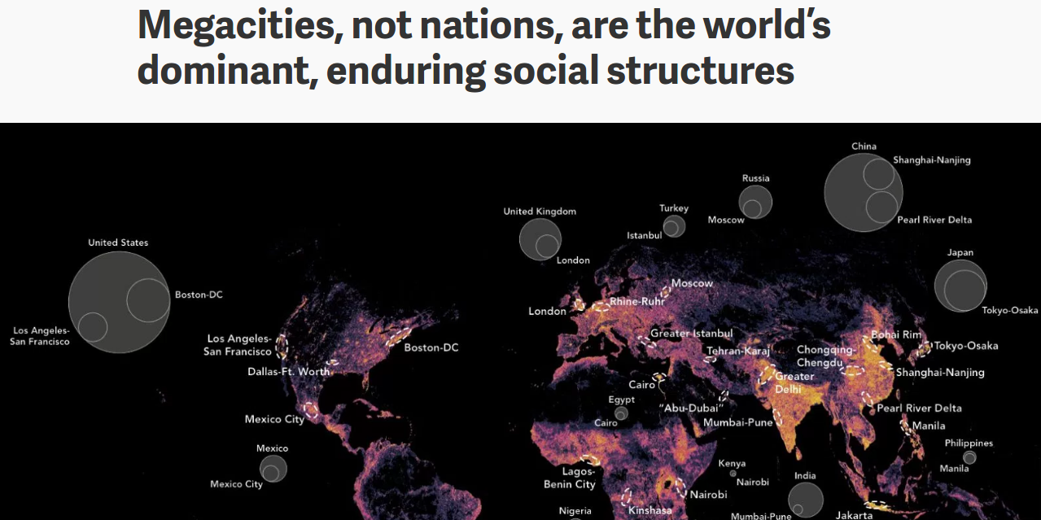
Conclusions
This model can be compared to the behaviour of unicellular organisms but also of humans around major cities, correctly predicting their migration when deaths start to increase abruptly (war zones and/or zones with a food shortage).
Source: Quartz
(qz.com)

Slide 21
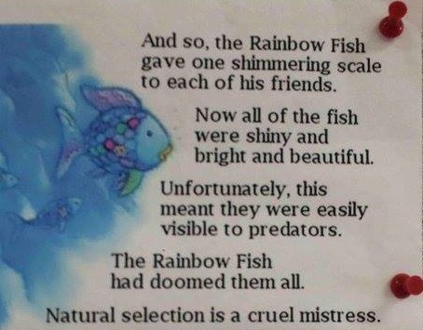
The end

