Slide 1
Lecture 10: Machine Learning II
Information and Communication Technologies

Slide 2


The linear regression
The cricket chirps method to calculate the temperature
The mathematical writing:
$$y=m.x+b$$
The machine learning writing:
$$y^{′}=b+ w_{1}x_{1}$$
y’ is the label, x is the feature, w is the weight and b is the bias (also called w₀)

Slide 3
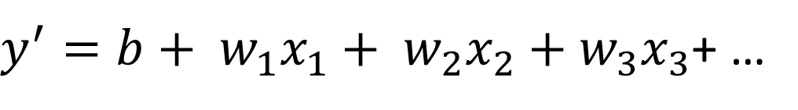
The model
You can train it to get the following equation:
You can now infer the temperature with cricket chirps per minute:
for 50 cricket chirps per minute:
For 100 cricket chirps per minute:
If there are several features:
$y^{′}=b+ w_{1}x_{1}+ w_{2}x_{2}$ $+ w_{3}x_{3}$+ …

Slide 4
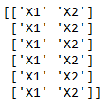

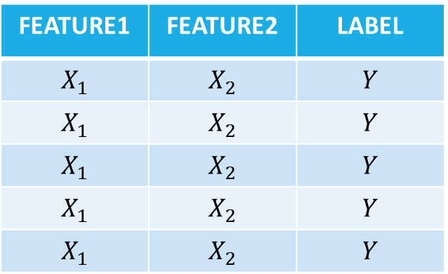
Providing data to scikit-learn
Should be provide in the same logic than a table to scikit-learn.
Example:
1st array
2nd array
FEATURE1 | FEATURE2 | LABEL
$$X_{1}$$ | $$X_{2}$$ | $$Y$$
$$X_{1}$$ | $$X_{2}$$ | $$Y$$
$$X_{1}$$ | $$X_{2}$$ | $$Y$$
$$X_{1}$$ | $$X_{2}$$ | $$Y$$
$$X_{1}$$ | $$X_{2}$$ | $$Y$$

Slide 5
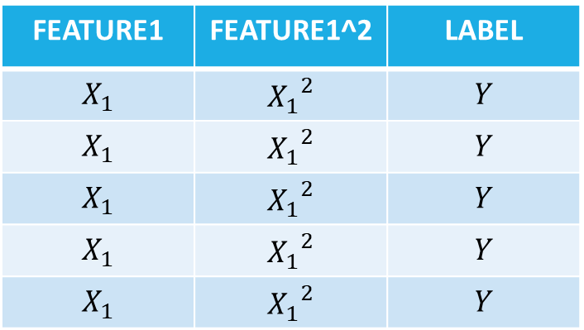

The polynomial regression with scikit-learn
The same than a linear regression with several feature where one feature is the square of another one.
FEATURE1 | FEATURE1^2 | LABEL
$$X_{1}$$ | $${X_{1}}^{2}$$ | $$Y$$
$$X_{1}$$ | $${X_{1}}^{2}$$ | $$Y$$
$$X_{1}$$ | $${X_{1}}^{2}$$ | $$Y$$
$$X_{1}$$ | $${X_{1}}^{2}$$ | $$Y$$
$$X_{1}$$ | $${X_{1}}^{2}$$ | $$Y$$
$$y^{′}=b+w_{1}{x_{1}}^{2}+ w_{2}x_{1}$$
$$y^{′}=b+w_{1}x_{2}+ w_{2}x_{1}$$
Where $x_{2}={x_{1}}^{2}$

