Slide 1
Lecture 9: Machine Learning I
Information and Communication Technologies

Slide 2
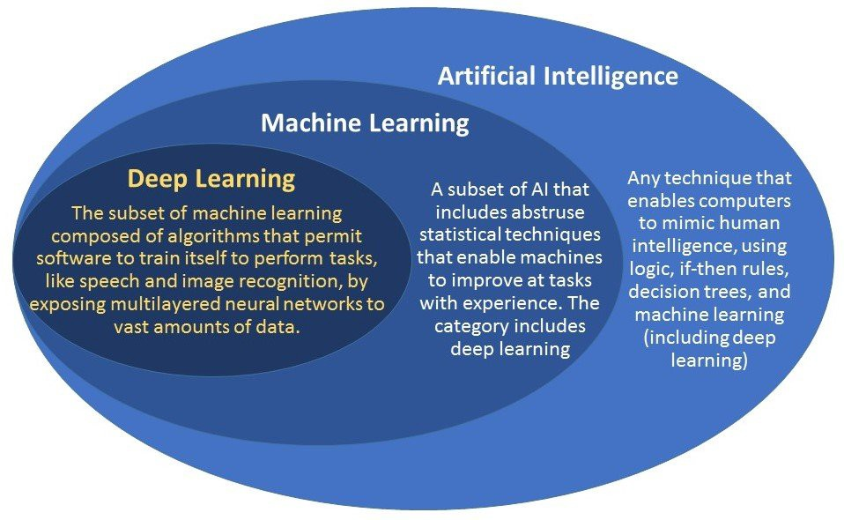
Introduction to ML

Slide 3
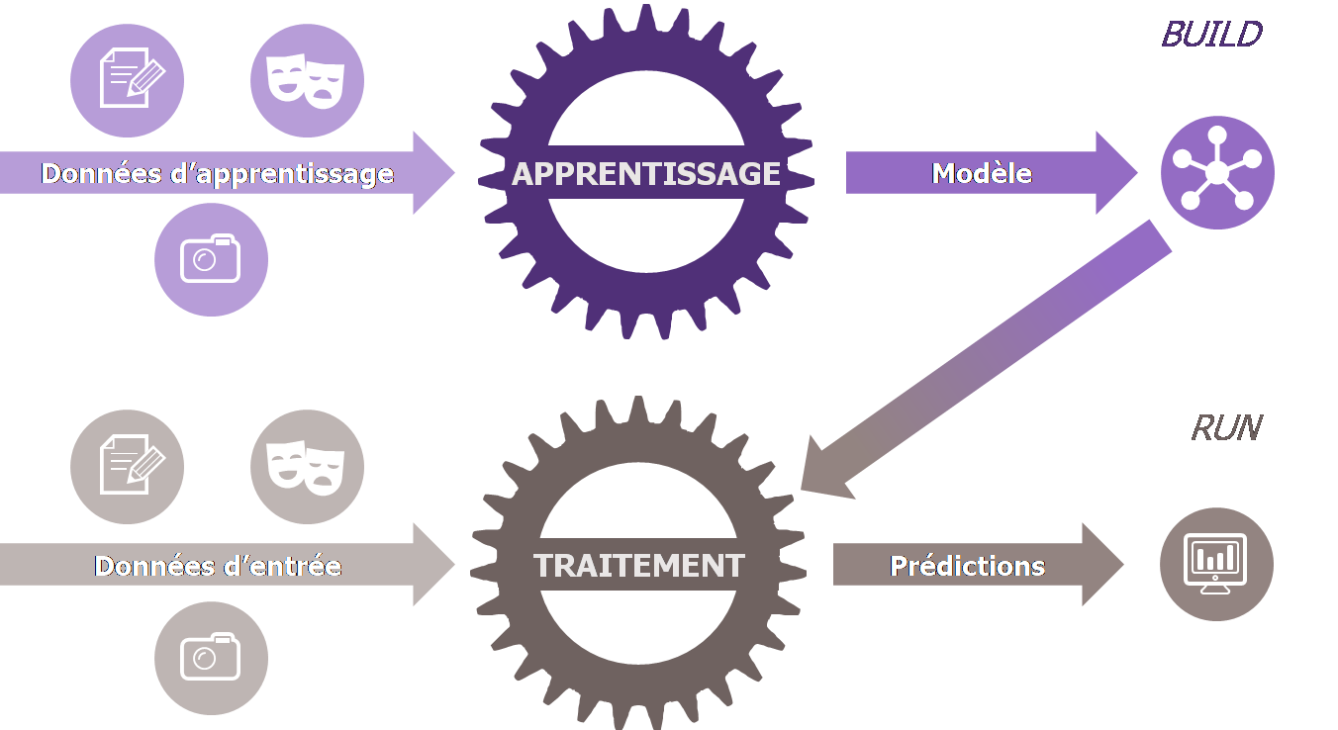
Introduction to ML
A Machine Learning system learn how to combine input to predict useful prediction or never-seen data
Model
Data
Learning
Unknow output data
Processing
Predictions

Slide 4
Some example
A spam analyser for e-mails
A system to predict stock market prices
A picture analyser
A weather model

Slide 5
Vocabulary
LABEL: the thing we are predicting. Example:
The price of the stock
The kind of animal in the picture
The temperature of air
In a simple linear regression : y = a*x + b, the label is y
FEATURE(s): the input variable(s). It can be one or several features in your model. Example:
The pixels of an image
The previous prices of stock market
In a simple linear regression: y = a*x + b, the feature is x

Slide 6
Vocabulary
EXAMPLES: it’s a particular instance of data. There is two categories:
Labelled examples, when the example contain the feature(s) and the label
Unlabelled examples , when the example contain only the feature(s)
You will train your model with labelled examples to predict unlabelled examples.

Slide 7
Vocabulary example
Here are three labelled examples:
House Age (feature) | Total Rooms (feature) | Total Bedrooms (feature) | House Price (label)
15 | 6 | 2 | 200 000$
1 | 3 | 1 | 80 000$
50 | 15 | 5 | 900 000$

Slide 8
Vocabulary example
Here are three unlabelled examples:
House Age (feature) | Total Rooms (feature) | Total Bedrooms (feature)
15 | 6 | 2
1 | 3 | 1
50 | 15 | 5

Slide 9
Vocabulary
MODEL: the model is the system than define the relationship between the features and the label. A model has two phases:
The training phase (learning phase): when you show your model some labelled examples to make it gradually learn the relationships between features and labels.
The inference: the process of the model where it predict the label of unlabelled examples with the features.

Slide 10
Vocabulary
Regression: a type of model which predict continuous values. For example:
The temperature
The price of the stock market
The price of a house
Classification: a type of model which predict discrete values. For example:
The animal on the picture
The category of a mail (spam or not spam)

Slide 11
Some examples
Using Machine Learning to predict:
The success of a movie in cinema
The best next chess moves
The future success of a student
Let’s try to see them in details

Slide 12


The linear regression
The cricket chirps method to calculate the temperature
The mathematical writing:
$$y=m.x+b$$
The machine learning writing:
$$y^{′}=b+ w_{1}x_{1}$$
y’ is the label, x is the feature, w is the weight and b is the bias (also called w₀)

Slide 13
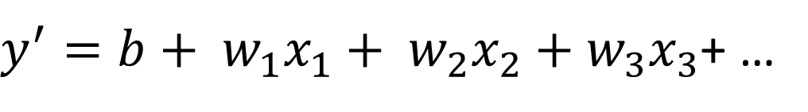
The model
You can train it to get the following equation:
You can now infer the temperature with cricket chirps per minute:
for 50 cricket chirps per minute:
For 100 cricket chirps per minute:
If there are several features:
$y^{′}=b+ w_{1}x_{1}+ w_{2}x_{2}$ $+ w_{3}x_{3}$+ …

Slide 14
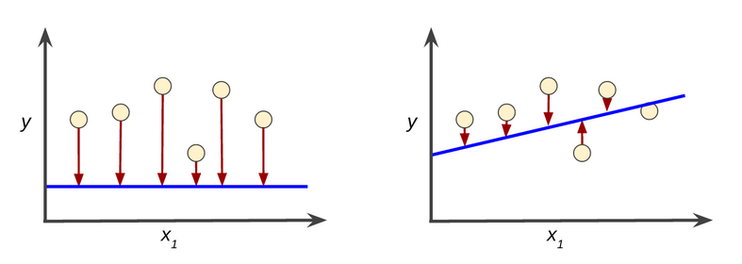
The training of a model: loss
Getting the best weights and bias from, labelled examples. The objective is to minimize loss.
Loss indicate how bad is your model in one prediction.

Slide 15

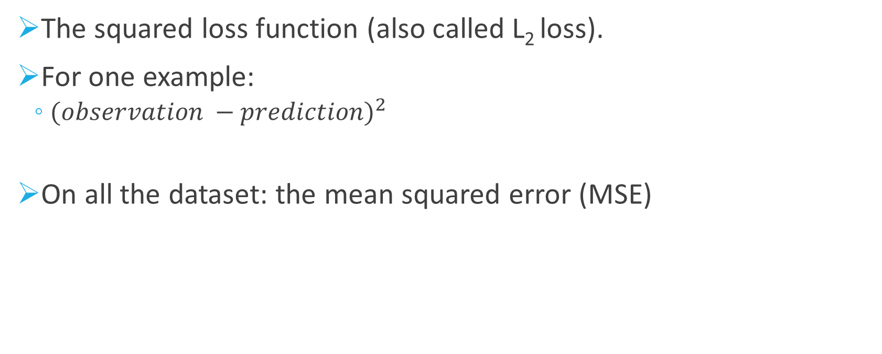
Calculation of loss
The squared loss function (also called L₂ loss).
For one example:
${(observation −prediction)}^{2}$
On all the dataset: the mean squared error (MSE)

Slide 16
Let’s see in our example
Let’s try to find a model and calculate its MSE.
Let’s compare it to Excel MSE
Note: MSE is really common in machine learning, it’s not the only method and not always the best

Slide 17
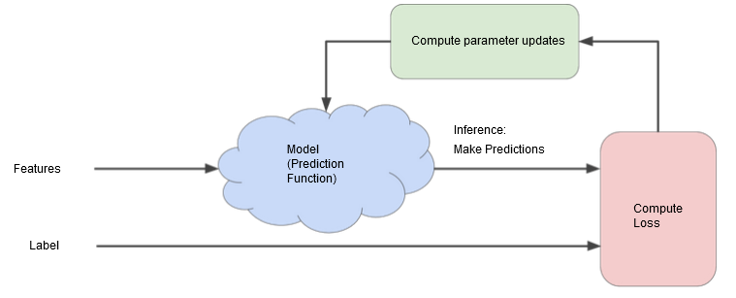
How to reduce loss?
The hot and cold game
Let’s try in our model

Slide 18
How to reduce loss?
The program iterate until the loss change extremely slowly: the model converged

Slide 19
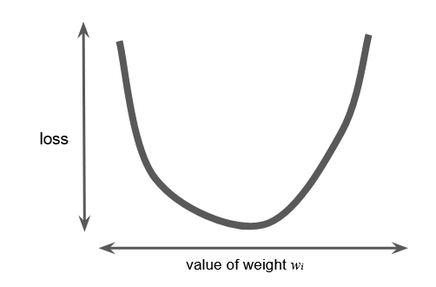
The gradient descent
What if we calculate MSE for all weights?

Slide 20
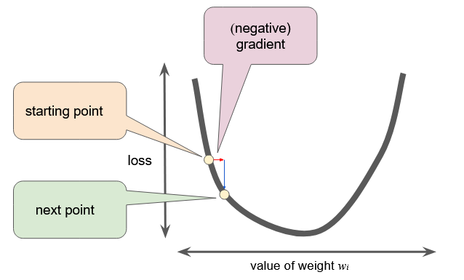
The gradient descent
Choose a point, calculate the derivative, find a new weight. Repeat.

Slide 21
The learning r ate
The learning rate is the factor use to multiply the magnitude of the vector to get the new weight.
It’s a hyper parameter: a parameter setup by the programmer for the learning phase.

Slide 22
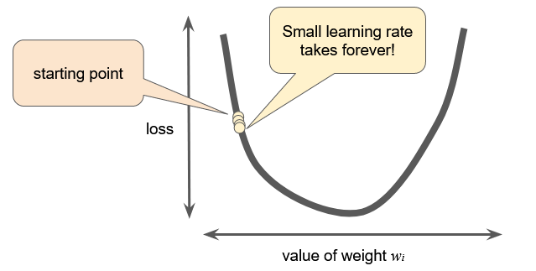
The learning rate
A too small learning rate => extremely long

Slide 23
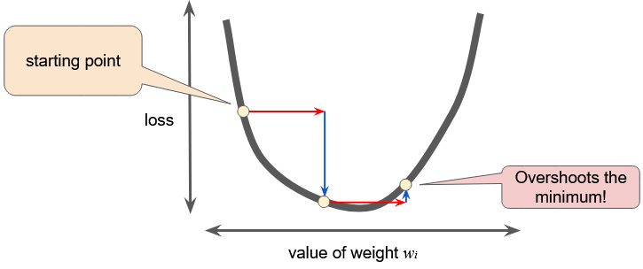
The learning rate
A too high learning rate => long or diverge

Slide 24
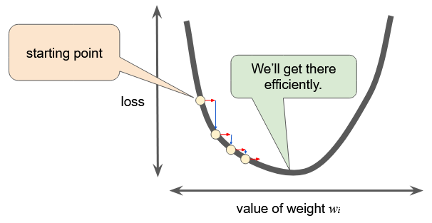
The learning rate
A right learning rate

Slide 25
Optimizing learning rate
https://developers.google.com/machine-learning/crash-course/fitter/graph

Slide 26
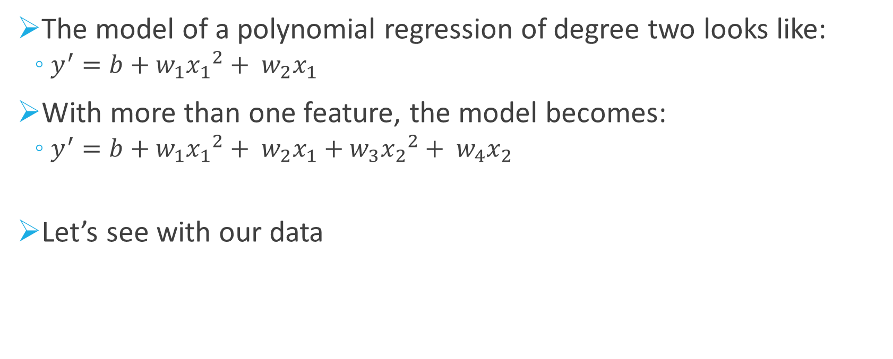
Polynomial regression
The model of a polynomial regression of degree two looks like:
$y^{′}=b+w_{1}{x_{1}}^{2}+ w_{2}x_{1}$
With more than one feature, the model becomes:
$y^{′}=b+w_{1}{x_{1}}^{2}+ w_{2}x_{1}+w_{3}{x_{2}}^{2}+ w_{4}x_{2}$
Let’s see with our data

Slide 27
Underfitting and overfitting
Underfitting: high MSE for the examples and for predictions
Overfitting: Low MSE for the examples and high MSE for the predictions

Slide 28
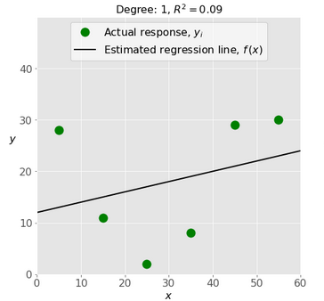
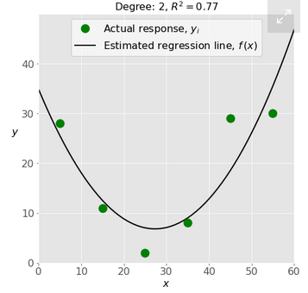
Underfitting
An underfitted model
A better model

Slide 29
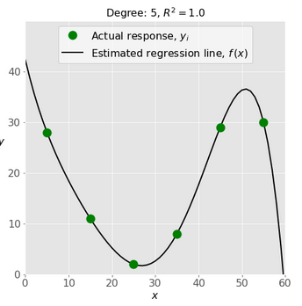
Overfitting
An overfitting model
A better model

Slide 30
Python and ML: Numpy and scikit-learn
Numpy package is really useful in Python
Similar to list but 50x faster
Scikit-learn is a good package to start machine learning (https://scikit-learn.org/stable/)

Slide 31
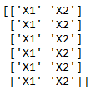

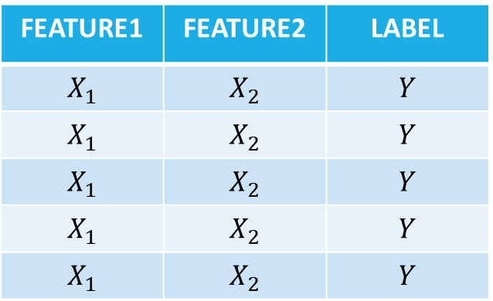
Providing data to scikit-learn
Should be provide in the same logic than a table to scikit-learn.
Example:
1st array
2nd array
FEATURE1 | FEATURE2 | LABEL
$$X_{1}$$ | $$X_{2}$$ | $$Y$$
$$X_{1}$$ | $$X_{2}$$ | $$Y$$
$$X_{1}$$ | $$X_{2}$$ | $$Y$$
$$X_{1}$$ | $$X_{2}$$ | $$Y$$
$$X_{1}$$ | $$X_{2}$$ | $$Y$$

Slide 32
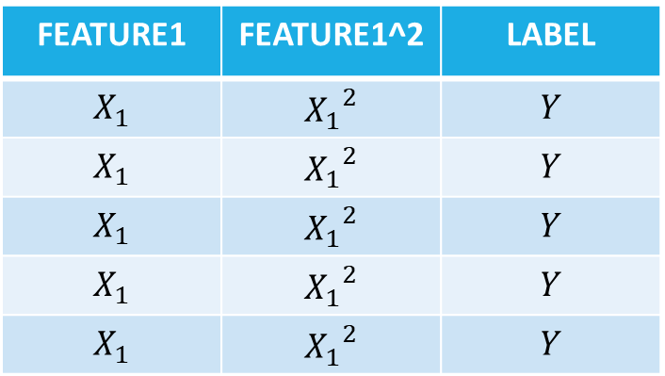

The polynomial regression with scikit-learn
The same than a linear regression with several feature where one feature is the square of another one.
FEATURE1 | FEATURE1^2 | LABEL
$$X_{1}$$ | $${X_{1}}^{2}$$ | $$Y$$
$$X_{1}$$ | $${X_{1}}^{2}$$ | $$Y$$
$$X_{1}$$ | $${X_{1}}^{2}$$ | $$Y$$
$$X_{1}$$ | $${X_{1}}^{2}$$ | $$Y$$
$$X_{1}$$ | $${X_{1}}^{2}$$ | $$Y$$
$$y^{′}=b+w_{1}{x_{1}}^{2}+ w_{2}x_{1}$$
$$y^{′}=b+w_{1}x_{2}+ w_{2}x_{1}$$
Where $x_{2}={x_{1}}^{2}$

