Slide 1
Indigo
Card Game Project

Slide 2
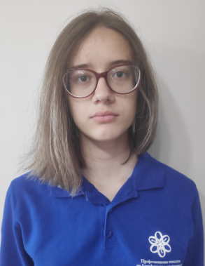
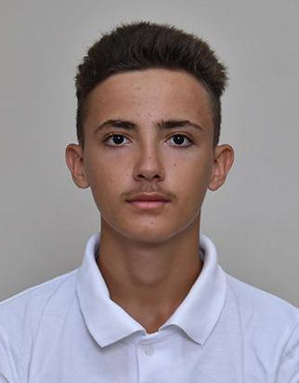

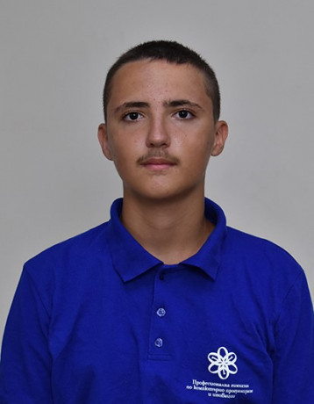
Our Team
Scrum Trainer
Back End Developer
Back End Developer
QA
Pamela Dimitrakova
Mihail Petrov
Maksim Vasilev
Hristiyan Petrov

Slide 3
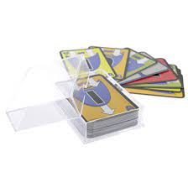
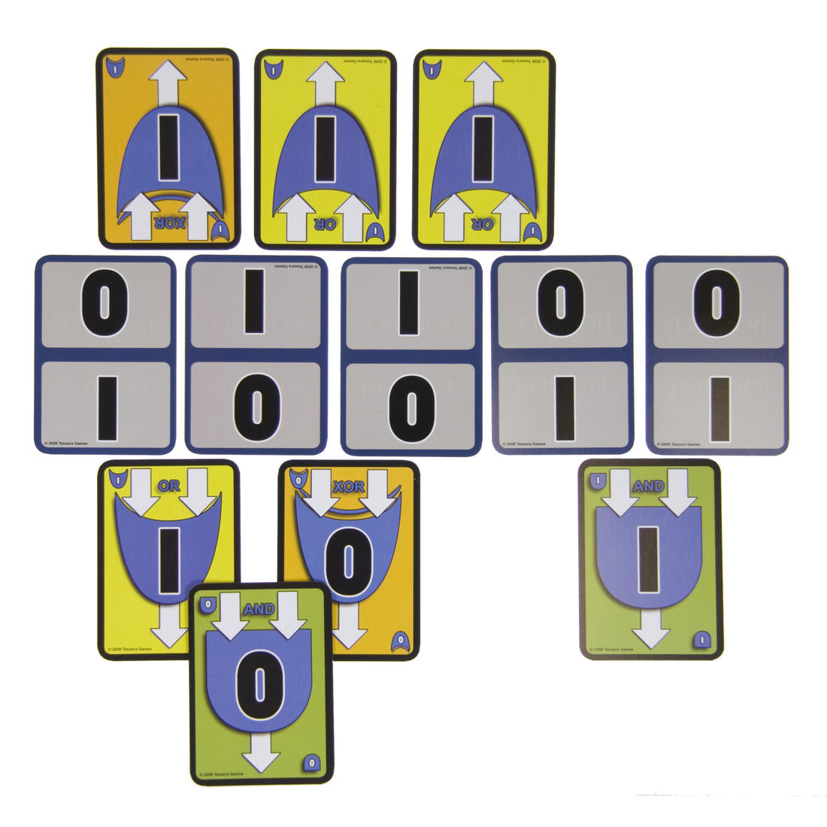
Idea
Our project is a recreation of the card game bOOleO, where you need to use boolean logic to create a pyramid faster than your opponent.

Slide 4
Realization
Create GitHub repo
Implement the game
Get ready to present
Create logo
Presentation and Documentation
Test the game

Slide 5

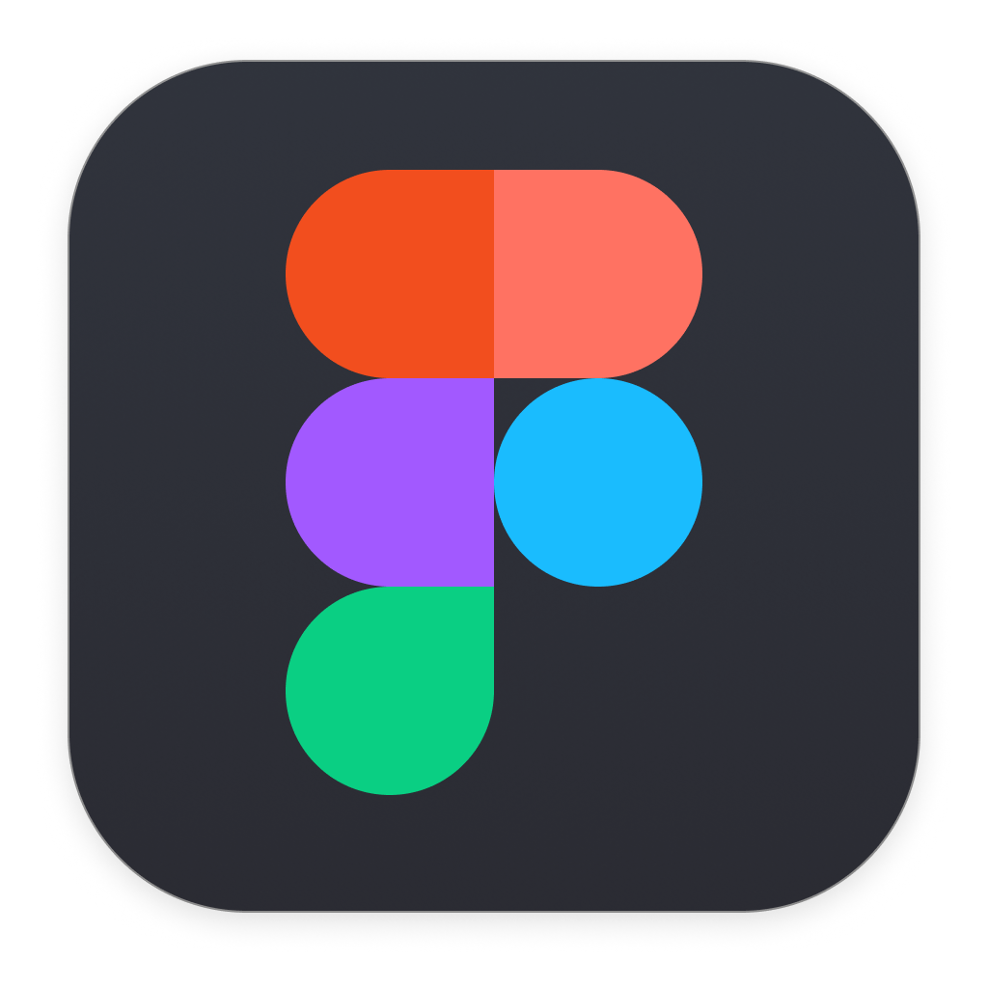







Technologies Used

Slide 6
Let’s move on to the game!

