Slide 1
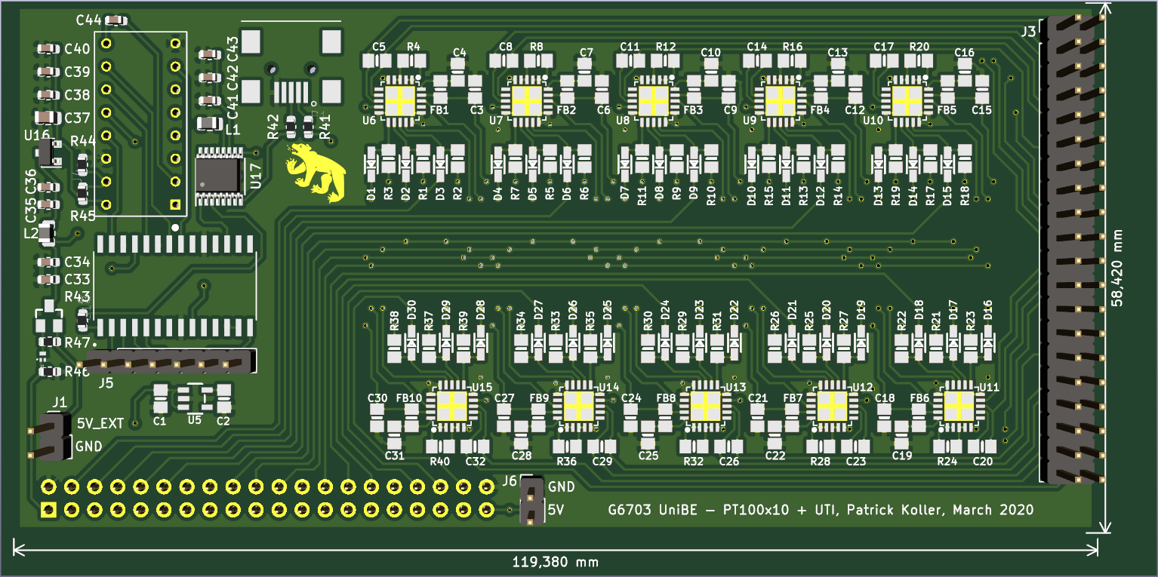
ArgonCube SC: PCB Design Front
UTI miniUSB
10x PT-100
UTI for lvl-meter
40-pin for
PT-100
UTI out
pins
5V_EXT

Slide 2
ArgonCube SC: PCB Design Front
UTI for lvl-meter
MOSFET power switch for UTI
(needs testing!)

Slide 3
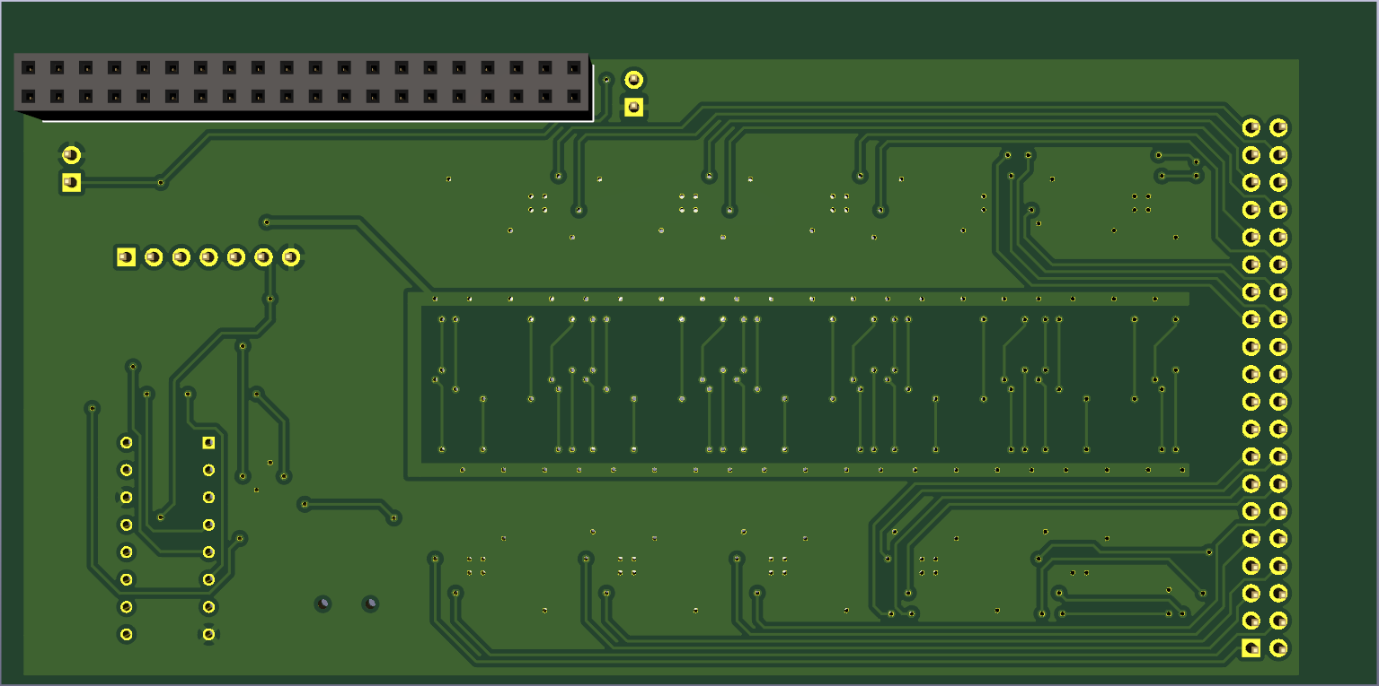
ArgonCube SC: PCB Design Back
20-pin socket for RPi

Slide 4
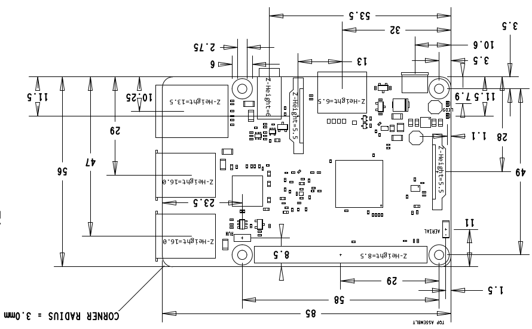
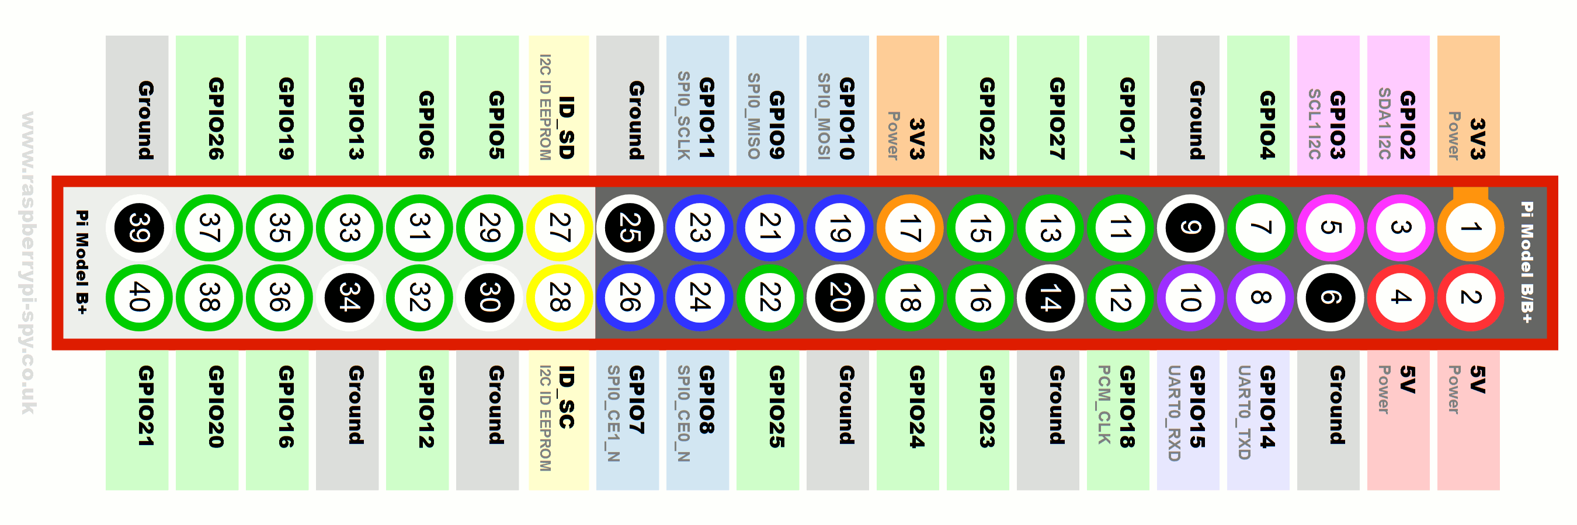
ArgonCube SC: Raspberry Pi Mezzanine
RPi 40-pin header

Slide 5
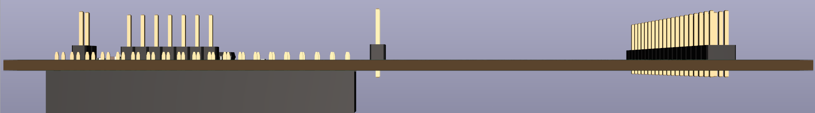
ArgonCube SC: Raspberry Pi Mezzanine
~ 15cm x 6cm

Slide 6
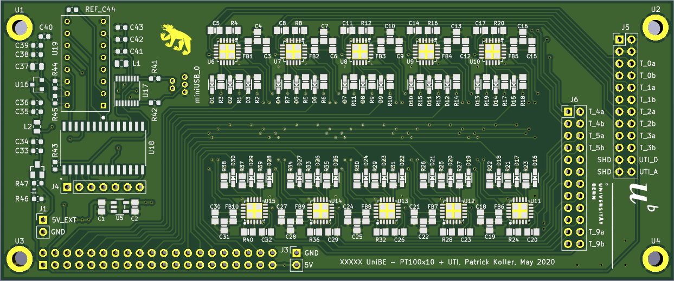
ArgonCube SC: Raspberry Pi Mezzanine New

Slide 7
ArgonCube SC: Questions
Do you need specific connectors for the lvl-meter?
Communication UTI ↔ RPi by miniUSB?
Do the dimensions fit with a CF-60 flange?

