Slide 1


VIRIDIS
School project - Website

Slide 2
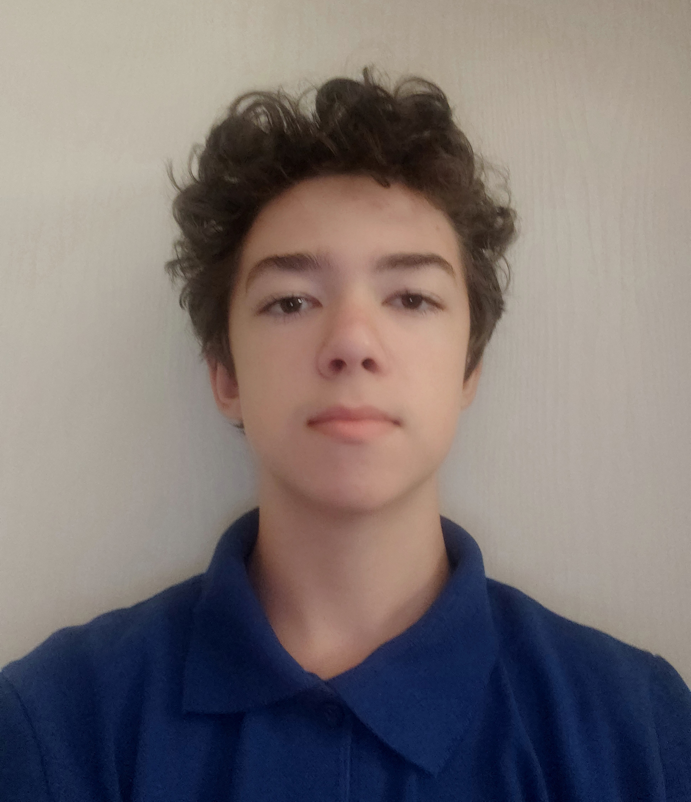

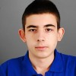

Our Team
Kaloyan Petrov
Front-end Developer
Petko Kovachev
Scrum Trainer
Martin Dimitrov
Front-end Developer
Petur Dimitrov
Designer

Slide 3
Idea
We had about 1 month total to create this website.
Our idea was to inform and warn people about our ecosystem and show them how they could help.
Once we thought of this idea in the span of a couple of days, we got to work.

Slide 4
Realization
We realized our project through collaborative work across different online platforms and coding environments.
Every 3-4 days we held meetings to discuss progress and responsibilities of the team members

Slide 5







Used technologies:

Slide 6
Now let's see the website!

