Slide 1

A Syphilis Transmission Model at the State Level - Updates
Jessie Lowell, Prevention Policy Modeling Lab
DSTDP-PPML Meeting
December 4, 2018

Slide 2
Major Research Questions
In the face of limited resources, what approaches to screening would be most effective at reducing syphilis burden in the population?
What levels of investment in contact tracing are most effective? Is this different for different population groups?
What is the estimated impact of more frequent screening versus expanded screening coverage in different contexts, and how does this vary by population group?
Notes:
Just read this. Kathy brought up contact tracing, we are collaborating with MA to get data.

Slide 3
Contact Tracing
Brought up by collaborators at Massachusetts DPH
State departments of public health invest significant resources into syphilis contact tracing
Adjustable parameters for percentage of screening rate accounted for by contact tracing
Stratification of contact tracing rates by demographic group
Notes:
Read this. There is previous work suggesting that contact tracing is cost-effective for syphilis, but we can invest different levels of resources into it relative to other types of screening, and need to figure out what is most effective.

Slide 4
Contact Tracing Data - Massachusetts
2014 data omitted for unreliability
Notes:
Massachusetts. One possibility is that as other screening goes up for men of color (this is both MSM & MSW), proportion contact traced goes down. But illustrates why this is useful to put into the model – this stuff changes!

Slide 5
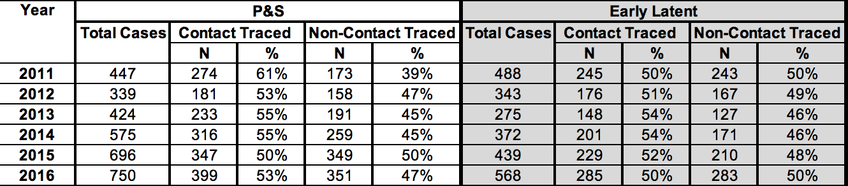
Contact Tracing Data - Louisiana
Notes:
Massachusetts. One possibility is that as other screening goes up for men of color (this is both MSM & MSW), proportion contact traced goes down. But illustrates why this is useful to put into the model – this stuff changes!

Slide 6
Initial Implementation of Contact Tracing
Percentage of cases contact-traced per stage per year
Impute contact tracing coverage, create new screening matrix, run counterfactual without contact tracing
The next slides are case reports – without contact tracing, we’d expect to see fewer case reports!
Notes:
These next figures are to show that contact tracing is operationalized and having an effect in the model. We are still playing around with understanding the underlying mechanisms for how the changes in screening rates, in the scenario with contact tracing and in the counterfactual, affect transmission.

Slide 7
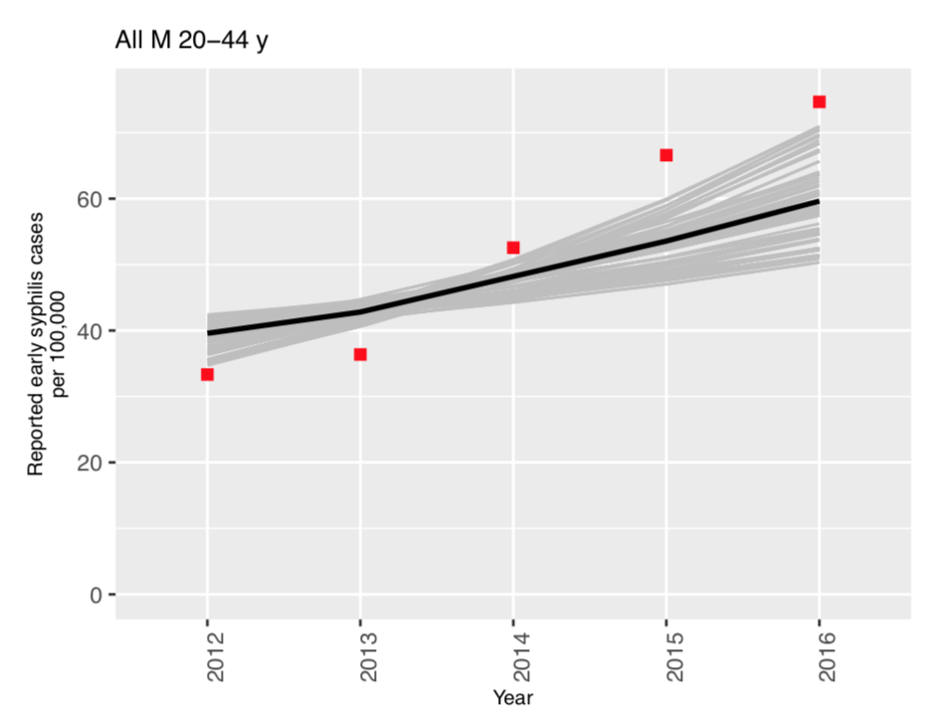
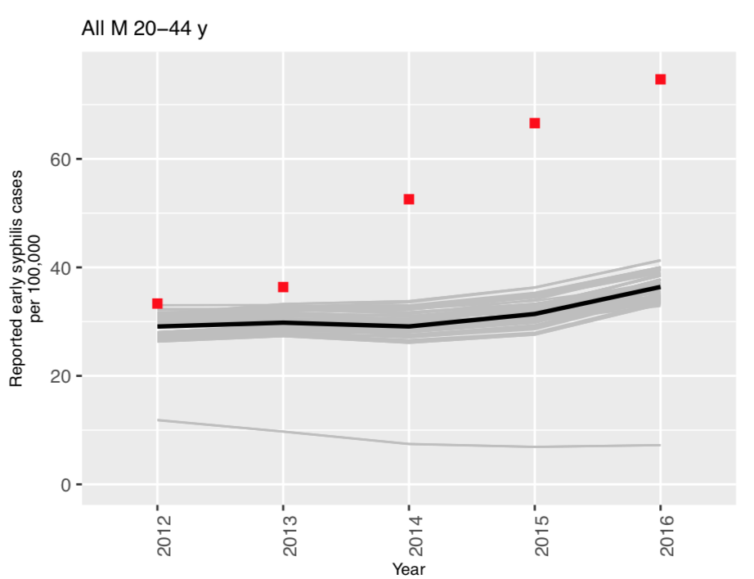
Contact Tracing Case Report Effects - Louisiana
Contact tracing vs Counterfactual – Young Men
Notes:
Massachusetts. One possibility is that as other screening goes up for men of color (this is both MSM & MSW), proportion contact traced goes down. But illustrates why this is useful to put into the model – this stuff changes!

Slide 8
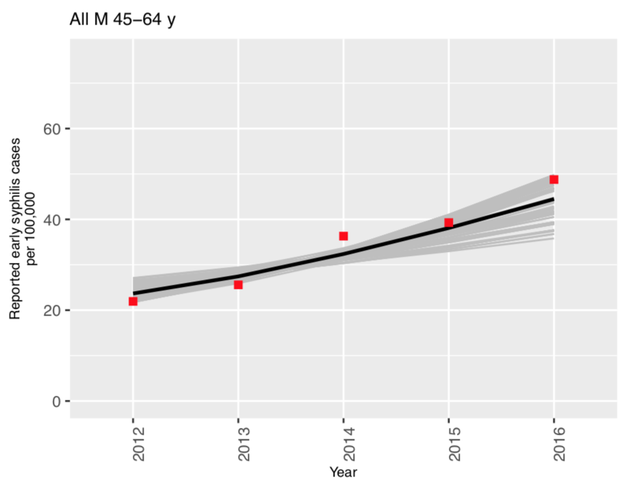
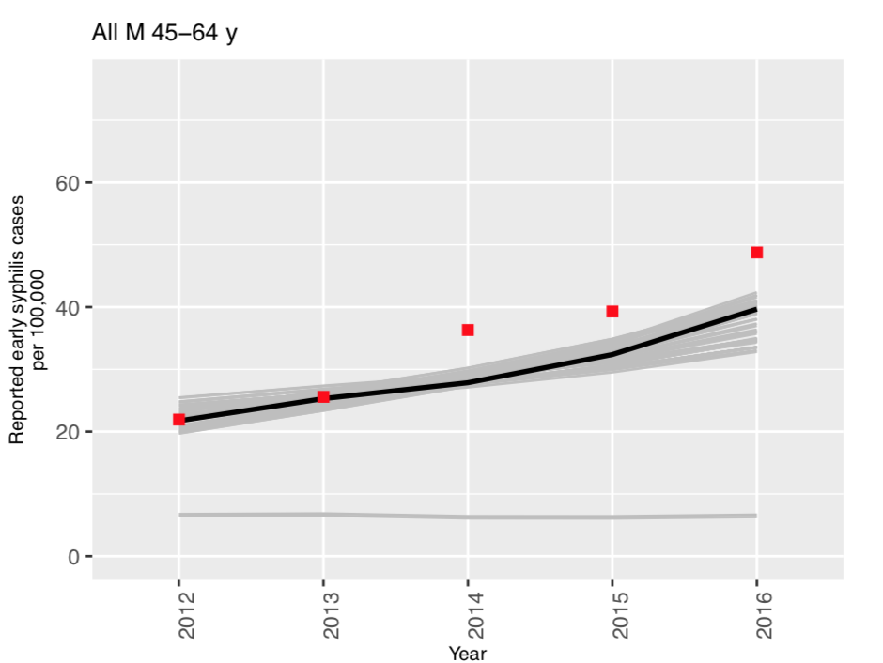
Contact Tracing Case Report Effects - Louisiana
Contact tracing vs Counterfactual – Old Men
Notes:
Massachusetts. One possibility is that as other screening goes up for men of color (this is both MSM & MSW), proportion contact traced goes down. But illustrates why this is useful to put into the model – this stuff changes!

Slide 9
Next Steps on Contact Tracing
Look at results for both states
Plots for prevalence or incidence, cases averted
Increase stratification

