Slide 1
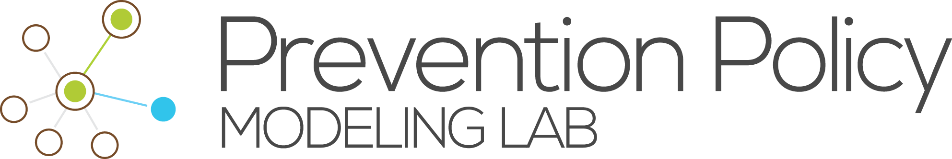
Modeling syphilis transmission in Massachusetts and Louisiana
Ashleigh Tuite, Prevention Policy Modeling Lab
On behalf of the PPML STI group
NEEMA All Grantee Meeting, Atlanta
October 30th-31st, 2017

Slide 2
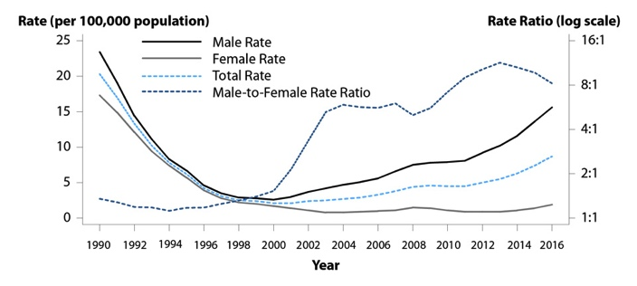
Background
Primary and Secondary Syphilis — Rates of Reported Cases by Sex and Male-to-Female Rate Ratios, United States, 1990–2016
Source: CDC STD Surveillance 2016

Slide 3
Background

Slide 4
Major Research Questions
In the face of limited resources, what approaches to screening would be most effective at reducing syphilis burden in the population?
What is the estimated impact of screening interventions in different contexts?
i.e., are different screening approaches expected to be more effective in different affected population groups?

Slide 5
Approach
Develop a risk-structured transmission model to characterize the epidemiology of syphilis and evaluate the potential impact of different approaches to syphilis screening on epidemic dynamics and the health of affected individuals.
Incorporate both MSM and heterosexual populations.
Fit model to outbreaks in different geographical regions.

Slide 6
Transmission model overview
SR
ER
IR₁
IR₂
LR₁
LR₂
T₁
T₂
T₃
S
E
I₁
I₂
L₁
L₂
A

Slide 7
Metapopulation model
Hispanic
Other
HIV-positive
MSM
Black
 | M |  |  |  | F
 | Young | Old |  | Young |  | Old
Low activity
High activity
HIV-negative MSM

Slide 8
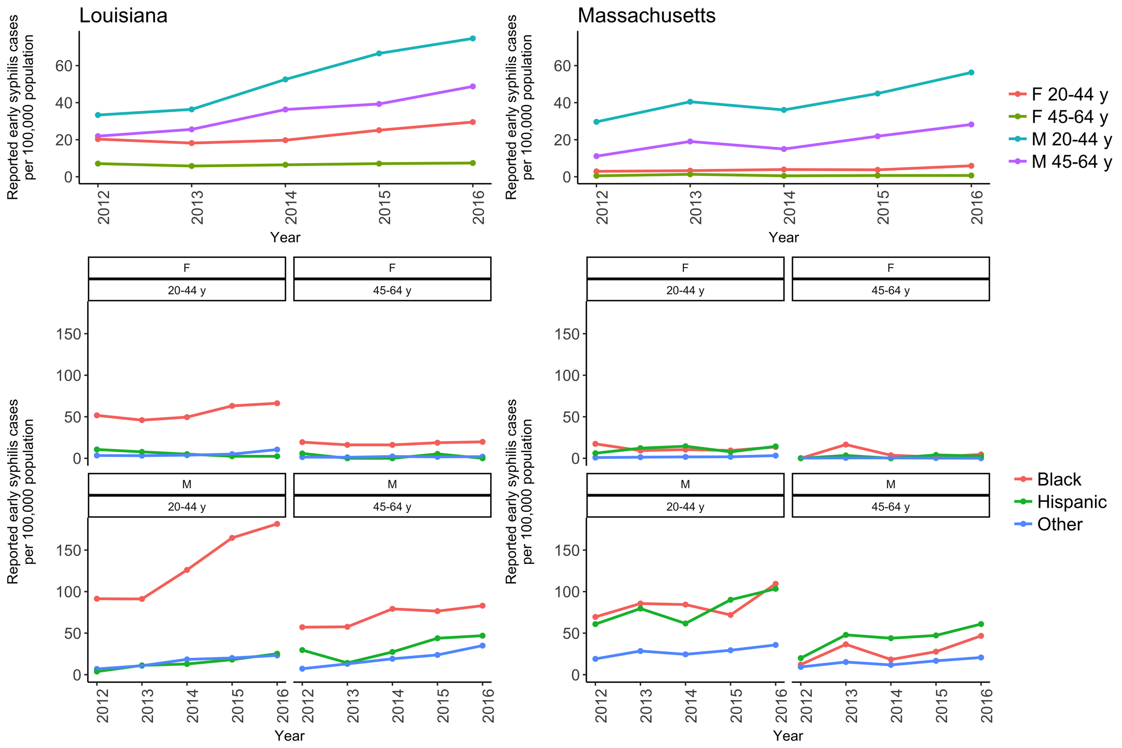
Geographic regions: Louisiana and Massachusetts

Slide 9
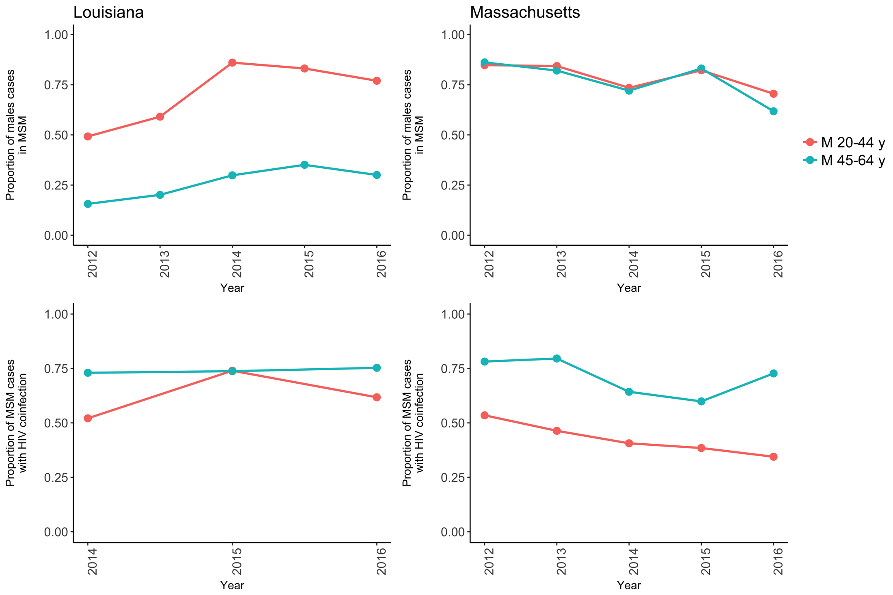
Geographic regions: Louisiana and Massachusetts

Slide 10
Model calibration to data
Using an adaptive Metropolis-Hastings MCMC approach for model calibration
Bayesian approach to estimate probability distributions for uncertain parameters, given the model and available data

Slide 11
Acknowledgments
Harvard
Josh Salomon
Minttu Rönn
Nick Menzies
DSTDP, CDC
Andres Berruti
Harrell Chesson
Tom Gift
Louisiana Department of Public Health
Catherine Desmarais
Jessica Fridge
Massachusetts Department of Public Health
Kathy Hsu
Lauren Molotnikov

