Slide 1


Slide 2




Employee Maintenance
New Employee
Tomek Dąbrowski
DomBros
dombros@gmail.com
@Dom_Bros
dombrosblog.wordpress.com

Slide 3
Agenda:
New employee – generally
TeamCity as an executive engine
Data (CSV file, for the beginning and it stay)
Data validation
Data transformation
„Start-Process”

Slide 4
Employee maintenance
Change employee (Standard and Change Position)
New employee
Leave employee

Slide 5
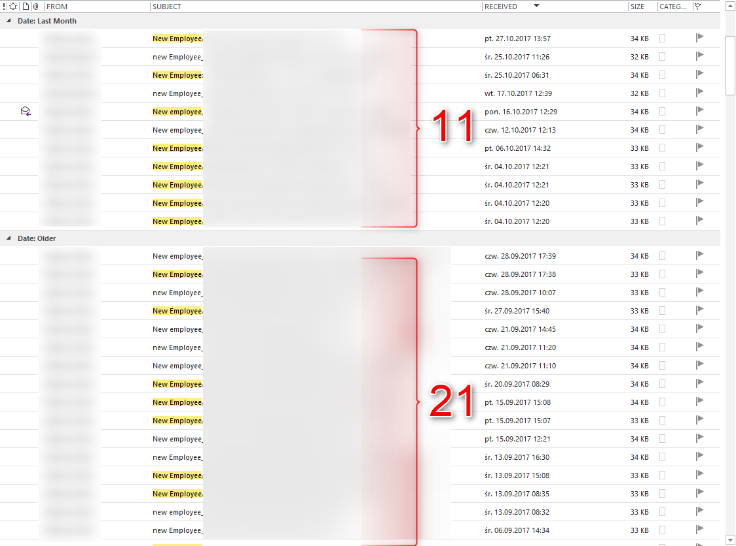
New employee

Slide 6
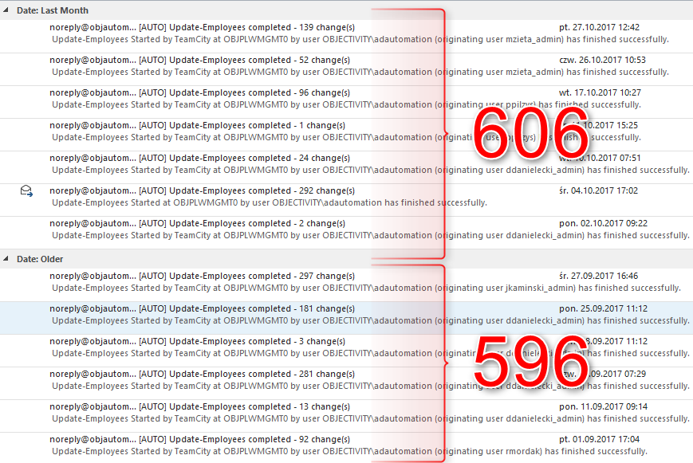
Employee change, maintenance

Slide 7
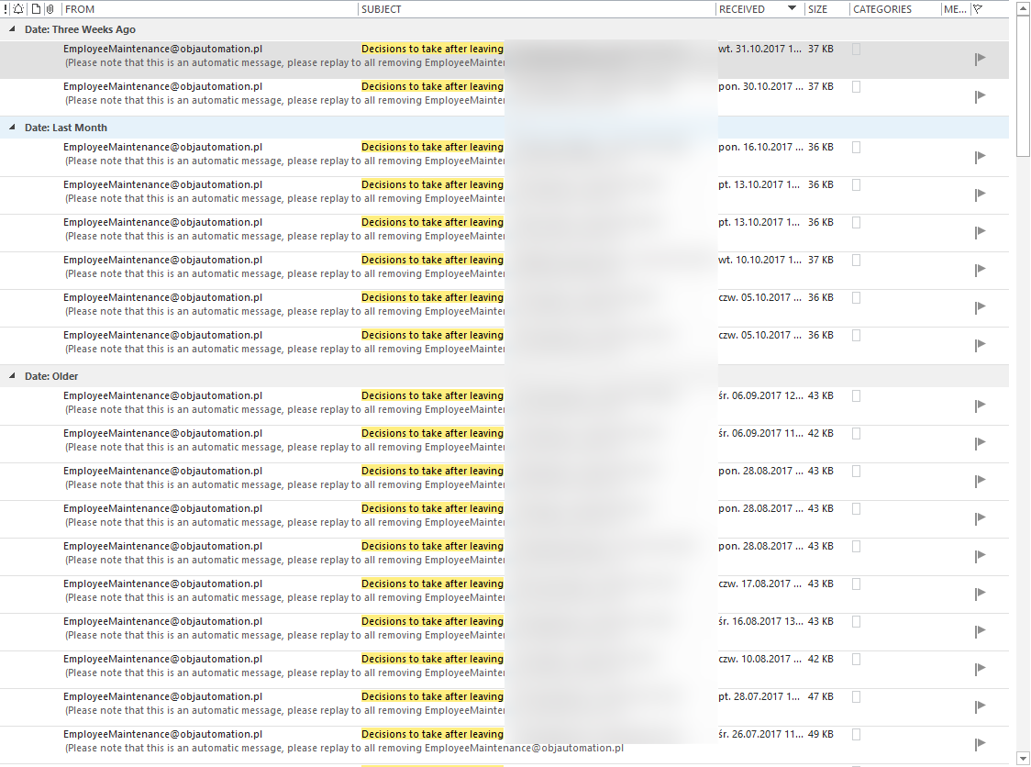
Leave employee

Slide 8
Process:
Resources
CSV file
IT
SVN commit and first manual validation
TC
Build modules
TC
Prepare OS (cmdlets, files, pass)
TC
Start remote PowerShell process

Slide 9
Process:
TC PS
Validate data
TC PS
Transform data
TC PS
Prepare work data
TC PS
Start proces of change
TC PS
Log to SQL
TC
Start remote PowerShell process

Slide 10
Process:
TC PS
Start proces of change
AD
Atrributes
Share
AD Azure
Exchange
SPO
Office 365
License

Slide 11
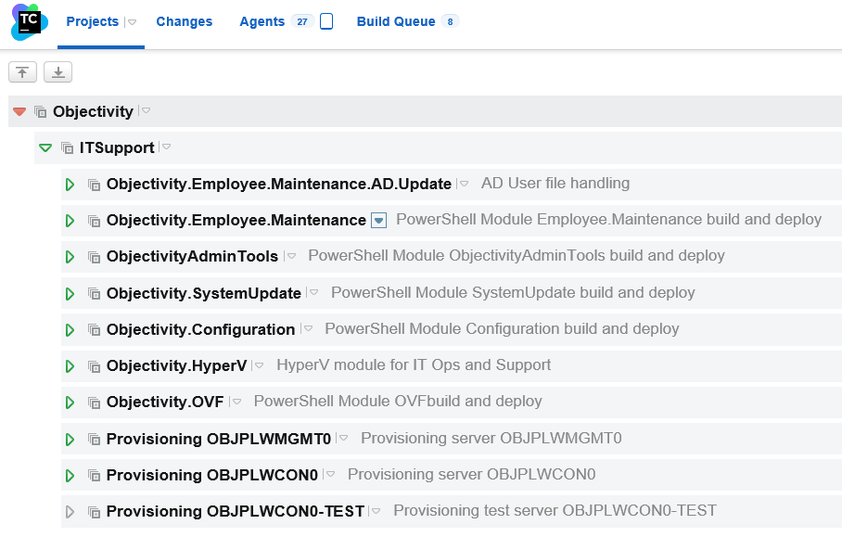
TeamCity

Slide 12
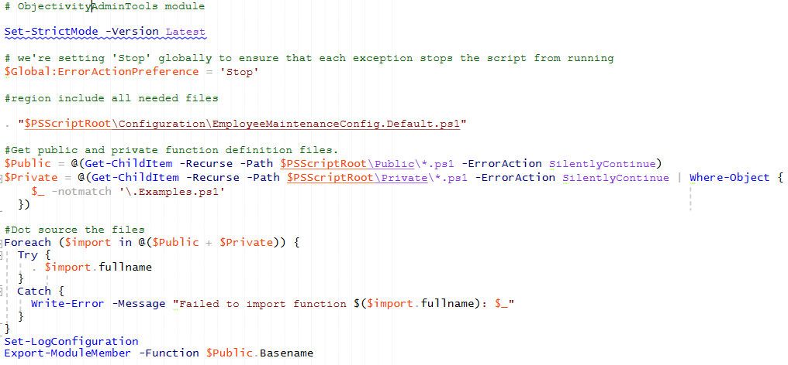
Objectivity.Employee.Maintenance

Slide 13
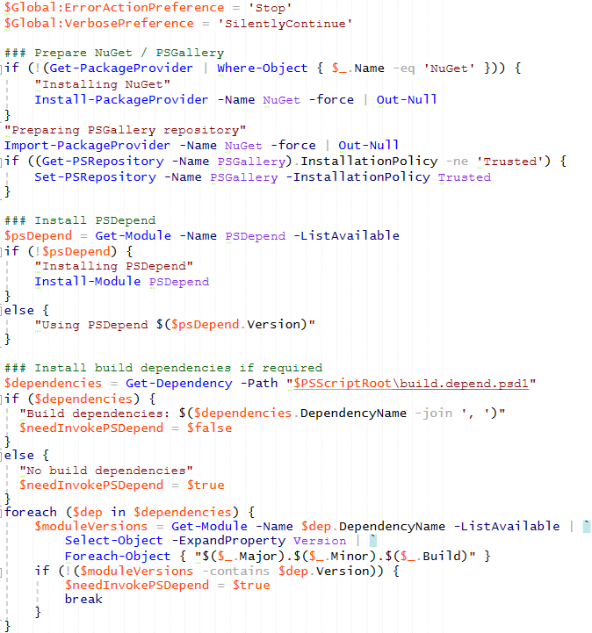
Build

Slide 14
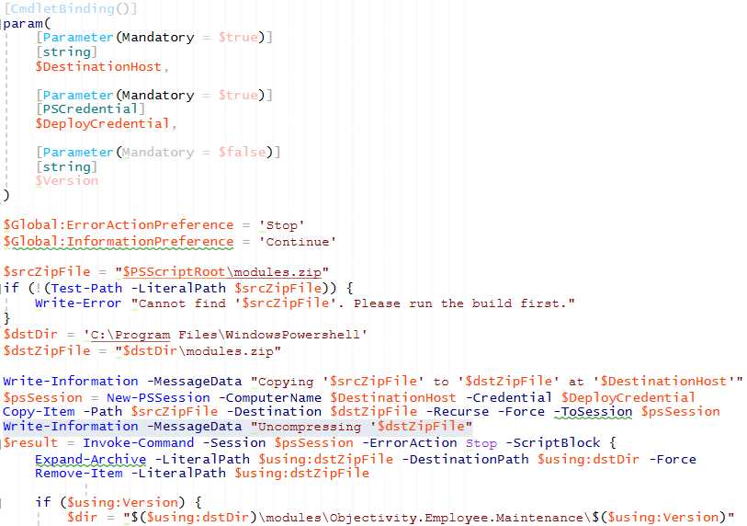
Deploy

Slide 15
TeamCity
VCS
Parameters
Trigger
Dependecies

Slide 16
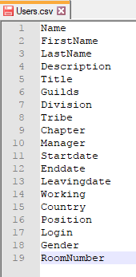
Data – CSV file from Resources Team

Slide 17
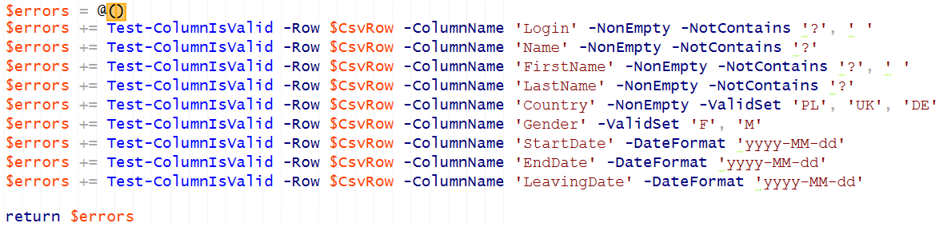
Data validation
.\PPoShTools\PPoShTools\Public\Csv\Get-CsvData.ps1
.\Objectivity.Employee.Maintenance\Objectivity.Employee.Maintenance\Private\ADUserMaintenance\Get-ConfigEmployeesValidationRules.ps1
.\PPoShTools\PPoShTools\Public\Csv\Test-ColumnIsValid.ps1

Slide 18
Date validation
https://msdn.microsoft.com/en-us/library/system.datetime.tryparseexact(v=vs.110).aspx
$value = '2017-31-01'
$DateFormat = 'yyyy-MM-dd'
[datetime]$date = New-Object -TypeName DateTime
[DateTime]::TryParseExact($value, $DateFormat, [System.Globalization.CultureInfo]::InvariantCulture, [System.Globalization.DateTimeStyles]::None, [ref]$date)

Slide 19
Additional data validation
# Check there are no 2 rows with the same login
# Check there are no name changes (currently this is not allowed)
# Check that all required groups (tribes/guilds/chapters) are in AD
# Check that all manager names are available in the input data
.\Objectivity.Employee.Maintenance\Objectivity.Employee.Maintenance\Private\ADUserMaintenance\Test-EmployeesData.ps1

Slide 20
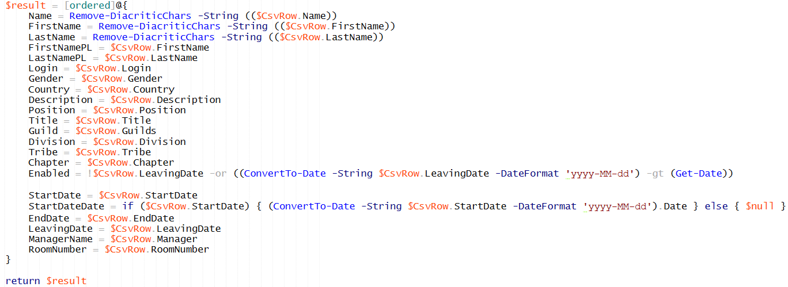
Data transformation
.\Objectivity.Employee.Maintenance\Objectivity.Employee.Maintenance\Private\ADUserMaintenance\Get-ConfigEmployeesTransformRules.ps1
.\PPoShTools\PPoShTools\Public\Utils\ConvertTo-Date.ps1

Slide 21
Start
# 3. For each CSV row
# 3a. If user does not exist in AD, add
# 3b. If userWA does not exist in AD, add
# 3c. Update attributes of the AD user
# 3d. Update attributes of the AD userWA
# 3e. Ensure AD user is added to common groups
# 3f. Ensure AD user is added to single Guild / Tribe / Chapter group
(remove from all other Guilds / Tribes / Chapters)
# 3g. Ensure user has Home directory with FullControl permissions
# 3h. Ensure user has mailbox enabled.
# 4. Pushing AD Azure synchronization
# 5. For each CSV row processing AD Azure and o365 params
# 5a. Ensure user has Office 365 enabled.
# 6. Write summary and if any change has been made
and -SendEmail was specified, send e-mail.

Slide 22
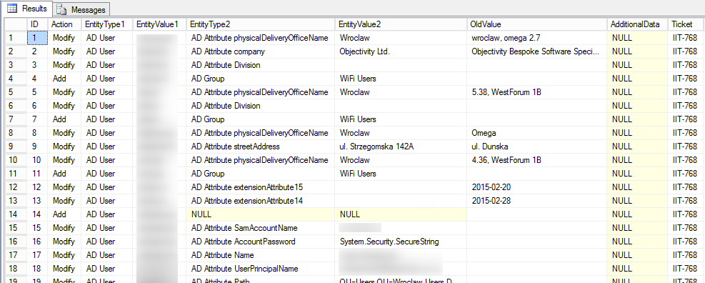
Change Log

