Slide 1


Slide 2




Employee Maintenance
Leave Employee
Tomek Dąbrowski
DomBros
System Engineer @ Objectivity
dombros@gmail.com
@Dom_Bros
dombrosblog.wordpress.com

Slide 3
Agenda:
Leave employee – generally
SQL – check list, change log
Template function
Check list managment
„Start-Process”
~60 steps on the check list

Slide 4
Employee maintenance
Change employee (standard and change position)
New employee
Leave employee

Slide 5
Employee new, leave

Slide 6
Employee change

Slide 7
Naming convention
Objectivity.Employee.Maintenance
Objectivity.SystemUpdate
Objectivity.HyperV
Objectivity.Configuration
Objectivity.AdminTools
Objectivity.OStools

Slide 8
Build proces
Develop
Git Commit
TeamCity build
TeamCity deploy

Slide 9
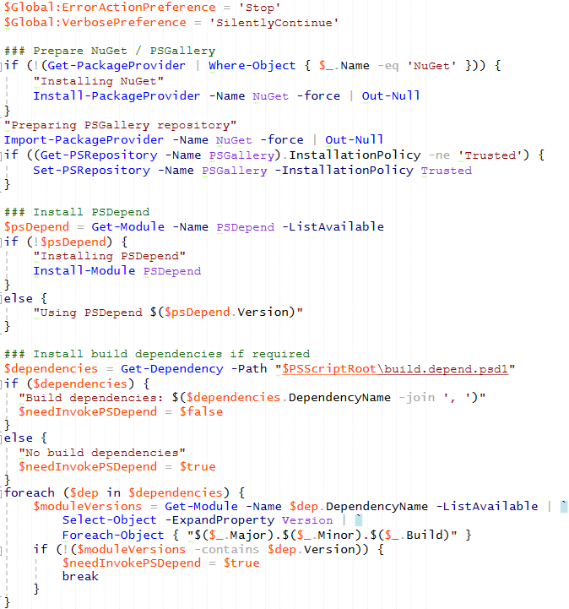
Build - demo

Slide 10
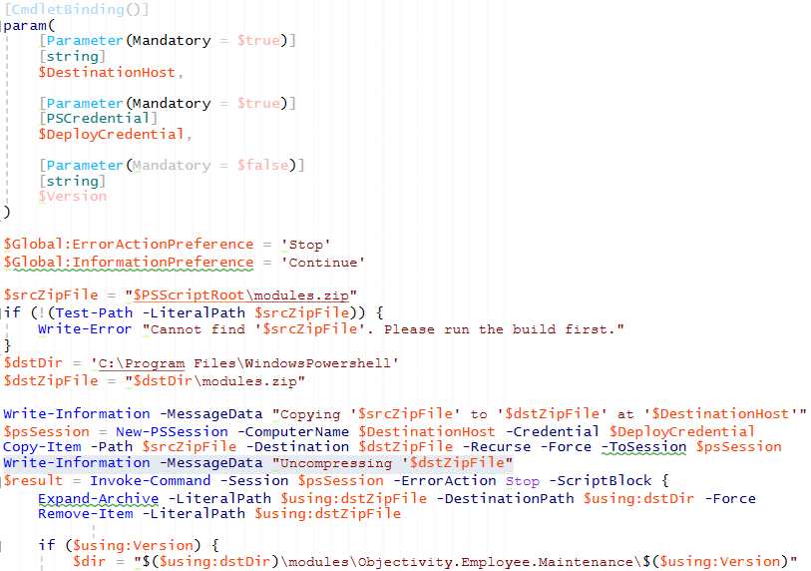
Deploy - demo

Slide 11
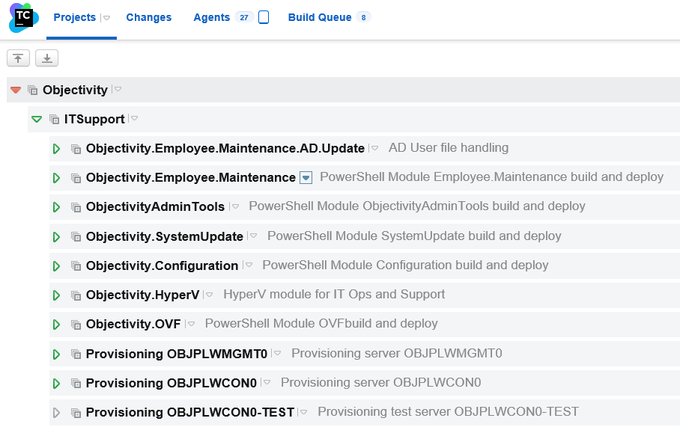
TeamCity

Slide 12
TeamCity
VCS
Parameters
Trigger
Dependecies

Slide 13
Communication process
IT Admin
Employee
Maintenance
Jira
TeamCity
HR

Slide 14
Architecture

Slide 15
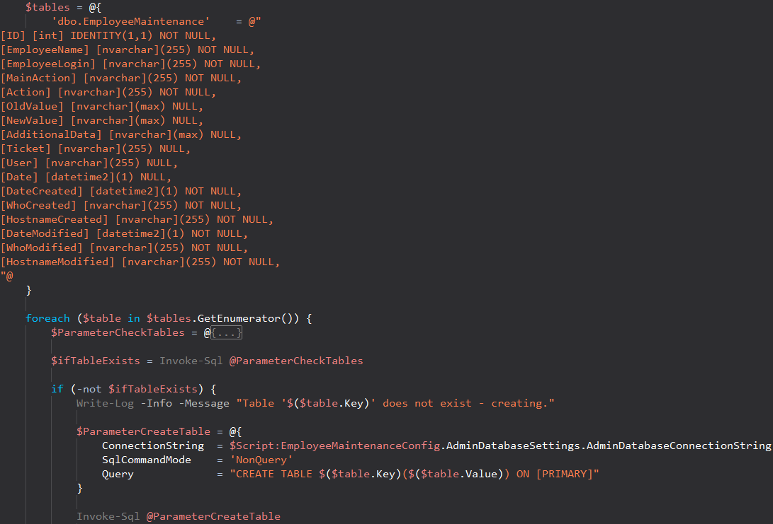
SQL, DB - new environment - demo

Slide 16
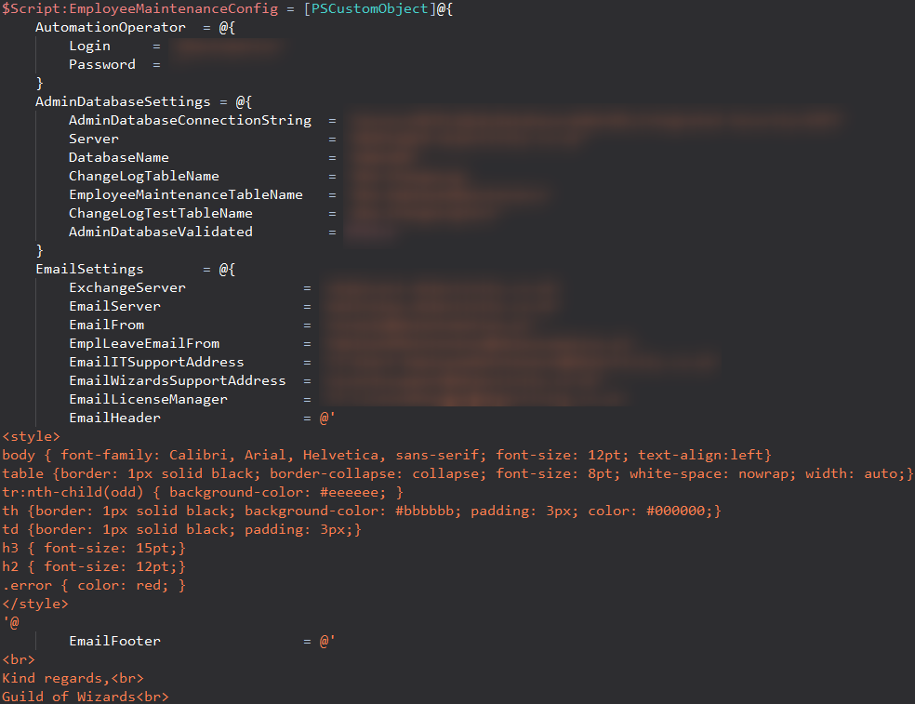
Configuration - demo

Slide 17
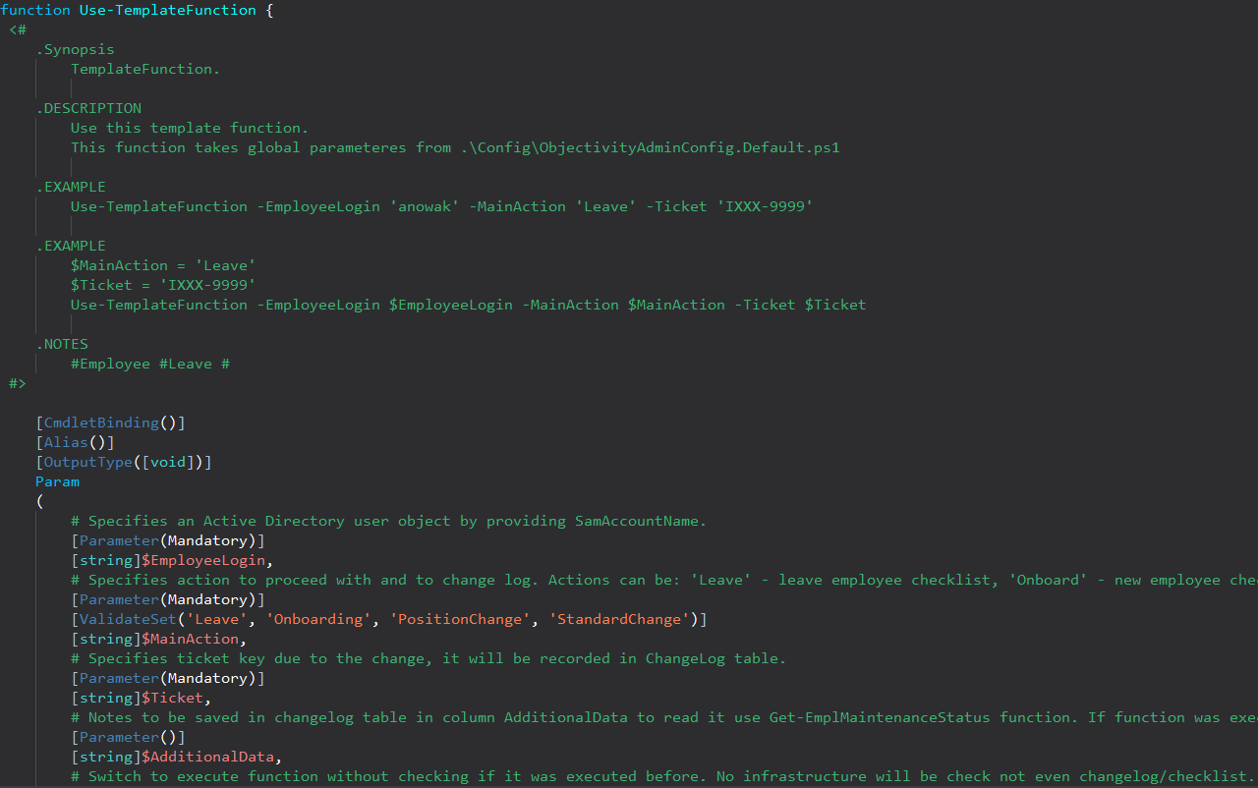
Template function - demo

Slide 18
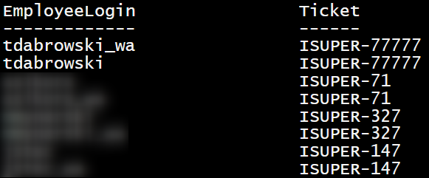
New function run trought all „old leave” - demo

Slide 19
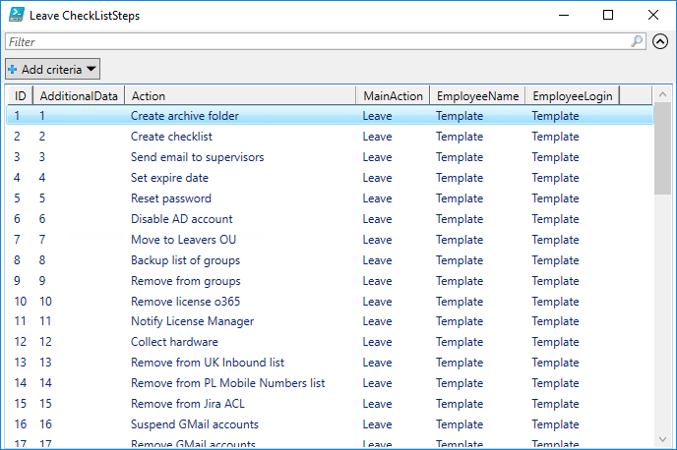
Check list types
New
Standard change
Change position
Leave

Slide 20
Check list managment - demo
Get-EmplCheckListStep
Set-EmplCheckListStep
Add-EmplCheckListStep

Slide 21
Start-EmplLeave
Demo

Slide 22
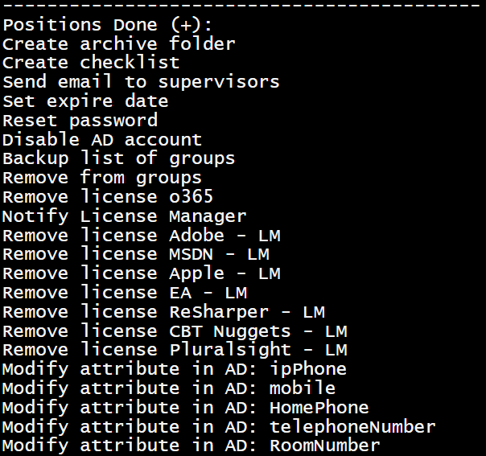
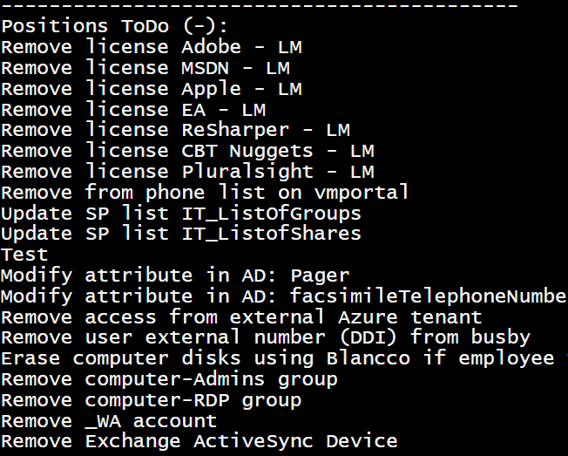
Get-EmplPositionsToDo
-EmployeeLogin $EmployeeLogin -MainAction $MainAction -Ticket $Ticket

Slide 23
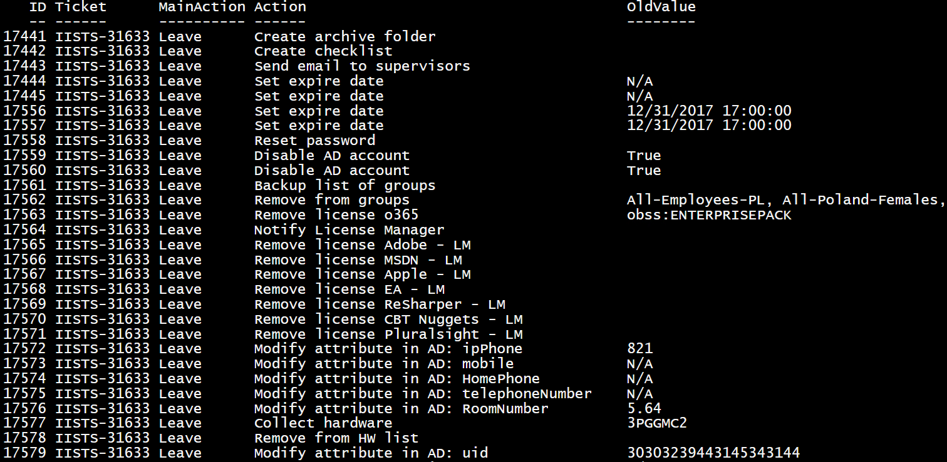
Change Log

Slide 24
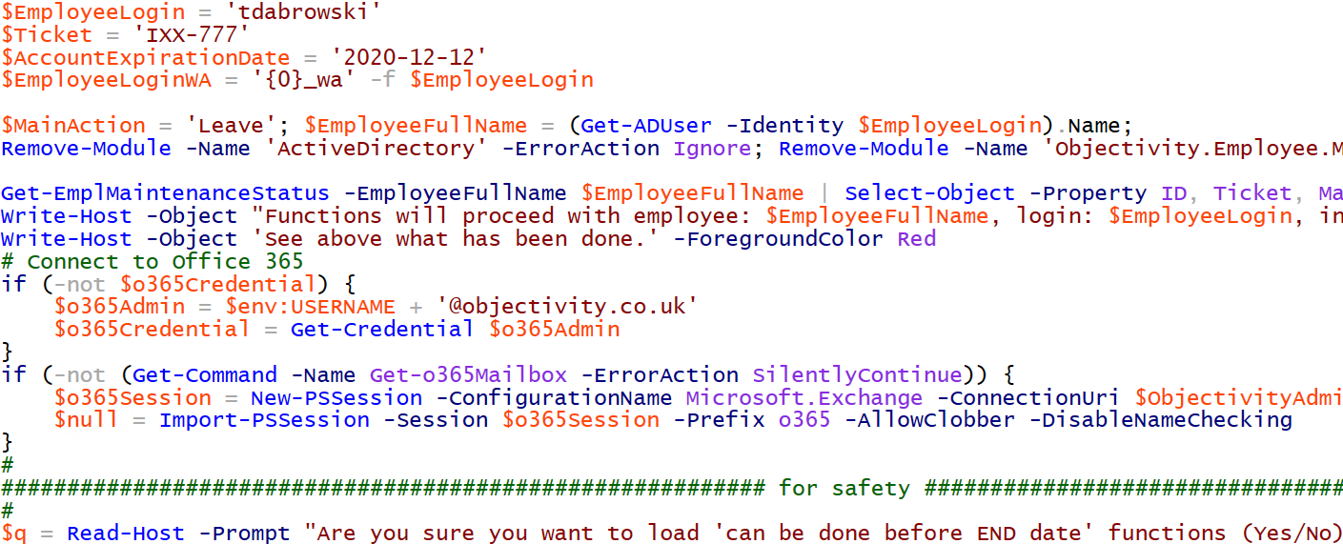
Start-EmplLeave
-EmployeeLogin 'tdabrowski' -Ticket 'IXX-777' -AccountExpirationDate '2020-12-12'

Slide 25
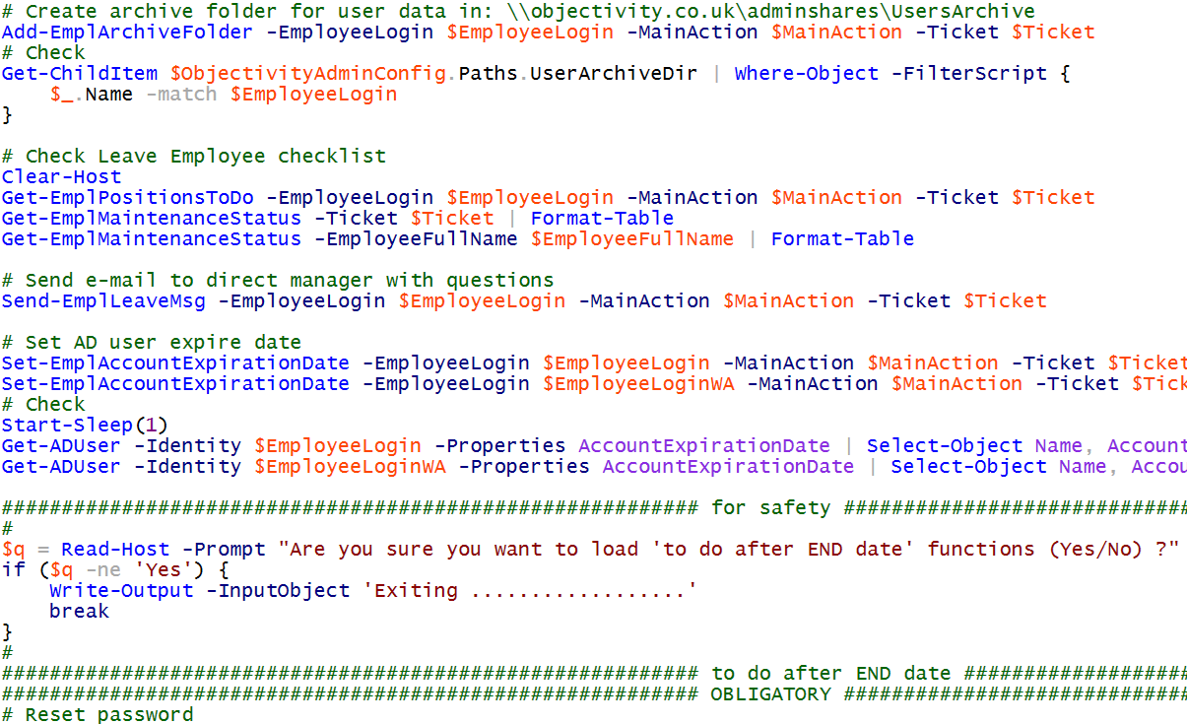
Start-EmplLeave
-EmployeeLogin 'tdabrowski' -Ticket 'IXX-777' -AccountExpirationDate '2020-12-12'

Slide 26
Alter-EmplLeaveTemplate

Slide 27
Start-EmplNew

