Slide 1

Are Transformers Effective for Time Series Forecasting?
Ailing Zeng et al., AAAI 2023
2026.03.31
부산대학교
데이터사이언스전문대학원
석사과정 박진호

Slide 2
CONTENTS
1
Introduction
2
Background
3
LSTF-Linear
4
Experiments
5
Conclusion

Slide 3
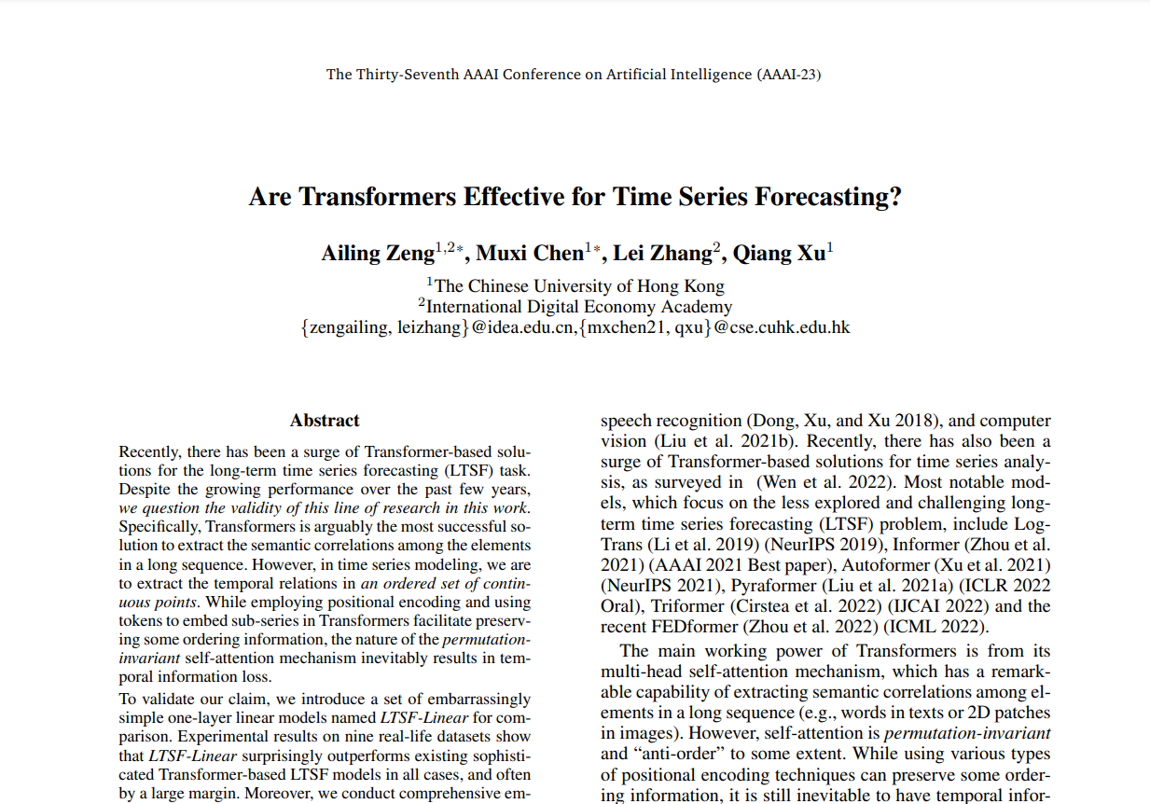
Introduction
Paper Introduction
Released on ArXiv on May 26, 2022, presented at the 2023 AAAI Conference.
The paper's author, Ailing Zeng et al., is a research team mainly conducting research on time series.
Citations: 1146

Slide 4
Background
Time-series data
A time series refers to a sequence of data points indexed in a discrete-time order.
The data points are time-stamped, and consecutive observations are correlated.

Slide 5
Q & A

Slide 6
THANK YOU

