Slide 1
Introduction
Chapter 1
Risk Management and Financial Institutions 4e, Chapter 1, Copyright © John C. Hull 2015

Slide 2
Risk vs Return
There is a trade off between risk and expected return
The higher the risk, the higher the expected return
Risk Management and Financial Institutions 4e, Chapter 1, Copyright © John C. Hull 2015

Slide 3
Example (Table 1.1, page 2)
Suppose Treasuries yield 5% and the returns for an equity investment are:
Probability | Return
0.05 | +50%
0.25 | +30%
0.40 | +10%
0.25 | –10%
0.05 | –30%
Risk Management and Financial Institutions 4e, Chapter 1, Copyright © John C. Hull 2015

Slide 4
Example continued
We can characterize investments by their expected return and standard deviation of return
For the equity investment:
  Expected return =10%
  Standard deviation of return =18.97%
Risk Management and Financial Institutions 4e, Chapter 1, Copyright © John C. Hull 2015

Slide 5
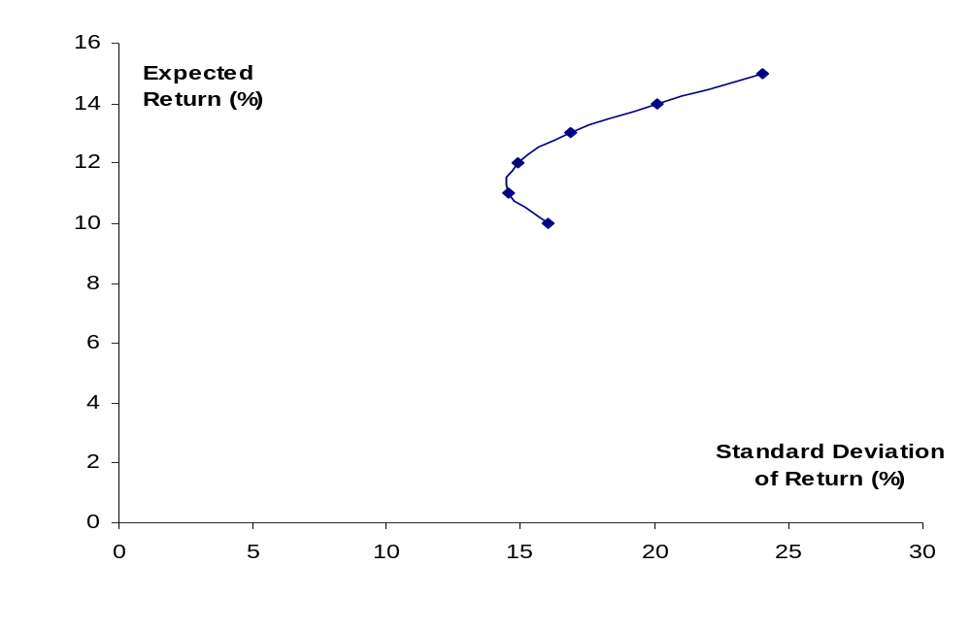
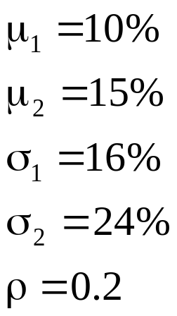
Combining Two Risky Investments (page 5)
Risk Management and Financial Institutions 4e, Chapter 1, Copyright © John C. Hull 2015

Slide 6
Efficient Frontier of Risky Investments (Figure 1.3, page 6)
Efficient Frontier
Expected Return
Investments
S.D. of Return
Risk Management and Financial Institutions 4e, Chapter 1, Copyright © John C. Hull 2015

Slide 7
Efficient Frontier of All Investments (Figure 1.4, page 6)
J
Expected Return
M
E(R_{M})
I
Previous Efficient Frontier
F
R_{F}
New Efficient Frontier
S.D. of Return
σ_{M}
Risk Management and Financial Institutions 4e, Chapter 1, Copyright © John C. Hull 2015

Slide 8

Systematic vs Non-Systematic Risk (equation 1.3, page 8)
We can calculate the best fit linear relationship between return from investment and return from market
Systematic Risk (non-diversifiable)
Non-systematic risk (diversifiable)
Risk Management and Financial Institutions 4e, Chapter 1, Copyright © John C. Hull 2015

Slide 9

The Capital Asset Pricing Model (Figure 1.5, page 9)
Expected Return E(R)
E(R_{M})
R_{F}
Beta
1.0
Risk Management and Financial Institutions 4e, Chapter 1, Copyright © John C. Hull 2015

Slide 10
Assumptions
Investors care only about expected return and SD of return
The ε’s of different investments are independent
Investors focus on returns over one period
All investors can borrow or lend at the same risk-free rate
Tax does not influence investment decisions
All investors make the same estimates of μ’s, σ’s and ρ’s.
Risk Management and Financial Institutions 4e, Chapter 1, Copyright © John C. Hull 2015

Slide 11
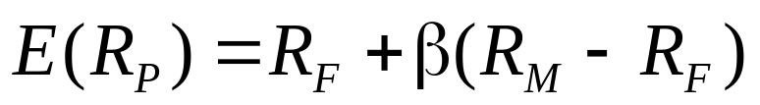
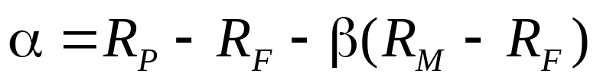
Alpha
Alpha measure the extra return on a portfolio in excess of that predicted by CAPM
so that
Risk Management and Financial Institutions 4e, Chapter 1, Copyright © John C. Hull 2015

Slide 12
Arbitrage Pricing Theory
Returns depend on several factors
We can form portfolios to eliminate the dependence on the factors
This leads to result that expected return is linearly dependent on the realization of the factors
Risk Management and Financial Institutions 4e, Chapter 1, Copyright © John C. Hull 2015

Slide 13
Risk vs Return for Companies
If shareholders care only about systematic risk, should the same be true of company managers?
In practice companies are concerned about total risk
Earnings stability and company survival are important managerial objectives
The regulators of financial institutions are primarily interested in total risk
“Bankruptcy costs” arguments show that that managers may be acting in the best interests of shareholders when they consider total risk
Risk Management and Financial Institutions 4e, Chapter 1, Copyright © John C. Hull 2015

Slide 14
What Are Bankruptcy Costs? (Business Snapshot 1.1, page 15)
Lost sales (There is a reluctance to buy from a bankrupt company.)
Key employees leave
Legal and accounting costs
Risk Management and Financial Institutions 4e, Chapter 1, Copyright © John C. Hull 2015

Slide 15
Approaches to Bank Risk Management
Risk aggregation: aims to get rid of non-systematic risks with diversification
Risk decomposition: tackles risks one by one
In practice banks use both approaches
Risk Management and Financial Institutions 4e, Chapter 1, Copyright © John C. Hull 2015

Slide 16
Credit Ratings
Moody’s | S&P and Fitch
Aaa | AAA
Aa | AA
A | A
Baa | BBB
Ba | BB
B | B
Caa | CCC
Ca | CC
C | C
Investment grade bonds
Non-investment grade bonds
Risk Management and Financial Institutions 4e, Chapter 1, Copyright © John C. Hull 2015

Slide 17
Subdivisions
Moody’s divides Aa into Aa1, Aa2, Aa3.
S&P and Fitch divide AA into AA+, AA, and AA−
Other rating categories are subdivided similarly except AAA (Aaa) and the two lowest categories.
Risk Management and Financial Institutions 4e, Chapter 1, Copyright © John C. Hull 2015

