Slide 1
Insurance Companies and Pension Plans
Chapter 3
Risk Management and Financial Institutions 4e, Chapter 3, Copyright © John C. Hull 2015

Slide 2
Types of Life Insurance (pages 45-49)
Term life
Whole life
Variable life
Universal life
Endowment life
Group life
Risk Management and Financial Institutions 4e, Chapter 3, Copyright © John C. Hull 2015

Slide 3
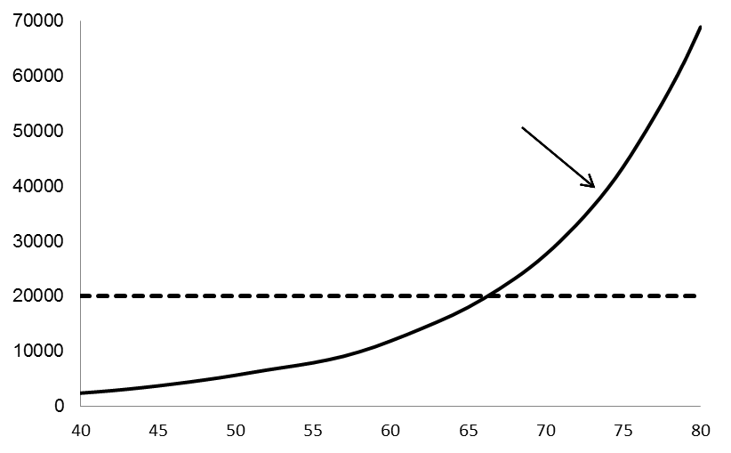
Cost of Whole Life Insurance Compared with Annual Premium (Figure 3.1)
Cost per year
Surplus
Annual Premium
Risk Management and Financial Institutions 4e, Chapter 3, Copyright © John C. Hull 2015

Slide 4
Investment of Surplus
Some contracts allow the policyholder to choose how the surplus is invested
There are tax deferral advantages compared with a regular investment and in some jurisdictions the beneficiary of a life insurance policy does not have to pay any tax
Risk Management and Financial Institutions 4e, Chapter 3, Copyright © John C. Hull 2015

Slide 5
Annuity Contracts (pages 49-50)
Typically a lump sum payment is used to buy a life-time annuity
Annuity can start immediately or be deferred
Accumulation value can depend in a complicated way on the performance of stock indices
There may be penalty-free withdrawals
Risk Management and Financial Institutions 4e, Chapter 3, Copyright © John C. Hull 2015

Slide 6
Extract from US Mortality Tables (2009): Male
Age | Prob. death within one year | Prob. Survival | Life expectancy (yrs)
30 | 0.001419 | 0.97372 | 47.52
31 | 0.001445 | 0.97234 | 46.59
32 | 0.001478 | 0.97093 | 45.65
33 | 0.001519 | 0.96950 | 44.72
Risk Management and Financial Institutions 4e, Chapter 3, Copyright © John C. Hull 2015

Slide 7
Extract from US Mortality Tables (2009): Female
Age | Prob. death within one year | Prob. Survival | Life expectancy (yrs)
30 | 0.000662 | 0.98551 | 51.82
31 | 0.000699 | 0.98486 | 50.86
32 | 0.000739 | 0.98417 | 49.89
33 | 0.000780 | 0.98344 | 48.93
Risk Management and Financial Institutions 4e, Chapter 3, Copyright © John C. Hull 2015

Slide 8
How Tables Are Used In Pricing Life Insurance
Consider a female aged 30
Probability of death during first year is 0.000662
Probability of death during second year is
(1-0.000662) × 0.000699
Probability of death during third year is
  (1-0.000662) × (1-0.000699) ×0.000739
etc
Minimum premium is such that present value of inflows equals present value of outflows.
Risk Management and Financial Institutions 4e, Chapter 3, Copyright © John C. Hull 2015

Slide 9
Longevity Derivatives (page 54)
Used by life insurance companies and pension funds
A population is defined and coupon on a bond depends on the number of members of the population still alive
Risk Management and Financial Institutions 4e, Chapter 3, Copyright © John C. Hull 2015

Slide 10
Property-Casualty Insurance
Property insurance is concerned with loss or damage to property from fire, theft, etc
Casualty insurance is concerned legal liability exposures
What are the biggest risks facing property-casualty insurers?
Risk Management and Financial Institutions 4e, Chapter 3, Copyright © John C. Hull 2015

Slide 11
CAT Bonds (page 55-56)
CAT bonds are an alternative to traditional reinsurance
This is a bond issued by a subsidiary of an insurance company that pays a higher-than-normal interest rate.
If claims of a certain type are above a certain level, the interest and possibly the principal on the bond are used to meet claims
Risk Management and Financial Institutions 4e, Chapter 3, Copyright © John C. Hull 2015

Slide 12
Example of Ratios for Property-Casualty Insurance (Table 3.2)
Loss Ratio | 75%
Expense ratio | 30%
Combined ratio | 105%
Dividends | 1%
Combined ratio after dividends | 106%
Investment income | (9%)
Operating ratio | 97%
Risk Management and Financial Institutions 4e, Chapter 3, Copyright © John C. Hull 2015

Slide 13
When Do Premiums Change?
In life insurance premiums typically stay the same throughout the life of the contract
In property-casualty insurance premiums are changed from year to year as risks are reassessed
In heath insurance premiums can rise because of the overall cost of health care but not because the health risks of the policyholder increase
Risk Management and Financial Institutions 4e, Chapter 3, Copyright © John C. Hull 2015

Slide 14
Moral Hazard and Adverse Selection (pages 58-59)
Moral hazard is the risk that the existence of the insurance policy causes the policyholder to take more risks
Adverse selection is the tendency for an insurance company to attract bad risks when it cannot perfectly distinguish between good and bad risks
Risk Management and Financial Institutions 4e, Chapter 3, Copyright © John C. Hull 2015

Slide 15
Typical Summary Balance Sheet: Life Insurance (Investments are mostly long-term corporate bonds)
Assets |  |  | Liabs and Net worth
Investments | 90 |  | Policy Reserves | 80
Other assets | 10 |  | Sub Long Term Debt | 10
 |  |  | Equity Capital | 10
Total | 100 |  |  | 100
Risk Management and Financial Institutions 4e, Chapter 3, Copyright © John C. Hull 2015

Slide 16
Typical Summary Balance Sheet: Property-Casualty Insurance (Investments are mostly liquid shorter maturity bonds)
Assets |  |  | Liabs and Net worth
Investments | 90 |  | Policy Reserves | 45
Other assets | 10 |  | Unearned premiums | 15
 |  |  | Sub Long Term Debt | 10
 |  |  | Equity Capital | 30
Total | 100 |  |  | 100
Risk Management and Financial Institutions 4e, Chapter 3, Copyright © John C. Hull 2015

Slide 17
Regulation of Insurance Companies
US: Mostly at the state level
Europe: Mostly at the EU level
Risk Management and Financial Institutions 4e, Chapter 3, Copyright © John C. Hull 2015

Slide 18
Pension Plans
Defined benefit plan
  Contributions are pooled
  Benefits are determined by a formula dependent on the final salary of the employee and the number of years of service
Defined contribution plan
  Contributions for each employee are kept separate and invested on behalf of the employee
  When the employee retires the accumulated value of the contributions is usually converted to an annuity
Risk Management and Financial Institutions 4e, Chapter 3, Copyright © John C. Hull 2015

Slide 19
Defined Benefit Plans
Actuaries estimate liabilities and calculate a surplus or deficit for the plan.
The discount rate used for private plans is the AA borrowing rate
Deficits must be funded by the company within a prescribed period
A perfect storm: Declining equity prices coupled with declining interest rates
Risk Management and Financial Institutions 4e, Chapter 3, Copyright © John C. Hull 2015

Slide 20
Are Defined Benefit Plans Viable?
Employer plus employee contributions are typically 15% of salary or less
Actuarial estimates show that about 25% of salary is necessary to fund most plans
Funds typically invest 60% in equities and are relying on good investment returns from equity investments to meet obligations
Should members of DB plans bear some of the risk associated with equity returns?
Risk Management and Financial Institutions 4e, Chapter 3, Copyright © John C. Hull 2015

