Slide 1
Trading in Financial Markets
Chapter 5
Risk Management and Financial Institutions, 4e, Chapter 5, Copyright © John C. Hull 2015

Slide 2
Financial Markets (pages 93-94)
Exchange traded
  Traditionally exchanges have used the open-outcry system, but electronic trading has now become the norm
  Contracts are standard; there is virtually no credit risk
Over-the-counter (OTC)
  A network of dealers at financial institutions, corporations, and fund managers who trade directly with each other
  Contracts can be non-standard; there is some credit risk
Risk Management and Financial Institutions, 4e, Chapter 5, Copyright © John C. Hull 2015

Slide 3
Clearing Houses
Clearing houses stand between traders in the exchange-traded market.
Clearing houses require traders to post cash or marketable securities as collateral (referred to as margin) and clearing house members contribute to a guarantee fund
The margin is set to be sufficiently high that exchange is unlikely to lose money if it has to close out a trader
This combined with the guaranty fund means that traders are subject to virtually no credit risk
Risk Management and Financial Institutions, 4e, Chapter 5, Copyright © John C. Hull 2015

Slide 4
Alternatives for Clearing OTC Trades
Bilaterally
  Usually Involves an ISDA Master Agreement
  Transactions between two participants netted
  May require collateral to be posted
Through CCPs
  CCP behaves like an exchange clearinghouse and stands between two sides
  It required initial and variation margin
  All transactions with CCP netted
Risk Management and Financial Institutions, 4e, Chapter 5, Copyright © John C. Hull 2015

Slide 5
Regulatory Changes for OTC Derivatives (page 95)
Standard OTC derivatives in the U.S. must be traded on electronic platforms known as SEFs. (In Europe the electronic platforms are referred to as organized trading facilities, OTFs)
Standard derivatives traded between financial institutions must be cleared through CCPs
Non-standard derivatives traded between financial institutions can be cleared bilaterally but more collateral than before has to be posted
Trades have to be reported to a central trade repository
Risk Management and Financial Institutions, 4e, Chapter 5, Copyright © John C. Hull 2015

Slide 6
Short Selling (Pages 96-97)
Short selling involves selling securities you do not own
Your broker borrows the securities from another client and sells them in the market in the usual way
At some stage you must buy the securities back so they can be replaced in the account of the client
Risk Management and Financial Institutions, 4e, Chapter 5, Copyright © John C. Hull 2015

Slide 7
Short Selling (continued)
You must pay dividends and other benefits the owner of the securities receives
The cash flows from a short position that is entered into at time T₁ and closed out at time T₂ are the opposite of those from a long position where asset is bought at time T₁ and sold at time T₂, except that there may be a small fee for borrowing the asset
Risk Management and Financial Institutions, 4e, Chapter 5, Copyright © John C. Hull 2015

Slide 8
Derivatives
Forwards
Futures
Swaps
Options
Exotics
Risk Management and Financial Institutions, 4e, Chapter 5, Copyright © John C. Hull 2015

Slide 9
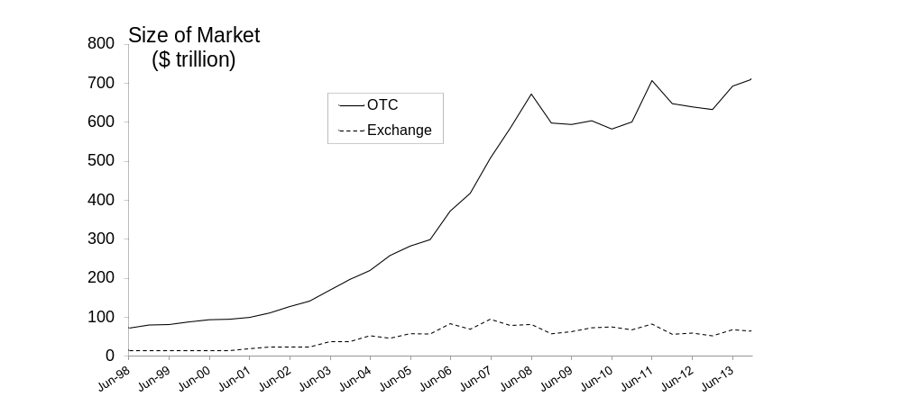
Growth of Derivatives Markets (Figure 5.1)
Risk Management and Financial Institutions, 4e, Chapter 5, Copyright © John C. Hull 2015

Slide 10
Forward Contracts
A forward contract is an agreement to buy or sell an asset at a certain price at a certain future time
Forward contracts trade in the over-the-counter market
They are particularly popular on currencies and interest rates
Risk Management and Financial Institutions, 4e, Chapter 5, Copyright © John C. Hull 2015

Slide 11
Foreign Exchange Quotes for GBP June 17, 2014 (See page 99)
 | Bid | Offer
Spot | 1.6961 | 1.6965
1-month forward | 1.6957 | 1.6962
3-month forward | 1.6950 | 1.6955
1-year forward | 1.6919 | 1.6925
Risk Management and Financial Institutions, 4e, Chapter 5, Copyright © John C. Hull 2015

Slide 12
Profit from a Long Forward Position
Profit
Price of Underlying
at Maturity
K
Risk Management and Financial Institutions, 4e, Chapter 5, Copyright © John C. Hull 2015
Notes:
14

Slide 13
Profit from a Short Forward Position
Profit
Price of Underlying
at Maturity
K
Risk Management and Financial Institutions, 4e, Chapter 5, Copyright © John C. Hull 2015
Notes:
15

Slide 14
Futures Contracts (page 100-101)
Agreement to buy or sell an asset for a certain price at a certain time
Similar to forward contract
Whereas a forward contract is traded OTC, a futures contract is traded on an exchange
Risk Management and Financial Institutions, 4e, Chapter 5, Copyright © John C. Hull 2015

Slide 15
Futures Contract continued
Contracts are settled daily (e.g., if a contract is on 200 ounces of December gold and the December futures moves $2 in my favor, I receive $400; if it moves $2 against me I pay $400)
Both sides to a futures contract are required to post margin (cash or marketable securities) with the exchange clearinghouse. This ensures that they will honor their commitments under the contract.
Risk Management and Financial Institutions, 4e, Chapter 5, Copyright © John C. Hull 2015

Slide 16
Swaps
A swap is an agreement to exchange cash flows at specified future times according to certain specified rules
Risk Management and Financial Institutions, 4e, Chapter 5, Copyright © John C. Hull 2015

Slide 17
An Example of a “Plain Vanilla” Interest Rate Swap
An agreement to receive 6-month LIBOR & pay a fixed rate of 5% per annum every 6 months for 3 years on a notional principal of $100 million
Next slide illustrates cash flows
Risk Management and Financial Institutions, 4e, Chapter 5, Copyright © John C. Hull 2015

Slide 18
Cash Flows for one set of LIBOR rates
(See Table 5.4, page 104)
---------Millions of Dollars---------
LIBOR
FLOATING
FIXED
Net
Date
Rate
Cash Flow
Cash Flow
Cash Flow
Mar.5, 2010
4.2%
Sept. 5, 2010
4.8%
+2.10
–2.50
–0.40
Mar.5, 2011
5.3%
+2.40
–2.50
–0.10
Sept. 5, 2011
5.5%
+2.65
–2.50
+0.15
Mar.5, 2012
5.6%
+2.75
–2.50
+0.25
Sept. 5, 2012
5.9%
+2.80
–2.50
+0.30
Mar.5, 2013
6.4%
+2.95
–2.50
+0.45
Risk Management and Financial Institutions, 4e, Chapter 5, Copyright © John C. Hull 2015

Slide 19
Typical Uses of an
Interest Rate Swap
Converting a liability from
  fixed rate to floating rate
  floating rate to fixed rate
Converting an investment from
  fixed rate to floating rate
  floating rate to fixed rate
Risk Management and Financial Institutions, 4e, Chapter 5, Copyright © John C. Hull 2015

Slide 20
Quotes By a Swap Market Maker (Table 5.5, page 105)
Maturity | Bid (%) | Offer (%) | Swap Rate (%)
2 years | 6.03 | 6.06 | 6.045
3 years | 6.21 | 6.24 | 6.225
4 years | 6.35 | 6.39 | 6.370
5 years | 6.47 | 6.51 | 6.490
7 years | 6.65 | 6.68 | 6.665
10 years | 6.83 | 6.87 | 6.850
Risk Management and Financial Institutions, 4e, Chapter 5, Copyright © John C. Hull 2015

Slide 21
Other Types of Swaps sand Related Instruments
Floating-for-floating interest rate swaps, amortizing swaps, step up swaps, forward swaps, constant maturity swaps, compounding swaps, LIBOR-in-arrears swaps, accrual swaps, diff swaps, cross currency interest rate swaps, equity swaps, extendable swaps, puttable swaps, swaptions, commodity swaps, volatility swaps……..
Risk Management and Financial Institutions, 4e, Chapter 5, Copyright © John C. Hull 2015

Slide 22
Options
A call option is an option to buy a certain asset by a certain date for a certain price (the strike price)
A put option is an option to sell a certain asset by a certain date for a certain price (the strike price)
Options trade on both exchanges and in the OTC market
Risk Management and Financial Institutions, 4e, Chapter 5, Copyright © John C. Hull 2015

Slide 23
American vs European Options
An American option can be exercised at any time during its life
A European option can be exercised only at maturity
Risk Management and Financial Institutions, 4e, Chapter 5, Copyright © John C. Hull 2015

Slide 24
Intel Option Prices: June 17, 2014; Stock Price=29.97 (See Table 5.6; page 106)
Strike Price | Aug14 Call | Oct14 Call | Jan15 Call | Aug14 Put | Oct14 Put | Jan15 Put
18 | 2.30 | 2.45 | 2.80 | 0.30 | 0.66 | 1.13
19 | 1.45 | 1.76 | 2.17 | 0.60 | 0.99 | 1.53
20 | 0.84 | 1.20 | 1.62 | 1.04 | 1.43 | 2.04
21 | 0.41 | 0.82 | 1.22 | 1.60 | 2.02 | 2.64
Risk Management and Financial Institutions, 4e, Chapter 5, Copyright © John C. Hull 2015

Slide 25
Options vs Futures/Forwards
A futures/forward contract gives the holder the obligation to buy or sell at a certain price
An option gives the holder the right to buy or sell at a certain price
Risk Management and Financial Institutions, 4e, Chapter 5, Copyright © John C. Hull 2015

Slide 26
Hedging Examples
A US company will pay £10 million for imports from Britain in 3 months and decides to hedge using a long position in a forward contract
An investor owns 1,000 shares currently worth $28 per share. A two-month put with a strike price of $27.50 costs $1. The investor decides to hedge by buying 10 contracts
Risk Management and Financial Institutions, 4e, Chapter 5, Copyright © John C. Hull 2015
Notes:
16

Slide 27
Options vs Forwards
Forward contracts lock in a price for a future transaction
Options provide insurance. They limit the downside risk while not giving up the upside potential
For this reason options are more attractive to many corporate treasurers than forward contracts
Risk Management and Financial Institutions, 4e, Chapter 5, Copyright © John C. Hull 2015

Slide 28
Interest Rate Options
Caps and floors
Swap options
Bond options
Risk Management and Financial Institutions, 4e, Chapter 5, Copyright © John C. Hull 2015

Slide 29
Nontraditional Derivatives (pages 108-112)
Weather derivatives
Energy derivatives
  Oil
  Natural gas
  Electricity
Risk Management and Financial Institutions, 4e, Chapter 5, Copyright © John C. Hull 2015

Slide 30
Exotic Options (pages 112-114)
Asian options
Barrier option
Basket options
Binary options
Compound options
Lookback options
Risk Management and Financial Institutions, 4e, Chapter 5, Copyright © John C. Hull 2015

Slide 31
Example of the Use of Exotic Options (Business Snapshot 5.3, page 113)
If a company earns revenue month by month in many different currencies, Asian basket put options can provide an appropriate hedge
Risk Management and Financial Institutions, 4e, Chapter 5, Copyright © John C. Hull 2015

Slide 32
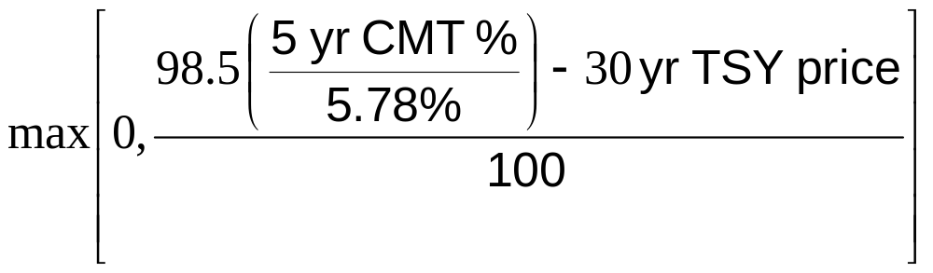
Structured Products
Products created to meet the needs of clients
A bizarre structures product is the “10/30” deal between Bankers Trust and Procter and Gamble (See Business Snapshot 5.4)
The payments by P&G were
Risk Management and Financial Institutions, 4e, Chapter 5, Copyright © John C. Hull 2015

Slide 33
Types of Traders
Hedgers
Speculators
Arbitrageurs
Some of the largest trading losses in derivatives have occurred because individuals who had a mandate to be hedgers or arbitrageurs switched to being speculators (See for example SocGen, Business Snapshot 5.5, page 115)
Risk Management and Financial Institutions, 4e, Chapter 5, Copyright © John C. Hull 2015

