Slide 1
The Credit Crisis of 2007
Chapter 6
Risk Management and Financial Institutions 4e, Chapter 6, Copyright © John C. Hull 2015

Slide 2
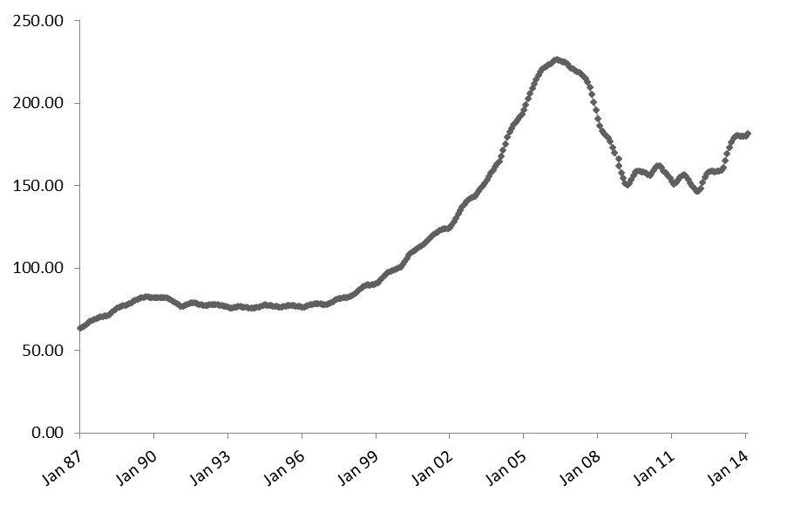
U.S. Real Estate Prices, 1987 to 2014: S&P/Case-Shiller Composite-10 Index
Risk Management and Financial Institutions 4e, Chapter 6, Copyright © John C. Hull 2015

Slide 3
What happened…
Starting in 2000, mortgage originators in the US relaxed their lending standards and created large numbers of subprime first mortgages.
This, combined with very low interest rates, increased the demand for real estate and prices rose.
To continue to attract first time buyers and keep prices increasing they relaxed lending standards further
Features of the market: 100% mortgages, ARMs, teaser rates, NINJAs, liar loans, non-recourse borrowing
Risk Management and Financial Institutions 4e, Chapter 6, Copyright © John C. Hull 2015

Slide 4
What happened...
Mortgages were packaged in financial products and sold to investors
Banks found it profitable to invest in the AAA rated tranches because the promised return was significantly higher than the cost of funds and capital requirements were low
In 2007 the bubble burst. Some borrowers could not afford their payments when the teaser rates ended. Others had negative equity and recognized that it was optimal for them to exercise their put options.
U.S. real estate prices fell and products, created from the mortgages, that were previously thought to be safe began to be viewed as risky
There was a “flight to quality” and credit spreads increased to very high levels
Risk Management and Financial Institutions 4e, Chapter 6, Copyright © John C. Hull 2015

Slide 5
Asset Backed Security (Simplified)
ABS
Senior Tranche
Principal: $75 million
Return = 6%
Asset 1
Asset 2
Asset 3

Asset n
Principal:
$100 million
SPV
Mezzanine Tranche
Principal:$20 million
Return = 10%
Equity Tranche
Principal: $5 million
Return =30%
A “waterfall” defines the precise rules for allocating cash flows to tranches
Risk Management and Financial Institutions 4e, Chapter 6, Copyright © John C. Hull 2015

Slide 6
The Waterfall
Asset Cash Flows
Senior Tranche
Mezzanine Tranche
Equity Tranche
Risk Management and Financial Institutions 4e, Chapter 6, Copyright © John C. Hull 2015

Slide 7
ABS CDOs or Mezz CDOs (Simplified)
ABSs
Subprime Mortgages
Senior Tranches (75%)
AAA
ABS CDO
Senior Tranche (75%)
AAA
Mezzanine Tranches (20%)
BBB
Mezzanine Tranche (20%) BBB
Equity Tranches (5%)
Not Rated
Equity Tranche (5%)
How much of the original portfolio of subprime mortgages is AAA?
Risk Management and Financial Institutions 4e, Chapter 6, Copyright © John C. Hull 2015

Slide 8
Losses to AAA Tranche of ABS CDO (Table 6.1)
Losses on Subprime portfolios | Losses on Mezzanine Tranche of ABS | Losses on Equity Tranche of ABS CDO | Losses on Mezzanine Tranche of ABS CDO | Losses on Senior Tranche of ABS CDO
10% | 25% | 100% | 100% | 0%
15% | 50% | 100% | 100% | 33.3%
20% | 75% | 100% | 100% | 66.7%
25% | 100% | 100% | 100% | 100%
Risk Management and Financial Institutions 4e, Chapter 6, Copyright © John C. Hull 2015

Slide 9
A More Realistic Structure
(Figure 6.5)
High Grade ABS CDO
Senior AAA
88%
Junior AAA
5%
AA
3%
A
2%
ABS
BBB
1%
AAA
81%
NR
1%
AA
11%
Subprime Mortgages
A
4%
Mezz ABS CDO
CDO of CDO
BBB
3%
Senior AAA
62%
Senior AAA
60%
BB, NR
1%
Junior AAA
14%
Junior AAA
27%
AA
8%
AA
4%
A
6%
A
3%
BBB
6%
BBB
3%
NR
4%
NR
2%
Risk Management and Financial Institutions 4e, Chapter 6, Copyright © John C. Hull 2015

Slide 10
BBB Tranches
BBB tranches of ABSs were often quite thin (1% wide)
This means that they have a quite different loss distribution from BBB bonds and should not be treated as equivalent to BBB bonds
They tend to be either safe or completely wiped out (cliff risk)
What does this mean for the tranches of the Mezz ABS CDO?
Risk Management and Financial Institutions 4e, Chapter 6, Copyright © John C. Hull 2015

Slide 11
Regulatory Arbitrage
Capital required for securities created from a portfolio of mortgages was considerably less than capital that would be required if mortgages had been kept on the balance sheet
Risk Management and Financial Institutions 4e, Chapter 6, Copyright © John C. Hull 2015

Slide 12
Role of Incentives
Arguably the incentives of valuers, the creators of ABSs and ABS CDOs, and rating agencies helped to create the crisis
Compensation plans of traders created short-term horizons for decision making
Risk Management and Financial Institutions 4e, Chapter 6, Copyright © John C. Hull 2015

Slide 13
Importance of Transparency
ABSs and ABS CDOs were complex inter-related products
Once the AAA rated tranches were perceived as risky they became very difficult to trade because investors realized they did not understand the risks
Other credit related products with simpler structures (eg, credit default swaps) continued to trade during the crisis.
Risk Management and Financial Institutions 4e, Chapter 6, Copyright © John C. Hull 2015

Slide 14
Lessons from the Crisis (page 133-134)
Beware irrational exuberance
Do not underestimate default correlations in stressed markets
Recovery rate depends on default rate
Compensation structures did not create the right incentives
If a deal seems too good to be true (eg, a AAA earning LIBOR plus 100 bp) it probably is
Do not rely on ratings
Transparency is important in financial markets
Resecuritization was a badly flawed idea
Risk Management and Financial Institutions 4e, Chapter 6, Copyright © John C. Hull 2015

