Slide 1
Valuation and Scenario Analysis: The Risk-Neutral and Real Worlds
Chapter 7
Risk Management and Financial Institutions 4e, Chapter 7, Copyright © John C. Hull 2015

Slide 2
Valuation vs. Scenario Analysis
In valuation, we are interested in the present value of future cash flows
In scenario analysis, we are interested in the range of situations that might exist at a future time
Risk Management and Financial Institutions 4e, Chapter 7, Copyright © John C. Hull 2015

Slide 3
Example (page 137)
One-year European call option on a stock worthy $50 with a strike price of $55
The value might be calculated as $4.5 and it might be sold for $5
But a scenario analysis might show there is a 5% chance of the stock price rising above $80
This would cost the seller about $20
Risk Management and Financial Institutions 4e, Chapter 7, Copyright © John C. Hull 2015

Slide 4
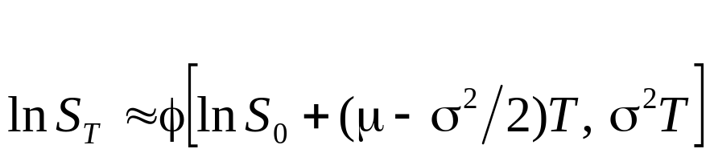
Volatility and Asset Prices
If the average return from an asset is μ and its volatility is σ then the most popular model (known as geometric Brownian) motion gives
where S_{T} is the stock price at time T and φ(m,v) is a normal distribution with mean m and variance v.
Risk Management and Financial Institutions 4e, Chapter 7, Copyright © John C. Hull 2015

Slide 5
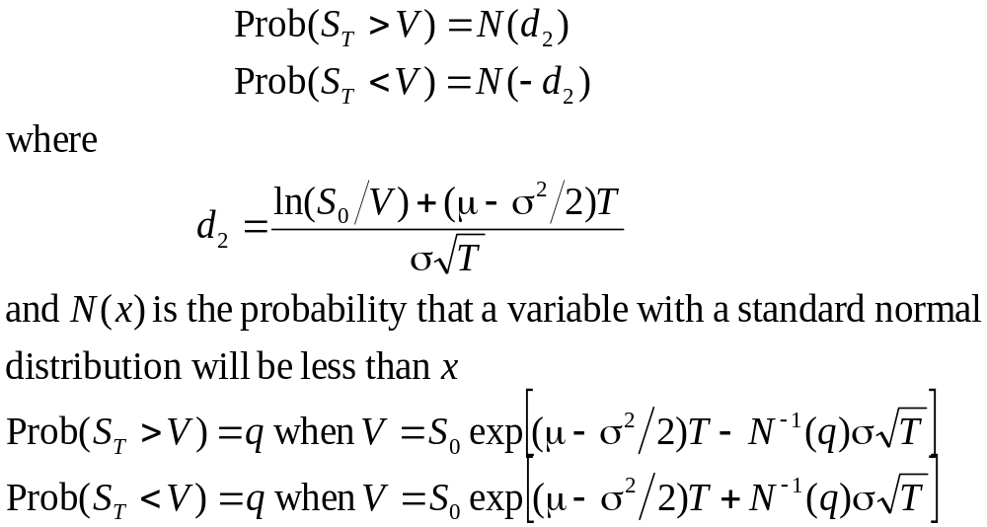
Probability of Extreme Values
Risk Management and Financial Institutions 4e, Chapter 7, Copyright © John C. Hull 2015

Slide 6
Risk-Neutral Valuation (pages 139-143)
In a risk-neutral world investors do not require an extra expected return for bearing risks
If when valuing derivatives we assume that the world is risk-neutral, we get the right valuation for the real world (where investors do require an extra return for bearing risks) as well as for the risk-neutral world
Options, Futures, and Other Derivatives, 9th Edition, Copyright © John C. Hull 2014

Slide 7
Applying Risk-Neutral Valuation to Value a European Stock Option
1. Assume that the expected return from the stock is the risk-free rate
2. Calculate the expected payoff from the option
3. Discount at the risk-free rate
Options, Futures, and Other Derivatives, 9th Edition, Copyright © John C. Hull 2014

Slide 8
Valuing a Forward Contract with Risk-Neutral Valuation
Payoff is S_{T} – K
Expected payoff in a risk-neutral world is S₀e^{rT} – K
Present value of expected payoff is
e^{−rT}[S₀e^{rT} – K] = S₀ – Ke^{−rT}
Options, Futures, and Other Derivatives, 9th Edition, Copyright © John C. Hull 2014

Slide 9
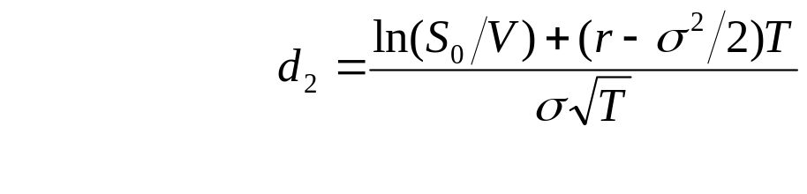
Valuing a Binary Option with Risk-Neutral Valuation
Consider a binary option that pays off $100 if the stock price at time T is greater than V
The value of the binary option is 100e^{−rT}N(d₂) where r is the risk-free rate (assumed constant) and N(d₂) is the probability that the stock price is greater than V in a risk-neutral world
Risk Management and Financial Institutions 4e, Chapter 7, Copyright © John C. Hull 2015

Slide 10
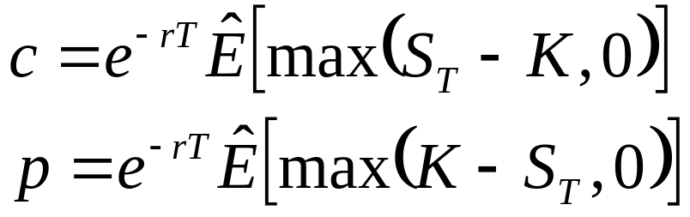

Black-Scholes-Merton
where c is the value of a European call option, p is the value of a European put option, K is the strike price and denotes expected value in a risk-neutral world
Options, Futures, and Other Derivatives, 9th Edition, Copyright © John C. Hull 2014

Slide 11
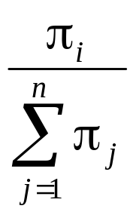
Discrete Future Outcomes (pages 142-143)
Suppose that a variable can take n different values
Define π_{i} as the value of a derivative that pays off $1 if the ith outcome occurs
When applying risk-neutral valuation we set the risk-neutral probability of the ith outcome equal to
Risk Management and Financial Institutions 4e, Chapter 7, Copyright © John C. Hull 2015

Slide 12
Default Probabilities
Risk-neutral default probabilities can be implied from bond prices or credit spreads.
They are greater than real-world default probabilities
Risk Management and Financial Institutions 4e, Chapter 7, Copyright © John C. Hull 2015

Slide 13
Girsanov’s Theorem (page 144)
For valuation we work in the risk-neutral world
For scenario analysis we work in the real world
Girsanov’s theorem shows that when we move from one world to the other expected returns change but volatilities stay the same
Risk Management and Financial Institutions 4e, Chapter 7, Copyright © John C. Hull 2015

Slide 14
Why Both the Real and Risk-Neutral Worlds Can Be Relevant for Scenario Analysis
In a scenario analysis we should
  Randomly sample paths followed by market variables out to the time horizon
  Value the portfolio using risk-neutral valuation at the time horizon for each sample
Risk Management and Financial Institutions 4e, Chapter 7, Copyright © John C. Hull 2015

Slide 15

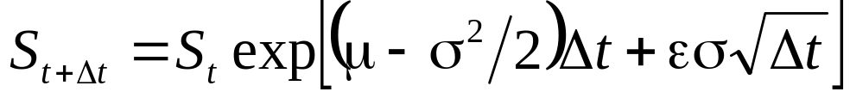
Monte Carlo Simulation (page 145)
For a variable with a constant expected return, μ, and a constant volatility, σ
where ε is a random sample from a standard normal distribution
This means
Risk Management and Financial Institutions 4e, Chapter 7, Copyright © John C. Hull 2015

Slide 16
Mean Reversion
Interest rate, volatilities, and some commodity prices follow mean reverting processes where they are pulled back to a long run average value
Superimposed on the pull is a random change
Risk Management and Financial Institutions 4e, Chapter 7, Copyright © John C. Hull 2015

Slide 17
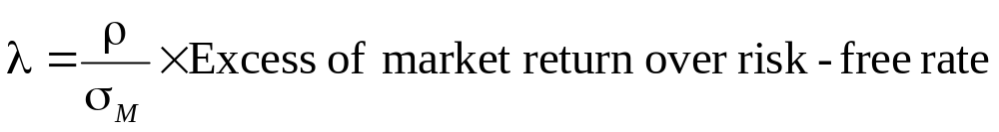
Determining Real World Processes
To determine real world processes from risk-neutral processes for a variable we can use CAPM to adjust the expected return
If σ is the volatility of the variable, σ_{M} is the volatility of an index of market returns market, ρ is the correlation between percentage changes in the variable and percentage changes in the market index, then we should increase the expected return by λσ where
Risk Management and Financial Institutions 4e, Chapter 7, Copyright © John C. Hull 2015

Slide 18
Example
If a commodity is uncorrelated with the return on a market index its expected return should be the same in both worlds
But if ρ = 0.3, σ = 40%, σ_{Μ} = 20%, and the excess return of the market over the risk-free rate is 6%, then λ=0.09 and the expected return should be 3.6% higher in the real world than the risk-neutral world
Risk Management and Financial Institutions 4e, Chapter 7, Copyright © John C. Hull 2015

