Slide 1
How Traders Manage Their Risks
Chapter 8
Risk Management and Financial Institutions, 4e, Chapter 8, Copyright © John C. Hull 2015

Slide 2
A Trader’s Gold Portfolio. How Should Risks Be Hedged? (Table 8.1, page 154)
Position | Value ($)
Spot Gold | 9,180,000
Forward Contracts | – 3,060,000
Futures Contracts | 2,000
Swaps | 180,000
Options | – 6,110,000
Exotics | 125,000
Total | 317,000
Risk Management and Financial Institutions, 4e, Chapter 8, Copyright © John C. Hull 2015

Slide 3
Delta
Delta of a portfolio is the partial derivative of a portfolio with respect to the price of the underlying asset (gold in this case)
Suppose that a $0.1 increase in the price of gold leads to the gold portfolio decreasing in value by $100
The delta of the portfolio is −1000
The portfolio could be hedged against short-term changes in the price of gold by buying 1000 ounces of gold. This is known as making the portfolio delta neutral
Risk Management and Financial Institutions, 4e, Chapter 8, Copyright © John C. Hull 2015

Slide 4
Linear vs Nonlinear Products
When the price of a product is linearly dependent on the price of an underlying asset a “hedge and forget’’ strategy can be used
Non-linear products require the hedge to be rebalanced to preserve delta neutrality
Risk Management and Financial Institutions, 4e, Chapter 8, Copyright © John C. Hull 2015

Slide 5
Example of Hedging a Nonlinear Product (pages 156-160)
A bank has sold for $300,000 a European call option on 100,000 shares of a nondividend paying stock
S₀ = 49, K = 50, r = 5%, σ = 20%,
T = 20 weeks, μ = 13%
The Black-Scholes-Merton value of the option is $240,000
How does the bank hedge its risk to lock in a $60,000 profit?
Risk Management and Financial Institutions, 4e, Chapter 8, Copyright © John C. Hull 2015

Slide 6
Delta of the Option
Option
price
Slope = Δ
B
A
Stock price
Risk Management and Financial Institutions, 4e, Chapter 8, Copyright © John C. Hull 2015

Slide 7
Delta Hedging
Initially the delta of the option is 0.522
The delta of the position is -52,200
This means that 52,200 shares must purchased to create a delta neutral position
But, if a week later delta falls to 0.458, 6,400 shares must be sold to maintain delta neutrality
Tables 8.2 and 8.3 (pages 158 and 159) provide examples of how delta hedging might work for the option.
Risk Management and Financial Institutions, 4e, Chapter 8, Copyright © John C. Hull 2015

Slide 8
Table 8.2: Option closes in the money
Week | Stock Price | Delta | Shares Purchased
0 | 49.00 | 0.522 | 52,200
1 | 48.12 | 0.458 | (6,400)
2 | 47.37 | 0.400 | (5,800)
3 | 50.25 | 0.596 | 19,600
…. | ….. | …. | …..
19 | 55.87 | 1.000 | 1,000
20 | 57.25 | 1.000 | 0
Risk Management and Financial Institutions, 4e, Chapter 8, Copyright © John C. Hull 2015

Slide 9
Table 8.3: Option closes out of the money
Week | Stock Price | Delta | Shares Purchased
0 | 49.00 | 0.522 | 52,200
1 | 49.75 | 0.568 | 4,600
2 | 52.00 | 0.705 | 13,700
3 | 50.00 | 0.579 | (12,600)
…. | ….. | …. | …..
19 | 46.63 | 0.007 | (17,600)
20 | 48.12 | 0.000 | (700)
Risk Management and Financial Institutions, 4e, Chapter 8, Copyright © John C. Hull 2015

Slide 10
Where the Costs Come From
Delta hedging a short option position tends to involve selling after a price decline and buying after a price increase
This is a “sell low, buy high” strategy.
The total costs incurred are close to the theoretical price of the option
Risk Management and Financial Institutions, 4e, Chapter 8, Copyright © John C. Hull 2015

Slide 11
Gamma
Gamma (Γ) is the rate of change of delta (Δ) with respect to the price of the underlying asset
Gamma is greatest for options that are close to the money
Risk Management and Financial Institutions, 4e, Chapter 8, Copyright © John C. Hull 2015

Slide 12
Gamma Measures the Delta Hedging Errors Caused By Curvature (Figure 8.4, page 161)
Call
price
C''
C'
C
Stock price
S
S'
Risk Management and Financial Institutions, 4e, Chapter 8, Copyright © John C. Hull 2015

Slide 13
Vega
Vega (ν) is the rate of change of the value of a derivatives portfolio with respect to volatility
Like gamma, vega tends to be greatest for options that are close to the money
Risk Management and Financial Institutions, 4e, Chapter 8, Copyright © John C. Hull 2015

Slide 14
Gamma and Vega Limits
In practice, a traders must keep gamma and vega within limits set by risk management
Risk Management and Financial Institutions, 4e, Chapter 8, Copyright © John C. Hull 2015

Slide 15
Theta
Theta (Θ) of a derivative (or portfolio of derivatives) is the rate of change of the value with respect to the passage of time
The theta of a call or put is usually negative. This means that, if time passes with the price of the underlying asset and its volatility remaining the same, the value of the option declines
Risk Management and Financial Institutions, 4e, Chapter 8, Copyright © John C. Hull 2015

Slide 16
Rho
Rho is the partial derivative with respect to a parallel shift in all interest rates in a particular country
Risk Management and Financial Institutions, 4e, Chapter 8, Copyright © John C. Hull 2015

Slide 17
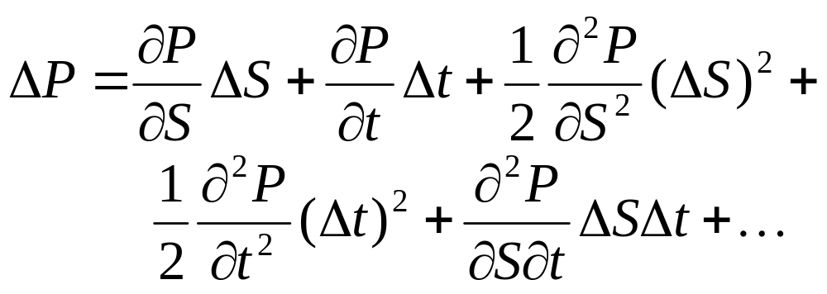
Taylor Series Expansion (Equation 8.1, page 167)
Risk Management and Financial Institutions, 4e, Chapter 8, Copyright © John C. Hull 2015

Slide 18
Interpretation of Gamma
(Equation 8.2, page 167)
For a delta neutral portfolio,
ΔP ≈ Θ Δt + ½ΓΔS ²
ΔP
ΔP
ΔS
ΔS
Positive Gamma
Negative Gamma
Risk Management and Financial Institutions, 4e, Chapter 8, Copyright © John C. Hull 2015

Slide 19
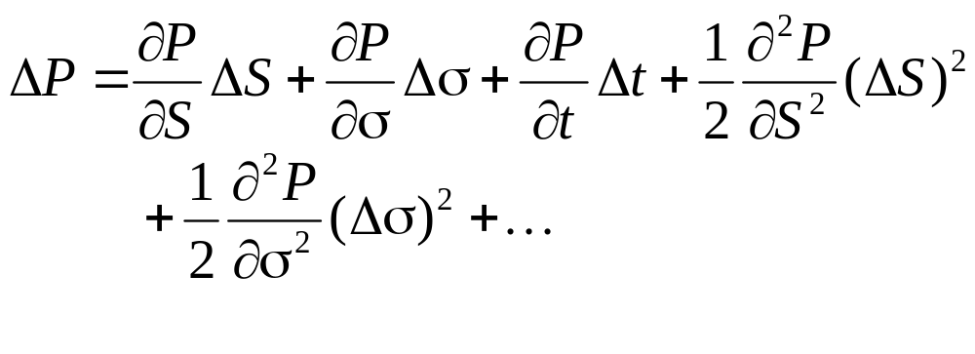
Taylor Series Expansion when Volatility is Uncertain
Risk Management and Financial Institutions, 4e, Chapter 8, Copyright © John C. Hull 2015

Slide 20
Managing Delta, Gamma, & Vega
Δ can be changed by taking a position in the underlying
To adjust Γ & ν it is necessary to take a position in an option or other derivative
Risk Management and Financial Institutions, 4e, Chapter 8, Copyright © John C. Hull 2015

Slide 21
Hedging in Practice
Traders usually ensure that their portfolios are delta-neutral at least once a day
Whenever the opportunity arises, they improve gamma and vega
As portfolio becomes larger hedging becomes less expensive
Risk Management and Financial Institutions, 4e, Chapter 8, Copyright © John C. Hull 2015

Slide 22
Static Options Replication
(pages 169-170)
This involves approximately replicating an exotic option with a portfolio of vanilla options
Underlying principle: if we match the value of an exotic option on some boundary, we have matched it at all interior points of the boundary
Static options replication can be contrasted with dynamic options replication where we have to trade continuously to match the option
Risk Management and Financial Institutions, 4e, Chapter 8, Copyright © John C. Hull 2015

Slide 23
Scenario Analysis
A scenario analysis involves testing the effect on the value of a portfolio of different assumptions concerning asset prices and their volatilities
Risk Management and Financial Institutions, 4e, Chapter 8, Copyright © John C. Hull 2015

