Slide 1
Interest Rate Risk
Chapter 9
Risk Management and Financial Institutions, 4e, Chapter 9, Copyright © John C. Hull 2015

Slide 2
Management of Net Interest Income (Table 9.1, page 176)
Suppose that the market’s best guess is that future short term rates will equal today’s rates
What would happen if a bank posted the following rates?
How can the bank manage its risks?
Maturity (yrs) | Deposit Rate | Mortgage Rate
1 | 3% | 6%
5 | 3% | 6%
Risk Management and Financial Institutions, 4e, Chapter 9, Copyright © John C. Hull 2015

Slide 3
Management of Net Interest Income
Most banks have asset-liability management groups to manage interest rate risk
When long term loans are funded with short term deposits interest rate swaps can be used to hedge the interest rate risk
But this does not hedge the liquidity risk
Risk Management and Financial Institutions, 4e, Chapter 9, Copyright © John C. Hull 2015

Slide 4
LIBOR Rates and Swap Rates
LIBOR rates are rates with maturities up to one year for interbank transactions where the borrower has a AA-rating
Swap Rates are the fixed rates exchanged for floating in an interest rate swap agreement
Risk Management and Financial Institutions, 4e, Chapter 9, Copyright © John C. Hull 2015

Slide 5
Understanding Swap Rates
A bank can
  Lend to a series AA-rated borrowers for ten successive six month periods
  Swap the LIBOR interest received for the five-year swap rate
This shows that the swap rate has the credit risk corresponding to a series of short-term loans to AA-rated borrowers
Risk Management and Financial Institutions, 4e, Chapter 9, Copyright © John C. Hull 2015

Slide 6
Extending the LIBOR Curve
Alternative 1: Create a term structure of interest rates showing the rate of interest at which a AA-rated company can borrow now for 1, 2, 3 … years
Alternative 2: Use swap rates so that the term structure represents future short term AA borrowing rates
Alternative 2 is the usual approach. It creates the LIBOR/swap term structure of interest rates
Risk Management and Financial Institutions, 4e, Chapter 9, Copyright © John C. Hull 2015

Slide 7
Risk-Free Rate
Traders has traditionally assumed that the LIBOR/swap zero curve is the risk-free zero curve
The Treasury curve is about 50 basis points below the LIBOR/swap zero curve
Treasury rates are considered to be artificially low for a variety of regulatory and tax reasons
Risk Management and Financial Institutions, 4e, Chapter 9, Copyright © John C. Hull 2015

Slide 8
OIS Rate
LIBOR/swap rates were clearly not “risk-free” during the crisis
As a result there has been a trend toward using overnight indexed swap (OIS) rates as proxies for the risk-free rate instead of LIBOR and swap rates
The OIS rate is the rate swapped for the geometric average of overnight borrowing rates. (In the U.S. the relevant overnight rate is the fed funds rate)
Risk Management and Financial Institutions, 4e, Chapter 9, Copyright © John C. Hull 2015

Slide 9
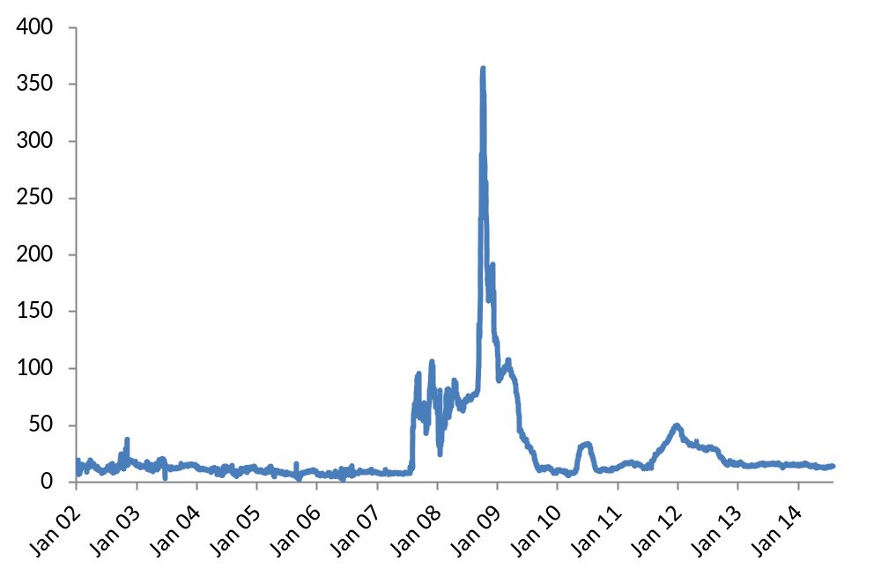
3-month LIBOR-OIS Spread
Risk Management and Financial Institutions, 4e, Chapter 9, Copyright © John C. Hull 2015

Slide 10
Repo Rate
A financial institution owning securities agrees to sell them today for a certain price and buy them back in the future for a slightly higher price
It is obtaining a secured loan
The interest on the loan is the difference between the two prices
Risk Management and Financial Institutions, 4e, Chapter 9, Copyright © John C. Hull 2015

Slide 11
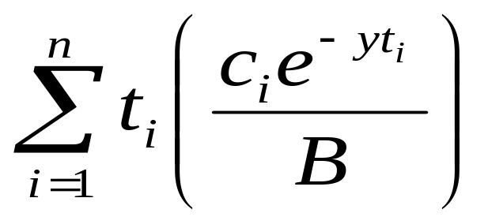
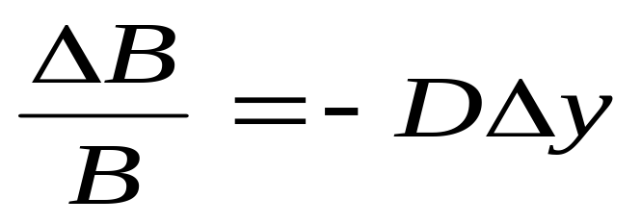
Duration (page 182)
Duration of a bond that provides cash flow c_{i} at time t_{i} is
where B is its price and y is its yield (continuously compounded)
This leads to
Risk Management and Financial Institutions, 4e, Chapter 9, Copyright © John C. Hull 2015

Slide 12
Calculation of Duration for a 3-year bond paying a coupon 10%. Bond yield=12%. (Table 9.3, page 183)
Time (yrs) | Cash Flow ($) | PV ($) | Weight | Time × Weight
0.5 | 5 | 4.709 | 0.050 | 0.025
1.0 | 5 | 4.435 | 0.047 | 0.047
1.5 | 5 | 4.176 | 0.044 | 0.066
2.0 | 5 | 3.933 | 0.042 | 0.083
2.5 | 5 | 3.704 | 0.039 | 0.098
3.0 | 105 | 73.256 | 0.778 | 2.333
Total | 130 | 94.213 | 1.000 | 2.653
Risk Management and Financial Institutions, 4e, Chapter 9, Copyright © John C. Hull 2015

Slide 13
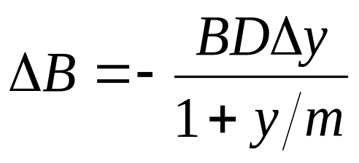
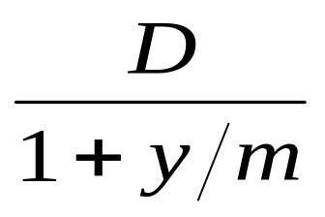
Duration Continued
When the yield y is expressed with compounding m times per year
The expression
is referred to as the “modified duration”
Risk Management and Financial Institutions, 4e, Chapter 9, Copyright © John C. Hull 2015

Slide 14
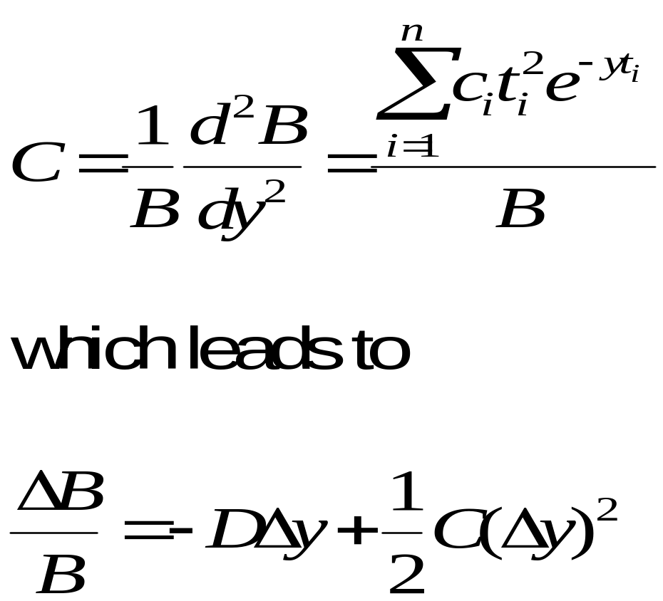
Convexity (Page 185-187)
The convexity of a bond is defined as
Risk Management and Financial Institutions, 4e, Chapter 9, Copyright © John C. Hull 2015

Slide 15
Portfolios
Duration and convexity can be defined similarly for portfolios of bonds and other interest-rate dependent securities
The duration of a portfolio is the weighted average of the durations of the components of the portfolio. Similarly for convexity.
Risk Management and Financial Institutions, 4e, Chapter 9, Copyright © John C. Hull 2015

Slide 16
What Duration and Convexity Measure
Duration measures the effect of a small parallel shift in the yield curve
Duration plus convexity measure the effect of a larger parallel shift in the yield curve
However, they do not measure the effect of non-parallel shifts
Risk Management and Financial Institutions, 4e, Chapter 9, Copyright © John C. Hull 2015

Slide 17
Other Measures
Dollar Duration: Product of the portfolio value and its duration
Dollar Convexity: Product of convexity and value of the portfolio
Risk Management and Financial Institutions, 4e, Chapter 9, Copyright © John C. Hull 2015

Slide 18
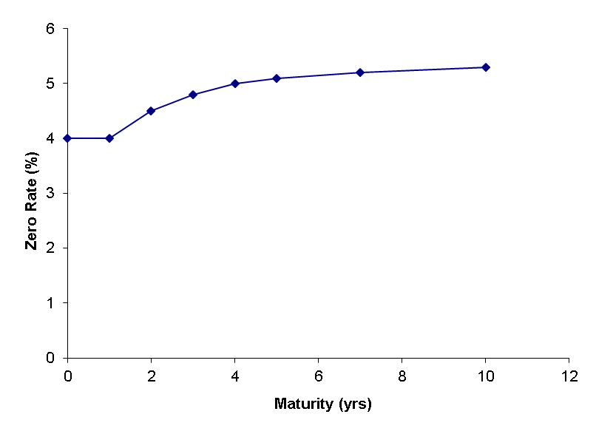
Starting Zero Curve (Figure 9.4, page 190)
Risk Management and Financial Institutions, 4e, Chapter 9, Copyright © John C. Hull 2015

Slide 19
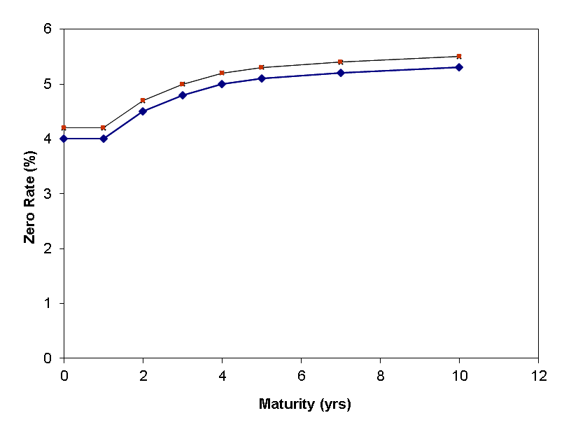
Parallel Shift
Risk Management and Financial Institutions, 4e, Chapter 9, Copyright © John C. Hull 2015

Slide 20
Partial Duration
A partial duration calculates the effect on a portfolio of a change to just one point on the zero curve
Risk Management and Financial Institutions, 4e, Chapter 9, Copyright © John C. Hull 2015

Slide 21
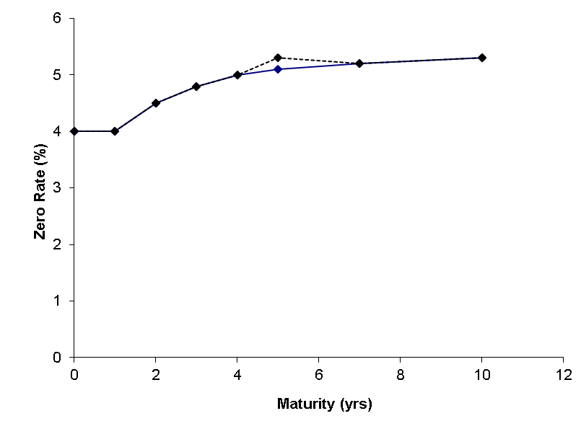
Partial Duration continued
(Figure 9.5, page 190)
Risk Management and Financial Institutions, 4e, Chapter 9, Copyright © John C. Hull 2015

Slide 22
Example (Table 9.5, page 190)
Maturity yrs | 1 | 2 | 3 | 4 | 5 | 7 | 10 | Total
Partial duration | 0.2 | 0.6 | 0.9 | 1.6 | 2.0 | −2.1 | −3.0 | 0.2
Risk Management and Financial Institutions, 4e, Chapter 9, Copyright © John C. Hull 2015

Slide 23
Partial Durations Can Be Used to Investigate the Impact of Any Yield Curve Change
Any yield curve change can be defined in terms of changes to individual points on the yield curve
For example, to define a rotation we could change the 1-, 2-, 3-, 4-, 5-, 7, and 10-year maturities by −3e, − 2e, − e, 0, e, 3e, 6e
Risk Management and Financial Institutions, 4e, Chapter 9, Copyright © John C. Hull 2015

Slide 24
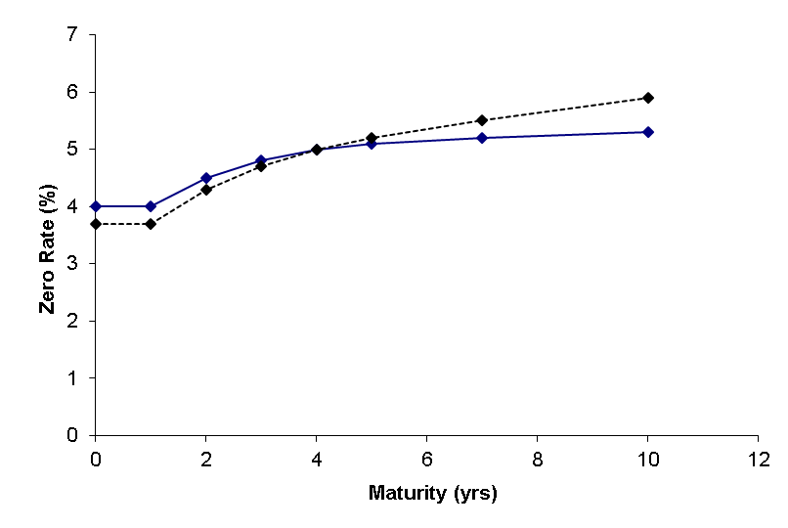
Combining Partial Durations to Create Rotation in the Yield Curve
(Figure 9.6, page 191)
Risk Management and Financial Institutions, 4e, Chapter 9, Copyright © John C. Hull 2015

Slide 25
Impact of Rotation
The impact of the rotation on the proportional change in the value of the portfolio in the example is
Risk Management and Financial Institutions, 4e, Chapter 9, Copyright © John C. Hull 2015

Slide 26
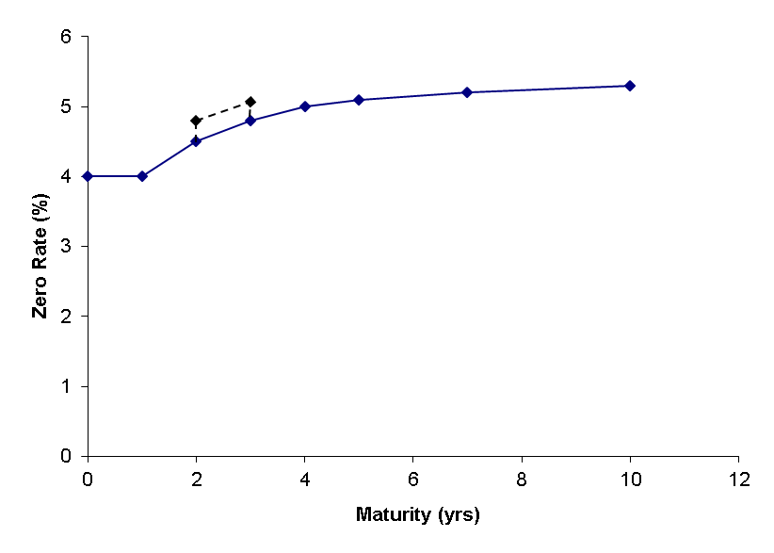
Alternative approach (Figure 9.7, page 192)
Bucket the yield curve and investigate the effect of a small change to each bucket
Risk Management and Financial Institutions, 4e, Chapter 9, Copyright © John C. Hull 2015

Slide 27
Principal Components Analysis
Attempts to identify standard shifts (or factors) for the yield curve so that most of the movements that are observed in practice are combinations of the standard shifts
Risk Management and Financial Institutions, 4e, Chapter 9, Copyright © John C. Hull 2015

Slide 28
Results (Tables 9.7 and 9.8)
The first factor is a roughly parallel shift (90.9% of variance explained)
The second factor is a twist 6.8% of variance explained)
The third factor is a bowing (1.3% of variance explained)
Risk Management and Financial Institutions, 4e, Chapter 9, Copyright © John C. Hull 2015

Slide 29
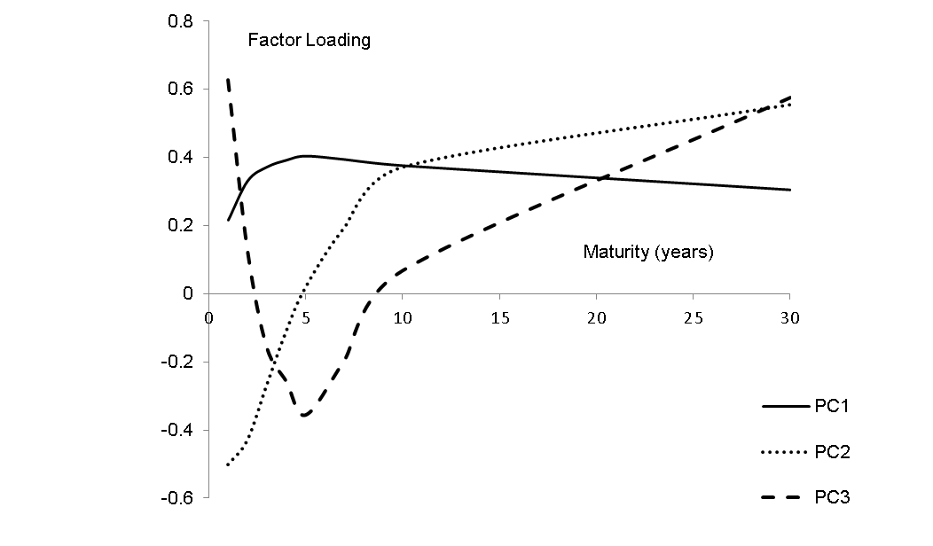
The Three Factors (Figure 9.8 page 195)
Risk Management and Financial Institutions, 4e, Chapter 9, Copyright © John C. Hull 2015

Slide 30
Alternatives for Calculating Multiple Deltas to Reflect Non-Parallel Shifts in Yield Curve
Shift individual points on the yield curve by one basis point (the partial duration approach)
Shift segments of the yield curve by one basis point (the bucketing approach)
Shift quotes on instruments used to calculate the yield curve
Calculate deltas with respect to the shifts given by a principal components analysis.
Risk Management and Financial Institutions, 4e, Chapter 9, Copyright © John C. Hull 2015

Slide 31
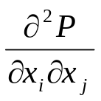
Gamma for Interest Rates
Gamma has the form
where x_{i} and x_{j} are yield curve shifts considered for delta
To avoid information overload one possibility is consider only i = j
Another is to consider only parallel shifts in the yield curve and calculate convexity
Another is to consider the first two or three types of shift given by a principal components analysis
Risk Management and Financial Institutions, 4e, Chapter 9, Copyright © John C. Hull 2015

Slide 32
Vega for Interest Rates
One possibility is to make the same change to all interest rate implied volatilities. (However implied volatilities for long-dated options change by less than those for short-dated options.)
Another is to do a principal components analysis on implied volatility changes for the instruments that are traded
Risk Management and Financial Institutions, 4e, Chapter 9, Copyright © John C. Hull 2015

