Slide 1
Volatility
Chapter 10
Risk Management and Financial Institutions 4e, Chapter 10, Copyright © John C. Hull 2015

Slide 2

Definition of Volatility
Suppose that S_{i} is the value of a variable on day i. The volatility per day is the standard deviation of ln(S_{i} /S_{i-1})
Normally days when markets are closed are ignored in volatility calculations (see Business Snapshot 10.1, page 203)
The volatility per year is times the daily volatility
Variance rate is the square of volatility
Risk Management and Financial Institutions 4e, Chapter 10, Copyright © John C. Hull 2015

Slide 3
Implied Volatilities
Of the variables needed to price an option the one that cannot be observed directly is volatility
We can therefore imply volatilities from market prices and vice versa
Risk Management and Financial Institutions 4e, Chapter 10, Copyright © John C. Hull 2015

Slide 4
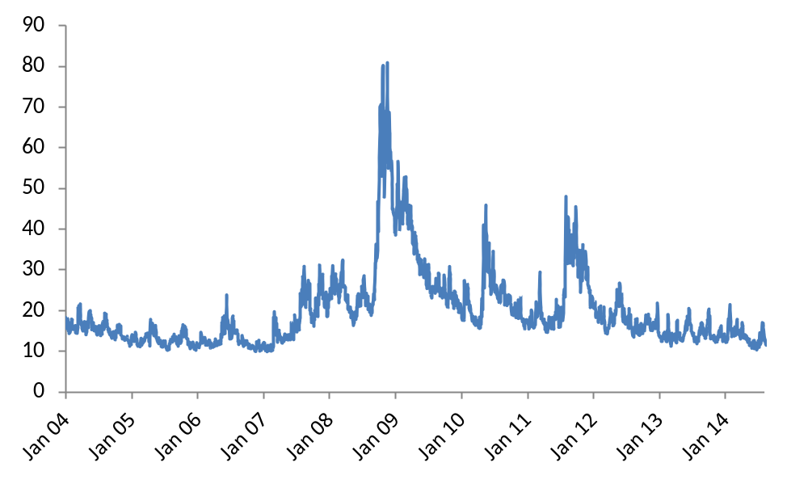
VIX Index: A Measure of the Implied Volatility of the S&P 500 (Figure 10.1, page 204)
Risk Management and Financial Institutions 4e, Chapter 10, Copyright © John C. Hull 2015

Slide 5
Are Daily Changes in Exchange Rates Normally Distributed? Table 10.1, page 205
 | Real World (%) | Normal Model (%)
>1 SD | 25.04 | 31.73
>2SD | 5.27 | 4.55
>3SD | 1.34 | 0.27
>4SD | 0.29 | 0.01
>5SD | 0.08 | 0.00
>6SD | 0.03 | 0.00
Risk Management and Financial Institutions 4e, Chapter 10, Copyright © John C. Hull 2015

Slide 6
Heavy Tails
Daily exchange rate changes are not normally distributed
  The distribution has heavier tails than the normal distribution
  It is more peaked than the normal distribution
This means that small changes and large changes are more likely than the normal distribution would suggest
Many market variables have this property, known as excess kurtosis
Risk Management and Financial Institutions 4e, Chapter 10, Copyright © John C. Hull 2015

Slide 7
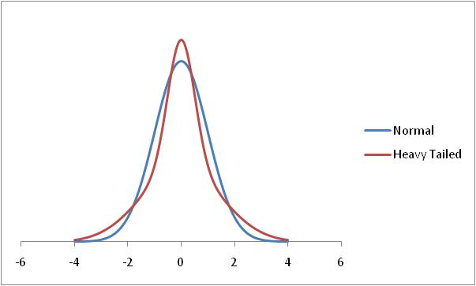
Normal and Heavy-Tailed Distribution
Risk Management and Financial Institutions 4e, Chapter 10, Copyright © John C. Hull 2015

Slide 8
Alternatives to Normal Distributions: The Power Law (See page 207)
Prob(v > x) = Kx^{-α}
This seems to fit the behavior of the returns on many market variables better than the normal distribution
Risk Management and Financial Institutions 4e, Chapter 10, Copyright © John C. Hull 2015

Slide 9
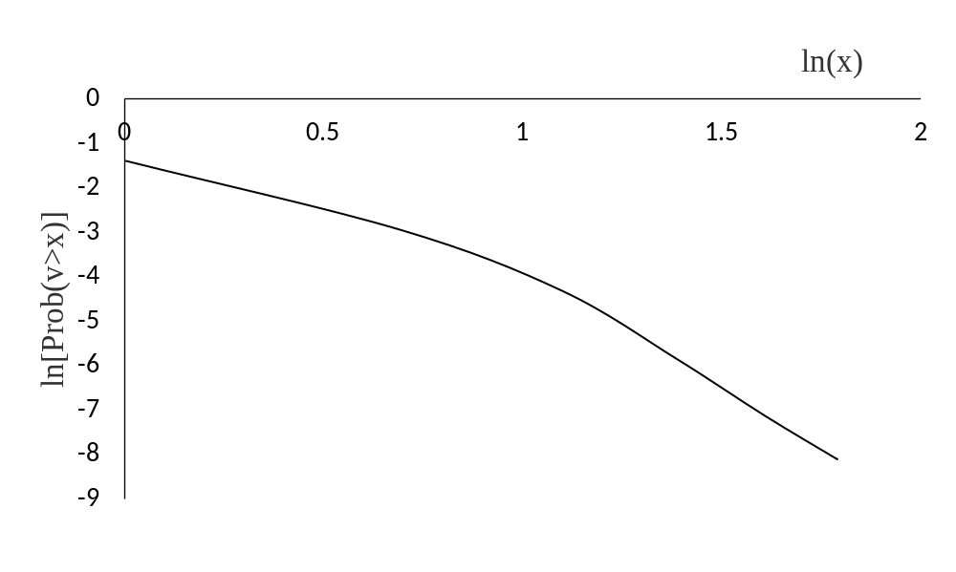
Log-Log Test for Exchange Rate Data (v is number of standard deviations which the exchange rate moves)
Risk Management and Financial Institutions 4e, Chapter 10, Copyright © John C. Hull 2015

Slide 10
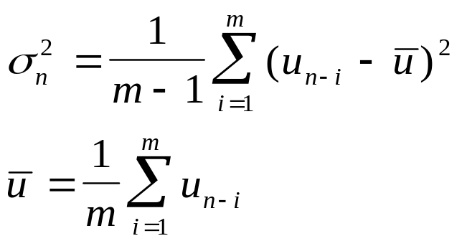
Standard Approach to Estimating Volatility
Define σ_{n} as the volatility per day between day n−1 and day n, as estimated at end of day n−1
Define S_{i} as the value of market variable at end of day i
Define u_{i}= ln(S_{i}/S_{i-1})
Risk Management and Financial Institutions 4e, Chapter 10, Copyright © John C. Hull 2015

Slide 11
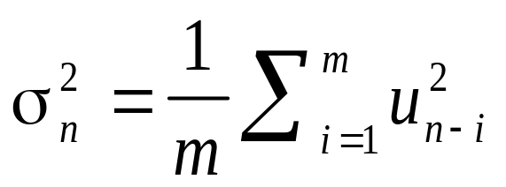
Simplifications Usually Made in
Risk Management
Define u_{i} as (S_{i}−S_{i−1})/S_{i−1}
Assume that the mean value of u_{i} is zero
Replace m−1 by m
This gives
Risk Management and Financial Institutions 4e, Chapter 10, Copyright © John C. Hull 2015

Slide 12
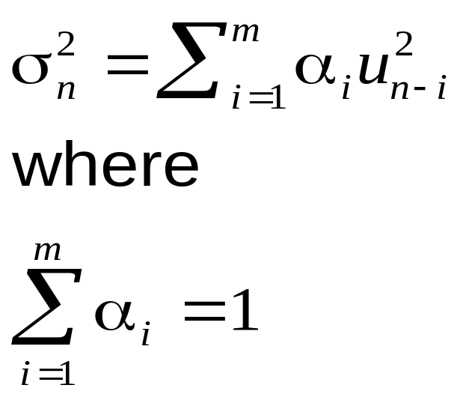
Weighting Scheme
Instead of assigning equal weights to the observations we can set
Risk Management and Financial Institutions 4e, Chapter 10, Copyright © John C. Hull 2015

Slide 13
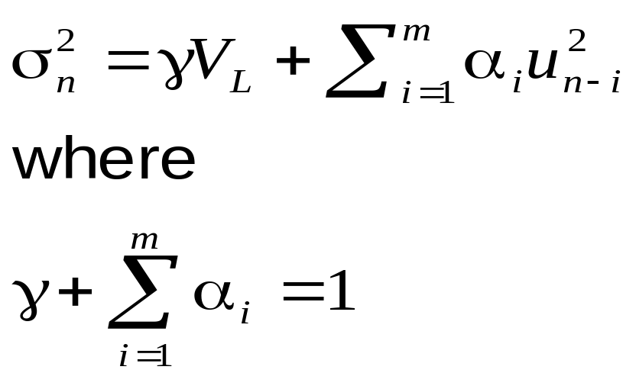
ARCH(m) Model
In an ARCH(m) model we also assign some weight to the long-run variance rate, V_{L}:
Risk Management and Financial Institutions 4e, Chapter 10, Copyright © John C. Hull 2015

Slide 14
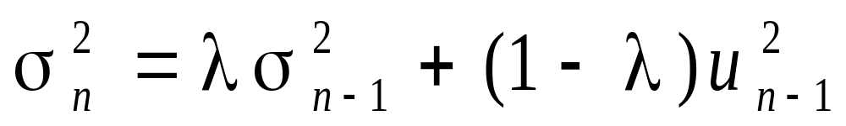
EWMA Model (page 212)
In an exponentially weighted moving average model, the weights assigned to the u² decline exponentially as we move back through time
This leads to
Risk Management and Financial Institutions 4e, Chapter 10, Copyright © John C. Hull 2015

Slide 15
Attractions of EWMA
Relatively little data needs to be stored
We need only remember the current estimate of the variance rate and the most recent observation on the market variable
Tracks volatility changes
λ = 0.94 has been found to be a good choice across a wide range of market variables
Risk Management and Financial Institutions 4e, Chapter 10, Copyright © John C. Hull 2015

Slide 16
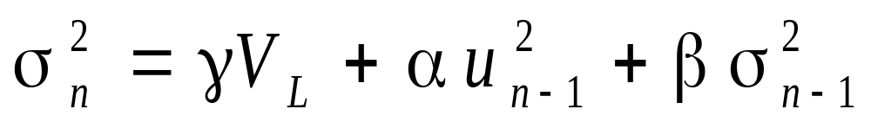
GARCH (1,1), page 214
In GARCH (1,1) we assign some weight to the long-run average variance rate
Since weights must sum to 1
γ + α + β =1
Risk Management and Financial Institutions 4e, Chapter 10, Copyright © John C. Hull 2015

Slide 17
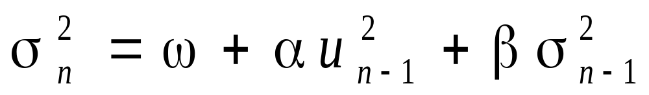
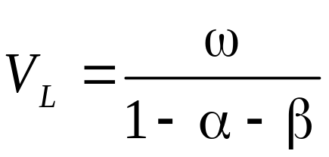
GARCH (1,1) continued
Setting ω = γV_{L} the GARCH (1,1) model is
and
Risk Management and Financial Institutions 4e, Chapter 10, Copyright © John C. Hull 2015

Slide 18
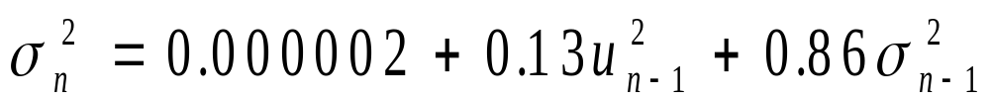
Example
Suppose
The long-run variance rate is 0.0002 so that the long-run volatility per day is 1.4%
Risk Management and Financial Institutions 4e, Chapter 10, Copyright © John C. Hull 2015

Slide 19
Example continued
Suppose that the current estimate of the volatility is 1.6% per day and the most recent percentage change in the market variable is 1%.
The new variance rate is
The new volatility is 1.53% per day
Risk Management and Financial Institutions 4e, Chapter 10, Copyright © John C. Hull 2015

Slide 20
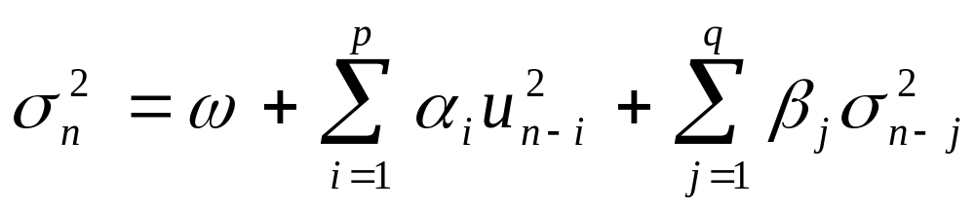
GARCH (p,q)
Risk Management and Financial Institutions 4e, Chapter 10, Copyright © John C. Hull 2015

Slide 21
Other Models
Many other GARCH models have been proposed
For example, we can design a GARCH models so that the weight given to u_{i}² depends on whether u_{i} is positive or negative
Risk Management and Financial Institutions 4e, Chapter 10, Copyright © John C. Hull 2015

Slide 22
Maximum Likelihood Methods
In maximum likelihood methods we choose parameters that maximize the likelihood of the observations occurring
Risk Management and Financial Institutions 4e, Chapter 10, Copyright © John C. Hull 2015

Slide 23
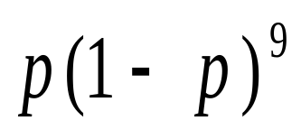
Case 1 (page 216)
We observe that a certain event happens one time in ten trials. What is our estimate of the proportion of the time, p, that it happens?
The probability of the outcome is
We maximize this to obtain a maximum likelihood estimate: p = 0.1
Risk Management and Financial Institutions 4e, Chapter 10, Copyright © John C. Hull 2015

Slide 24
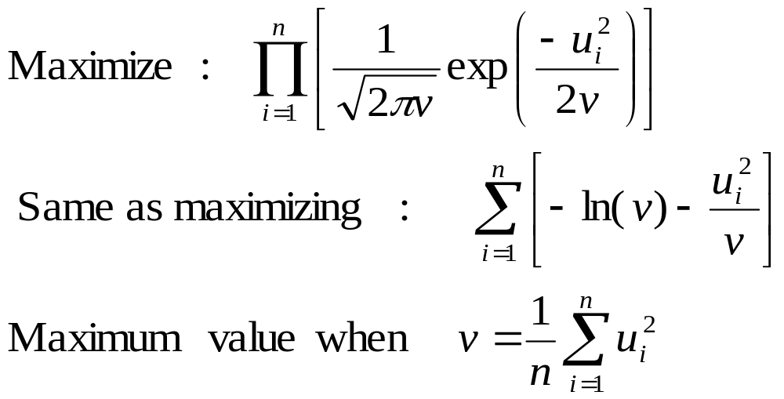
Case 2 (page 216-217)
Estimate the variance of observations from a normal distribution with mean zero
Risk Management and Financial Institutions 4e, Chapter 10, Copyright © John C. Hull 2015

Slide 25
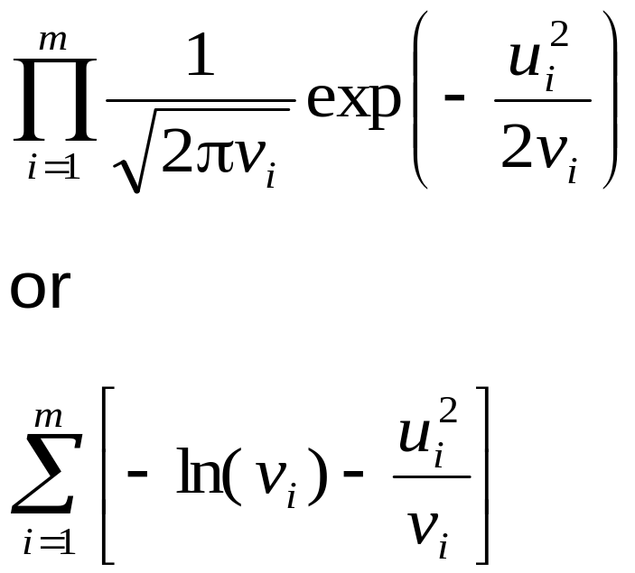
Application to EWMA and GARCH
We choose parameters that maximize
Options, Futures, and Other Derivatives, 9th Edition, Copyright © John C. Hull 2014

Slide 26
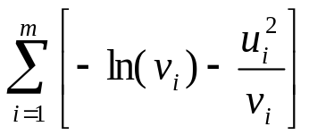
S&P 500 Excel Application
Start with trial values of parameters (λ for EWMA and ω, α, and β for GARCH(1,1)
Update variances
Calculate
Use solver to search for values of parameters that maximize this objective function
For efficient operation of Solver: set up spreadsheet so that ensure that search is over parameters that are of same order of magnitude and test alternative starting conditions
Options, Futures, and Other Derivatives, 9th Edition, Copyright © John C. Hull 2014

Slide 27
S&P 500 Excel Application (Table 10.4)
Date | Day | S_{i} | u_{i}=(S_{i}−S_{i-1})/S_{i-1} | v_{i} =σ_{i}² | −ln(v_{i} ) −u_{i}² /v_{i}
18-Jul-2005 | 1 | 1221.13
19-Jul-2005 | 2 | 1229.35 | 0.006731
20-Jul-2005 | 3 | 1235.20 | 0.004759 | 0.00004531 | 9.5022
21-Jul-2005 | 4 | 1227.04 | −0.006606 | 0.00004447 | 9.0393
……. | ….. | ……. | ……….. | …………. | …………
13-Aug-2010 | 1279 | 1079.25 | −0.004024 | 0.00016327 | 8.6209
Total |  |  |  |  | 10,228.2349
Options, Futures, and Other Derivatives, 9th Edition, Copyright © John C. Hull 2014

Slide 28
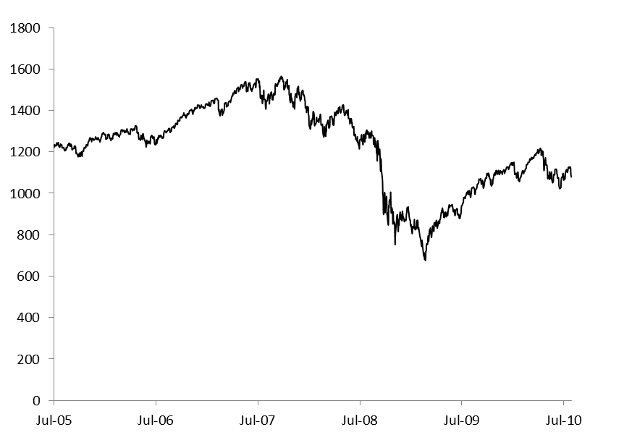
The S&P 500 (Figure 10.4)
Risk Management and Financial Institutions 4e, Chapter 10, Copyright © John C. Hull 2015

Slide 29
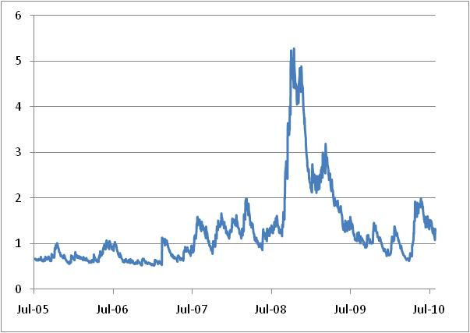
The GARCH Estimate of Volatility of the S&P 500 (Figure 10.5)
ω=0.0000013465, α=0.083394, β=0.910116
Options, Futures, and Other Derivatives, 9th Edition, Copyright © John C. Hull 2014

Slide 30
Variance Targeting
One way of implementing GARCH(1,1) that increases stability is by using variance targeting
The long-run average variance equal to the sample variance
Only two other parameters then have to be estimated
Risk Management and Financial Institutions 4e, Chapter 10, Copyright © John C. Hull 2015

Slide 31
How Good is the Model?
The Ljung-Box statistic tests for autocorrelation
We compare the autocorrelation of the
u_{i}² with the autocorrelation of the u_{i}²/σ_{i}²
Options, Futures, and Other Derivatives, 9th Edition, Copyright © John C. Hull 2014

Slide 32
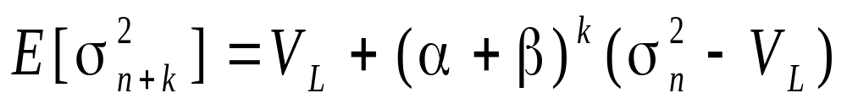
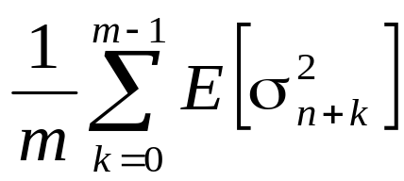
Forecasting Future Volatility
(equation 10.14, page 223)
A few lines of algebra shows that
The variance rate for an option expiring on day m is
Options, Futures, and Other Derivatives, 9th Edition, Copyright © John C. Hull 2014

Slide 33
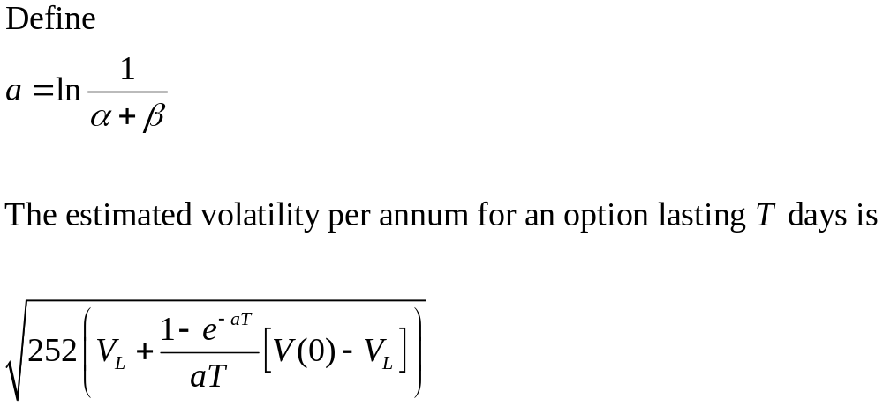
Forecasting Future Volatility continued (equation 10.15, page 224)
Options, Futures, and Other Derivatives, 9th Edition, Copyright © John C. Hull 2014

Slide 34
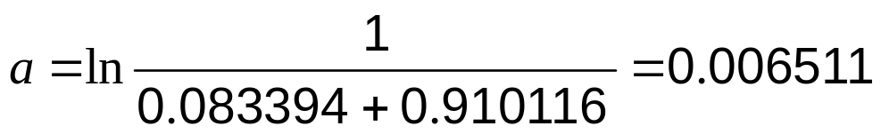
S&P Example
ω=0.0000013465, α=0.083394, β=0.910116
Option Life (days) | 10 | 30 | 50 | 100 | 500
Est. Volatility (% per annum) | 27.36 | 27.10 | 26.87 | 26.35 | 24.32
Options, Futures, and Other Derivatives, 9th Edition, Copyright © John C. Hull 2014

Slide 35
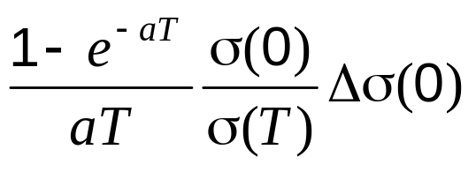
Volatility Term Structures
GARCH (1,1) suggests that, when calculating vega, we should shift the long maturity volatilities less than the short maturity volatilities
When instantaneous volatility changes by Δσ(0), volatility for T-day option changes by
Options, Futures, and Other Derivatives, 9th Edition, Copyright © John C. Hull 2014

Slide 36
Results for S&P 500 (Table 10.7)
When instantaneous volatility changes by 1%
Option Life (days) | 10 | 30 | 50 | 100 | 500
Volatility increase (%) | 0.97 | 0.92 | 0.87 | 0.77 | 0.33
Options, Futures, and Other Derivatives, 9th Edition, Copyright © John C. Hull 2014

