Slide 1
Value at Risk and Expected Shortfall
Chapter 12
Risk Management and Financial Institutions 4e, Chapter 12, Copyright © John C. Hull 2015

Slide 2
The Question Being Asked in VaR
“What loss level is such that we are X% confident it will not be exceeded in N business days?”
Risk Management and Financial Institutions 4e, Chapter 12, Copyright © John C. Hull 2015

Slide 3
VaR and Regulatory Capital
Regulators have traditionally used VaR to calculate the capital they require banks to keep
The market-risk capital has been based on a 10-day VaR estimated where the confidence level is 99%
Credit risk and operational risk capital are based on a one-year 99.9% VaR
Risk Management and Financial Institutions 4e, Chapter 12, Copyright © John C. Hull 2015

Slide 4
Advantages of VaR
It captures an important aspect of risk
in a single number
It is easy to understand
It asks the simple question: “How bad can things get?”
Risk Management and Financial Institutions 4e, Chapter 12, Copyright © John C. Hull 2015

Slide 5
Example 12.1 (page 257)
The gain from a portfolio during six month is normally distributed with mean $2 million and standard deviation $10 million
The 1% point of the distribution of gains is 2−2.33×10 or − $21.3 million
The VaR for the portfolio with a six month time horizon and a 99% confidence level is $21.3 million.
Risk Management and Financial Institutions 4e, Chapter 12, Copyright © John C. Hull 2015

Slide 6
Example 12.2 (page 258)
All outcomes between a loss of $50 million and a gain of $50 million are equally likely for a one-year project
The VaR for a one-year time horizon and a 99% confidence level is $49 million
Risk Management and Financial Institutions 4e, Chapter 12, Copyright © John C. Hull 2015

Slide 7
Examples 12.3 and 12.4 (page 258)
A one-year project has a 98% chance of leading to a gain of $2 million, a 1.5% chance of a loss of $4 million, and a 0.5% chance of a loss of $10 million
The VaR with a 99% confidence level is $4 million
What if the confidence level is 99.9%?
What if it is 99.5%?
Risk Management and Financial Institutions 4e, Chapter 12, Copyright © John C. Hull 2015

Slide 8
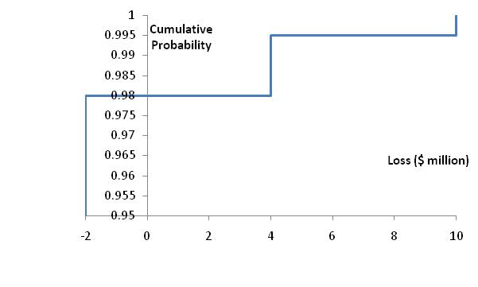
Cumulative Loss Distribution for Examples 12.3 and 12.4 (Figure 12.3, page 258)
Risk Management and Financial Institutions 4e, Chapter 12, Copyright © John C. Hull 2015

Slide 9
VaR vs. Expected Shortfall
VaR is the loss level that will not be exceeded with a specified probability
Expected shortfall (ES) is the expected loss given that the loss is greater than the VaR level (also called C-VaR and Tail Loss)
Regulators have indicated that they plan to move from using VaR to using ES for determining market risk capital
Two portfolios with the same VaR can have very different expected shortfalls
Risk Management and Financial Institutions 4e, Chapter 12, Copyright © John C. Hull 2015

Slide 10
Distributions with the Same VaR but Different Expected Shortfalls
VaR
VaR
Risk Management and Financial Institutions 4e, Chapter 12, Copyright © John C. Hull 2015

Slide 11
Coherent Risk Measures (page 260)
Define a coherent risk measure as the amount of cash that has to be added to a portfolio to make its risk acceptable
Properties of coherent risk measure
  If one portfolio always produces a worse outcome than another its risk measure should be greater
  If we add an amount of cash K to a portfolio its risk measure should go down by K
  Changing the size of a portfolio by λ should result in the risk measure being multiplied by λ
  The risk measures for two portfolios after they have been merged should be no greater than the sum of their risk measures before they were merged
Risk Management and Financial Institutions 4e, Chapter 12, Copyright © John C. Hull 2015

Slide 12
VaR vs Expected Shortfall
VaR satisfies the first three conditions but not the fourth one
ES satisfies all four conditions.
Risk Management and Financial Institutions 4e, Chapter 12, Copyright © John C. Hull 2015

Slide 13
Example 12.5 and 12.7
Each of two independent projects has a probability 0.98 of a loss of $1 million and 0.02 probability of a loss of $10 million
What is the 97.5% VaR for each project?
What is the 97.5% expected shortfall for each project?
What is the 97.5% VaR for the portfolio?
What is the 97.5% expected shortfall for the portfolio?
Risk Management and Financial Institutions 4e, Chapter 12, Copyright © John C. Hull 2015

Slide 14
Examples 12.6 and 12.8
A bank has two $10 million one-year loans. Possible outcomes are as follows
If a default occurs, losses between 0% and 100% are equally likely. If a loan does not default, a profit of 0.2 million is made.
What is the 99% VaR and expected shortfall of each project
What is the 99% VaR and expected shortfall for the portfolio
Outcome | Probability
Neither Loan Defaults | 97.5%
Loan 1 defaults, loan 2 does not default | 1.25%
Loan 2 defaults, loan 1 does not default | 1.25%
Both loans default | 0.00%
Risk Management and Financial Institutions 4e, Chapter 12, Copyright © John C. Hull 2015

Slide 15
Spectral Risk Measures
A spectral risk measure assigns weights to quantiles of the loss distribution
VaR assigns all weight to Xth percentile of the loss distribution
Expected shortfall assigns equal weight to all percentiles greater than the Xth percentile
For a coherent risk measure weights must be a non-decreasing function of the percentiles
Risk Management and Financial Institutions 4e, Chapter 12, Copyright © John C. Hull 2015

Slide 16
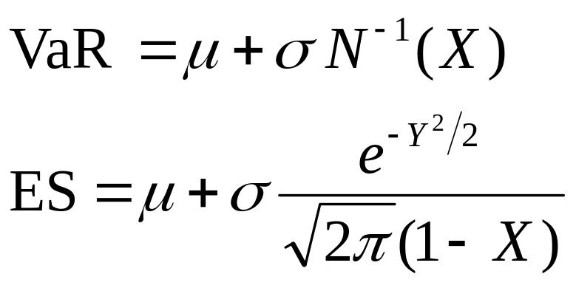
Normal Distribution Assumption
When losses (gains) are normally distributed with mean μ and standard deviation σ
Risk Management and Financial Institutions 4e, Chapter 12, Copyright © John C. Hull 2015

Slide 17
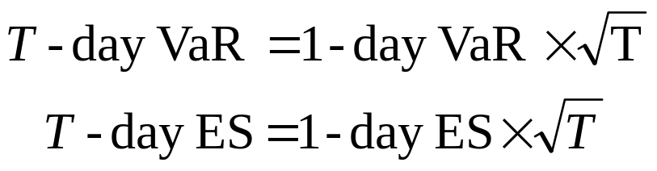
Changing the Time Horizon
If losses in successive days are independent, normally distributed, and have a mean of zero
Risk Management and Financial Institutions 4e, Chapter 12, Copyright © John C. Hull 2015

Slide 18
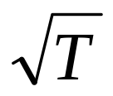
Extension
If there is autocorrelation ρ between the losses (gains) on successive days, we replace by
in these equations
Risk Management and Financial Institutions 4e, Chapter 12, Copyright © John C. Hull 2015

Slide 19
Ratio of T-day VaR to 1-day VaR (Table 12.1, page 266)
 | T=1 | T=2 | T=5 | T=10 | T=50 | T=250
ρ=0 | 1.0 | 1.41 | 2.24 | 3.16 | 7.07 | 15.81
ρ=0.05 | 1.0 | 1.45 | 2.33 | 3.31 | 7.43 | 16.62
ρ=0.1 | 1.0 | 1.48 | 2.42 | 3.46 | 7.80 | 17.47
ρ=0.2 | 1.0 | 1.55 | 2.62 | 3.79 | 8.62 | 19.35
Risk Management and Financial Institutions 4e, Chapter 12, Copyright © John C. Hull 2015

Slide 20
Choice of VaR Parameters
Time horizon should depend on how quickly portfolio can be unwound. Regulators are planning to move toward a system where ES is used and the time horizon depends on liquidity. (See Fundamental Review of the Trading Book)
Confidence level depends on objectives. Regulators use 99% for market risk and 99.9% for credit/operational risk.
A bank wanting to maintain a AA credit rating might use confidence levels as high as 99.97% for internal calculations.
Risk Management and Financial Institutions 4e, Chapter 12, Copyright © John C. Hull 2015

Slide 21
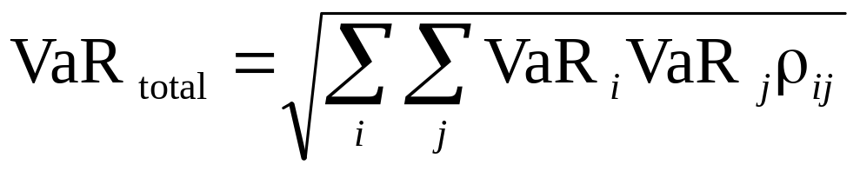
Aggregating VaRs
  An approximate approach that seems to works well is
  where VaR_{i} is the VaR for the ith segment, VaR_{total} is the total VaR, and ρ_{ij} is the coefficient of correlation between losses from the ith and jth segments
Risk Management and Financial Institutions 4e, Chapter 12, Copyright © John C. Hull 2015

Slide 22
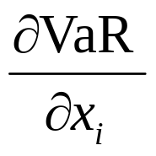
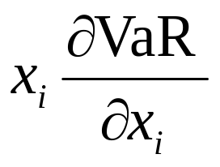
VaR Measures for a Portfolio where an amount x_{i} is invested in the ith component of the portfolio (page 268-270)
Marginal VaR:
Incremental VaR: Incremental effect of the ith component on VaR
Component VaR:
Risk Management and Financial Institutions 4e, Chapter 12, Copyright © John C. Hull 2015

Slide 23
Properties of Component VaR
The component VaR is approximately the same as the incremental VaR
The total VaR is the sum of the component VaR’s (Euler’s theorem)
The component VaR therefore provides a sensible way of allocating VaR to different activities
Risk Management and Financial Institutions 4e, Chapter 12, Copyright © John C. Hull 2015

Slide 24
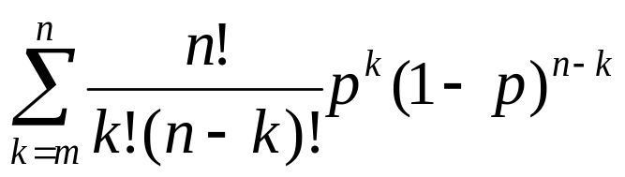
Back-testing (page 270-273)
Back-testing a VaR calculation methodology involves looking at how often exceptions (loss > VaR) occur
Alternatives: a) compare VaR with actual change in portfolio value and b) compare VaR with change in portfolio value assuming no change in portfolio composition
Suppose that the theoretical probability of an exception is p (=1−X). The probability of m or more exceptions in n days is
Risk Management and Financial Institutions 4e, Chapter 12, Copyright © John C. Hull 2015

Slide 25
Bunching
Bunching occurs when exceptions are not evenly spread throughout the back testing period
Statistical tests for bunching have been developed by Christoffersen (See page 200)
Risk Management and Financial Institutions 4e, Chapter 12, Copyright © John C. Hull 2015

