Slide 1
Historical Simulation and Extreme Value Theory
Chapter 13
Risk Management and Financial Institutions 4e, Chapter 13, Copyright © John C. Hull 2015

Slide 2
Historical Simulation
Collect data on the daily movements in all market variables.
The first simulation trial assumes that the percentage changes in all market variables are as on the first day
The second simulation trial assumes that the percentage changes in all market variables are as on the second day
and so on
Risk Management and Financial Institutions 4e, Chapter 13, Copyright © John C. Hull 2015

Slide 3
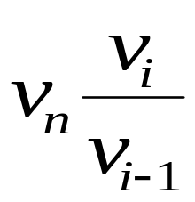
Historical Simulation continued
Suppose we use n days of historical data with today being day n
Let v_{i} be the value of a variable on day i
There are n-1 simulation trials
The ith trial assumes that the value of the market variable tomorrow (i.e., on day n+1) is
Risk Management and Financial Institutions 4e, Chapter 13, Copyright © John C. Hull 2015

Slide 4
Example: Portfolio on Sept 25, 2008 (Table 13.1, page 278)
Index | Amount Invested ($000s)
DJIA | 4,000
FTSE 100 | 3,000
CAC 40 | 1,000
Nikkei 225 | 2,000
Total | 10,000
Risk Management and Financial Institutions 4e, Chapter 13, Copyright © John C. Hull 2015

Slide 5
U.S. Dollar Equivalent of Stock Indices (Table 13.2, page 279)
Day | Date | DJIA | FTSE | CAC 40 | Nikkei
0 | Aug 7, 2006 | 11,219.38 | 11,131.84 | 6,373.89 | 131.77
1 | Aug 8, 2006 | 11,173.59 | 11,096.28 | 6,378.16 | 134.38
2 | Aug 9, 2006 | 11,076.18 | 11,185.35 | 6,474.04 | 135.94
3 | Aug 10, 2006 | 11,124.37 | 11,016.71 | 6,357.49 | 135.44
…. | …… | …… | ….. | …… | ……
499 | Sep 24, 2008 | 10,825.17 | 9,438.58 | 6,033.93 | 114.26
500 | Sep 25, 2008 | 11,022.06 | 9,599.90 | 6,200.40 | 112.82
Risk Management and Financial Institutions 4e, Chapter 13, Copyright © John C. Hull 2015

Slide 6
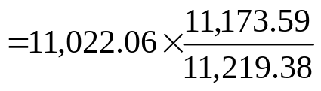
Scenarios (Table 13.3, page 279)
Scenario Number | DJIA | FTSE | CAC | Nikkei | Portfolio Value | Loss
1 | 10,977.08 | 9,569.23 | 6,204.55 | 115.05 | 10,014.334 | -14.334
2 | 10,925.97 | 9,676.96 | 6,293.60 | 114.13 | 10,027.481 | -27,481
3 | 11,070.01 | 9,455.16 | 6,088.77 | 112.40 | 9,946.736 | 53,264
…. | …… | ….. | ….. | ….. | ….. | …..
499 | 10,831.43 | 9,383.49 | 6,051.94 | 113.85 | 9,857.465 | 142.535
500 | 11,222.53 | 9,763.97 | 6,371.45 | 111.40 | 10,126.439 | -126.439
Risk Management and Financial Institutions 4e, Chapter 13, Copyright © John C. Hull 2015

Slide 7
Losses (Table 13.4, page 281)
Scenario Number | Loss ($000s)
494 | 477.841
339 | 345.435
349 | 282.204
329 | 277.041
487 | 253.385
227 | 217.974
131 | 205.256
One-day 99% VaR=$253,385
One-day 99% ES is (477,841+345,435+282,204+277,041+253,385)/5=$327,181
Risk Management and Financial Institutions 4e, Chapter 13, Copyright © John C. Hull 2015

Slide 8
Stressed VaR and Stressed ES
Instead of basing calculations on the movements in market variables over the last n days, we can base calculations on movements during a period in the past that would have been particularly bad for the current portfolio
This produces measures known as “stressed VaR” and “stressed ES”
Risk Management and Financial Institutions 4e, Chapter 13, Copyright © John C. Hull 2015

Slide 9
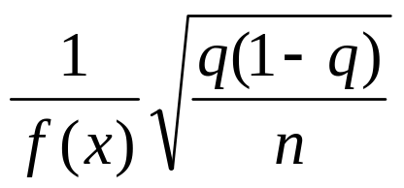
Accuracy of VaR (page 282)
Suppose that x is the qth quantile of the loss distribution when it is estimated from n observations. The standard error of x is
where f(x) is an estimate of the probability density of the loss at the qth quantile calculated by assuming a probability distribution for the loss
Risk Management and Financial Institutions 4e, Chapter 13, Copyright © John C. Hull 2015

Slide 10
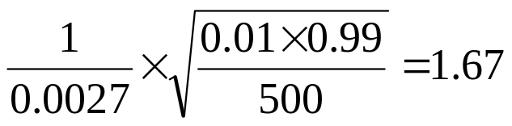
Example 13.1 (page 283)
We estimate the 0.01-quantile from 500 observations as $25 million
We estimate f(x) by approximating the actual empirical distribution with a normal distribution mean zero and standard deviation $10 million
The 0.01 quantile of the approximating distribution is NORMINV(0.01,0,10) = 23.26 and the value of f(x) is NORMDIST(23.26,0,10,FALSE)=0.0027
The estimate of the standard error is therefore
Risk Management and Financial Institutions 4e, Chapter 13, Copyright © John C. Hull 2015

Slide 11
Weighting of Observations
Let weights assigned to observations decline exponentially as we go back in time
Rank observations from worst to best
Starting at worst observation sum weights until the required quantile is reached
Risk Management and Financial Institutions 4e, Chapter 13, Copyright © John C. Hull 2015

Slide 12
Application to 4-Index Portfolio λ=0.995 (Table 13.5, page 285)
Scenario Number | Loss ($000s) | Weight | Cumulative Weight
494 | 477.841 | 0.00528 | 0.00528
339 | 345.435 | 0.00243 | 0.00771
349 | 282.204 | 0.00255 | 0.01027
329 | 277.041 | 0.00231 | 0.01258
487 | 253.385 | 0.00510 | 0.01768
227 | 217.974 | 0.00139 | 0.01906
One-day 99% VaR=$282,204
One day 99% ES is
[0.00528×477,841+0.00243×345,435+(0.01−0.00528 − 0.00243)×282,204]/0.01 = $400,914
Risk Management and Financial Institutions 4e, Chapter 13, Copyright © John C. Hull 2015

Slide 13
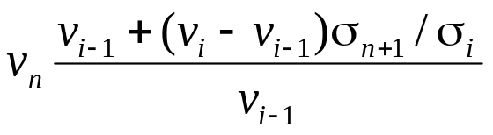
Volatility Updating
Use a volatility updating scheme to monitor volatilities of all market variables
If the current volatility for a market variable is β times the volatility on Day i, multiply the percentage change observed on day i by β
Value of market variable under ith scenario becomes
Risk Management and Financial Institutions 4e, Chapter 13, Copyright © John C. Hull 2015

Slide 14
Volatilities (% per Day) Estimated for Next Day in 4-Index Example (Table 13.6, page 286)
Day | Date | DJIA | FTSE | CAC 40 | Nikkei
0 | Aug 7, 2006 | 1.11 | 1.42 | 1.40 | 1.38
1 | Aug 8, 2006 | 1.08 | 1.38 | 1.36 | 1.43
2 | Aug 9, 2006 | 1.07 | 1.35 | 1.36 | 1.41
3 | Aug 10, 2006 | 1.04 | 1.36 | 1.39 | 1.37
…. | …… | …… | …… | …… | ……
499 | Sep 24, 2008 | 2.21 | 3.28 | 3.11 | 1.61
500 | Sep 25, 2008 | 2.19 | 3.21 | 3.09 | 1.59
Risk Management and Financial Institutions 4e, Chapter 13, Copyright © John C. Hull 2015

Slide 15
Volatility Adjusted Losses (Table 13.7, page 287)
Scenario Number | Loss ($000s)
131 | 1,082.969
494 | 715.512
227 | 687.720
98 | 661.221
329 | 602.968
339 | 546.540
74 | 492.764
One-day 99% VaR = $602,968
One-day 99% ES = (1,082,969+715,512+687,720+661,221+602,968)/5 = $750,078
Risk Management and Financial Institutions 4e, Chapter 13, Copyright © John C. Hull 2015

Slide 16
A Simpler Approach
Monitor variance of simulated losses on the portfolio using EWMA
If current standard deviation of losses is β_{P} times the standard deviation of simulated losses on Day i, multiply ith loss given by the standard approach by β_{P}
This approach gives VaR and ES as $627,916 and $747,619, respectively
Risk Management and Financial Institutions 4e, Chapter 13, Copyright © John C. Hull 2015

Slide 17
The Bootstrap Method to Determine Confidence Intervals
Suppose there are 500 daily changes
Calculate a 95% confidence interval for VaR by sampling 500,000 times with replacement from daily changes to obtain 1000 sets of changes over 500 days
Calcuate VaR for each set and calculate a confidence interval
This is known as the bootstrap method
Risk Management and Financial Institutions 4e, Chapter 13, Copyright © John C. Hull 2015

Slide 18
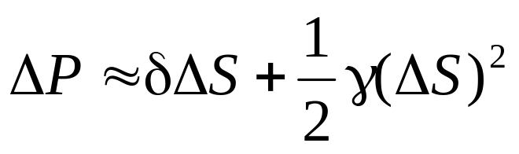
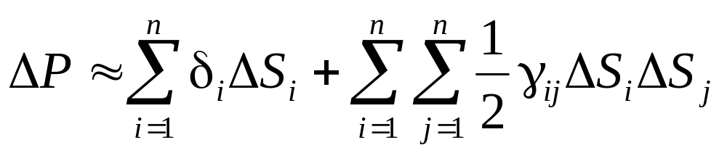
Computational Issues
To avoid revaluing a complete portfolio many times a delta/gamma approximation is sometimes used
When a derivative depend on only one underlying variable, S
With many variables
Risk Management and Financial Institutions 4e, Chapter 13, Copyright © John C. Hull 2015

Slide 19
Extreme Value Theory (page 289-295)
Extreme value theory can be used to investigate the properties of the right tail of the empirical distribution of a variable x. (If we interested in the left tail we consider the variable –x.)
We first choose a level u somewhat in the right tail of the distribution
We then use Gnedenko’s result which shows that for a wide class of distributions as u increases the probability distribution that v lies between u and u+y conditional that it is greater than u tends to a generalized Pareto distribution
Risk Management and Financial Institutions 4e, Chapter 13, Copyright © John C. Hull 2015

Slide 20
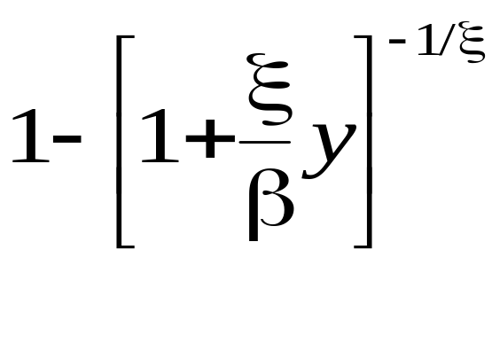
Generalized Pareto Distribution
This has two parameters ξ (the shape parameter) and β (the scale parameter)
The cumulative distribution is
Risk Management and Financial Institutions 4e, Chapter 13, Copyright © John C. Hull 2015

Slide 21
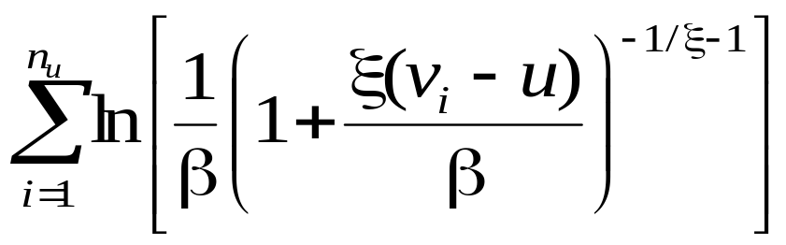
Maximum Likelihood Estimator (Equation 13.7, page 291)
The observations, x_{i}, are sorted in descending order. Suppose that there are n_{u} observations greater than u
We choose ξ and β to maximize
Risk Management and Financial Institutions 4e, Chapter 13, Copyright © John C. Hull 2015

Slide 22
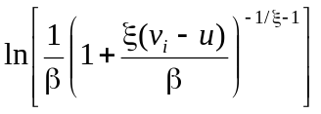
Using Maximum Likelihood for 4-Index Example, u=160 (Table 13.10, page 293)
Scenario | Loss ($000s) | Rank
494 | 477.841 | 1 | -8.97
339 | 345.435 | 2 | -7.47
349 | 282.204 | 3 | -6.51
329 | 277.041 | 4 | -6.42
487 | 253.385 | 5 | -5.99
304 | 160.778 | 22 | -3.71
Total |  |  | -108.37
Risk Management and Financial Institutions 4e, Chapter 13, Copyright © John C. Hull 2015

Slide 23
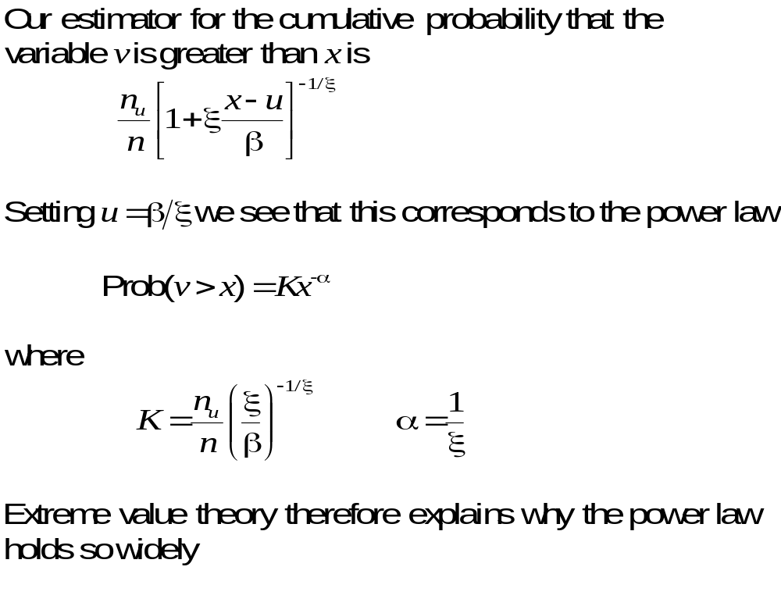
Tail Probabilities
Risk Management and Financial Institutions 4e, Chapter 13, Copyright © John C. Hull 2015

Slide 24
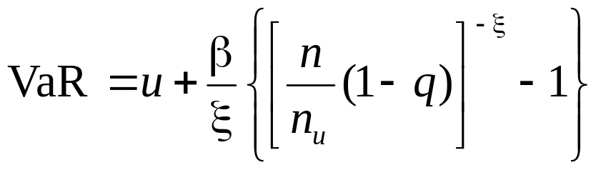
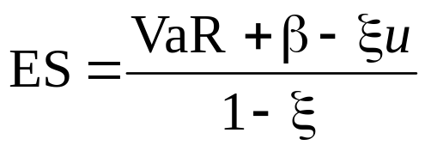
Estimating VaR and ES Using Extreme Value Theory (page 292)
Setting the probability that v>x equal to 1−q we obtain an estimate of VaR with a confidence level of q
Also
Risk Management and Financial Institutions 4e, Chapter 13, Copyright © John C. Hull 2015

