Slide 1
Model-Building
Approach
Chapter 14
Risk Management and Financial Institutions 4e, Chapter 14, Copyright © John C. Hull 2015

Slide 2
The Model-Building Approach
The main alternative to historical simulation is to make assumptions about the probability distributions of the returns on the market variables
This is known as the model building approach (or sometimes the variance-covariance approach)
Risk Management and Financial Institutions 4e, Chapter 14, Copyright © John C. Hull 2015

Slide 3
Microsoft Example (page 299-302)
We have a position worth $10 million in Microsoft shares
The volatility of Microsoft is 2% per day (about 32% per year)
We use N=10 and X=99
Risk Management and Financial Institutions 4e, Chapter 14, Copyright © John C. Hull 2015

Slide 4
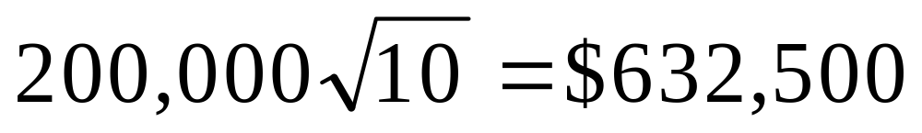
Microsoft Example continued
The standard deviation of the change in the portfolio in 1 day is $200,000
The standard deviation of the change in 10 days is
Risk Management and Financial Institutions 4e, Chapter 14, Copyright © John C. Hull 2015

Slide 5
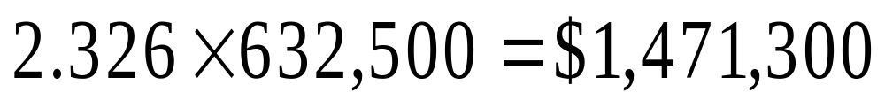
Microsoft Example continued
We assume that the expected change in the value of the portfolio is zero (This is OK for short time periods)
We assume that the change in the value of the portfolio is normally distributed
Since N(–2.326)=0.01, the VaR is
Risk Management and Financial Institutions 4e, Chapter 14, Copyright © John C. Hull 2015

Slide 6
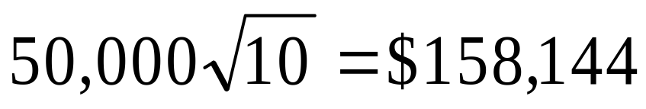
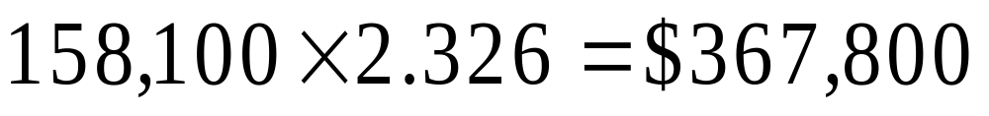
AT&T Example
Consider a position of $5 million in AT&T
The daily volatility of AT&T is 1% (approx 16% per year)
The SD per 10 days is
The VaR is
Risk Management and Financial Institutions 4e, Chapter 14, Copyright © John C. Hull 2015

Slide 7
Portfolio (page 301)
Now consider a portfolio consisting of both Microsoft and AT&T
Suppose that the correlation between the returns is 0.3
Risk Management and Financial Institutions 4e, Chapter 14, Copyright © John C. Hull 2015

Slide 8
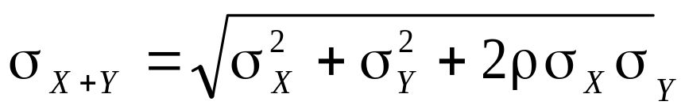
S.D. of Portfolio
A standard result in statistics states that
In this case σ_{X} = 200,000 and σ_{Y} = 50,000 and ρ = 0.3. The standard deviation of the change in the portfolio value in one day is therefore 220,200
Risk Management and Financial Institutions 4e, Chapter 14, Copyright © John C. Hull 2015

Slide 9
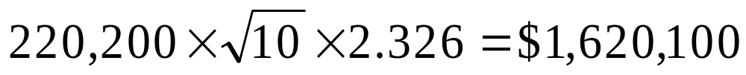
VaR for Portfolio
The 10-day 99% VaR for the portfolio is
The benefits of diversification are
(1,471,300+367,800)–1,620,100=$219,000
What is the incremental effect of the AT&T holding on VaR?
Risk Management and Financial Institutions 4e, Chapter 14, Copyright © John C. Hull 2015

Slide 10
ES Results (10-day 99%)
Microsoft shares: $1,687,000
AT&T shares: $421,700
Portfolio: $1,857,600
Risk Management and Financial Institutions 4e, Chapter 14, Copyright © John C. Hull 2015

Slide 11
The Linear Model
We assume
The daily change in the value of a portfolio is linearly related to the daily returns from market variables
The returns from the market variables are normally distributed
Risk Management and Financial Institutions 4e, Chapter 14, Copyright © John C. Hull 2015

Slide 12
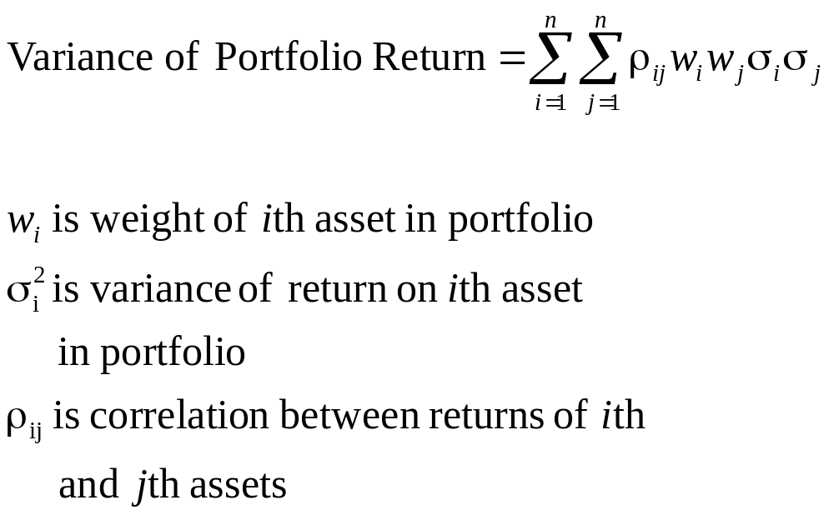
Markowitz Result for Variance of Return on Portfolio
Risk Management and Financial Institutions 4e, Chapter 14, Copyright © John C. Hull 2015

Slide 13
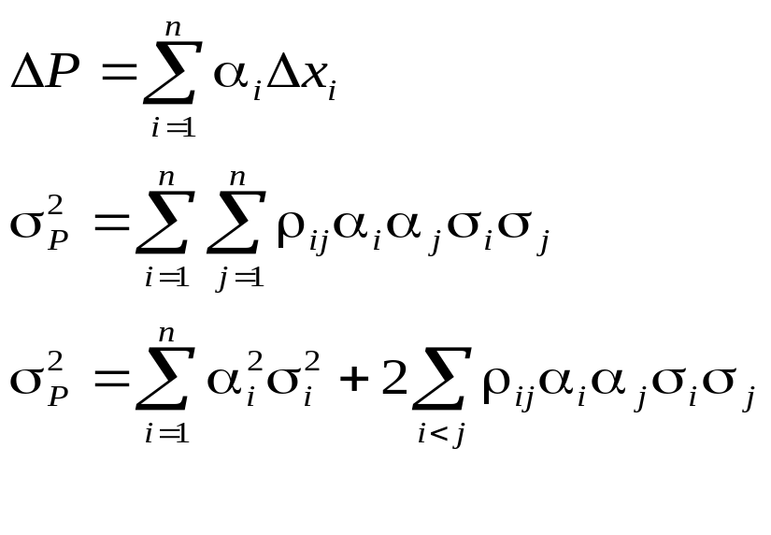
Corresponding Result for Variance of Portfolio Value
σ_{i} is the daily volatility of the ith asset (i.e., SD of daily returns)
σ_{P} is the SD of the change in the portfolio value per day
α_{i} =w_{i} P is amount invested in ith asset
Risk Management and Financial Institutions 4e, Chapter 14, Copyright © John C. Hull 2015

Slide 14
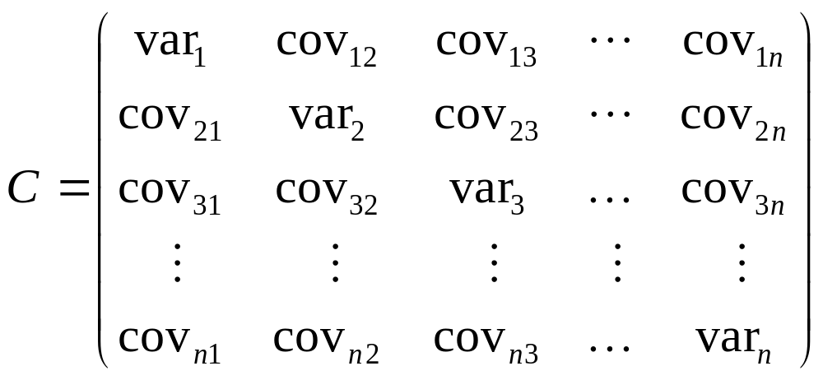
Covariance Matrix (var_{i} = cov_{ii})
(page 304)
Risk Management and Financial Institutions 4e, Chapter 14, Copyright © John C. Hull 2015

Slide 15
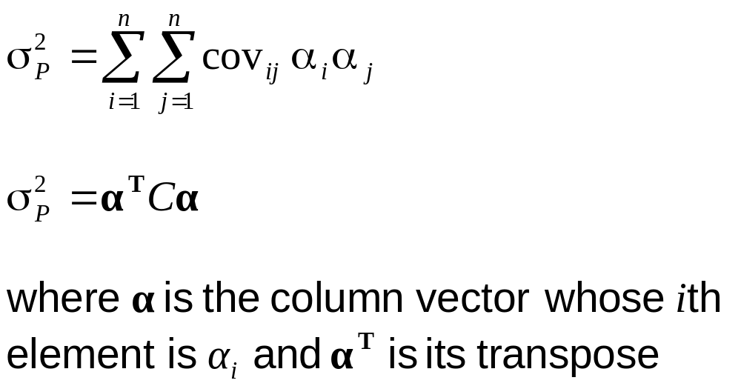
Alternative Expressions for σ_{P}² page 304
Risk Management and Financial Institutions 4e, Chapter 14, Copyright © John C. Hull 2015

Slide 16
Four Index Example Using Last 500 Days of Data to Estimate Covariances
 | Equal Weight | EWMA : λ=0.94
One-day 99% VaR | $217,757 | $471,025
One-day 99% ES | $249,476 | $539,637
Risk Management and Financial Institutions 4e, Chapter 14, Copyright © John C. Hull 2015

Slide 17
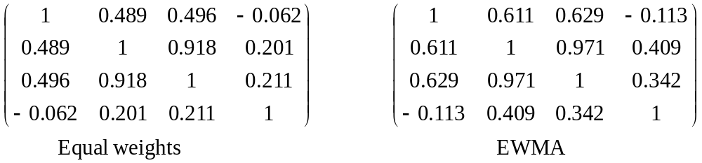
Volatilities and Correlations Increased in Sept 2008
Volatilities (% per day)
 | DJIA | FTSE | CAC | Nikkei
Equal Weights | 1.11 | 1.42 | 1.40 | 1.38
EWMA | 2.19 | 3.21 | 3.09 | 1.59
Correlations
Risk Management and Financial Institutions 4e, Chapter 14, Copyright © John C. Hull 2015

Slide 18
Alternatives for Handling Interest Rates
Duration approach: Linear relation between ΔP and Δy but assumes parallel shifts)
Cash flow mapping: Variables are zero-coupon bond prices with about 10 different maturities
Principal components analysis: 2 or 3 independent shifts with their own volatilities
Risk Management and Financial Institutions 4e, Chapter 14, Copyright © John C. Hull 2015

Slide 19
Handling Interest Rates: Cash Flow Mapping (page 307-309)
We choose as market variables zero-coupon bond prices with standard maturities (1mm, 3mm, 6mm, 1yr, 2yr, 5yr, 7yr, 10yr, 30yr)
Suppose that the 5yr rate is 6% and the 7yr rate is 7% and we will receive a cash flow of $10,000 in 6.5 years.
The volatilities per day of the 5yr and 7yr bonds are 0.50% and 0.58% respectively
Risk Management and Financial Institutions 4e, Chapter 14, Copyright © John C. Hull 2015

Slide 20
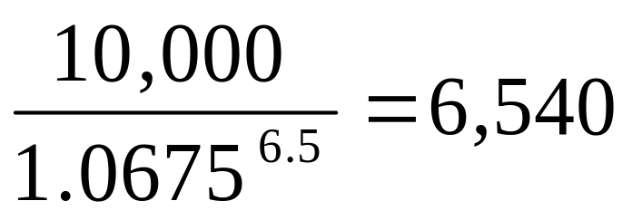
Example continued
We interpolate between the 5yr rate of 6% and the 7yr rate of 7% to get a 6.5yr rate of 6.75%
The PV of the $10,000 cash flow is
Risk Management and Financial Institutions 4e, Chapter 14, Copyright © John C. Hull 2015

Slide 21
Example continued
We interpolate between the 0.5% volatility for the 5yr bond price and the 0.58% volatility for the 7yr bond price to get 0.56% as the volatility for the 6.5yr bond
We allocate α of the PV to the 5yr bond and (1- α) of the PV to the 7yr bond
Risk Management and Financial Institutions 4e, Chapter 14, Copyright © John C. Hull 2015

Slide 22
Example continued
Suppose that the correlation between movement in the 5yr and 7yr bond prices is 0.6
To match variances
This gives α=0.074
Risk Management and Financial Institutions 4e, Chapter 14, Copyright © John C. Hull 2015

Slide 23
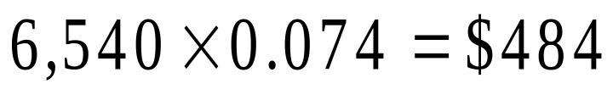
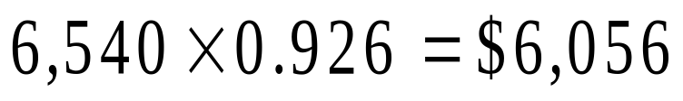
Example continued
The value of 6,540 received in 6.5 years
in 5 years and by
in 7 years.
This cash flow mapping preserves value and variance
Risk Management and Financial Institutions 4e, Chapter 14, Copyright © John C. Hull 2015

Slide 24
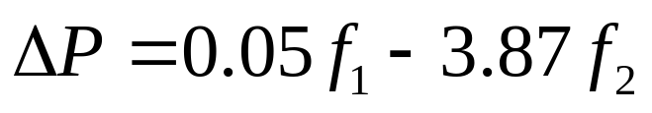
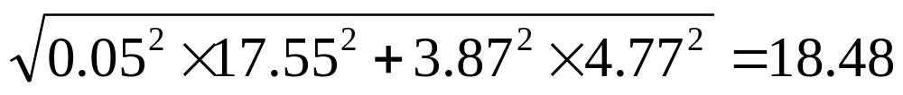
Using a PCA to Calculate VaR (page 309-310)
Suppose we calculate
where f₁ is the first factor and f₂ is the second factor
If the SD of the factor scores are 17.55 and 4.77 the SD of ΔP is
Risk Management and Financial Institutions 4e, Chapter 14, Copyright © John C. Hull 2015

Slide 25
When Linear Model Can be Used
Portfolio of stocks
Portfolio of bonds
Forward contract on foreign currency
Interest-rate swap
Risk Management and Financial Institutions 4e, Chapter 14, Copyright © John C. Hull 2015

Slide 26
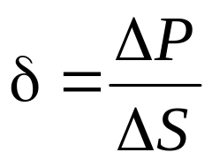
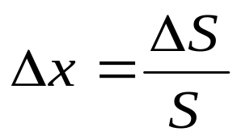
The Linear Model and Options
Consider a portfolio of options dependent on a single stock price, S. Define
and
Risk Management and Financial Institutions 4e, Chapter 14, Copyright © John C. Hull 2015

Slide 27
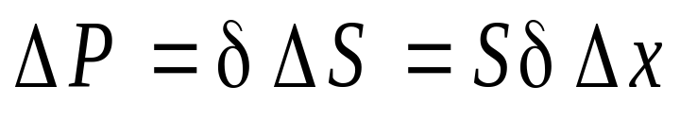
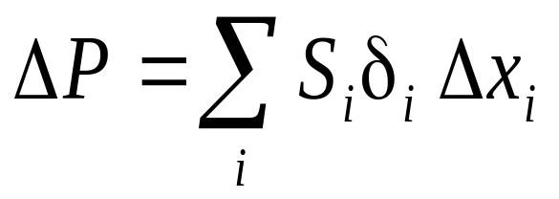
Linear Model and Options continued
As an approximation
Similarly when there are many underlying market variables
where δ_{i} is the delta of the portfolio with respect to the ith asset
Risk Management and Financial Institutions 4e, Chapter 14, Copyright © John C. Hull 2015

Slide 28
Example
Consider an investment in options on Microsoft and AT&T. Suppose the stock prices are 120 and 30 respectively and the deltas of the portfolio with respect to the two stock prices are 1,000 and 20,000 respectively
As an approximation
where Δx₁ and Δx₂ are the percentage changes in the two stock prices
Risk Management and Financial Institutions 4e, Chapter 14, Copyright © John C. Hull 2015

Slide 29
But the Distribution of the Daily Return on an Option is not Normal
The linear model fails to capture skewness in the probability distribution of the portfolio value.
Risk Management and Financial Institutions 4e, Chapter 14, Copyright © John C. Hull 2015

Slide 30
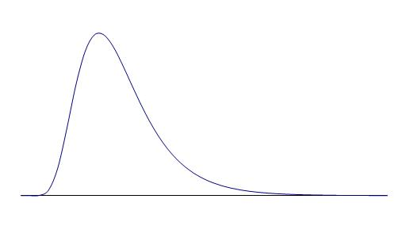
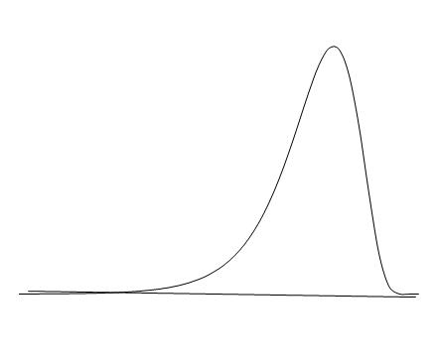
Impact of Gamma
(See Figure 14.1, page 313)
Positive Gamma
Negative Gamma
Risk Management and Financial Institutions 4e, Chapter 14, Copyright © John C. Hull 2015

Slide 31
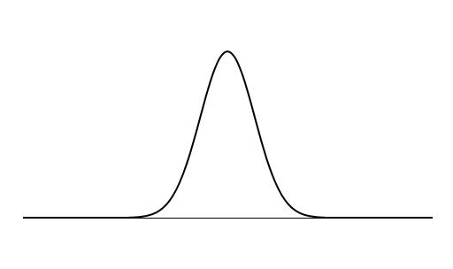
Translation of Asset Price Change to Price Change for Long Call (Figure 14.2, page 313)
Long Call
Asset Price
Risk Management and Financial Institutions 4e, Chapter 14, Copyright © John C. Hull 2015

Slide 32
Translation of Asset Price Change to Price Change for Short Call (Figure 14.3, page 314)
Asset Price
Short Call
Risk Management and Financial Institutions 4e, Chapter 14, Copyright © John C. Hull 2015

Slide 33
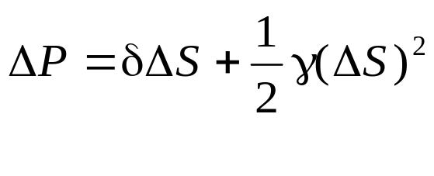
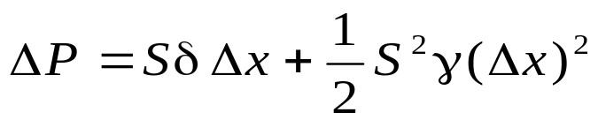
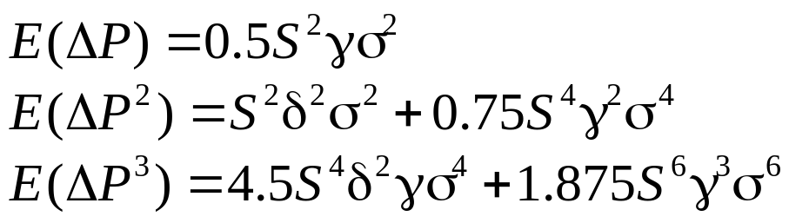
Quadratic Model
(page 314-316)
For a portfolio dependent on a single asset price it is approximately true that
so that
Moments are
Risk Management and Financial Institutions 4e, Chapter 14, Copyright © John C. Hull 2015

Slide 34
Quadratic Model continued
When there are a small number of underlying market variable moments can be calculated analytically from the delta/gamma approximation
The Cornish –Fisher expansion can then be used to convert moments to fractiles
However when the number of market variables becomes large this is no longer feasible
Risk Management and Financial Institutions 4e, Chapter 14, Copyright © John C. Hull 2015

Slide 35
Monte Carlo Simulation (page 316-317)
To calculate VaR using MC simulation we
Value portfolio today
Sample once from the multivariate distributions of the Δx_{i}
Use the Δx_{i} to determine market variables at end of one day
Revalue the portfolio at the end of day
Risk Management and Financial Institutions 4e, Chapter 14, Copyright © John C. Hull 2015

Slide 36
Monte Carlo Simulation continued
Calculate ΔP
Repeat many times to build up a probability distribution for ΔP
VaR is the appropriate fractile of the distribution times square root of N
For example, with 1,000 trial the 1 percentile is the 10th worst case.
Risk Management and Financial Institutions 4e, Chapter 14, Copyright © John C. Hull 2015

Slide 37
Speeding up Calculations with the Partial Simulation Approach
Use the approximate delta/gamma relationship between ΔP and the Δx_{i} to calculate the change in value of the portfolio (as in historical simulation)
Risk Management and Financial Institutions 4e, Chapter 14, Copyright © John C. Hull 2015

Slide 38
Alternative to Normal Distribution Assumption in Monte Carlo
In a Monte Carlo simulation we can assume non-normal distributions for the x_{i} (e.g., a multivariate t-distribution)
Can also use a Gaussian or other copula model in conjunction with empirical distributions
Risk Management and Financial Institutions 4e, Chapter 14, Copyright © John C. Hull 2015

Slide 39
Model Building vs Historical Simulation
Model building approach can be used for investment portfolios where there are no derivatives, but it does not usually work when for portfolios where
    There are derivatives
    Positions are close to delta neutral
Risk Management and Financial Institutions 4e, Chapter 14, Copyright © John C. Hull 2015

