Slide 1
Basel II.5, Basel III, and Other Post-Crisis Changes
Chapter 16
Risk Management and Financial Institutions 4e, Chapter 16, Copyright © John C. Hull 2015

Slide 2
Basel II.5 (Implemented Dec 31, 2011)
Stressed VaR for market risk
  Calculated over one year period of stressed market conditions
  Capital = max(VaR_{t-1},m_{c} × VaR_{avg})
  +max(sVaR_{t-1}, m_{s} × sVaR_{avg})
Incremental Risk Charge
  Ensures that products such as bonds and credit derivatives in the trading book have the same capital requirement that they would if they were in the banking book
Risk Management and Financial Institutions 4e, Chapter 16, Copyright © John C. Hull 2015

Slide 3
Basel II.5 continued
Comprehensive Risk Measure
  Designed to make sure sufficient capital is kept for instruments in the trading book that depend on on credit default correlations
  Standard approach:
Credit Rating | AAA or AA | A | BBB | BB | Below BB
Securitizations | 1.6% | 4% | 8% | 28% | Deduction
Resecuritizations | 3.2% | 8% | 18% | 52% | Deduction
Risk Management and Financial Institutions 4e, Chapter 16, Copyright © John C. Hull 2015

Slide 4
Basel III
Capital Definition and Requirements
Capital Conservation Buffer
Countercyclical Buffer
Leverage Ratio
Liquidity Ratios
Capital for CVA Risk
Risk Management and Financial Institutions 4e, Chapter 16, Copyright © John C. Hull 2015

Slide 5
Capital Definition and Requirements
  Three types:
  Common equity Tier 1
  Additional Tier 1
  Tier 2
  Definitions tightened
  Limits
  Common equity > 4.5% of RWA
  Tier 1 > 6% of RWA
  Tier 1 plus Tier 2 > 8% of RWA
  Capital levels implemented
  Phased implementation of capital definition stretching to January 1, 2018
Risk Management and Financial Institutions 4e, Chapter 16, Copyright © John C. Hull 2015

Slide 6
Capital Conservation Buffer
Extra 2.5% of common equity required in normal times to absorb losses in periods of stress
If total common equity is less than 7% (=4.5%+2.5%) dividends are restricted
Phased in between January 1, 2016 and January 1, 2019
Risk Management and Financial Institutions 4e, Chapter 16, Copyright © John C. Hull 2015

Slide 7
Countercyclical Buffer
Extra equity capital to allow for cyclicality of bank earnings
Left to the discretion of national regulators
Can be as high as 2.5% of RWA
Dividends restricted when capital is below required level
Phased in between January 1, 2016 and January 1, 2019
Risk Management and Financial Institutions 4e, Chapter 16, Copyright © John C. Hull 2015

Slide 8
Leverage Ratio
Ratio of Tier 1 capital to total exposure (not risk weighted) must be greater than 3% (Higher in U.S. and UK)
Exposure includes all items on balance sheet, derivatives exposures (calculated as in Basel I), securities financing exposures, and some off-balance sheet items
To be introduced on January 1, 2018 after a transition period
Risk Management and Financial Institutions 4e, Chapter 16, Copyright © John C. Hull 2015

Slide 9
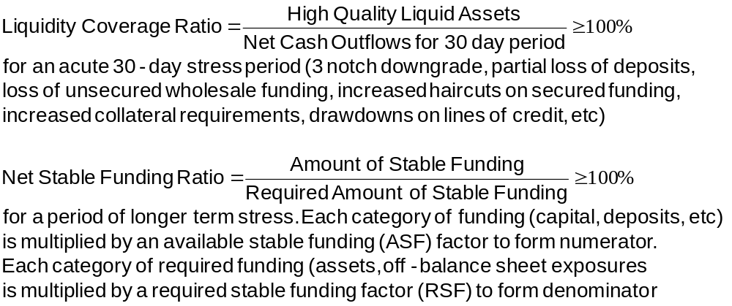
Liquidity Risk Ratios
The LCR and NSFR will be introduced on January 1, 2015 and January 1, 2018, respectively
Risk Management and Financial Institutions 4e, Chapter 16, Copyright © John C. Hull 2015

Slide 10
ASF Factors (Table 16.4, page 362)
ASF Factor | Category
100% | Tier 1 and Tier 2 capital Preferred stock and borrowing with a remaining maturity greater than 1 year
90% | Stable demand deposits and term deposits
80% | Les stable demand deposits and term deposits
50% | Wholesale demand deposits
0% | All other liability and equity categories
Risk Management and Financial Institutions 4e, Chapter 16, Copyright © John C. Hull 2015

Slide 11
RSF Factors (Table 16.5, page 362)
RSF Factor | Category
0% | Cash and short-term instruments (<1 yr)
5% | Claims on sovereign governments with a risk weight =0% (>1 yr)
20% | Corporate bonds rating AA or higher (>1 yr) Claims on sovereigns with risk weight =20%
50% | Gold, equities, and bond rated A
65% | Residential mortgages
85% | Loans to retail and small business (<1 year)
100% | All other assets
Risk Management and Financial Institutions 4e, Chapter 16, Copyright © John C. Hull 2015

Slide 12
Capital for CVA Risk
CVA is the adjustment to the value of transactions with a counterparty to allow for the possibility of a counterparty default
Basel III requires market risk capital for CVA risk arising from changing credit spreads
Risk Management and Financial Institutions 4e, Chapter 16, Copyright © John C. Hull 2015

Slide 13
G-SIBs
G-SIBs are Global Systemically Important Banks
These are required to hold extra Tier 1 equity capital between 1% and 3.5% of risk-weighted assets
For banks in the 2.5% category (JPMorgan and HSBC in Nov 2014 list) Tier 1 equity capital is the basic 4.5% plus the 2.5% capital conservation buffer plus 2.5% for being G-SIBs. This totals 9.5% of RWAs. The total capital requirement (including additional Tier 1 and Tier 2 is 13%)
There are also proposals from the FSB and Basel Committee concerning the total loss absorbing capacity (TLAC) of G-SIBs. This concerns requirements for the total of equity, debt and eligible liabilities
Risk Management and Financial Institutions 4e, Chapter 16, Copyright © John C. Hull 2015

Slide 14
D-SIBs
D-SIBs are domestic systemically important banks.
These banks may be subject to additional capital, extra disclosure, and stress tests.
In the United States, banks with assets over $50 billion are classified as D-SIBs. (There were 22 in 2014)
Risk Management and Financial Institutions 4e, Chapter 16, Copyright © John C. Hull 2015

Slide 15
Contingent Convertible Bonds
Bonds which automatically get converted into equity if certain conditions are satisfied
In Credit Suisse issue (See Business Snapshot 16.1) there is conversion if
  Tier 1 equity falls below 7% of RWA, or
  Swiss regulator determines that the bank needs public sector support
Risk Management and Financial Institutions 4e, Chapter 16, Copyright © John C. Hull 2015

Slide 16
Dodd-Frank includes…
New bodies to monitor systemic risk (FSOC and OFR)
Volcker rule
Central clearing for OTC derivatives
Living wills
More capital for SIFIs
No use of external ratings
Oversight of rating agencies
Originators of asset backed securities must keep “skin in the game”
Separately capitalized affiliates for more risky business
All trades reported to a central agency
…
Risk Management and Financial Institutions 4e, Chapter 16, Copyright © John C. Hull 2015

Slide 17
Rules in Other Countries
UK: Committee under Sir John Vickers led to Financial Services (Banking Reform Act) in 2013
In European Union committee headed by Erkki Liikanen proposed new regulations in 2012.
Risk Management and Financial Institutions 4e, Chapter 16, Copyright © John C. Hull 2015

Slide 18
Key issues all regulators are attempting to address
Central clearing
Use of electronic platforms to trade
Restrict proprietary trading (or at least insulate it from other activities)
Living wills
Compensation (less restrictions in U.S.)
Risk Management and Financial Institutions 4e, Chapter 16, Copyright © John C. Hull 2015

