Slide 1
Fundamental Review of Trading Book
Chapter 17
Risk Management and Financial Institutions 4e, Chapter 17, Copyright © John C. Hull 2015

Slide 2
Use of Expected Shortfall
VaR with a 99% confidence level is being replaced by ES with a 97.5% confidence level
The two measures are almost exactly the same when applied to normal distributions but the second measure is higher for distributions with heavier tails than the normal distribution
Risk Management and Financial Institutions 4e, Chapter 17, Copyright © John C. Hull 2015

Slide 3
Stressed ES
ES is to be estimated using data from what would have been a stressed 250-day period for the bank’s current portfolio
Risk Management and Financial Institutions 4e, Chapter 17, Copyright © John C. Hull 2015

Slide 4
The Shocks to Market Variables
The 10-day time horizon used for VaR in Basel I and Basel II.5 is being replaced by a calculation where the time horizon used for a market variable in ES calculations depends on its liquidity
Time horizons of 10, 20, 60,120, and 250 days are proposed
Risk Management and Financial Institutions 4e, Chapter 17, Copyright © John C. Hull 2015

Slide 5
Examples
Variable | Shock
Equity price (large cap) | 10 days
Precious metal price | 20 days
Interest rate volatility (ATM) | 60 days
Equity price volatility (small cap) | 120 days
Credit spread (structured product) | 250 days
Copyright © John C. Hull 2015

Slide 6
Calculation of ES
Calculation is to be based on overlapping 10-day periods and five ES calculations:
  All variable changed (ES₁)
  All variable except those with a time horizon of 10 days are changed (ES₂)
  All variables except those with time horizons of 10 and 20 days are changed (ES₃)
  All variables except those with time horizons of 10 and 20, and 60 days are changed (ES₄)
  Only variables with a time horizon of 250 days are changed (ES₅)
Copyright © John C. Hull 2015

Slide 7
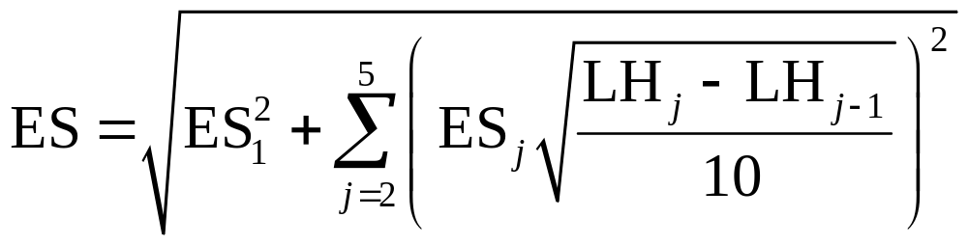
Calculation continued
where LH_{j} is the liquidity horizon in days for the jth category so that
LH₁=10, LH₂=20, LH₃=60, LH₄=120, and LH₅=250
Copyright © John C. Hull 2015

Slide 8
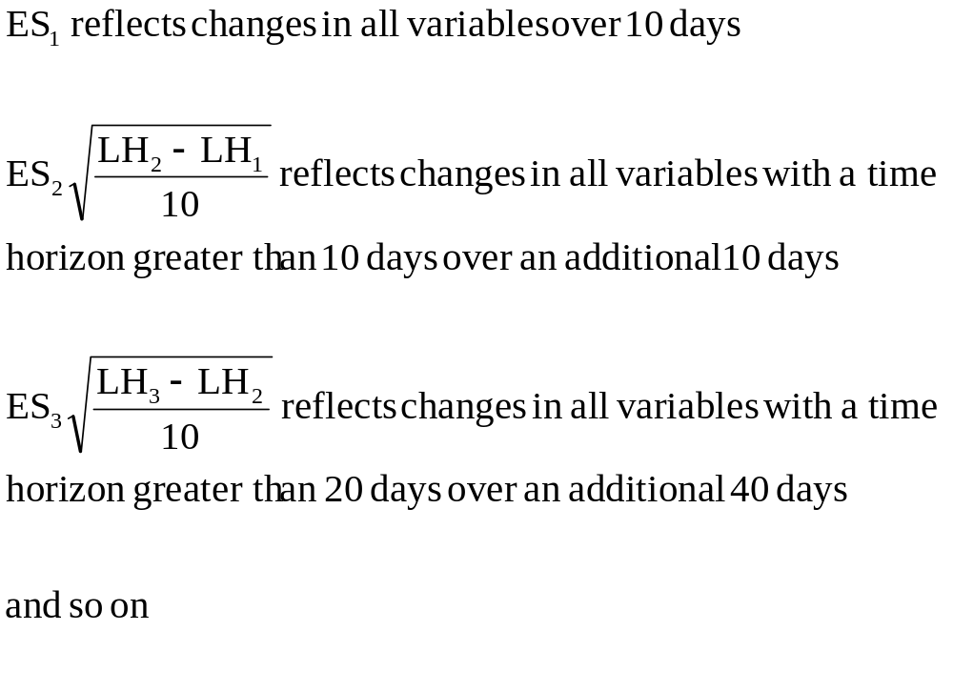
Components of the Final ES
Copyright © John C. Hull 2015

Slide 9
Aggregating Components
Assume that changes in one period are independent of change other period
An approximation to the total ES that we are interested is then obtained by taking the square root of the sum of the squares of the component ESs
Copyright © John C. Hull 2015

Slide 10
Other FRTB Details
Search for stressed periods can involve a subset of market variables providing these account for 75% of the current ES
Partial ESs must be calculated for risk categories. Capital under the internal models approach is a multiplier or the weighted average of a) the total ES and b) the sum of the partial ESs
Current one-day VaR (99% and 97.5% confidence levels) are backtested
Until models have been approved a revised standardized approach is to be used
Copyright © John C. Hull 2015

Slide 11
Trading Book vs. Banking Book
FRTB attempts to make the distinction between the trading book and the banking book clearer
It has rules covering the (very rare) situations when instruments can be moved from one book to another
Risk Management and Financial Institutions 4e, Chapter 17, Copyright © John C. Hull 2015

Slide 12
Credit Trades
The incremental risk charge is modified to recognize the distinction between
  Credit spread risk
  Jump to default risk
The first is handled as a market risk. The second is handled separately similarly to other credit risks (with a 1-year 99.9% VaR calculation)
Internal models not allowed for securitization products
Risk Management and Financial Institutions 4e, Chapter 17, Copyright © John C. Hull 2015

