Slide 1
Managing Credit Risk: Margin, OTC Markets, and CCPs
Chapter 18
Risk Management and Financial Institutions 4e, Chapter 18, Copyright © John C. Hull 2015

Slide 2
Margin and Exchange-Traded Products
Margin (i.e. collateral) is required from a trader when the trader could owe money at a future time
Balance in margin account calculated daily
If market moves against the trader, more margin (known as variation margin) may be required
Risk Management and Financial Institutions 4e, Chapter 18, Copyright © John C. Hull 2015

Slide 3
Examples: How does margin account work for….
Buying on margin,
Short selling
Futures contract for retail customer of broker
Futures contract for member of exchange clearing house
Options trader
Risk Management and Financial Institutions 4e, Chapter 18, Copyright © John C. Hull 2015

Slide 4
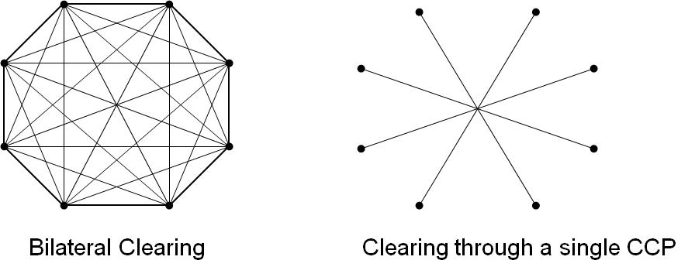
Clearing Arrangements for OTC Derivatives (Figure 18.1, page 388)
Bilateral clearing: usually governed by an ISDA Master agreement
Central clearing: a central counterparty (CCP) stands between the two sides
CCP
CCCCCP
Risk Management and Financial Institutions 4e, Chapter 18, Copyright © John C. Hull 2015

Slide 5
Regulations (page 389)
Standard OTC transactions between financial institutions must be cleared through a CCP (some exceptions for FX trades)
Nonstandard OTC transactions, some FX transactions, and transactions with end users can continue to be cleared bilaterally
Risk Management and Financial Institutions 4e, Chapter 18, Copyright © John C. Hull 2015

Slide 6
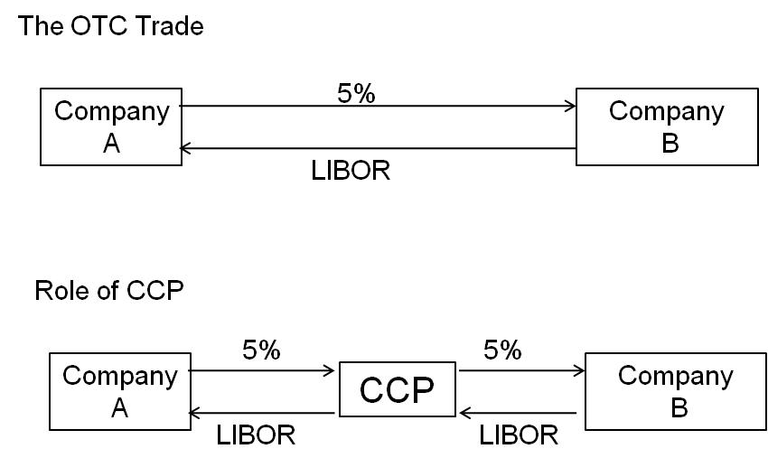
Central Clearing
Risk Management and Financial Institutions 4e, Chapter 18, Copyright © John C. Hull 2015

Slide 7
Central Clearing
Role of CCP is very similar to that of an exchange clearing house.
It stands between two sides
It requires initial margin and variation margin from its members reflecting all their transactions with CCP
The members may be clearing trades for other trading entities
Risk Management and Financial Institutions 4e, Chapter 18, Copyright © John C. Hull 2015

Slide 8
Funding of Losses when Positions Have to be Closed Out (CCP or Exchange Clearing House)
Initial margin of defaulting member
Default fund contributions of defaulting member
Default fund contributions of other members
Equity of CCP/Exchange Clearing House
Risk Management and Financial Institutions 4e, Chapter 18, Copyright © John C. Hull 2015

Slide 9
Bilateral Clearing
Usually governed by an ISDA Master agreement
This contains a credit support annex (CSA)
New rules being implemented between 2015 and 2019 require initial margin and variation margin for transactions between financial institutions
The initial margin must cover 10-day price moves with 99% confidence in stressed market conditions
Risk Management and Financial Institutions 4e, Chapter 18, Copyright © John C. Hull 2015

Slide 10
Bilateral Clearing: End Users
The CSA specifies
Threshold
Independent Amount
Minimum Transfer Amount Eligible Securities and Currencies
Haircuts
Two-sided vs. one-sided
Risk Management and Financial Institutions 4e, Chapter 18, Copyright © John C. Hull 2015

Slide 11
Netting (page 391)
Feature of both ISDA Master agreements and CCPs
All transactions are considered to be a single transaction…
  in the event of default
  for collateral calculations
Netting reduces initial margin requirements
Risk Management and Financial Institutions 4e, Chapter 18, Copyright © John C. Hull 2015

Slide 12
ISDAs and Defaults (page 392)
Settlement amount is mid market value of transactions adjusted for bid-offer spread incurred in replacing them
Non-defaulting party can keep any collateral posted by defaulting party up to the amount owed.
Risk Management and Financial Institutions 4e, Chapter 18, Copyright © John C. Hull 2015

Slide 13
Calculations
Define C as collateral posted by the defaulting party with the non-defaulting party (with negative values indicating that collateral is posted the other way)
Define V as the value after adjustments to the non-defaulting party
Exposure of non-defaulting party is max(V−C,0)
Payment by non-defaulting party is max(C−V,0)
Risk Management and Financial Institutions 4e, Chapter 18, Copyright © John C. Hull 2015

Slide 14
Collateral Increases (page 392-393)
Much more collateral will be needed to support derivatives trading
This collateral will usually have to be cash or government securities
This is liable to create liquidity pressures
Risk Management and Financial Institutions 4e, Chapter 18, Copyright © John C. Hull 2015

Slide 15
CCPs and Netting
CCPs should increase netting, because transactions with two different counterparties can be netted if both are cleared through the same CCP
But it will no longer be possible to net standard with nonstandard transactions
It is conceivable that benefits of netting could decrease….
Risk Management and Financial Institutions 4e, Chapter 18, Copyright © John C. Hull 2015

Slide 16
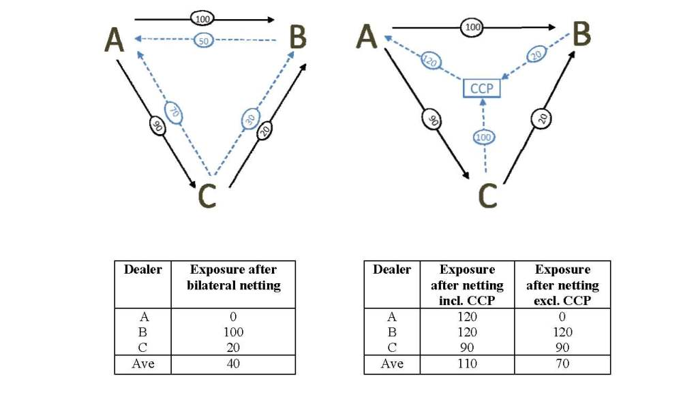
Simple Example: 3 market participants; 2 product types (Figure 18.3, page 393)
Risk Management and Financial Institutions 4e, Chapter 18, Copyright © John C. Hull 2015

Slide 17
Rehypothecation (Business Snapshot 18.1, page 395)
This involves using the collateral posted with you by one counterparty to satisfy the collateral demands of another party.
It will be restricted under the new rules
Risk Management and Financial Institutions 4e, Chapter 18, Copyright © John C. Hull 2015

Slide 18
SEFs and OTFs (page 395)
Whenever possible derivatives have to be traded on electronic platforms
This will create more price transparency
But it may erode the profits of derivatives dealers
Risk Management and Financial Institutions 4e, Chapter 18, Copyright © John C. Hull 2015

Slide 19
A Convergence…
OTC and exchange-traded derivatives markets are becoming more similar to each other as far as
  the way trading is done
  the way transactions are cleared
  The collateral (margin) that has to be posted
Risk Management and Financial Institutions 4e, Chapter 18, Copyright © John C. Hull 2015

Slide 20
CCPs and Too-Big-To Fail (page 396)
It can be argued that CCPs are the new TBTF financial institutions
However, CCPs are much easier to regulate than banks and so moving risks to CCPs may make the financial system safer
Risk Management and Financial Institutions 4e, Chapter 18, Copyright © John C. Hull 2015

