Slide 1
Estimating Default Probabilities
Chapter 19
Risk Management and Financial Institutions 4e, Chapter 19, Copyright © John C. Hull 2015

Slide 2
Altman’s Z-score (Manufacturing companies) page 400
X₁=Working Capital/Total Assets
X₂=Retained Earnings/Total Assets
X₃=EBIT/Total Assets
X₄=Market Value of Equity/Book Value of Liabilities
X₅=Sales/Total Assets
Z = 1.2X₁+1.4X₂+3.3X₃+0.6X₄+0.99X₅
If the Z > 3.0 default is unlikely; if 2.7 < Z < 3.0 we should be on alert. If 1.8 < Z < 2.7 there is a moderate chance of default; if Z < 1.8 there is a high chance of default
Risk Management and Financial Institutions 4e, Chapter 19, Copyright © John C. Hull 2015

Slide 3
Estimating Default Probabilities
Alternatives:
  Use historical data
  Use credit spreads
  Use Merton’s model
Risk Management and Financial Institutions 4e, Chapter 19, Copyright © John C. Hull 2015

Slide 4
Historical Data
Historical data provided by rating agencies can be used to estimate the probability of default
Risk Management and Financial Institutions 4e, Chapter 19, Copyright © John C. Hull 2015

Slide 5
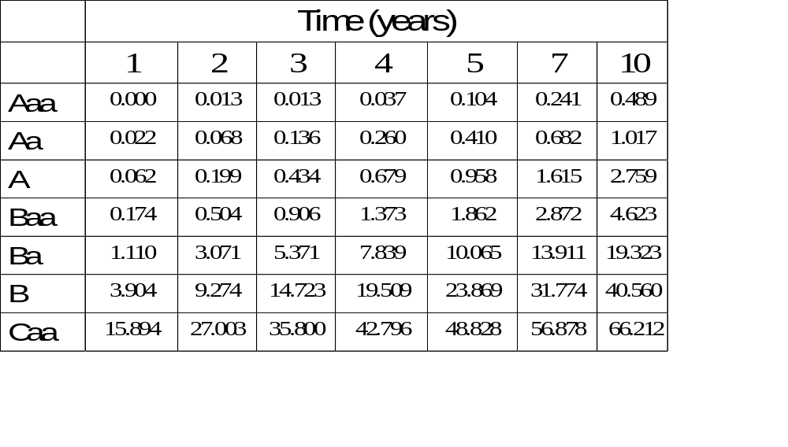
Cumulative Average Default Rates % (1970-2013, Moody’s) Table 19.1, page 402
Risk Management and Financial Institutions 4e, Chapter 19, Copyright © John C. Hull 2015

Slide 6
Interpretation
The table shows the probability of default for companies starting with a particular credit rating
A company with an initial credit rating of Baa has a probability of 0.174% of defaulting by the end of the first year, 0.504% by the end of the second year, and so on
Risk Management and Financial Institutions 4e, Chapter 19, Copyright © John C. Hull 2015

Slide 7
Do Default Probabilities Increase with Time?
For a company that starts with a good credit rating default probabilities tend to increase with time
For a company that starts with a poor credit rating default probabilities tend to decrease with time
Risk Management and Financial Institutions 4e, Chapter 19, Copyright © John C. Hull 2015

Slide 8
Hazard Rate vs. Unconditional Default Probability
The hazard rate or default intensity is the probability of default over a short period of time conditional on no earlier default
The unconditional default probability is the probability of default as seen at time zero
Risk Management and Financial Institutions 4e, Chapter 19, Copyright © John C. Hull 2015

Slide 9
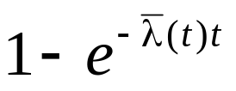
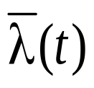
Properties of Hazard rates
Suppose that λ(t) is the hazard rate at time t
The probability of default between times t and t+Δt conditional on no earlier default is λ(t)Δt
The probability of default by time t is
where is the average hazard rate between time zero and time t
Risk Management and Financial Institutions 4e, Chapter 19, Copyright © John C. Hull 2015

Slide 10
Recovery Rate
The recovery rate for a bond is usually defined as the price of the bond 30 days after default as a percent of its face value
Risk Management and Financial Institutions 4e, Chapter 19, Copyright © John C. Hull 2015

Slide 11
Recovery Rates; Moody’s: 1982 to 2013
(Table 19.2, page 404)
Class | Ave Rec Rate (%)
Senior secured bond | 52.2
Senior unsecured bond | 37.2
Senior subordinated bond | 31.0
Subordinated bond | 31.4
Junior subordinated bond | 24.7
Risk Management and Financial Institutions 4e, Chapter 19, Copyright © John C. Hull 2015

Slide 12
Recovery Rates Depend on Default Rates
Moody’s best fit estimate for the 1982 to 2007 period is
Ave Recovery Rate =
59.33 − 3.06 × Spec Grade Default Rate
R² of regression is about 0.5
Risk Management and Financial Institutions 4e, Chapter 19, Copyright © John C. Hull 2015

Slide 13
Credit Default Swaps (pages 404-409)
Buyer of the instrument acquires protection from the seller against a default by a particular company or country (the reference entity)
Example: Buyer pays a premium of 90 bps per year for $100 million of 5-year protection against company X
Premium is known as the credit default spread. It is paid for life of contract or until default
If there is a default, the buyer has the right to sell bonds with a face value of $100 million issued by company X for $100 million (Several bonds may be deliverable)
Risk Management and Financial Institutions 4e, Chapter 19, Copyright © John C. Hull 2015

Slide 14
CDS Structure (Figure 19.1, page 406)
90 bps per year
Default
Protection
Buyer, A
Default
Protection
Seller, B
Payoff if there is a default by reference entity=100(1-R)
Recovery rate, R, is the ratio of the value of the bond issued by reference entity immediately after default to the face value of the bond
Risk Management and Financial Institutions 4e, Chapter 19, Copyright © John C. Hull 2015

Slide 15
Other Details
Payments are usually made quarterly in arrears
In the event of default there is a final accrual payment by the buyer
Increasingly settlement is in cash and an auction process determines cash amount
Suppose payments are made quarterly in the example just considered. What are the cash flows if there is a default after 3 years and 1 month and recovery rate is 40%?
Risk Management and Financial Institutions 4e, Chapter 19, Copyright © John C. Hull 2015

Slide 16
Attractions of the CDS Market
Allows credit risks to be traded in the same way as market risks
Can be used to transfer credit risks to a third party
Can be used to diversify credit risks
Risk Management and Financial Institutions 4e, Chapter 19, Copyright © John C. Hull 2015

Slide 17
Credit Indices (page 408)
CDX IG: equally weighted portfolio of 125 investment grade North American companies
iTraxx: equally weighted portfolio of 125 investment grade European companies
If the five-year CDS index is bid 165 offer 166 it means that a portfolio of 125 CDSs on the CDX companies can be bought for 166bps per company, e.g., $800,000 of 5-year protection on each name could be purchased for $1,660,000 per year. When a company defaults the annual payment is reduced by 1/125.
Risk Management and Financial Institutions 4e, Chapter 19, Copyright © John C. Hull 2015

Slide 18
Use of Fixed Coupons
Increasingly CDSs and CDS indices trade like bonds
A coupon and a recovery rate is specified
There is an initial payments from the buyer to the seller or vice versa reflecting the difference between the currently quoted spread and the coupon
Risk Management and Financial Institutions 4e, Chapter 19, Copyright © John C. Hull 2015

Slide 19
Credit Default Swaps and Bond Yields (page 409-410)
Portfolio consisting of a 5-year par yield corporate bond that provides a yield of 6% and a long position in a 5-year CDS costing 100 basis points per year is (approximately) a long position in a riskless instrument paying 5% per year
What are arbitrage opportunities in this situation is risk-free rate is 4.5%? What if it is 5.5%?
Risk Management and Financial Institutions 4e, Chapter 19, Copyright © John C. Hull 2015

Slide 20
Risk-free Rate
The risk-free rate used by bond traders when quoting credit spreads is the Treasury rate
The risk-free rate traditionally assumed in derivatives markets is the LIBOR/swap rate
By comparing CDS spreads and bond yields it appears that in normal market conditions traders are assuming a risk-free rate 10 bp less than the LIBOR/swap rates
In stressed market conditions the gap between the LIBOR/swap rate and the “true” risk-free rate is liable to be much higher
Risk Management and Financial Institutions 4e, Chapter 19, Copyright © John C. Hull 2015

Slide 21
Asset Swaps
Asset swaps are used by the market as an estimate of the bond yield relative to LIBOR
The present value of the asset swap spread is an estimate of the present value of the cost of default
Risk Management and Financial Institutions 4e, Chapter 19, Copyright © John C. Hull 2015

Slide 22
Asset Swaps (page 410-411)
Suppose asset swap spread for a particular corporate bond is 150 basis points
One side pays coupons on the bond; the other pays LIBOR+150 basis points. The coupons on the bond are paid regardless of whether there is a default
In addition there is an initial exchange of cash reflecting the difference between the bond price and $100
The PV of the asset swap spread is the amount by which the price of the corporate bond is exceeded by the price of a similar risk-free bond when the LIBOR/swap curve is used for discounting
Risk Management and Financial Institutions 4e, Chapter 19, Copyright © John C. Hull 2015

Slide 23
CDS-Bond Basis
This is the CDS spread minus the Bond Yield Spread
Bond yield spread is usually calculated as the asset swap spread
Tended to be positive pre-crisis
Risk Management and Financial Institutions 4e, Chapter 19, Copyright © John C. Hull 2015

Slide 24
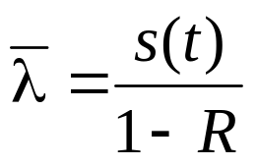
Using CDS Prices to Predict Default Probabilities
Average hazard rate between time zero and time t is to a good approximation
where s(t) is the credit spread calculated for a maturity of t and R is the recovery rate
Risk Management and Financial Institutions 4e, Chapter 19, Copyright © John C. Hull 2015

Slide 25
More Exact Calculation (page 413-414)
Suppose that a five year corporate bond pays a coupon of 6% per annum (semiannually). The yield is 7% with continuous compounding and the yield on a similar risk-free bond is 5% (with continuous compounding)
The expected loss from defaults is 8.75. This can be calculated as the difference between the market price of the bond and its risk-free price
Suppose that the unconditional probability of default is Q per year and that defaults always happen half way through a year (immediately before a coupon payment).
Risk Management and Financial Institutions 4e, Chapter 19, Copyright © John C. Hull 2015

Slide 26
Calculations
Time (yrs) | Def Prob | Recovery Amount | Risk-free Value | Loss | Discount Factor | PV of Exp Loss
0.5 | Q | 40 | 106.73 | 66.73 | 0.9753 | 65.08Q
1.5 | Q | 40 | 105.97 | 65.97 | 0.9277 | 61.20Q
2.5 | Q | 40 | 105.17 | 65.17 | 0.8825 | 57.52Q
3.5 | Q | 40 | 104.34 | 64.34 | 0.8395 | 54.01Q
4.5 | Q | 40 | 103.46 | 63.46 | 0.7985 | 50.67Q
Total |  |  |  |  |  | 288.48Q
Risk Management and Financial Institutions 4e, Chapter 19, Copyright © John C. Hull 2015

Slide 27
Calculations continued
We set 288.48Q = 8.75 to get Q = 3.03%
This analysis can be extended to allow defaults to take place more frequently
With several bonds we can use more parameters to describe the default probability distribution
Risk Management and Financial Institutions 4e, Chapter 19, Copyright © John C. Hull 2015

Slide 28
Real World vs Risk-Neutral Default Probabilities
The default probabilities backed out of bond prices or credit default swap spreads are risk-neutral default probabilities
The default probabilities backed out of historical data are real-world default probabilities
Risk Management and Financial Institutions 4e, Chapter 19, Copyright © John C. Hull 2015

Slide 29
A Comparison
Calculate 7-year hazard rates from the Moody’s data (1970-2013). These are real world default probabilities)
Use Merrill Lynch data (1996-2007) to estimate average 7-year default intensities from bond prices (these are risk-neutral default intensities)
Assume a risk-free rate equal to the 7-year swap rate minus 10 basis points
Risk Management and Financial Institutions 4e, Chapter 19, Copyright © John C. Hull 2015

Slide 30
The Data (Table 19.4, page 414)
Rating | Cumulative 7-year default probability(%): 1970-2013 | Average 7- year credit spread (bp): 1996-2007
Aaa | 0.241 | 35.74
Aa | 0.682 | 43.67
A | 1.615 | 68.68
Baa | 2.872 | 127.53
Ba | 13.911 | 280.28
B | 31.774 | 481.04
Caa | 56.878 | 1,103.70
Risk Management and Financial Institutions 4e, Chapter 19, Copyright © John C. Hull 2015

Slide 31
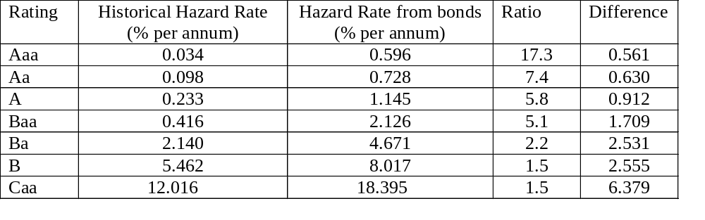
Real World vs Risk Neutral Default Probabilities , 7 year averages (Table 19.5, page 415)
Risk Management and Financial Institutions 4e, Chapter 19, Copyright © John C. Hull 2015

Slide 32
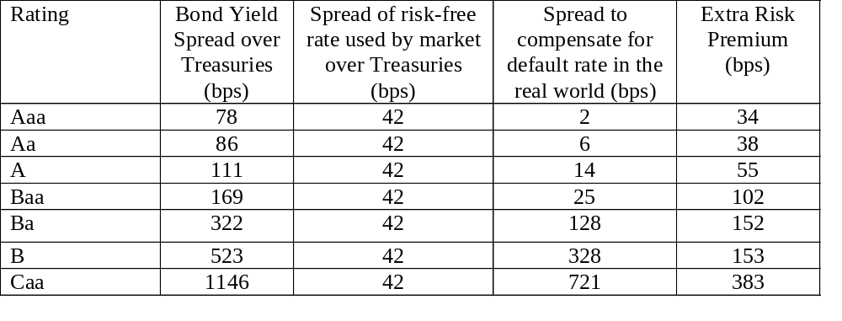
Risk Premiums Earned By Bond Traders (Table 19.6, page 416)
Risk Management and Financial Institutions 4e, Chapter 19, Copyright © John C. Hull 2015

Slide 33
Possible Reasons for These Results
(The third reason is the most important)
Corporate bonds are relatively illiquid
The subjective default probabilities of bond traders may be much higher than the estimates from Moody’s historical data
Bonds do not default independently of each other. This leads to systematic risk that cannot be diversified away.
Bond returns are highly skewed with limited upside. The non-systematic risk is difficult to diversify away and may be priced by the market
Risk Management and Financial Institutions 4e, Chapter 19, Copyright © John C. Hull 2015

Slide 34
Which World Should We Use?
We should use risk-neutral estimates for valuing credit derivatives and estimating the present value of the cost of default
We should use real world estimates for calculating credit VaR and scenario analysis
Risk Management and Financial Institutions 4e, Chapter 19, Copyright © John C. Hull 2015

Slide 35
Merton’s Model (Section 19.8, pages 419-422)
Merton’s model regards the equity as an option on the assets of the firm
In a simple situation the equity value is
max(V_{T} –D, 0)
where V_{T} is the value of the firm and D is the debt repayment required
Risk Management and Financial Institutions 4e, Chapter 19, Copyright © John C. Hull 2015

Slide 36
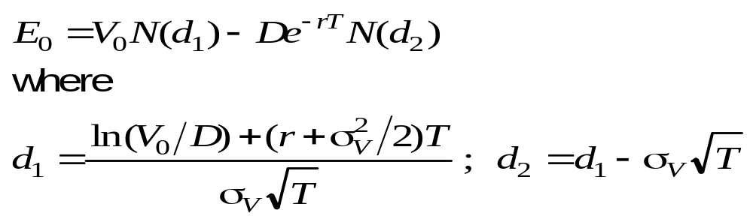
Equity vs. Assets
An option pricing model enables the value of the firm’s equity today, E₀, to be related to the value of its assets today, V₀, and the volatility of its assets, σ_{V}
Risk Management and Financial Institutions 4e, Chapter 19, Copyright © John C. Hull 2015

Slide 37
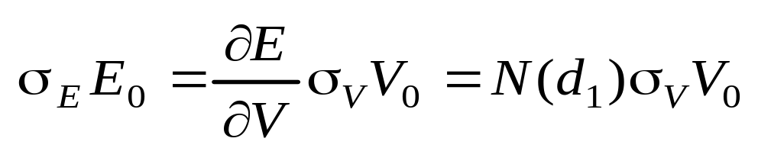
Volatilities
This equation together with the option pricing relationship enables V₀ and σ_{V} to be determined from E₀ and σ_{E}
Risk Management and Financial Institutions 4e, Chapter 19, Copyright © John C. Hull 2015

Slide 38
Example
A company’s equity is $3 million and the volatility of the equity is 80%
The risk-free rate is 5%, the debt is $10 million and time to debt maturity is 1 year
Solving the two equations yields V₀=12.40 and σ_{v}=21.23%
Risk Management and Financial Institutions 4e, Chapter 19, Copyright © John C. Hull 2015

Slide 39
Example continued
The probability of default is N(-d₂) or 12.7%
The market value of the debt is 9.40
The present value of the promised payment is 9.51
The expected loss is about 1.2%
The recovery rate is 91%
Risk Management and Financial Institutions 4e, Chapter 19, Copyright © John C. Hull 2015

Slide 40
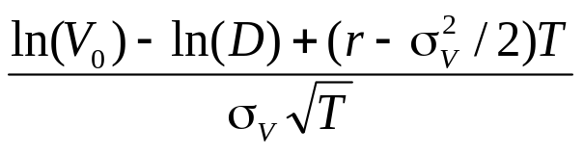
The Implementation of Merton’s Model to estimate real-world default probability (e.g. Moody’s KMV)
Choose time horizon
Calculate cumulative obligations to time horizon. We denote it by D
Use Merton’s model to calculate a theoretical probability of default
Use historical data to develop a one-to-one mapping of theoretical probability into real-world probability of default.
Assumption is that the rank ordering of probability of default given by the model is the same as that for real world probability of default
A distance to default measure is
Risk Management and Financial Institutions 4e, Chapter 19, Copyright © John C. Hull 2015

Slide 41
Risk-neutral vs. Real World
The average growth rate of the value of the assets, V, is greater in the real world than in the risk-neutral world
This means that V has more chance of dropping below the default point in a risk-neutral world than in the real world
This explains why risk-neutral default probabilities are higher than real-world default probabilities
Risk Management and Financial Institutions 4e, Chapter 19, Copyright © John C. Hull 2015

Slide 42
The Implementation of Merton’s Model to estimate risk-neutral default probability (e.g. CreditGrades)
Same approach can be used
In this case the assumption is that the rank ordering of probability of default given by the model is the same as that for real world probability of default
Risk Management and Financial Institutions 4e, Chapter 19, Copyright © John C. Hull 2015

