Slide 1
CVA and DVA
Chapter 20
Risk Management and Financial Institutions 4e, Chapter 20, Copyright © John C. Hull 2015

Slide 2
Simple Situations: Single Derivative and No Collateral
What is the exposure for
  Long position in option
  Short position in option
  Interest rate swap
Risk Management and Financial Institutions 4e, Chapter 20, Copyright © John C. Hull 2015

Slide 3
CVA
Credit value adjustment (CVA) is the amount by which a dealer must reduce the value of transactions because of counterparty default risk
Risk Management and Financial Institutions 4e, Chapter 20, Copyright © John C. Hull 2015

Slide 4
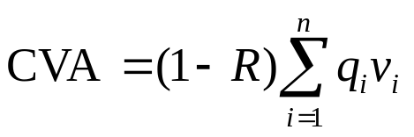
The CVA Calculation
………………
Time
0
t₁
t₂
t₃
t₄
t_{n}=T
………………
Default probability
q₁
q₂
q₃
q₄
q_{n}
………………
PV of expected net exposure
v₁
v₂
v₃
v₄
v_{n}
where R is the recovery rate
Risk Management and Financial Institutions 4e, Chapter 20, Copyright © John C. Hull 2015

Slide 5

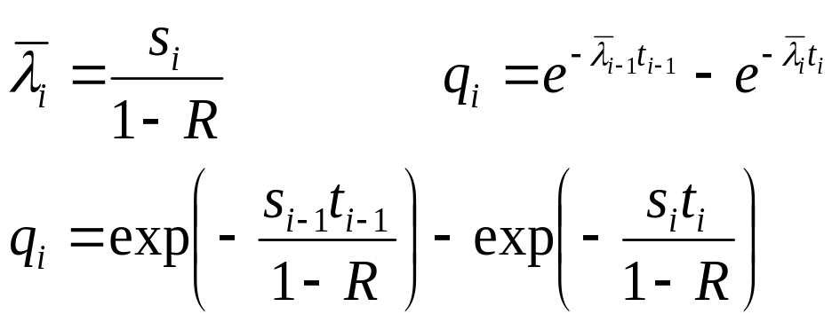
The Default Probabilities (equation 20.3, page 430)
The default probabilities (i.e., the q_{i}’s) are calculated from credit spreads
If s_{i} is the credit spread for maturity t_{i}, is the average hazard rate up to time t_{i} , and R is the recovery rate
Risk Management and Financial Institutions 4e, Chapter 20, Copyright © John C. Hull 2015

Slide 6
The Expected Exposures
The v_{i} are calculated using Monte Carlo simulation. Random paths are chosen for all the market variables underlying the derivatives and the net exposure is calculated at the mid point of each time interval.
v_{i} is the present value of the average net exposure at the ith default time
Risk Management and Financial Institutions 4e, Chapter 20, Copyright © John C. Hull 2015

Slide 7
The Expected Exposure
If no collateral is required, the exposure at each time for each random trial is max(V,0) where V is the value of the derivatives portfolio to the dealer
If the collateral equal to C is expected to be posted by the counterparty at the time of the default (with a negative C indicating collateral expected to be posted by the dealer), the exposure is max(V − C, 0)
This formula reflects the fact that the dealer will have an exposure if it has posted more collateral than the value of the derivatives to the counterparty.
Risk Management and Financial Institutions 4e, Chapter 20, Copyright © John C. Hull 2015

Slide 8
Calculation of Available Collateral
It is assumed that there is a “cure period” (sometimes called margin period of risk) immediately before a default during which collateral is not posted
If cure period is c days on each Monte Carlo trial we must calculate the value of the portfolio c days before each default time
This determines the collateral available at the default time
Risk Management and Financial Institutions 4e, Chapter 20, Copyright © John C. Hull 2015

Slide 9
Peak Exposure (page 432)
A high percentile (e.g. 97.5%) of the exposure distribution at a particular tiem
Maximum peak exposure (peak of peaks) is the maximum of the peak exposures across all the times considered
Risk Management and Financial Institutions 4e, Chapter 20, Copyright © John C. Hull 2015

Slide 10
Downgrade Triggers (page 432)
Collateral required (or possibly early termination) if counterparty is downgraded below a certain credit rating
They work well if counterparty has relatively few of them
Examples: AIG, Enron
Risk Management and Financial Institutions 4e, Chapter 20, Copyright © John C. Hull 2015

Slide 11
Incremental CVA
Results from Monte Carlo are stored so that the incremental impact of a new trade can be calculated without simulating all the other trades.
Risk Management and Financial Institutions 4e, Chapter 20, Copyright © John C. Hull 2015

Slide 12
CVA Risk
The CVA for a counterparty can be regarded as a complex derivative
Increasingly dealers are managing it like any other derivative
Two sources of risk:
  Changes in counterparty spreads
  Changes in market variables underlying the portfolio
Risk Management and Financial Institutions 4e, Chapter 20, Copyright © John C. Hull 2015

Slide 13
Basel III
Basel III requires CVA risk arising from a parallel shift in the term structure of counterparty credit spreads to be included in the calculation of capital for market risk
It does not require banks to include CVA risk arising from the underlying market variables
Risk Management and Financial Institutions 4e, Chapter 20, Copyright © John C. Hull 2015

Slide 14
Wrong Way/Right Way Risk
Simplest assumption is that probability of default q_{i} is independent of net exposure v_{i}.
Wrong-way risk occurs when q_{i} is positively dependent on v_{i}
Right-way risk occurs when q_{i} is negatively dependent on v_{i}
Risk Management and Financial Institutions 4e, Chapter 20, Copyright © John C. Hull 2015

Slide 15
Examples
Wrong-way risk typically occurs when
  Counterparty is selling credit protection
  Counterparty is a hedge fund taking a big speculative positions
Right-way risk typically occurs when
  Counterparty is buying credit protection
  Counterparty is partially hedging a major exposure
Risk Management and Financial Institutions 4e, Chapter 20, Copyright © John C. Hull 2015

Slide 16
Problems in Estimating Wrong Way/Right Way Risk
Knowing trades counterparty is doing with other dealers
Knowing how different market variables influence the fortunes of the counterparty
Risk Management and Financial Institutions 4e, Chapter 20, Copyright © John C. Hull 2015

Slide 17
Allowing for Wrong-Way risk
One common approach is to use the “alpha” multiplier to increase the v’s
Estimates of 1.07 to 1.1 for alpha obtained from banks
Basel II sets alpha equal to 1.4 or allows banks to use their own models, with a floor of 1.2
Risk Management and Financial Institutions 4e, Chapter 20, Copyright © John C. Hull 2015

Slide 18
DVA (more recent and more controversial)
Debit (or debt) value adjustment (DVA) is an estimate of the cost to the counterparty of a default by the dealer
Same formulas apply except that v is counterparty’s exposure to dealer and q is dealer’s probability of default
Accounting value of transactions with counterparty = No default value – CVA + DVA
Risk Management and Financial Institutions 4e, Chapter 20, Copyright © John C. Hull 2015

Slide 19
DVA continued
What happens to the reported value of transactions as dealer’s credit spread increases?
Risk Management and Financial Institutions 4e, Chapter 20, Copyright © John C. Hull 2015

Slide 20
Expected Exposure on Pair of Offsetting Interest Rate Swaps and a Pair of Offsetting Currency Swaps (No collateral)
(Figure 20.1, page 439)
Exposure
Currency swaps
Interest Rate Swaps
Maturity
Risk Management and Financial Institutions 4e, Chapter 20, Copyright © John C. Hull 2015

Slide 21
Interest Rate vs Currency Swaps
The q_{i}’s are the same for both
The v_{i}’s for an interest rate swap are on average much less than the v_{i}’s for a currency swap
The expected cost of defaults on a currency swap is therefore greater.
Risk Management and Financial Institutions 4e, Chapter 20, Copyright © John C. Hull 2015

Slide 22
Simple Example: Single transaction which provides a payoff at time T years and always has positive value to dealer
CVA has the effect of multiplying value of transaction by e^{−sT} where s is spread between T-year bond issued by counterparty and risk-free T-year bond
DVA is zero
Risk Management and Financial Institutions 4e, Chapter 20, Copyright © John C. Hull 2015

Slide 23
Example 20.2 (page 438)
A 2-year option sold by a counterparty to the dealer has a Black-Scholes value of $3
Assume a 2 year zero coupon bond issued by the counterparty has a yield of 1.5% greater than the risk free rate
If there is no collateral and there are no other transactions between the parties, value of option is 3e^{−0.015×2}=2.91
Risk Management and Financial Institutions 4e, Chapter 20, Copyright © John C. Hull 2015

Slide 24
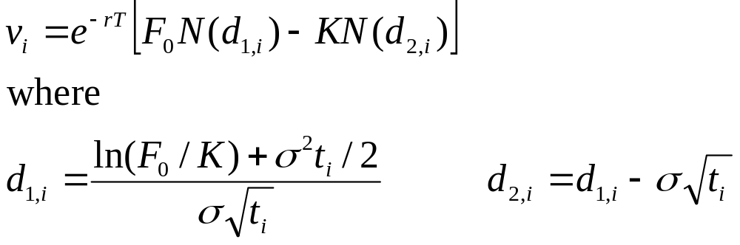
Dealer Has Single Uncollateralized Long Forward with Counterparty (page 439)
The value of a long forward contract at time t is
(F_{t}−K)e^{−r(T−t)}
The exposure at time t is e^{−r(T−t)} max(F_{t}−K, 0)
Using the Black-Scholes-Merton result to calculate the present value of E[max(F_{t}−K, 0)] gives
Risk Management and Financial Institutions 4e, Chapter 20, Copyright © John C. Hull 2015

