Slide 1
Credit Value at Risk
Chapter 21
Risk Management and Financial Institutions 4e, Chapter 21, Copyright © John C. Hull 2015

Slide 2
Rating Transitions
One year rating transition probabilities are published by rating agencies.
If we assume that the rating transition in one period is independent of that in other periods we can calculate the rating transition for any period (see Appendix J and software)
The “ratings momentum” phenomenon means that the independence assumption is not perfectly correct
Risk Management and Financial Institutions 4e, Chapter 21, Copyright © John C. Hull 2015

Slide 3
One-Year Rating Transition Matrix (% probability, Moody’s 1970-2013)
Table 21.1 page 446
Initial
Rating at year end
Rating
Aaa
Aa
A
Baa
Ba
B
Caa
Ca-C
Default
Aaa
90.65%
8.67%
0.65%
0.00%
0.03%
0.00%
0.00%
0.00%
0.00%
Aa
0.95%
89.44%
8.95%
0.54%
0.07%
0.02%
0.01%
0.00%
0.02%
A
0.06%
2.56%
90.73%
5.86%
0.58%
0.11%
0.03%
0.00%
0.06%
Baa
0.04%
0.18%
4.20%
90.27%
4.17%
0.78%
0.16%
0.02%
0.18%
Ba
0.01%
0.06%
0.37%
6.17%
83.45%
8.06%
0.65%
0.07%
1.16%
B
0.01%
0.03%
0.12%
0.34%
5.08%
82.90%
6.69%
0.65%
4.18%
Caa
0.00%
0.02%
0.02%
0.12%
0.42%
9.74%
71.07%
4.06%
14.55%
Ca-C
0.00%
0.00%
0.07%
0.00%
0.43%
2.37%
10.59%
42.36%
44.20%
Default
0.00%
0.00%
0.00%
0.00%
0.00%
0.00%
0.00%
0.00%
100.00%
Risk Management and Financial Institutions 4e, Chapter 21, Copyright © John C. Hull 2015

Slide 4
Five-Year Rating Transition Matrix (calculated from one-year transitions)
Table 21.2 page 447
Initial
Rating at end
Rating
Aaa
Aa
A
Baa
Ba
B
Caa
Ca-C
Default
Aaa
61.83%
28.85%
7.97%
1.02%
0.23%
0.06%
0.01%
0.00%
0.04%
Aa
3.19%
59.53%
30.10%
5.72%
0.90%
0.28%
0.08%
0.01%
0.19%
A
0.40%
8.67%
65.07%
20.36%
3.49%
1.12%
0.26%
0.04%
0.59%
Baa
0.18%
1.44%
14.58%
63.62%
12.63%
4.57%
0.98%
0.12%
1.87%
Ba
0.06%
0.39%
3.01%
18.39%
44.60%
20.67%
4.09%
0.46%
8.32%
B
0.04%
0.16%
0.71%
3.10%
12.88%
44.99%
12.85%
1.49%
23.79%
Caa
0.01%
0.07%
0.21%
0.83%
3.42%
18.63%
22.09%
2.75%
52.00%
Ca-C
0.00%
0.02%
0.14%
0.29%
1.27%
5.61%
7.16%
2.09%
83.40%
Default
0.00%
0.00%
0.00%
0.00%
0.00%
0.00%
0.00%
0.00%
100.00%
Risk Management and Financial Institutions 4e, Chapter 21, Copyright © John C. Hull 2015

Slide 5
One-Month Rating Transition Matrix (calculated from one-year transitions)
Table 21.3 page 447
Initial
Rating at month end
Rating
Aaa
Aa
A
Baa
Ba
B
Caa
Ca-C
Default
Aaa
99.18%
0.80%
0.02%
0.00%
0.00%
0.00%
0.00%
0.00%
0.00%
Aa
0.09%
99.06%
0.82%
0.03%
0.00%
0.00%
0.00%
0.00%
0.00%
A
0.00%
0.23%
99.17%
0.53%
0.04%
0.01%
0.00%
0.00%
0.00%
Baa
0.00%
0.01%
0.38%
99.13%
0.39%
0.06%
0.01%
0.00%
0.01%
Ba
0.00%
0.00%
0.02%
0.58%
98.47%
0.79%
0.04%
0.00%
0.09%
B
0.00%
0.00%
0.01%
0.02%
0.50%
98.39%
0.71%
0.06%
0.31%
Caa
0.00%
0.00%
0.00%
0.01%
0.01%
1.03%
97.11%
0.58%
1.26%
Ca-C
0.00%
0.00%
0.01%
0.00%
0.05%
0.22%
1.51%
93.03%
5.19%
Default
0.00%
0.00%
0.00%
0.00%
0.00%
0.00%
0.00%
0.00%
100.00%
Risk Management and Financial Institutions 4e, Chapter 21, Copyright © John C. Hull 2015

Slide 6
Credit VaR
Can be defined analogously to Market Risk VaR
A one year credit VaR with a 99.9% confidence is the loss level that we are 99.9% confident will not be exceeded over one year
Risk Management and Financial Institutions 4e, Chapter 21, Copyright © John C. Hull 2015

Slide 7

Vasicek’s Model (Equation 21.1, page 448)
For a large portfolio of loans, each of which has a probability of PD of defaulting by time T the worst case default rate that will not be exceeded at the X% confidence level is
where ρ is the Gaussian copula correlation
Risk Management and Financial Institutions 4e, Chapter 21, Copyright © John C. Hull 2015

Slide 8
VaR Model (Equation 21.2, page 448)
Extended by Gordy
Risk Management and Financial Institutions 4e, Chapter 21, Copyright © John C. Hull 2015

Slide 9
Credit Risk Plus
If default rate is assumed to be known we can use a Poisson distribution to determine the probability of m defaults (see equation 21. 3)
If we assume the default rate has a gamma distribution then the probability of m defaults has a negative binomial distribution (see equation 21.4 and Table 21.4)
Risk Management and Financial Institutions 4e, Chapter 21, Copyright © John C. Hull 2015

Slide 10
General Monte Carlo Simulation Approach for Credit Risk Plus
Sample overall default rate
Sample probability of default for each counterparty category (regress default rate for each category on overall default rate)
Sample number of losses for each counterparty category
Sample size of loss for each default
Calculate total loss from defaults
This is repeated many times to calculate a probability distribution for the total loss
Risk Management and Financial Institutions 4e, Chapter 21, Copyright © John C. Hull 2015

Slide 11
CreditMetrics (Section 21.4, page 451-454)
Calculates credit VaR by considering possible rating transitions
A Gaussian copula model is used to define the correlation between the ratings transitions of different companies
Risk Management and Financial Institutions 4e, Chapter 21, Copyright © John C. Hull 2015

Slide 12
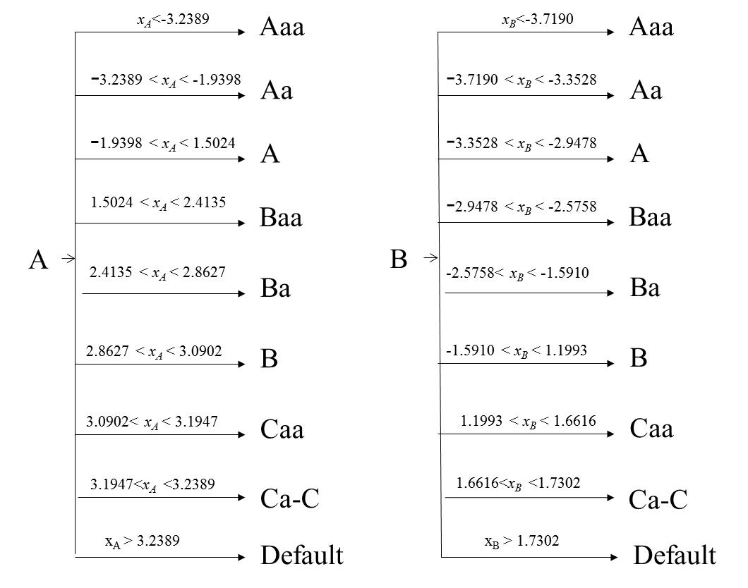
The Copula Model : x_{A} and x_{B} are sampled from correlated standard normals
Risk Management and Financial Institutions 4e, Chapter 21, Copyright © John C. Hull 2015

Slide 13
Credit Risk in the Trading Book
Alternatives to calculate 10-day 99% VaR
  Historical simulation to determine potential credit spread changes
  Calculate 10-day transition matrix and use a CreditMetrics approach
Risk Management and Financial Institutions 4e, Chapter 21, Copyright © John C. Hull 2015

Slide 14
Incremental Risk Charge
Banks must calculate a one year 99.9% VaR
This is to ensure that capital is similar to the capital that would be charged if the instrument were in the banking book
They are allowed to make a constant level of risk assumption (minimum liquidity horizon is three months)
Risk Management and Financial Institutions 4e, Chapter 21, Copyright © John C. Hull 2015

Slide 15
Constant Level of Risk Assumption
Suppose a bank has a BBB bond and uses a liquidity horizon of 3 months
At the end of each 3 month period the bond, if it has deteriorated is assumed to be sold and replaced with a new BBB bond
The one-year loss is then replaced by four three-month losses
A three month loss can be estimated using the CreditMetrics approach
Risk Management and Financial Institutions 4e, Chapter 21, Copyright © John C. Hull 2015

Slide 16
Fundamental Review of the Trading Book
This proposes that credit spread risk and jump to default risk are treated separately
Credit spread risk is a market risk
Jump to default risk is a credit risk
Constant level of risk assumption will be abandoned
Risk Management and Financial Institutions 4e, Chapter 21, Copyright © John C. Hull 2015

