Slide 1
Operational Risk
Chapter 23
Risk Management and Financial Institutions 4e, Chapter 23, Copyright © John C. Hull 2015

Slide 2
Definition of Operational Risk
“Operational risk is the risk of loss resulting from inadequate or failed internal processes, people, and systems, or from external events”
Basel Committee Jan 2001
Risk Management and Financial Institutions 4e, Chapter 23, Copyright © John C. Hull 2015

Slide 3
The Biggest Risk?
Operational risk is difficult to quantify but is now regarded as the biggest risk facing banks
Cyber risk is a big concern
Compliance risks can lead to huge losses (e.g. BNP Paribas’s $9 billion loss in 2014)
Risk Management and Financial Institutions 4e, Chapter 23, Copyright © John C. Hull 2015

Slide 4
What It Includes
The definition includes people risks, technology and processing risks, physical risks, legal risks, etc
The definition excludes reputation risk and strategic risk
Risk Management and Financial Institutions 4e, Chapter 23, Copyright © John C. Hull 2015

Slide 5
Regulatory Capital (page 481-483)
In Basel II there is a capital charge for Operational Risk
Three alternatives:
  Basic Indicator (15% of annual gross income)
  Standardized (different percentage for each business line)
  Advanced Measurement Approach (AMA)
Risk Management and Financial Institutions 4e, Chapter 23, Copyright © John C. Hull 2015

Slide 6
Categorization of Business Lines
Corporate finance
Trading and sales
Retail banking
Commercial banking
Payment and settlement
Agency services
Asset management
Retail brokerage
Risk Management and Financial Institutions 4e, Chapter 23, Copyright © John C. Hull 2015

Slide 7
Categorization of risks
Internal fraud
External fraud
Employment practices and workplace safety
Clients, products and business practices
Damage to physical assets
Business disruption and system failures
Execution, delivery and process management
Risk Management and Financial Institutions 4e, Chapter 23, Copyright © John C. Hull 2015

Slide 8
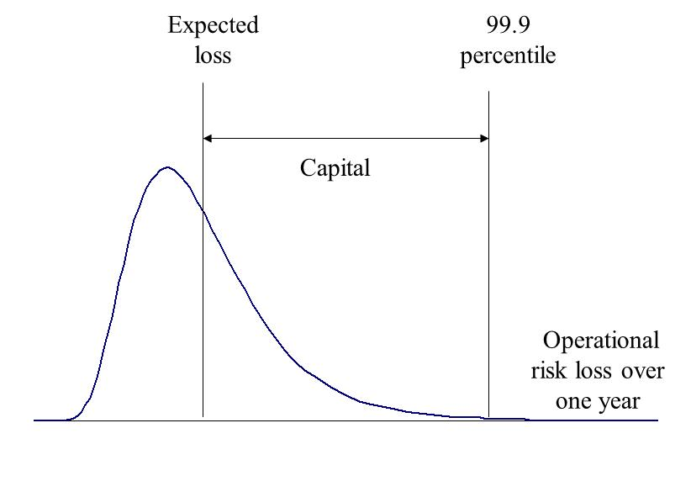
The AMA Approach
Risk Management and Financial Institutions 4e, Chapter 23, Copyright © John C. Hull 2015

Slide 9
The Task Under AMA
Banks need to estimate their exposure to each combination of type of risk and business line
Ideally this will lead to 7×8=56 VaR measures that can be combined into an overall VaR measure
Risk Management and Financial Institutions 4e, Chapter 23, Copyright © John C. Hull 2015

Slide 10
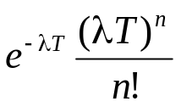
Loss Severity vs Loss Frequency (page 484-485)
Loss frequency should be estimated from the banks own data as far as possible. One possibility is to assume a Poisson distribution so that we need only estimate an average loss frequency. Probability of n events in time T is then
Loss severity can be based on internal and external historical data. One possibility is to assume a lognormal distribution so that we need only estimate the mean and SD of losses.
Risk Management and Financial Institutions 4e, Chapter 23, Copyright © John C. Hull 2015

Slide 11
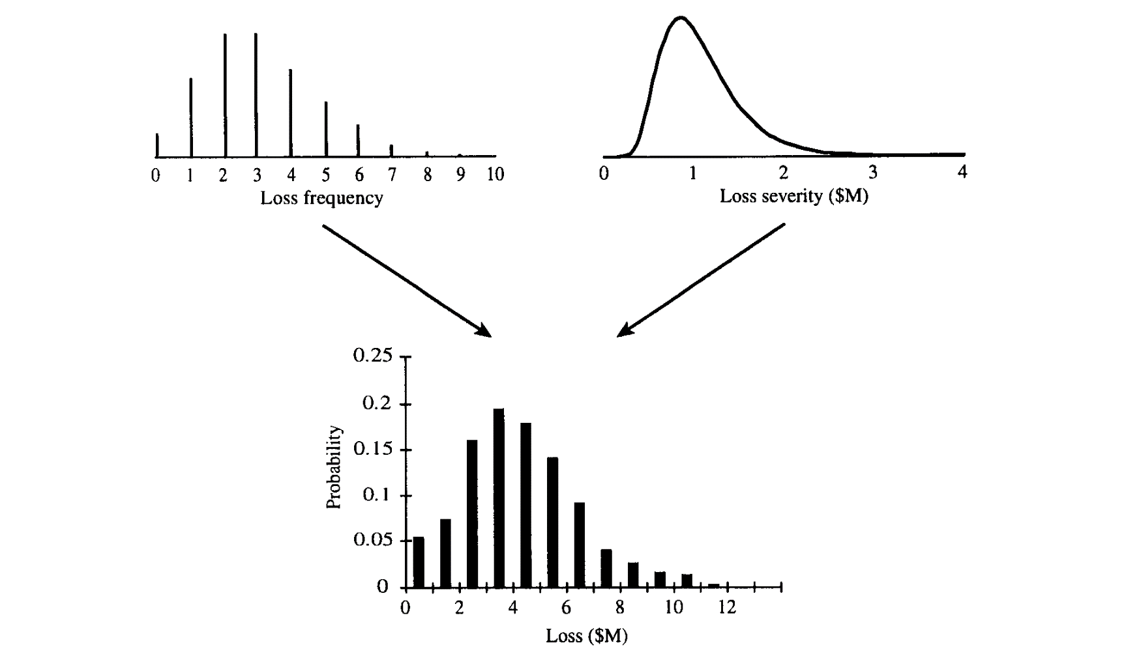
Using Monte Carlo to combine the Distributions (Figure 23.2, page 486)
Risk Management and Financial Institutions 4e, Chapter 23, Copyright © John C. Hull 2015

Slide 12
Monte Carlo Simulation Trial
Sample from frequency distribution to determine the number of loss events (=n)
Sample n times from the loss severity distribution to determine the loss severity for each loss event
Sum loss severities to determine total loss
Risk Management and Financial Institutions 4e, Chapter 23, Copyright © John C. Hull 2015

Slide 13
AMA Approach
Four elements specified by Basel committee:
Internal data
External data
Scenario analysis
Business environment and internal control factors
Risk Management and Financial Institutions 4e, Chapter 23, Copyright © John C. Hull 2015

Slide 14
Internal Data
Operational risk losses have not been recorded as well as credit risk losses
Important losses are low-frequency high severity-losses
Loss frequency should be estimated from internal data
Risk Management and Financial Institutions 4e, Chapter 23, Copyright © John C. Hull 2015

Slide 15
External Historical Loss Severity Data
Two possibilities
  data sharing
  data vendors
Data from vendors is based on publicly available information and therefore is biased towards large losses
Data from vendors can therefore only be used to estimate the relative size of the mean losses and SD of losses for different risk categories
Risk Management and Financial Institutions 4e, Chapter 23, Copyright © John C. Hull 2015

Slide 16
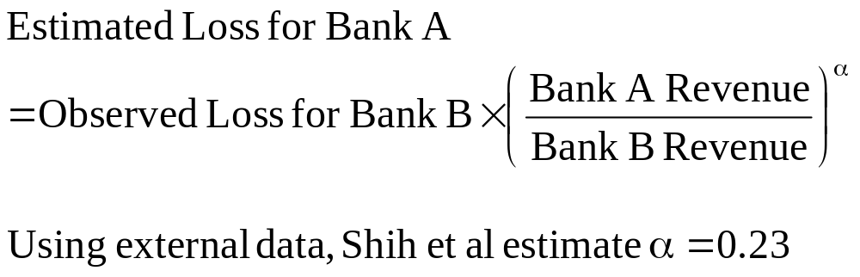
Scaling Data for Size (page 487)
Risk Management and Financial Institutions 4e, Chapter 23, Copyright © John C. Hull 2015

Slide 17
Scenario Analysis
Aim is to generate scenarios covering all low frequency high severity losses
Can be based on own experience and experience of other banks
Assign probabilities
Aggregate scenarios to provide loss distributions
Risk Management and Financial Institutions 4e, Chapter 23, Copyright © John C. Hull 2015

Slide 18
Business Environment and Internal Control Factors
Take account of
Complexity of business line
Technology used
Pace of change
Level of supervision
Staff turnover rates
etc
Risk Management and Financial Institutions 4e, Chapter 23, Copyright © John C. Hull 2015

Slide 19
Proactive Approaches
Establish causal relationships
RCSA
KRI
Allocate operational risk capital to encourage business units to reduce operational risk
Educate employees to be careful about what they write in emails and (when they work in the trading room) what they say over the phone
Risk Management and Financial Institutions 4e, Chapter 23, Copyright © John C. Hull 2015

Slide 20
Power Law
Prob (v > x) = Kx^{-α}
Research shows that this works quite well for operational risk losses
Distribution with heaviest tails (lowest α) tend to define the 99.9% worst case result
Risk Management and Financial Institutions 4e, Chapter 23, Copyright © John C. Hull 2015

Slide 21
Insurance (page 493-494)
Factors that affect the design of an insurance contract
  Moral hazard
  Adverse selection
To take account of these factors there are
  deductibles
  co-insurance provisions
  policy limits
Risk Management and Financial Institutions 4e, Chapter 23, Copyright © John C. Hull 2015

Slide 22
Sarbanes-Oxley (page 494-495)
CEO and CFO are more accountable
SEC has more powers
Auditors are not allowed to carry out significant non-audit tasks
Audit committee of board must be made aware of alternative accounting treatments
CEO and CFO must return bonuses in the event financial statements are restated
Risk Management and Financial Institutions 4e, Chapter 23, Copyright © John C. Hull 2015

