Slide 1
Model Risk
Chapter 25
Risk Management and Financial Institutions 4e, Chapter 25, Copyright © John C. Hull 2015

Slide 2
Marking the Prices of an Instrument to Market
Use prices quoted by market maker
Use price at which financial institution has traded product
Use prices from SEFs or interdealer brokers
Use price indications
Use model (marking to model)
Risk Management and Financial Institutions 4e, Chapter 25, Copyright © John C. Hull 2015

Slide 3
Accounting
FASB 157 and IASB 39 classify instruments as “held for sale” or “held to maturity”
Those classified as held for sale have to be marked to market
  Level 1: uses quoted prices in active markets
  Level 2: uses quoted prices for similar product in active markets or same product in non-active markets
  Level 3: requires valuation assumptions
Risk Management and Financial Institutions 4e, Chapter 25, Copyright © John C. Hull 2015

Slide 4
Model Risk Can Lead To…
Incorrect price at time product is bought or sold
Incorrect hedging
Risk Management and Financial Institutions 4e, Chapter 25, Copyright © John C. Hull 2015

Slide 5
Finance vs Physics (page 529-530)
The models of physics describe physical processes and are highly accurate. Their parameters do not change through time.
The models of finance describe human behavior. They are at best approximations. Parameters do change through time
Risk Management and Financial Institutions 4e, Chapter 25, Copyright © John C. Hull 2015

Slide 6
Calibration
Models of finance are calibrated to market prices daily
As a result parameters change from day to day
For a particular option maturing in three months volatility might be 20% on Day 1, 22% on Day 2, and 19% on Day 3.
Risk Management and Financial Institutions 4e, Chapter 25, Copyright © John C. Hull 2015

Slide 7
The Way Models Are Usually Used in Finance
Observe model prices for similar instruments that trade
Imply model parameters. Interpolate as appropriate
Value new instrument
Risk Management and Financial Institutions 4e, Chapter 25, Copyright © John C. Hull 2015

Slide 8
Linear Products
Very little uncertainty about the right model
But mistakes do happen. For example…
  Kidder Peabody (Business Snapshot 25.1, page 476)
  LIBOR-in Arrears Swaps (Business Snapshot 25.2, page 477)
Risk Management and Financial Institutions 4e, Chapter 25, Copyright © John C. Hull 2015

Slide 9
Standard Products
We do not need usually a model to know the price of an actively traded product. The market tells us the price.
The model is a communication tool (e.g., implied volatilities are quoted for options)
It is also an interpolation tool (e.g., a tool for interpolating between strike prices and maturities.
Risk Management and Financial Institutions 4e, Chapter 25, Copyright © John C. Hull 2015

Slide 10
Volatility Smiles
A volatility smile shows the variation of the implied volatility with the strike price
The volatility smile should be the same whether calculated from call options or put options
Risk Management and Financial Institutions 4e, Chapter 25, Copyright © John C. Hull 2015

Slide 11
The Volatility Smile for Foreign Currency Options
(Figure 25.2, page 532)
Implied
Volatility
Strike
Price
Risk Management and Financial Institutions 4e, Chapter 25, Copyright © John C. Hull 2015

Slide 12
The Volatility Smile for Equity Options (Figure 25.3, page 533)
Implied
Volatility
Strike
Price
Risk Management and Financial Institutions 4e, Chapter 25, Copyright © John C. Hull 2015

Slide 13
Volatility Term Structure
In addition to calculating a volatility smile, traders also calculate a volatility term structure
This shows the variation of implied volatility with the time to maturity of the option
Risk Management and Financial Institutions 4e, Chapter 25, Copyright © John C. Hull 2015

Slide 14
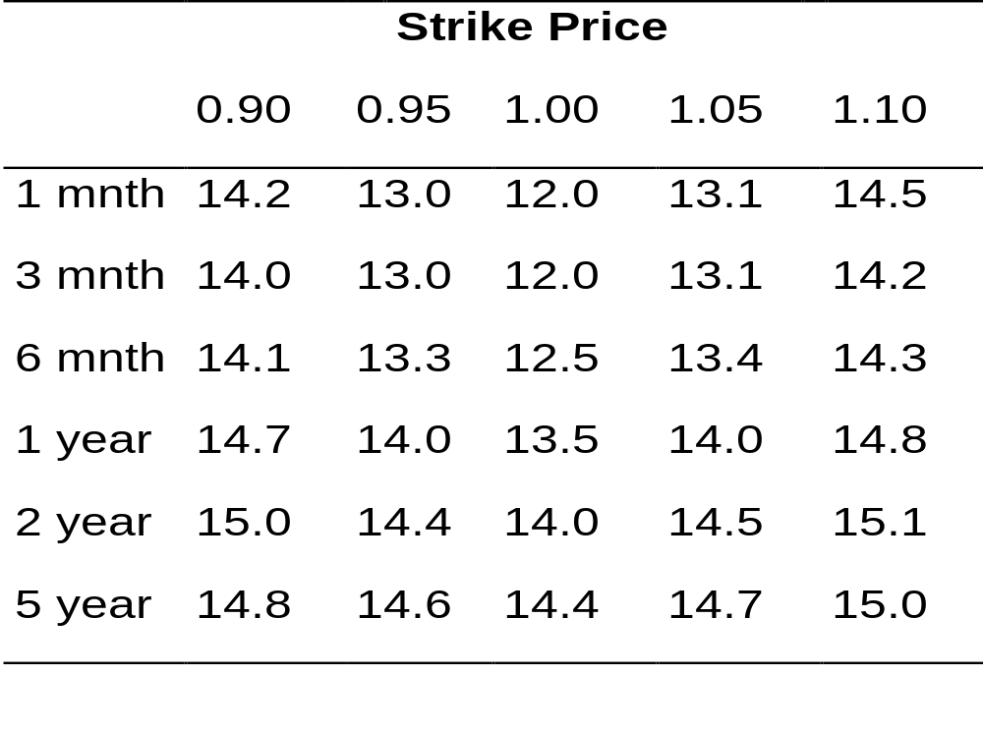
Example of a Volatility Surface
(Table 25.1, page 534)
Risk Management and Financial Institutions 4e, Chapter 25, Copyright © John C. Hull 2015

Slide 15
Official vs Research Models
It is important to distinguish between
  A financial institution’s official model for a product, which is should be designed to track market prices as closely as possible
  Research models, which are designed to develop trading strategies
Risk Management and Financial Institutions 4e, Chapter 25, Copyright © John C. Hull 2015

Slide 16
Hedging Actively Traded Products
Models are used in a more significant way for hedging than for pricing
We can distinguish “within model” hedging from ”outside model” hedging
Risk Management and Financial Institutions 4e, Chapter 25, Copyright © John C. Hull 2015

Slide 17
P&L Decomposition (page 537)
Distinguishes between:
P&L changes from risks that were unhedged
P&L changes from the hedging model being imperfect
P&L changes from new trades done during day
Risk Management and Financial Institutions 4e, Chapter 25, Copyright © John C. Hull 2015

Slide 18
Models for Nonstandard Products (page 537)
In the case of nonstandard products, models play a key role in both pricing and hedging
Risk Management and Financial Institutions 4e, Chapter 25, Copyright © John C. Hull 2015

Slide 19
Model Risk
Alternatives
  Use more than one model for pricing
  Create reserve accounts so that profits are not recognized immediately
  Carry out a sophisticated analysis to determine the range of models that price actively traded standard instruments consistently with the market.
Risk Management and Financial Institutions 4e, Chapter 25, Copyright © John C. Hull 2015

Slide 20
Model Audit Groups
Model audit groups within a bank
  Check that a model has been implemented correctly
  Examine whether there is a sound rationale for the model
  Compare the model with others that can accomplish the same task
  Specify limitations of model
  Assess uncertainties in prices and hedge parameters given by model
Risk Management and Financial Institutions 4e, Chapter 25, Copyright © John C. Hull 2015

Slide 21
Dangers in Model Building (page 540-541)
Overfitting
Overparametrization
Risk Management and Financial Institutions 4e, Chapter 25, Copyright © John C. Hull 2015

Slide 22
Detecting Model Problems (page 541-542)
Monitor types of trading a financial institution is doing with other financial institutions
Monitor profits being recorded from trading of different products
Risk Management and Financial Institutions 4e, Chapter 25, Copyright © John C. Hull 2015

