Slide 1
Economic Capital and RAROC
Chapter 26
Risk Management and Financial Institutions 4e, Chapter 26, Copyright © John C. Hull 2015

Slide 2
Economic Capital
A bank’s own assessment of the capital it requires
Risk Management and Financial Institutions 4e, Chapter 26, Copyright © John C. Hull 2015

Slide 3
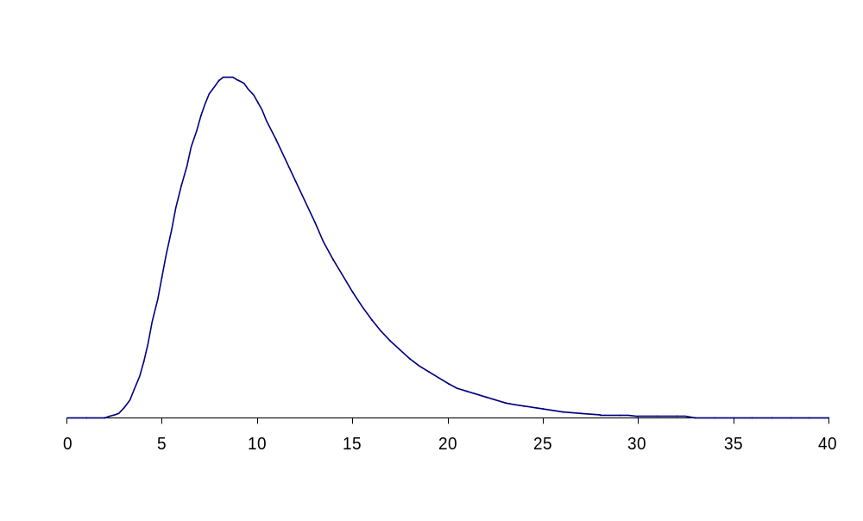
Model Used for Economic and Capital (Same as Regulatory Capital)
Figure 26.1, page 546
Expected
Loss
X percentile
Capital
Loss over one year
Risk Management and Financial Institutions 4e, Chapter 26, Copyright © John C. Hull 2015

Slide 4
Choice of Parameters
For a bank wishing to maintain a AA-rating, capital is chosen so that X is about 99.97% and time horizon is one year
This is because statistics from rating agencies show that an AA-rated company has a probability of only about 0.03% of defaulting in one year
Risk Management and Financial Institutions 4e, Chapter 26, Copyright © John C. Hull 2015

Slide 5
The Basel II Regulatory Environment (Figure 26.2, page 547)
Total Risk
Non-Business Risk
(regulatory capital):
Credit Risk
Market Risk
Operational Risk
Business Risk
(no regulatory capital):
Risk from Strategic Decisions
Reputation Risk
Risk Management and Financial Institutions 4e, Chapter 26, Copyright © John C. Hull 2015

Slide 6
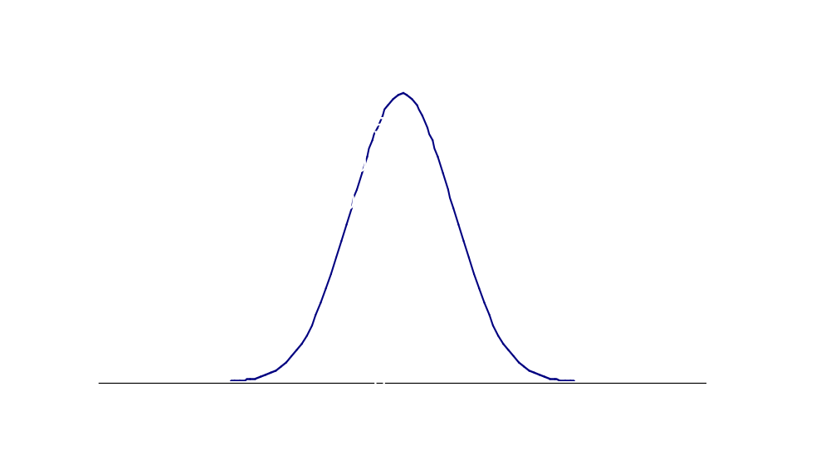
One-year Market Risk Gains/Loss Distribution (Figure 26.3, page 550)
Gain
Loss
Risk Management and Financial Institutions 4e, Chapter 26, Copyright © John C. Hull 2015

Slide 7
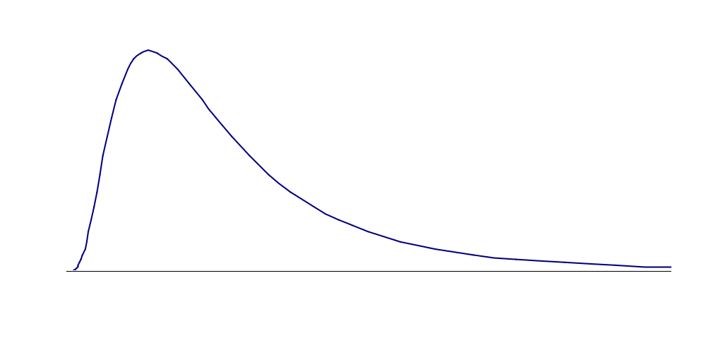
One-year Credit Risk Loss Distribution (Figure 26.4, page 550)
Loss
Risk Management and Financial Institutions 4e, Chapter 26, Copyright © John C. Hull 2015

Slide 8
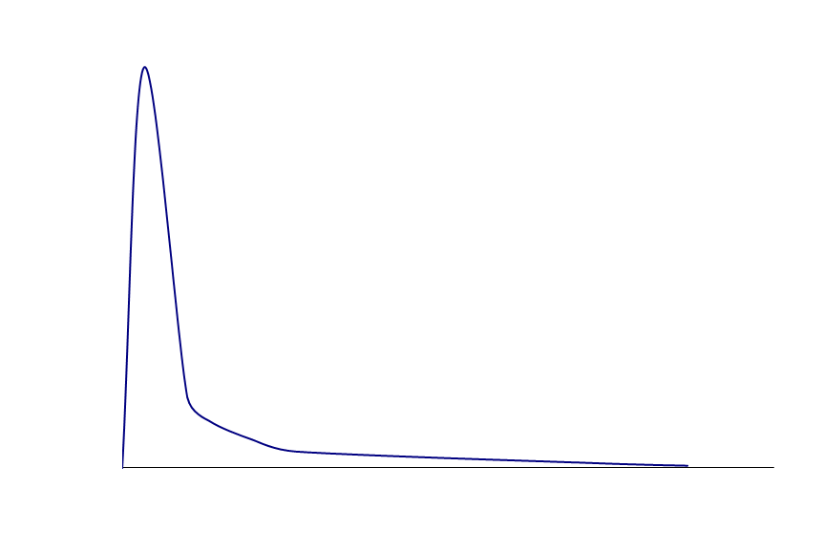
One Year Operational Risk Loss Distribution (Figure 26.5, page 550)
Loss
Risk Management and Financial Institutions 4e, Chapter 26, Copyright © John C. Hull 2015

Slide 9
Characteristics of Distributions (Table 26.1, page 551)
 | Second Moment (Variance) | Third Moment (Skewness) | Fourth Moment (Kurtosis)
Market Risk | High | Zero | Low
Credit Risk | Moderate | Moderate | Moderate
Operational Risk | Low | High | High
Risk Management and Financial Institutions 4e, Chapter 26, Copyright © John C. Hull 2015

Slide 10
European Growth Trust (Example of Operational Risk in Asset Management)
See Business Snapshot 26.1
No more than 10% of EGT could be invested in unlisted securities
Peter Young the fund manager violated this rule
The cost to Deutsche Bank was about $200 million
Risk Management and Financial Institutions 4e, Chapter 26, Copyright © John C. Hull 2015

Slide 11
Interactions of Risks
LGD and PD depend on market value
Credit
Risk
Market Risk
Operational risks can be contingent on market moves or credit events
Operational
Risk
Risk Management and Financial Institutions 4e, Chapter 26, Copyright © John C. Hull 2015

Slide 12
Integrated Risk Management
Typically a bank calculates economic capital for different types of risk and different units
It is then faced with the problem of aggregating the risks
Risk Management and Financial Institutions 4e, Chapter 26, Copyright © John C. Hull 2015

Slide 13
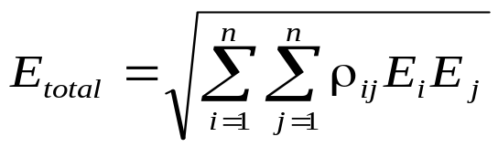
Combining the Distributions
Assume perfect correlation: overstates capital by about 40%
Assume distributions are normal for the purposes of aggregation: understates capital by about 40%
Hybrid approach:
seems to work reasonable well
Risk Management and Financial Institutions 4e, Chapter 26, Copyright © John C. Hull 2015

Slide 14
Example: Economic Capital Estimates (Table 26.2, page 554)
 | Business Unit 1 | Business Unit 2
Market Risk | 30 | 40
Credit Risk | 70 | 80
Operational Risk | 30 | 90
Risk Management and Financial Institutions 4e, Chapter 26, Copyright © John C. Hull 2015

Slide 15
Correlations
Market and credit risk within the same business unit: 0.5
Market and operational risk or credit and operational risk within the same business unit: 0.2
Market risks across business units: 0.4
Credit risk across business units: 0.6
Operational risk across business units: 0.0
Risk Management and Financial Institutions 4e, Chapter 26, Copyright © John C. Hull 2015

Slide 16
Total Economic Capital
Business Unit 1: 100.0
Business Unit 2: 153.7
Whole bank: 203.2
Diversification benefit is 253.7 – 203.2 = 50.5
How should this be allocated to the business units?
Equivalently how should the total economic capital of 203.2 be allocated?
Risk Management and Financial Institutions 4e, Chapter 26, Copyright © John C. Hull 2015

Slide 17
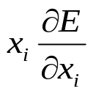
Alternatives
Allocate economic capital in proportion to the stand alone economic capitals
Allocate economic capital in proportion to marginal contribution of business units to total economic capital
Set economic capital for business unit i equal to where x_{i} is the size of business unit i
Risk Management and Financial Institutions 4e, Chapter 26, Copyright © John C. Hull 2015

Slide 18
Deutsche Bank Economic Capital (millions of Euros) Table 26.4, page 557
Credit Risk | 12,013
Market Risk | 12,738
Operational Risk | 5,253
Diversification benefits | (4,515)
Business Risk | 1,682
Total economic capital | 27,171
Total risk-weighted assets | 300,369
Common Equity Tier 1 Capital (% of RWA) | 12.8%
All Tier 1 Capital (% of RWA) | 16.9%
Tier 1 plus Tier 2 capital (% of RWA) | 18.5%
Risk Management and Financial Institutions 4e, Chapter 26, Copyright © John C. Hull 2015

Slide 19
RAROC (page 557-558)
RAROC is the return on economic capital for a business unit
The denominator is the economic capital allocated to the business unit
The numerator is the expected profit. This can be before or after tax and can include a interest at the risk-free rate on the economic capital
It is sometimes also referred to as RORAC
Risk Management and Financial Institutions 4e, Chapter 26, Copyright © John C. Hull 2015

Slide 20
Example 26.5 (page 558)
When lending in a certain region of the world an AA-rated bank estimates its average losses from defaults as 1% of outstanding loans per year
The 99.97% worst case loss is 5% of outstanding loans
Economic capital per $100 of loans is therefore $4
Risk Management and Financial Institutions 4e, Chapter 26, Copyright © John C. Hull 2015

Slide 21
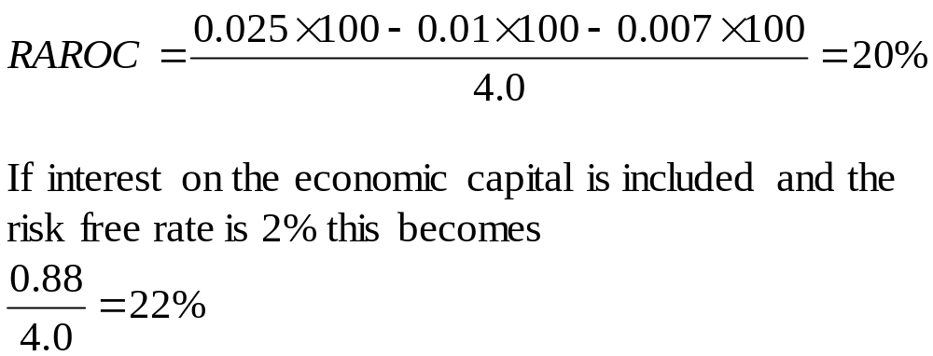
Example continued
The bank’s spread between cost of funds and interest charged is 2.5% and administrative costs are 0.7%
Risk Management and Financial Institutions 4e, Chapter 26, Copyright © John C. Hull 2015

Slide 22
Ex-ante vs Ex-post
RAROC was originally suggested as a tool to be used on an ex-ante basis. This means that we have to forecast the expected loss
It is then used as a tool to allocate capital to the most profitable parts of the business
It is also sometimes used on an ex-post basis for performance evaluation. Realized loss then replaces expected loss
Risk Management and Financial Institutions 4e, Chapter 26, Copyright © John C. Hull 2015

