Slide 1
Enterprise Risk Management
Chapter 27
Risk Management and Financial Institutions 4e, Chapter 27, Copyright © John C. Hull 2015

Slide 2
Definition (COSO)
“Enterprise risk management is a process, effected by an entity’s board of directors, management, and other personnel, applied in strategy setting and across the enterprise, designed to identify potential events that may affect the entity, and manage risk to be within its risk appetite, to provide reasonable assurance regarding the achievement of entity objectives.”
Risk Management and Financial Institutions 4e, Chapter 27, Copyright © John C. Hull 2015

Slide 3
Key Elements
Board involvement
Part of company’s strategy and help a company achieve its objectives
Identify adverse events
Manage risks consistently with risk appetite
Risk Management and Financial Institutions 4e, Chapter 27, Copyright © John C. Hull 2015

Slide 4
Risk Appetite
Regulators require banks to develop risk appetite frameworks
  How much loss at what confidence level are we prepared to risk
  What reputation risk are we prepared to take
  What credit rating risk are we prepared to take
  How concentrated should we allow our risks to become
  etc
Risk Management and Financial Institutions 4e, Chapter 27, Copyright © John C. Hull 2015

Slide 5
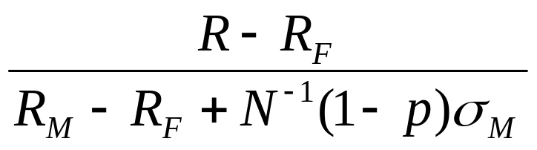
For a Fund Manager…(equation 27.1, page 565)
Key risk appetite question could be: What is the return, R, that we want to be exceeded with a high probability p
If R_{M} is the return from the market, R_{F} is the risk-free return, and σ_{M} is the standard deviation of the return from the market, then the β of the portfolio should be
Risk Management and Financial Institutions 4e, Chapter 27, Copyright © John C. Hull 2015

Slide 6
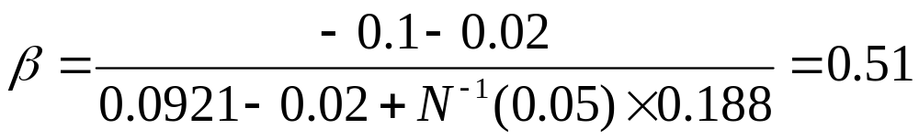
Example
Between 1994 and 2003 the mean market return was 9.21% and the standard deviation was 18.80%
If a fund manager wants to be 95% certain that the return will be greater than −10% when R_{F} = 2%, then
Risk Management and Financial Institutions 4e, Chapter 27, Copyright © John C. Hull 2015

Slide 7
Risk Culture
Decisions should be made in a disciplined way
Both short term and long term consequences should be considered
Sometimes decisions that are profitable in the short run can have adverse reputational and legal consequences in the long run
Examples:
  Bankers Trust
  Santander Rail deal
  Abacus
Risk Management and Financial Institutions 4e, Chapter 27, Copyright © John C. Hull 2015

Slide 8
Improving Risk Culture
Goldman Sachs showed in the aftermath of Abacus that it is possible to change the risk culture
Risk Management and Financial Institutions 4e, Chapter 27, Copyright © John C. Hull 2015

Slide 9
Major Risks
Important to identify major risks and decide what action, if any, should be taken
Alternatives:
  Exit activity giving rise to risk
  Reduce probability of adverse event
  Modify plans to reduce risk
  Transfer all or part of risk
  Take no action
Risk Management and Financial Institutions 4e, Chapter 27, Copyright © John C. Hull 2015

Slide 10
Avoid Cognitive Biases when Considering Risks
Wishful thinking
Anchoring on to first estimate
Availability (recent information given too much weight)
Representativeness (too much reliable on previous experiences)
Inverting conditionality
Sunk costs bias
Risk Management and Financial Institutions 4e, Chapter 27, Copyright © John C. Hull 2015

