Slide 1
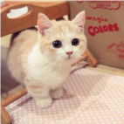
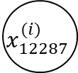

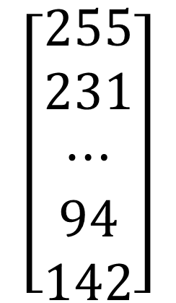
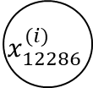



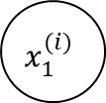

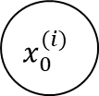





“it’s a cat”
image2vector
$$x_{0}^{(i)}$$
$$\left[\begin{aligned}255 \\ 231 \\ ⋯ \\ 94 \\ 142\end{aligned}\right]$$
/255
$$0.73≥0.5$$
$$w_{0}$$
/255
$$x_{1}^{(i)}$$
$$w_{1}$$
$$⋯$$
$$w_{12286}$$
$$w^{T}x^{(i)}+b$$
$$σ$$
$$0.73$$
$$x_{12286}^{(i)}$$
$$sigmoid$$
/255
$$w_{12287}$$
/255
$$x_{12287}^{(i)}$$

Slide 2
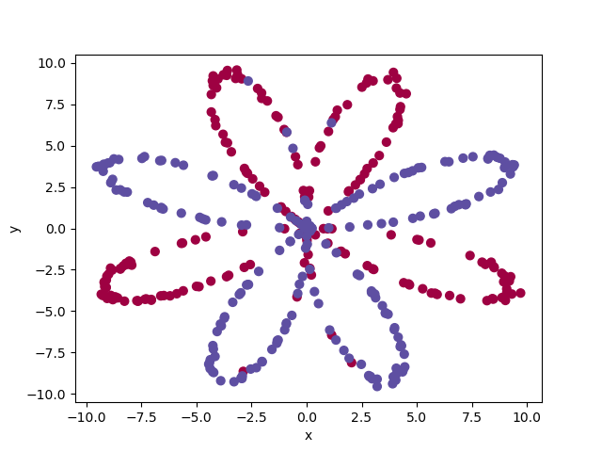
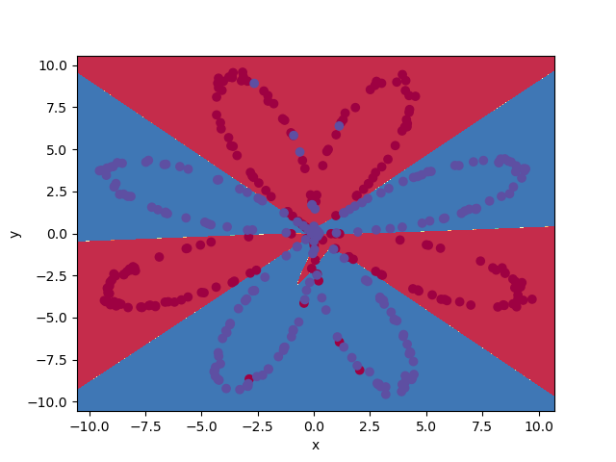
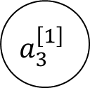
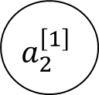
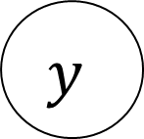

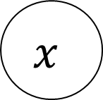

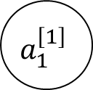
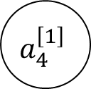
$$a_{1}^{\left[1\right]}$$
$$x$$
$$a_{2}^{\left[1\right]}$$
$$w^{[2]}a^{[1]}+b^{[2]}$$
$$σ$$
$$y$$
$$a_{3}^{\left[1\right]}$$
$$a_{4}^{\left[1\right]}$$
input layer
hidden layer (tanh)
output layer (sigmoid)

Slide 3


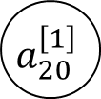


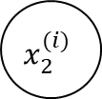

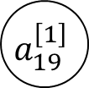
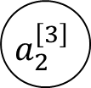

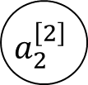
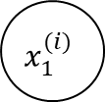

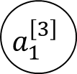
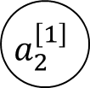
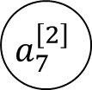
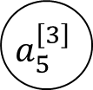

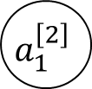

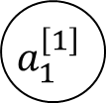
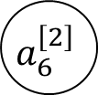
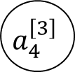
“it’s a cat”
$$0.73≥0.5$$
$$0.73$$
$$a_{1}^{\left[1\right]}$$
$$a_{1}^{\left[2\right]}$$
$$a_{1}^{\left[3\right]}$$
image2vector
/255
$$x_{1}^{(i)}$$
$$\left[\begin{aligned}255 \\ 231 \\ ⋯ \\ 94 \\ 142\end{aligned}\right]$$
$$a_{2}^{\left[1\right]}$$
$$a_{2}^{\left[2\right]}$$
$$a_{2}^{\left[3\right]}$$
/255
$$x_{2}^{(i)}$$
$$w^{[4]}a^{[3]}+b^{\left[4\right]}$$
$$σ$$
$$⋯$$
$$⋯$$
$$⋯$$
$$⋯$$
/255
$$x_{12285}^{(i)}$$
$$a_{19}^{\left[1\right]}$$
$$a_{4}^{\left[3\right]}$$
$$a_{6}^{\left[2\right]}$$
/255
$$x_{12286}^{(i)}$$
$$a_{20}^{\left[1\right]}$$
$$a_{7}^{\left[2\right]}$$
$$a_{5}^{\left[3\right]}$$
input layer
hidden layer 1
(relu)
hidden layer 2
(relu)
hidden layer 3
(relu)
output layer (sigmoid)

Slide 4
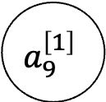
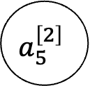
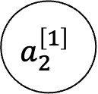
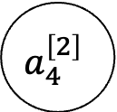
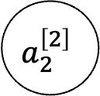
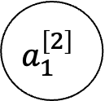
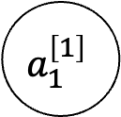


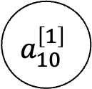

$$a_{1}^{\left[1\right]}$$
$$a_{1}^{\left[2\right]}$$
$$x$$
$$a_{2}^{\left[1\right]}$$
$$a_{2}^{\left[2\right]}$$
$$⋯$$
$$⋯$$
$$w^{[3]}a^{[2]}+b^{[3]}$$
$$σ$$
$$y$$
$$a_{9}^{\left[1\right]}$$
$$a_{4}^{\left[2\right]}$$
$$a_{10}^{\left[1\right]}$$
$$a_{5}^{\left[2\right]}$$
input layer
hidden layer 1 of size 10 (relu)
hidden layer 2 of size 5(relu)
output layer (sigmoid)

Slide 5

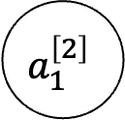
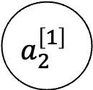


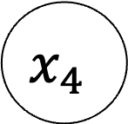
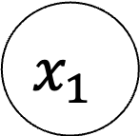

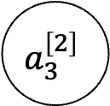
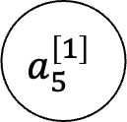
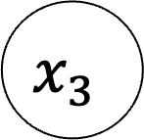
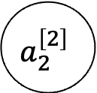
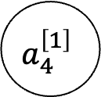
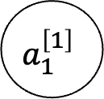
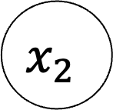
$$x_{1}$$
$$a_{1}^{\left[1\right]}$$
$$a_{1}^{\left[2\right]}$$
$$x_{2}$$
$$a_{2}^{\left[1\right]}$$
$$a_{2}^{\left[2\right]}$$
$$⋯$$
$$⋯$$
$$w^{[3]}a^{[2]}+b^{[3]}$$
$$σ$$
$$x_{3}$$
$$a_{4}^{\left[1\right]}$$
$$a_{3}^{\left[2\right]}$$
$$x_{4}$$
$$a_{5}^{\left[1\right]}$$
input layer
hidden layer 1 of size 5 (relu)
hidden layer 2 of size 3(relu)
output layer (sigmoid)

