Slide 1



Keylogger & Defence
Team 9:
Lu Hao
Guo Jie
Nan Jing
Peng Yibo
Huo Jiaxin
Zheng Yucheng

Slide 2
CONTENT
Attack
Model
Defence
Strategy
Introduction

Slide 3
1
Introduction

Slide 4
Explanation
Record keystrokes
Spread through network
Steal users' account numbers, passwords and other private information
Reside in the computer's operating system
Keyboard API layer, memory, kernel layer, etc.
Keylogging behavior is hard to spot
Do not cause obvious computer problems
Be good at hiding
Appears as a normal file or traffic
Reinstall itself

Slide 5
Motivation
Learn more about this type of attack model
Develop better defence strategies
Protect computers from attacks
Protect important information
Employers can determine how employees use computers at work with consent
Record passwords and other data when operating system crash
Scientists use keystroke logging as a research tool to study human writing process

Slide 6
Attack
Model
2

Slide 7
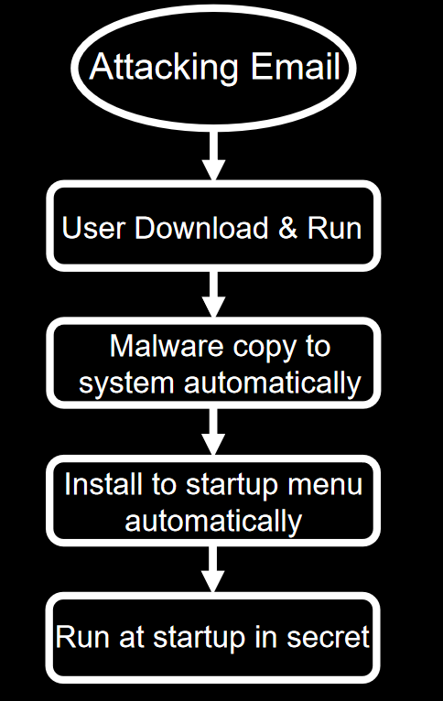
Keylogger Installation

Slide 8
Record Keystroke
Keylogger
Listen to the keyboard
Ctrl+C or Use mouse to copy
Get the info of the system
Get the screen shot
Press Key
No
Get the name of window
Get the content of clipboard
Save the result to documents
Interval > 3 s
Yes
Write the result to document
Use the analyzer
Package as an email
Send the email

Slide 9
Analyze Keystroke
Read file &Analyze strings
Include “Tab” and “Enter”?
Correct email format?
No
Yes
Yes
Correct sort order?
No
Saved as substring?
Get possible username
Yes
Correct Password format?
Yes
Get possible username & password
Yes
Save to file
Get possible password

Slide 10
Send File
Email the parsed file to attacker with useful information
Be sent every 20 seconds
Use smtplib.SMTP_SSL to connect to mailbox server
Enter account name and authorization code to log in
Use MIMEMultipart to package files into one email
User system information, clipboard information, screenshots, raw keylogging, processed keylogging and other files
Send email to attacker's mailbox

Slide 11
Strengths
Save content of the keys that user taps continuously as a string
Improves efficiency of later analysis
Screenshot function can directly obtain user's screen
The information obtained is more abundant
Obtain title of the window that users currently input
Measure the importance of keystroke information

Slide 12
Defence
Strategy
3

Slide 13
Defence Strategy
Simulate input random string（RS）
Kill the process
Delete the keylogger exe file
Capture packages
Determine whether RS are included
No
Get process name by PID
Get process location by PID
Included?
Yes
Obtain attacker PID from IP address
Judge protocol type
Yes
No
Parse packages to get recipient's info
SMTP?

Slide 14
Strengths
Low probability of false detection
The process containing random string module in the global environment must be keylogger
Security keyboard is used in the defense measures
It is not detected by system when entering sensitive information
Prevent keylogger from recording sensitive information

Slide 15
Limitation
Simulate the input string may interfere with the user's input
Type a random string may occur in other applications
Packet capture process
Attacker adopts special encoding methods like encrypted transmission
The corresponding packet cannot be detected
Attackers use techniques like hidden IP or springboard
IP address will not be found

Slide 16
Improvement
Plan to use the virtual keyboard
to complete the input of sensitive information
Will not be detected by the keylogger
Ensure the security of information

Slide 17
Reference
Tuli, P., & Sahu, P. (2013). System monitoring and security using keylogger. International Journal of Computer Science and Mobile Computing, 2(3), 106-111.
Ahmed, Y. A., Maarof, M. A., Hassan, F. M., & Abshir, M. M. (2014). Survey of Keylogger technologies. International journal of computer science and telecommunications, 5(2).
Cho, J., Cho, G., & Kim, H. (2015, July). Keyboard or keylogger?: a security analysis of third-party keyboards on android. In 2015 13th Annual Conference on Privacy, Security and Trust (PST) (pp. 173-176). IEEE.
Wazid, M., Sharma, R., Katal, A., Goudar, R. H., Bhakuni, P., & Tyagi, A. (2013, August). Implementation and embellishment of prevention of Keylogger spyware attacks. In International symposium on security in computing and communication (pp. 262-271). Springer, Berlin, Heidelberg.

