Slide 1
Sales Forecasting &
Regional Performance
Comprehensive Data Science Project
Data Science Internship Capstone | 100 transactions, Jan–Apr 2024

Slide 2
Business Problem
What leadership wants to know from 3 months of sales data
Where is sales performance strong or weak across regions and products?
Can we forecast revenue for the next few weeks?
Can we estimate what a new deal is worth, before it's priced?
Dataset: 100 transactions · 4 regions · 5 products · ₹12.4M total revenue · no missing/duplicate data

Slide 3
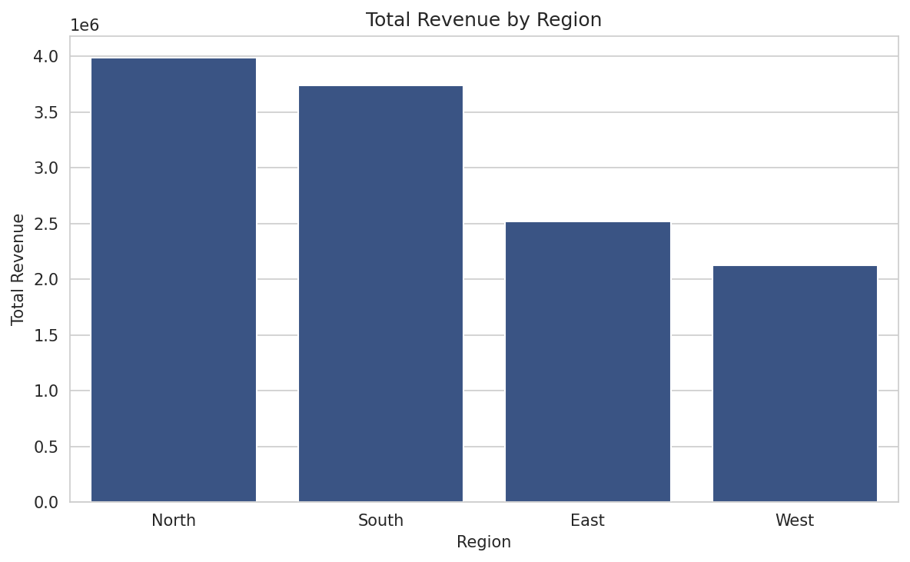
Revenue by Region
North and South lead; West trails
Key takeaway
North (₹3.98M) and South (₹3.74M) bring in the most revenue.
West (₹2.12M) is clearly behind the other three regions.

Slide 4
Is the Regional Gap Real?
A one-way ANOVA test on deal size across regions
p ≈ 0.10
(not significant at 5%, but close)
West's average deal (₹81.7K) is the lowest of all 4 regions (vs ₹132–142K elsewhere).
The test doesn't quite reach the standard 5% cutoff — likely because the sample is small (100 deals).
The gap comes from fewer units sold per deal in West, not a different product mix.

Slide 5
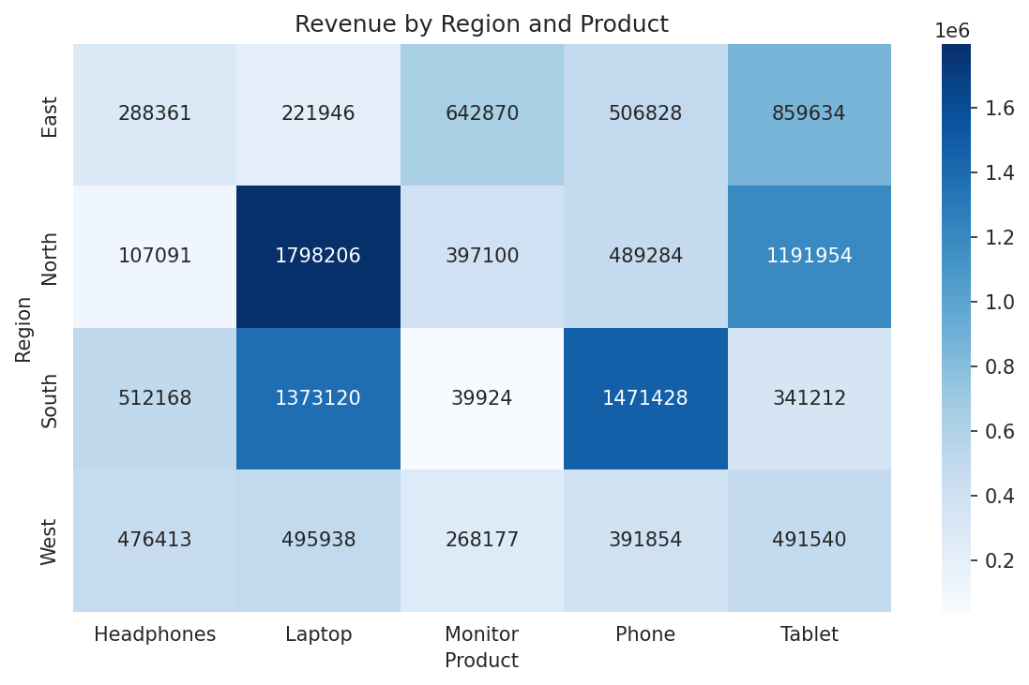
Revenue by Region & Product
Checking if West's gap is about product mix
Key takeaway
West sells across the same 5 products as other regions.
The shortfall isn't concentrated in one product — it's a broad, region-wide pattern.

Slide 6
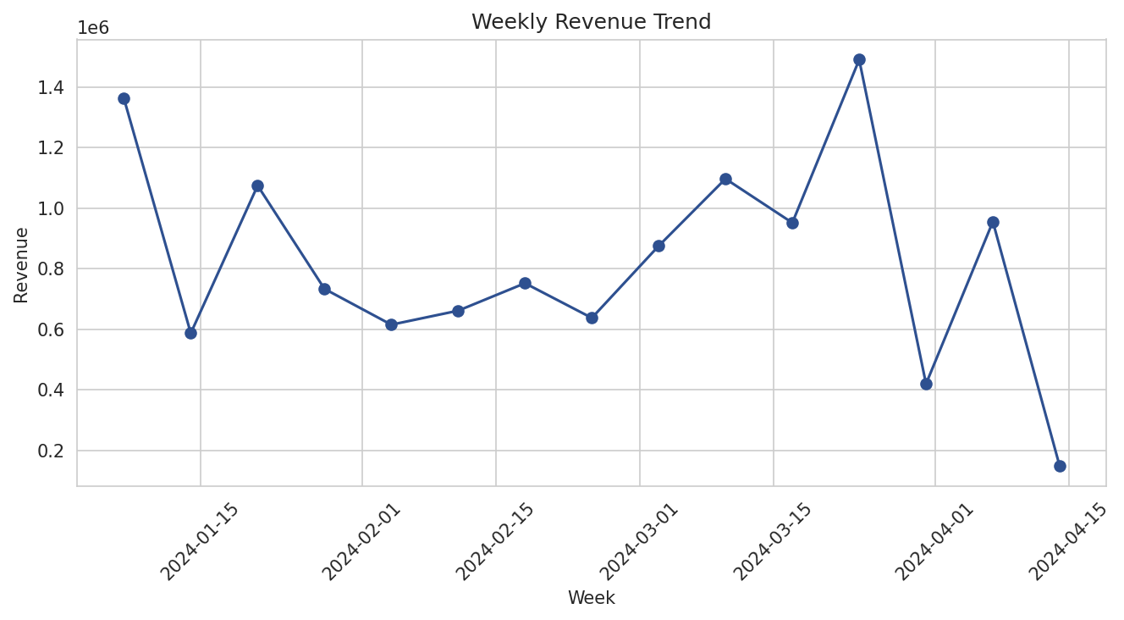
Weekly Revenue Trend
14 weeks of history — is there a trend?
Key takeaway
No clear upward or downward trend visible yet.
A flat historical average beat a linear trend line when tested on the last 3 weeks.
Forecast for next 4 weeks: ~₹824K/week.

Slide 7
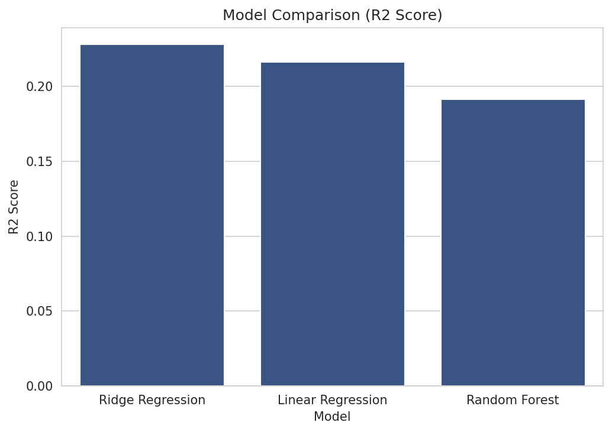
Comparing Prediction Models
5-fold cross-validation on 3 regression models
Key takeaway
Ridge Regression scored best on cross-validation.
Random Forest overfit slightly with this little data.
Ridge selected as the final model.

Slide 8
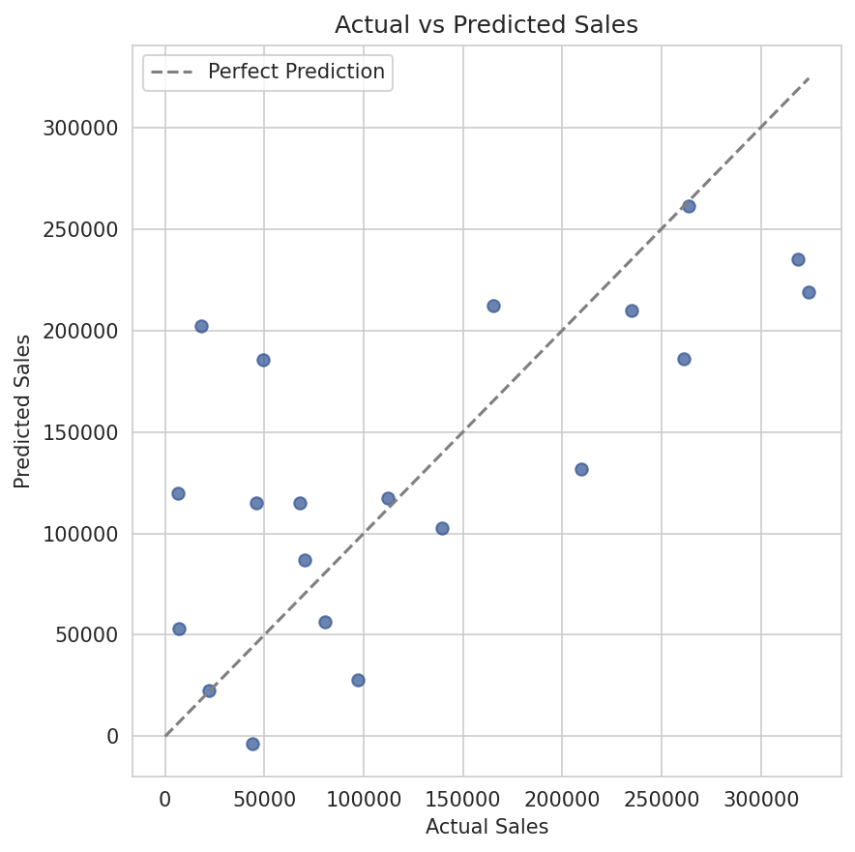
Model Performance
Ridge Regression on the test set
Key takeaway
R² ≈ 0.46, MAE ≈ ₹60,600.
Points cluster reasonably around the perfect-prediction line.
Good for rough pipeline sizing — not precise enough for a final quote.

Slide 9
Recommendations
1. Look into West's sales process
2. Budget to the average, not a trend
Focus on deal size (bundling, upselling) rather than the product catalog.
Use ~₹824K/week; revisit monthly as more data arrives.
3. Use the model for early planning
4. Re-test significance later
R² 0.46 — good for pipeline sizing, not final pricing.
Regional gap is descriptively real; re-run the ANOVA as more deals come in.

Slide 10
Deployed Dashboard
Streamlit dashboard: sales overview, forecast, and deal-value estimator
Full analysis, code, and reports on GitHub
Thank you!

