Slide 1

About Us
Welcome to People Hunt Consultancy
People Hung Consultancy is a boutique Executive Search firm and HR Consultancy firm based in Hong Kong, with global reach. We are dedicated to meeting the recruitment and human resources needs of businesses across various sectors. We have established a strong track record in our specializations. Our focus includes a range of industries and functions, some of these industries include: Fast- Moving Consumer Goods (FMCG), Information Technology and Telecommunications, Luxury and Retails, and Healthcare industries, we excel in sourcing talent for a wide range of positions, from Associates level up to Partner.
Our approach is rooted in building strong connections between candidates and corporate clients through a customized search methodology. We leverage innovative talent mapping solutions and deep local market insights to ensure a successful match. Working with the best, we represent only the best in the industry, high performing individuals that can really make a difference to our client's success.
Our Values
We are focused on building long-term relationships with our clients and candidates and have built a reputation based on confidentiality, honesty, the highest level of integrity and working ethics in all our actions.

Slide 2


Our service
Our service includes permanent, temporary and contract appointments covering all levels for associates, middle management and senior executives.
Clients
Our approach is simple. We listen very carefully, and we make sure we understand your business and needs. Our bespoke solutions aim to connect companies to the most qualified candidates who can give our clients‘ businesses a competitive advantage.
People Hunt keeps ahead of its competition by continuously growing its understanding of the constantly evolving employment market. Coupled with this knowledge, everything we do is underpinned by professionalism, commitment and communication.
Candidates
Your career is our business. We are only as good as the people we place. The majority of candidates we speak to have approached us after being referred by our network or have appeared on our radar as part of our headhunting process. We invest time and energy in getting to know you, not just your CV. Our team work hard to match your skill set, aspirations, and experience to clients with the right requirements and company culture for you.

Slide 3
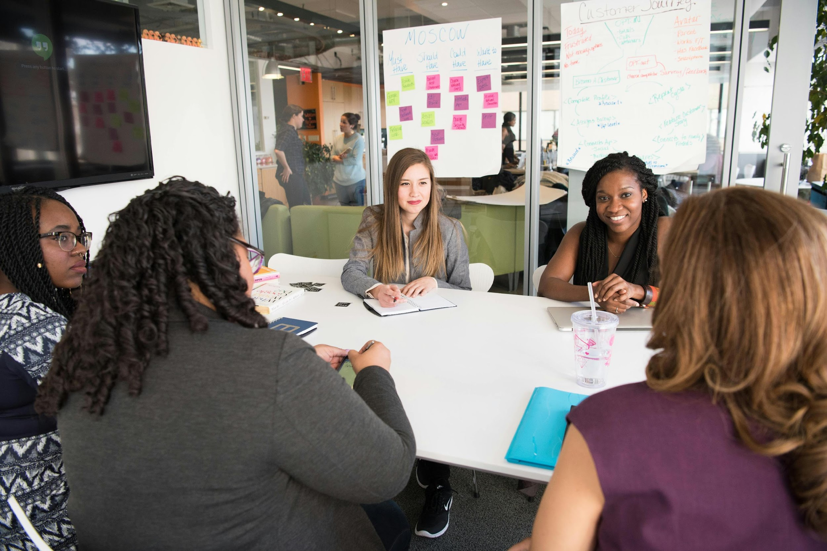
Work for Us
At People Hunt Consultancy , we are dedicated to fostering a diverse and inclusive workforce that reflects the diverse communities we serve. We believe that a variety of perspectives and backgrounds enrich our team and enhance our ability to connect talent with opportunity.
Explore more about our mission and values, and discover how you can be a part of our dynamic team!
If you are interested in joining us, please submit your CV via the email as follows:
info@peoplehuntconsultancy.com

Slide 4



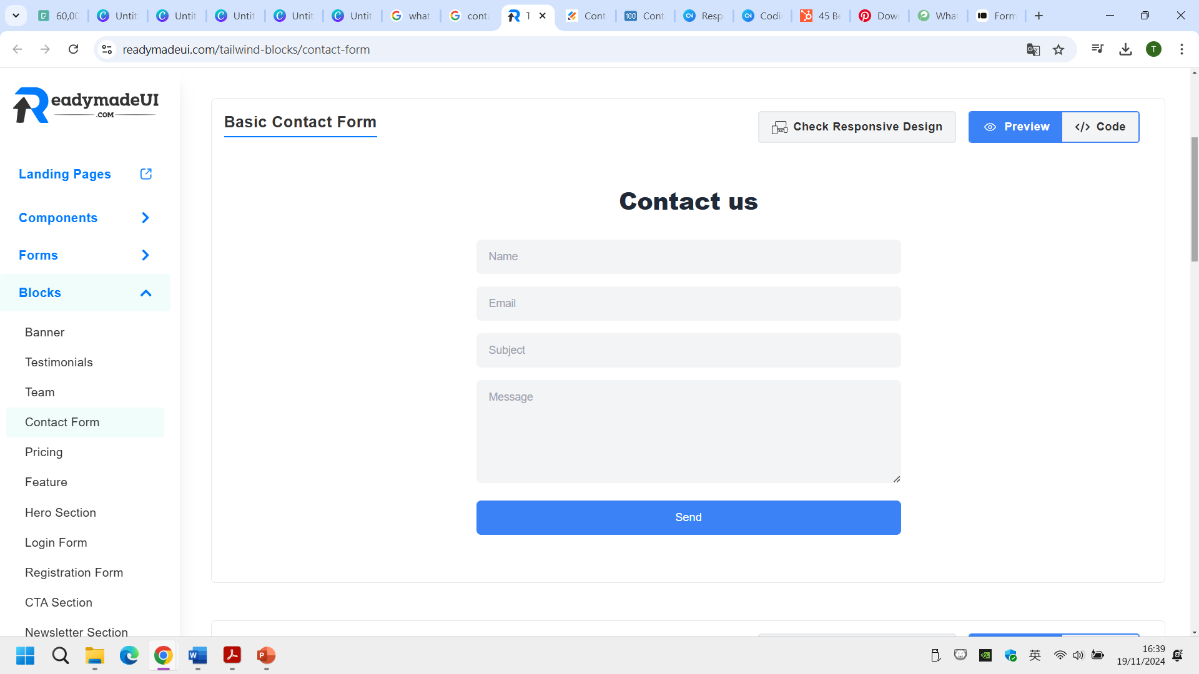
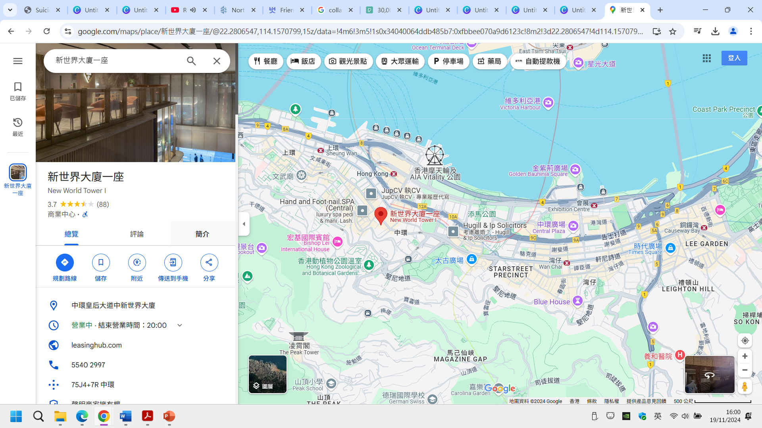
Contact Us
Address: Unit 506, 5/F, New World Tower I, 18 Queen's Road Central, Hong Kong
Tel: 852-37560173
Linkedin: https://www.linkedin.com/company/people-hunt-consultancy/
Email: info@peoplehuntconsultancy.com

