Slide 1
Face
Mask
Detection
Pornphat Sroison
61130500244

Slide 2
01
Background

Slide 3
Background
“
The whole world today, is facing the COVID-19 pandemic. People are using various measures to control the spread of Coronavirus. Wearing a face mask is one of such most important to reduce the risk of viral transmission.
”
Notes:
The whole world today, is facing the COVID-19 pandemic. People are using various measures and it have a lot of research
to control the spread of Coronavirus. One of research have also proved that wearing a face mask remarkably reduces the problem
of viral transmission. There are many public places as well as public service providers require customers to use the service and
place only if they wear mask correctly. However, it is not feasible to manually check whether a person is wearing a face mask or not.
So, Machine Learning and Artificial Intelligence consist of various technologies will provide effective solutions to complex problems in this areas.

Slide 4
02
Objective and Scope

Slide 5
Objective
01
02
03
To provide some effective technology for preventing the spread of Coronavirus.
To safety of society by predicting the future outbreaks of COVID-19.
Ensure a safe working environment and
save the lives of people.
Notes:
The main objective of “Face mask detection” project is
1.To provide some effective technology for preventing the spread of Coronavirus
2.Help to take necessary precautions for the safety of society by predicting the future outbreaks of COVID-19.
3.Ensure a safe working environment and save the lives of people.

Slide 6
Scope
Real-time Face Mask Detection
with 3 Classes
Notes:
In order to prevent the spread of Coronavirus, this project have made an attempt to develop a face mask detection system
using machine learning and image processing. For this system, one can detect a person are wearing a face mask or not.
If the person is not wearing a face mask, then system will show some message like ‘No Mask ‘. If a person is wearing a face mask
but it not properly, then system will show message 'incorrect mask' and otherwise it will show ‘Mask’ message

Slide 7
03
Datasets

Slide 8
Datasets
Total : 5,911 images
Without Mask
Incorrect Mask
Correct Mask
1,918 images
2,049 images
1,944 images
Split Data
Training Dataset = 80%
Testing Dataset = 20%
Notes:
I separate datasets into 3 classes: without mask, incorrect mask and correct mask.
Each class has about 2000 pictures and total images about 6000.
Then split data into training 80% and testing 20%

Slide 9

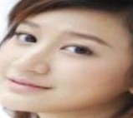
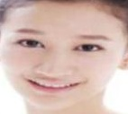
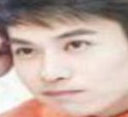
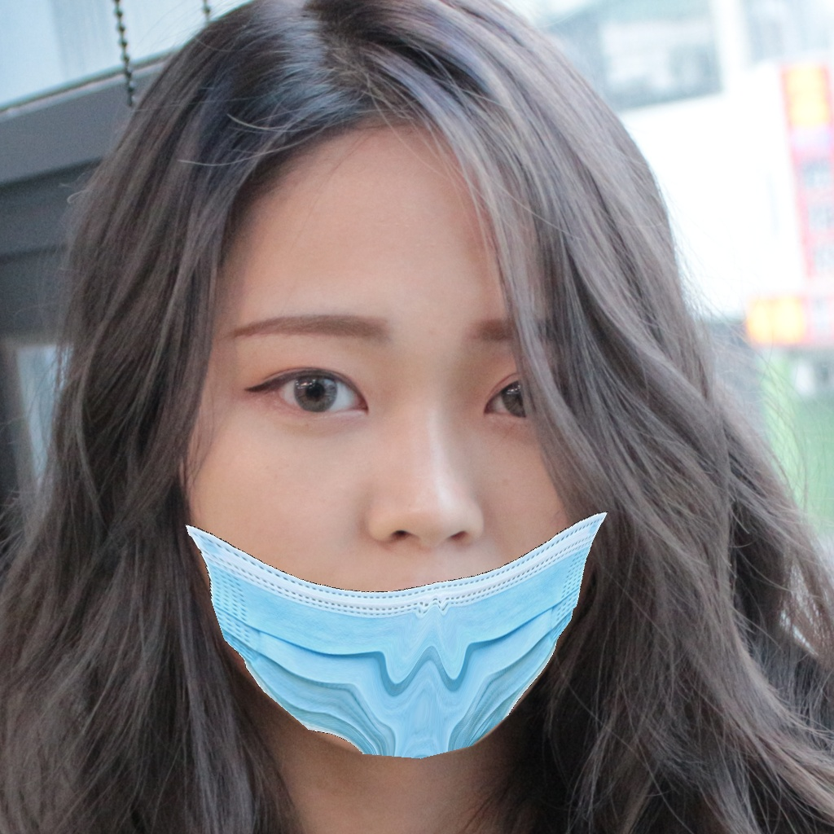
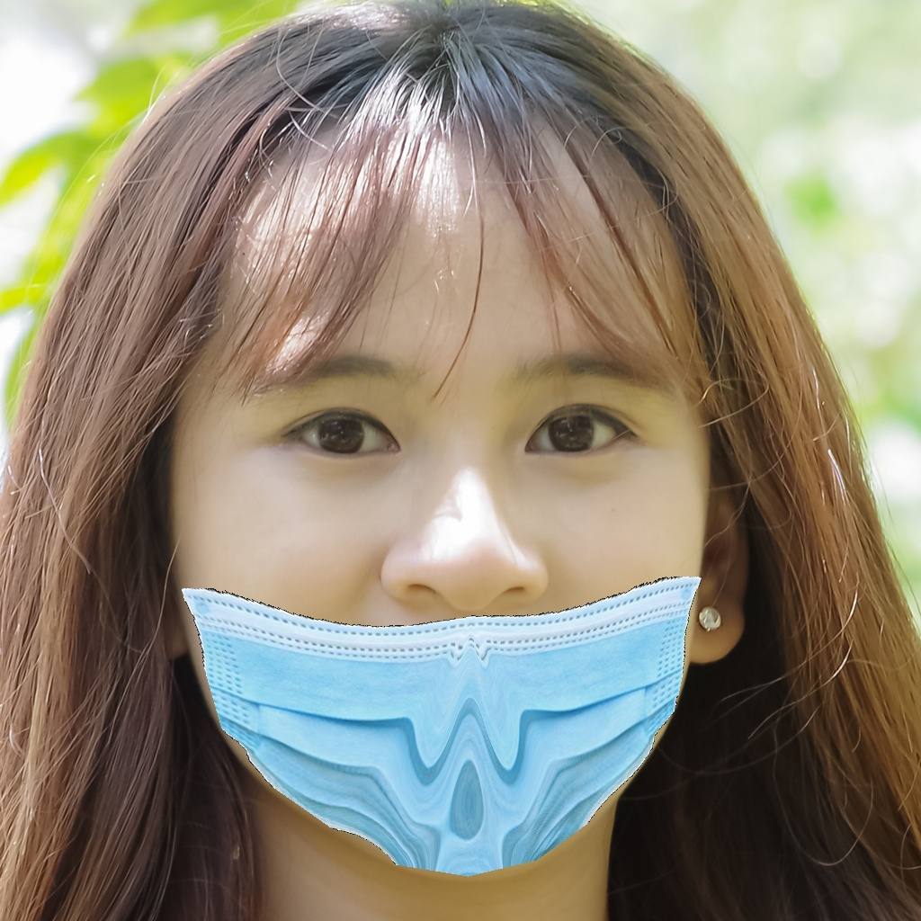
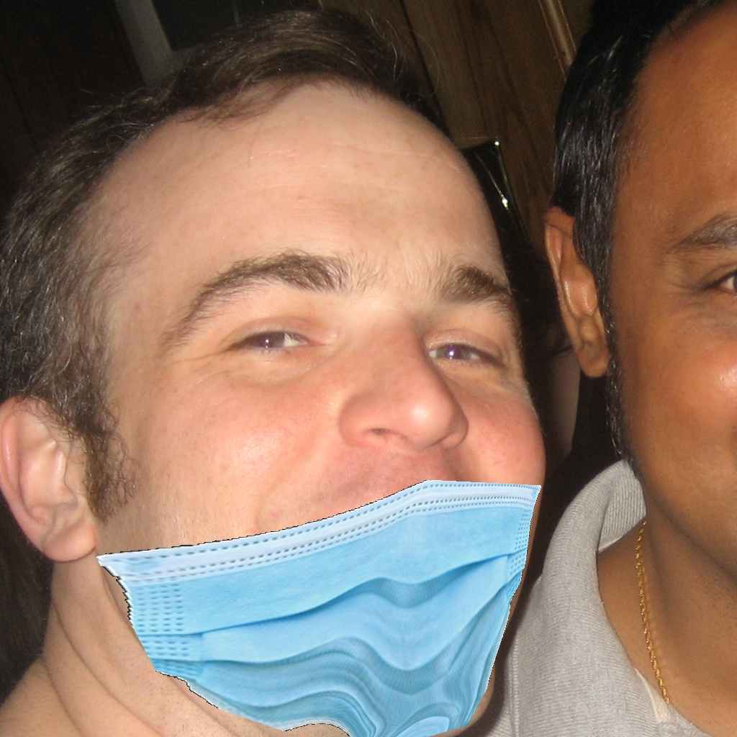
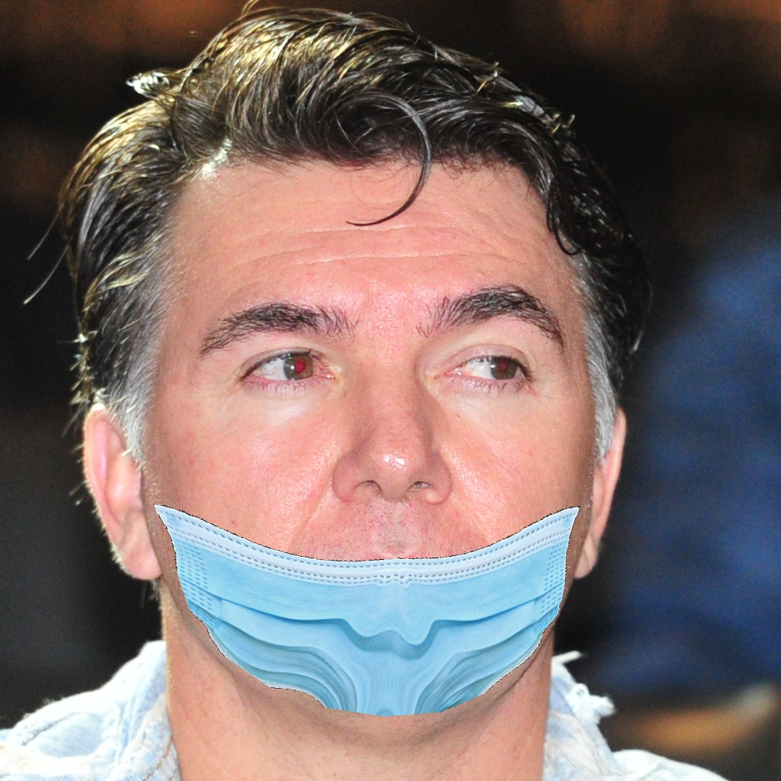
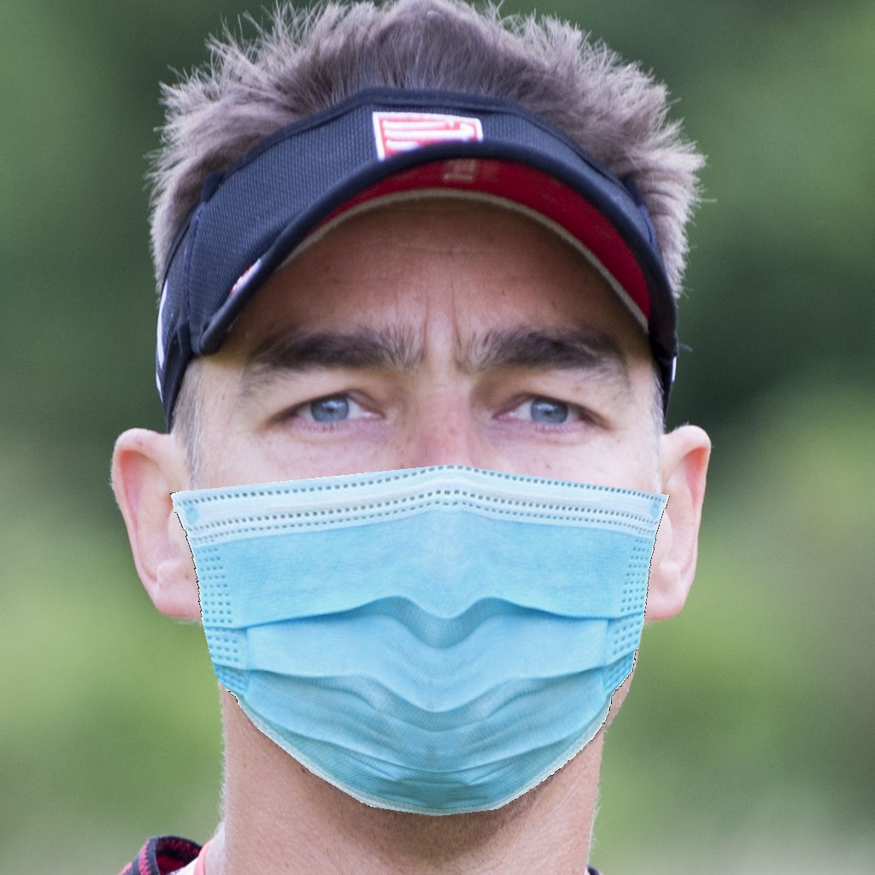
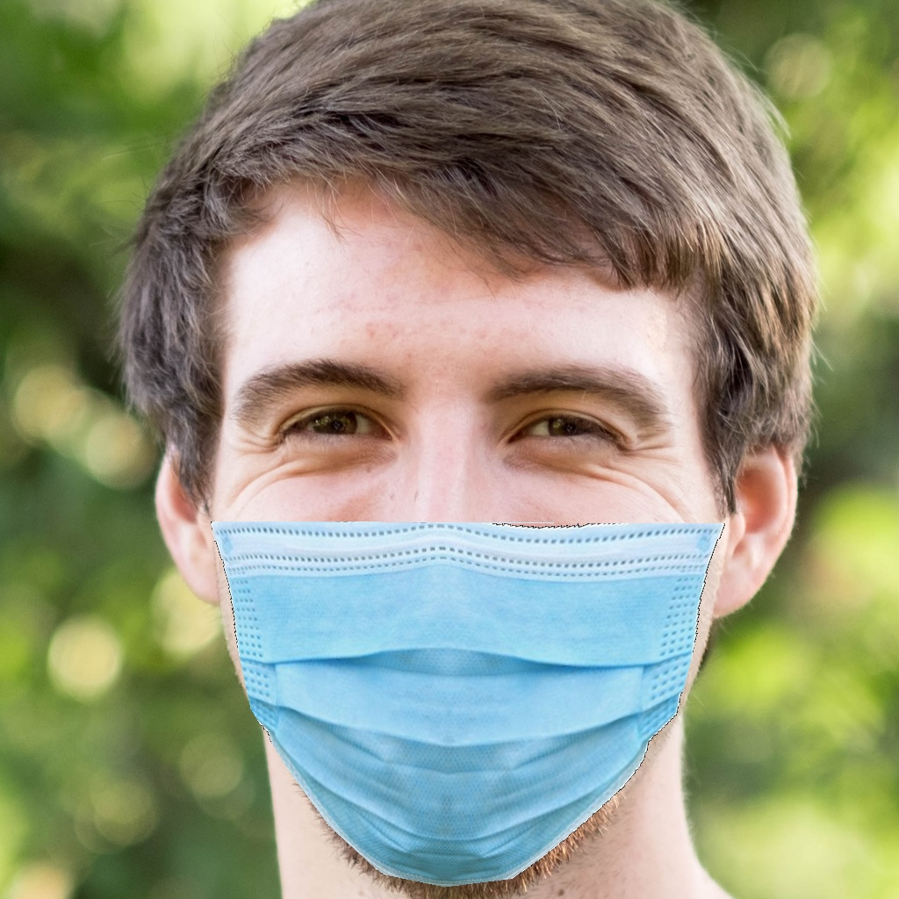
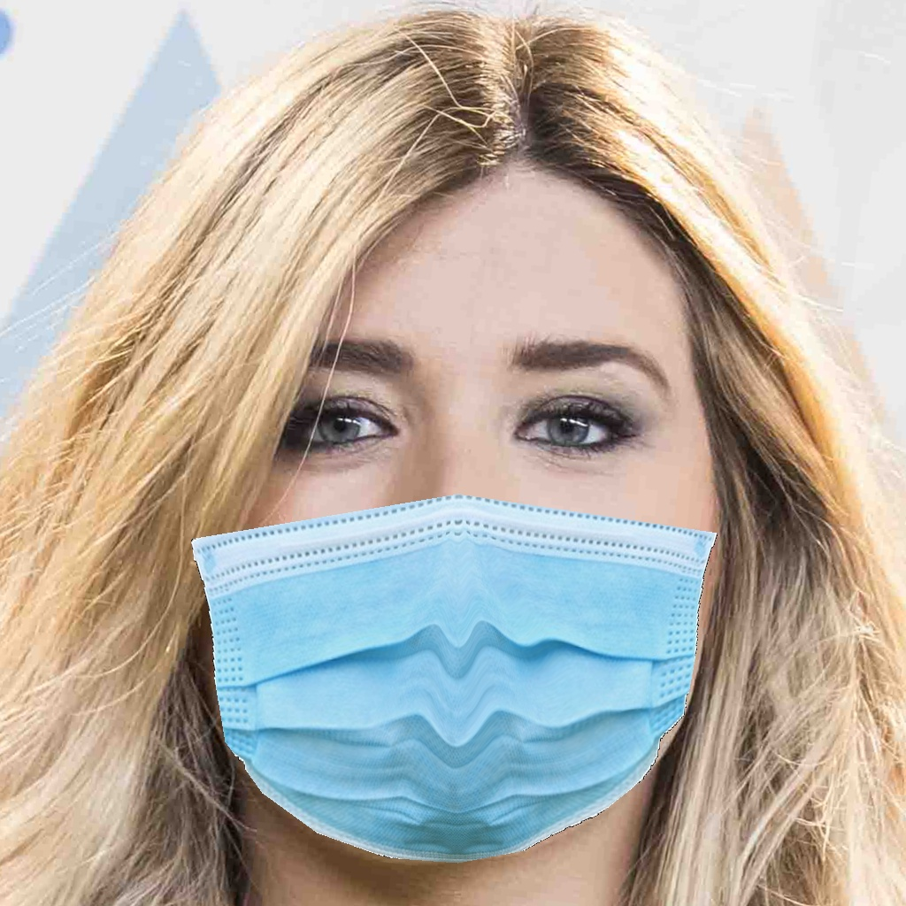
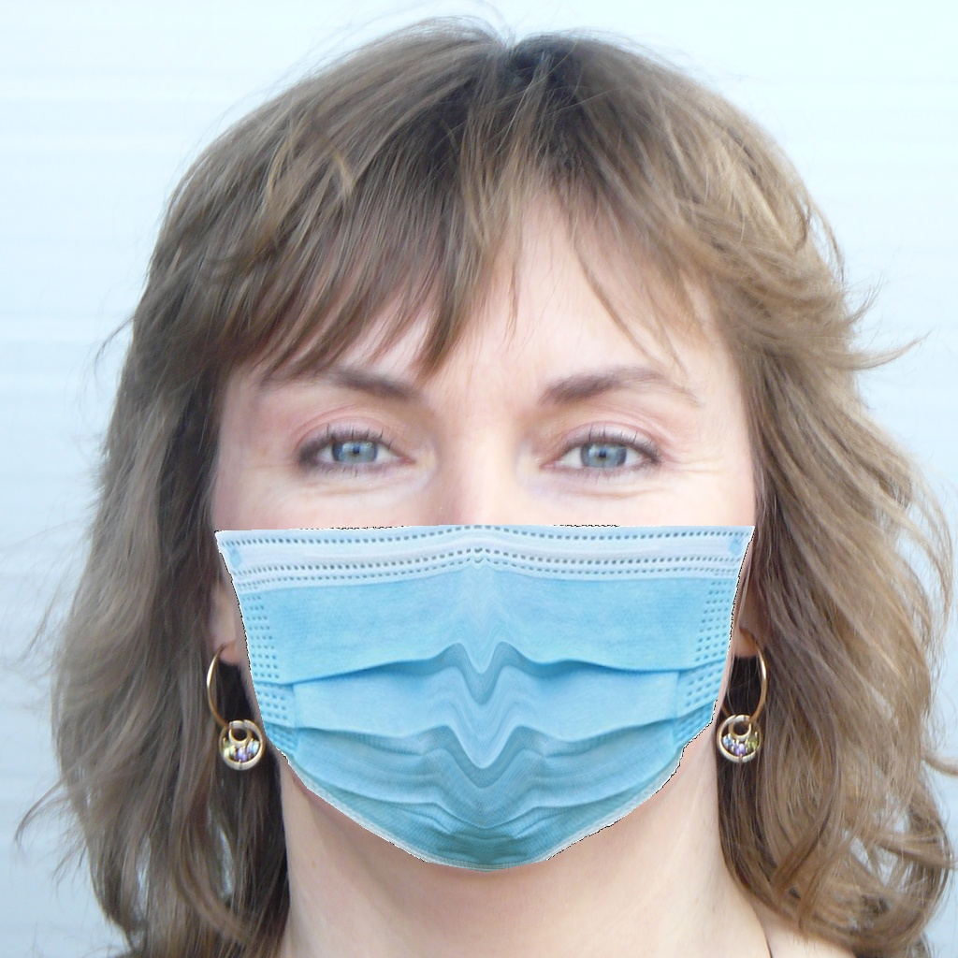
Sample Images of Each Class
Without Mask : Person not wearing a mask
Incorrect Mask : The mask not covers the nose.
Correct Mask : Person is wearing mask properly
Notes:
This is a sample images of each class. For the class without mask is person not wear mask.
For class incorrect mask is Person wearing a mask but it not properly. Because the mask not covers the nose.
And class correct mask is person wear mask properly.

Slide 10
04
Model

Slide 11
Capture an image through webcam
Extraction of images from frames.
Load face mask detection model
Apply image
preprocessing
Display message according to result
Convert result into image frame
Apply face mask detector
(Mask or not)
Notes:
Initially this project will capture an image through webcam to detect person’s face. Extraction images from the frames.
Then face mask detector model will be loaded. Operation on images will be performed for detection by Image preprocessing,
apply face mask detector. And Respective results will be converted into image frames.

Slide 12

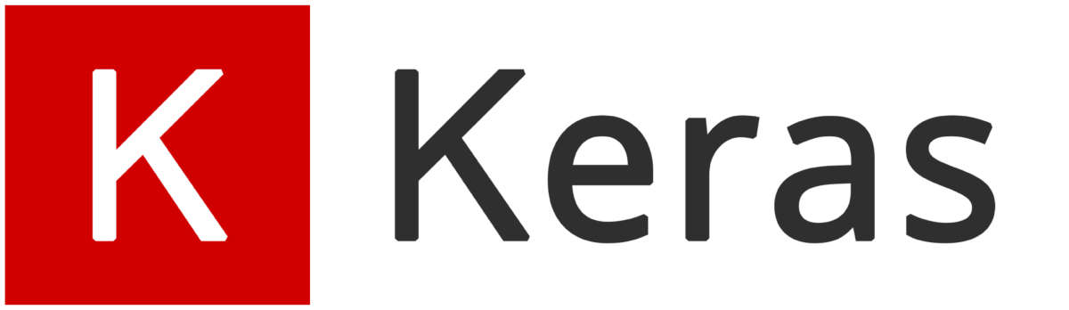


Model
Process of acquiring data, training models, solving the predictions, and refining future results.
Used for developing and evaluating different deep learning models.
Provides a real-time optimized Computer Vision library, tools, and hardware.
OpenCV

Slide 13
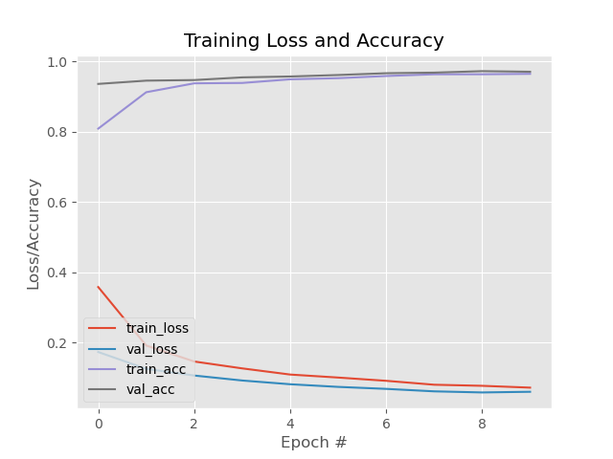
Training Accuracy and Training Loss
MobileNetV2 Model
Accuracy = 0.958
Notes:
Training Accuracy and loss, you can see that the graph of train and validation accuracy the value close to 1
and train and validation loss the value close to 0 when epoch = 10

Slide 14
DEMO
Notes:
If person is wearing mask properly then system will display message like “Mask” with green signal.
If the person in not wearing in proper way, then system will display message like “Incorrect Mask” with Blue signal.
If the person is not wearing mask, then system will display message like “No Mask” with red signal.

Slide 15
References
Source Code
Datasets
https://www.kaggle.com/andrewmvd/face-mask-detection
https://github.com/cabani/MaskedFace-Net
Model and OpenCV
https://www.pyimagesearch.com/2020/05/04/covid-19-face-mask-detector-with-opencv-keras-tensorflow-and-deep-learning/
https://fortes-arthur.medium.com/building-a-personalized-face-mask-detection-using-opencv-and-deep-learning-4aae008c95a0
https://www.mygreatlearning.com/blog/real-time-face-detection/
https://drive.google.com/drive/folders/13s2tJ1jBYrNihibeTjvsbfwN9Kv_-3jP?usp=sharing

Slide 16
Thanks
You

