Slide 1
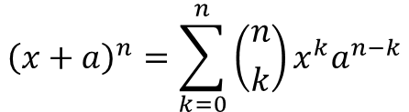
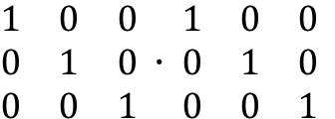
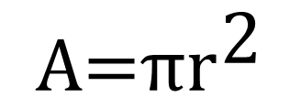

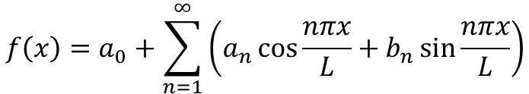

PPTX 기호 삽입
$${\text{A}\text{=}\text{π}\text{r}}^{\text{2}}$$
$$f\left(x\right)=a_{0}+\sum_{n=1}^{∞}{\left(a_{n}\cos{\frac{nπx}{L}}+b_{n}\sin{\frac{nπx}{L}}\right)}$$
$${\left(x+a\right)}^{n}=\sum_{k=0}^{n}{\left({n \atop k}\right)x^{k}a^{n−k}}$$
$$a^{2}+b^{2}=c^{2}$$
$${\left(1+x\right)}^{n}=1+\frac{nx}{1!}+\frac{n\left(n−1\right)x^{2}}{2!}+…$$
$\begin{matrix}1 & 0 & 0 \\ 0 & 1 & 0 \\ 0 & 0 & 1\end{matrix} ∙ \begin{matrix}1 & 0 & 0 \\ 0 & 1 & 0 \\ 0 & 0 & 1\end{matrix}$

Slide 2
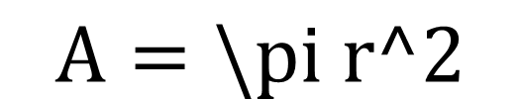

latex로 수식 표현한 경우
$$A=\backslash pi r^2$$
$$\backslash left(x+a\backslash right)^n=\backslash sum_\{k=0\}^\{n\}\{\backslash binom\{n\}\{k\}x^ka^\{n−k\}\}$$
$$\backslash left(1+x\backslash right)^n=1+\backslash frac\{nx\}\{1!\}+\backslash frac\{n\backslash left(n−1\backslash right)x^2\}\{2!\}+\backslash ldots$$
$$f\backslash left(x\backslash right)=a_0+\backslash sum_\{n=1\}^\{\backslash infty\}\backslash left(a_n\backslash cos\{\backslash frac\{n\backslash pi x\}\{L\}\}+b_n\backslash sin\{\backslash frac\{n\backslash pi x\}\{L\}\}\backslash right)$$
$$a^2+b^2=c^2$$
$\backslash begin\{matrix\}1\&0\&0\backslash \backslash 0\&1\&0\backslash \backslash 0\&0\&1\backslash \backslash \backslash end\{matrix\}\backslash \backslash bullet\backslash \backslash begin\{matrix\}1\&0\&0\backslash \backslash 0\&1\&0\backslash \backslash 0\&0\&1\backslash \backslash \backslash end\{matrix\}$

Slide 3

$$±∞=≠\sim ×÷!∝<≪>≫≤≥∓≅≈≡∀∁∂√∛∜∪∩∅\%°℉℃∆∇∃∄∈∋←↑→↓↔∴+−¬αβγδεεθθμπρστφω∗∙⋮⋯⋰⋱ℵℶ∎$$
$$αβγδεεζηθθικλμνξοππρρσςτυφφχψωΑΒΓΔΕΖΗΘΙΚΛΜΝΞΟΠΡΣΤΥΦΧΨΩ$$
$$∀∁ℂ∂ðℇϜℲℊℋℌhℏ℩ıℑjκℒℓℕ℘ℚℛℜℝℤ℧Åℬ℮ℰ∃∄ℱℳℴℵℶℷℸ$$
$$+−÷×±∓∝∕∗∘∙⋅∩∪⊎⊓⊔∧∨=≠<>≤≥≮≰≯≱≡∼≃≈≅≢≄≉≇∝≪≫∈∋∉⊂⊃⊆⊇≺≻≼≽⊏⊐⊑⊒∥⊥⊢⊣⋈≍$$
$$∑∫∬∭∮∯∰∱∲∳∏∐⋂⋃⋀⋁⨀⨂⨁⨄⨃∔∸∖⋒⋓⊟⊠⊡⊞⋇⋉⋊⋋⋌⋏⋎⊝⊺⊕⊖⊗⊘⊙⊛⊚†‡⋆⋄≀△⋀⋁⨀⨂⨁⨅⨆⨄⨃$$
$$∴∵⋘⋙≦≧≲≳⋖⋗≶⋚≷⋛≑≒≓∽≊⋍≼≽⋞⋟≾≿⋜⋝⊆⊇⊲⊳⊴⊵⊨⋐⋑⊏⊐⊩⊪≖≗≜≏≎∝≬⋔≐⋈$$
$$←→↑↓↔↕⇐⇒⇑⇓⇔⇕⟵⟶⟷⟸⟹⟺↗↖↘↙↚↛↮⇍⇏⇎⇠⇢↤↦⟻⟼↩↪↼↽⇀⇁↿↾⇃⇂⇋⇌⇇⇉⇈⇊⇆⇄↫↬↢↣↰↱↲↳⇚⇛↞↠↶↷↺↻⊸↭↜↝⇜⇝$$
$$≠≮≯≰≱≢≁≄≉≇≭≨≩⊀⊁⋠⋡∉∌⊄⊅⊈⊉⊊⊋⋢⋣⋦⋧⋨⋩⋪⋫⋬⋭∤∦⊬⊭⊮⊯∄$$
$$𝒜ℬ𝒞𝒟ℰℱ𝒢ℋℐ𝒥𝒦ℒℳ𝒩𝒪𝒫𝒬ℛ𝒮𝒯𝒰𝒱𝒲𝒳𝒴𝒵𝒶𝒷𝒸𝒹ℯ𝒻ℊ𝒽𝒾𝒿𝓀ℓ𝓂𝓃ℴ𝓅𝓆𝓇𝓈𝓉𝓊𝓋𝓌𝓍𝓎𝓏$$
$$𝔄𝔅ℭ𝔇𝔈𝔉𝔊ℌℑ𝔍𝔎𝔏𝔐𝔑𝔒𝔓𝔔ℜ𝔖𝔗𝔘𝔙𝔚𝔛𝔜ℨ𝔞𝔟𝔠𝔡𝔢𝔣𝔤𝔥𝔦𝔧𝔨𝔩𝔪𝔫𝔬𝔭𝔮𝔯𝔰𝔱𝔲𝔳𝔴𝔵𝔶𝔷$$
$$𝔸𝔹ℂ𝔻𝔼𝔽𝔾ℍ𝕀𝕁𝕂𝕃𝕄ℕ𝕆ℙℚℝ𝕊𝕋𝕌𝕍𝕎𝕏𝕐ℤ𝕒𝕓𝕔𝕕𝕖𝕗𝕘𝕙𝕚𝕛𝕜𝕝𝕞𝕟𝕠𝕡𝕢𝕣𝕤𝕥𝕦𝕧𝕨𝕩𝕪𝕫$$
$$∟∠∡∢⊾⊿⋕⊥∤∥∦∶∷∴∵∎$$

Slide 4

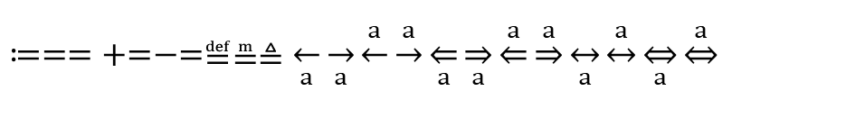

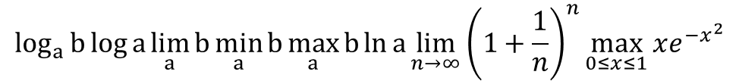
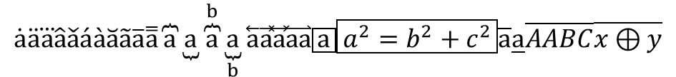

$$\frac{a}{b}a/ba/b\frac{a}{b}\frac{dy}{dx}\frac{Δy}{Δx}\frac{∂y}{∂x}\frac{δy}{δx}\frac{π}{2}$$
$$a^{b}a_{b}a_{b}^{c}{}_{a}^{b}cx_{y^{2}}e^{−iωt}x^{2}{}_{1}^{n}Y$$
$$\sqrt{a}\sqrt[a]{b}\sqrt[2]{a}\sqrt[3]{a}\frac{−b±\sqrt{b^{2}−4ac}}{2a}\sqrt{a^{2}+b^{2}}$$
$$\int{a}\int_{a}^{b}{c}\int_{a}^{b}{c}\iint{a}\iint_{a}^{b}{c}\iint_{a}^{b}{c}\iiint{a}\iiint_{a}^{b}{c}\iiint_{a}^{b}{c}\oint{a}\oint_{a}^{b}{c}\oint_{a}^{b}{c}∯{a}∯_{a}^{b}{c}∯_{a}^{b}{c}∰{a}∰_{a}^{b}{c}∰_{a}^{b}{c}ⅆxⅆyⅆθ$$
$$\sum_{a}^{b}{c}\sum_{a}^{b}{c}\sum_{a}{b}\sum_{a}{b}\prod{a}\prod_{a}^{b}{c}\prod_{a}^{b}{c}\prod_{a}{b}\prod_{a}{b}\coprod{a}\coprod_{a}^{b}{c}\coprod_{a}^{b}{c}\coprod_{a}{b}\coprod_{a}{b}\bigcup{a}\bigcup_{a}^{b}{c}\bigcup_{a}^{b}{c}\bigcup_{a}{b}\bigcup_{a}{b}\bigcap{a}\bigcap_{a}^{b}{c}\bigcap_{a}^{b}{c}\bigcap_{a}{b}\bigcap_{a}{b}\sum{a}$$
$$\bigvee{a}\bigvee_{a}^{b}{c}\bigvee_{a}^{b}{c}\bigvee_{a}{b}\bigvee_{a}{b}\bigwedge{a}\bigwedge_{a}^{b}{c}\bigwedge_{a}^{b}{c}\bigwedge_{a}{b}\bigwedge_{a}{b}\sum_{k}{\left({n \atop k}\right)}\sum_{i=0}^{n}{a}\sum_{\begin{aligned}0≤i≤m \\ 0<j<n\end{aligned}}{P\left(i,j\right)}\prod_{k=1}^{n}{A_{k}}\bigcup_{n=1}^{m}{\left(X_{n}∩Y_{n}\right)}$$
$$\left(a\right)\left[a\right]\left\{a\right\}\left\langle a\right\rangle \left\lfloor a\right\rfloor \left\lceil a\right\rceil \left|a\right|\left\|a\right\|\left[a\right[\left]a\right]\left]a\right[⟦a⟧\left(a | b\right)\left\{a | b\right\}\left\langle a | b\right\rangle \left\langle a | b | c\right\rangle \left(a\right.\left.b\right)\left[a\right.\left.b\right]\left\{a\right.\left.b\right\}\left\langle a\right.\left.b\right\rangle \left\lfloor a\right.\left.b\right\rfloor \left\lceil a\right.\left.b\right\rceil \left|a\right.\left.b\right|\left\|a\right.\left.b\right\|⟦ab⟧\left\{\begin{aligned}a \\ b\end{aligned}\right.\left\{\begin{aligned}a \\ b \\ c\end{aligned}\right.{a \atop b}\left({a \atop b}\right)f\left(x\right)=\left\{\begin{aligned}−&x, x<0 \\ &x, x≥0\end{aligned}\right.\left({n \atop k}\right)\left\langle {n \atop k}\right\rangle$$
$$\sin{a}\cos{a}\tan{a}\csc{a}\sec{a}\cot{a}\sin^{−1}{a}\cos^{−1}{a}\tan^{−1}{a}\csc^{−1}{a}\sec^{−1}{a}\cot^{−1}{a}\sinh{a}\cosh{a}\tanh{a}\operatorname{csch}{a}\operatorname{sech}{a}\coth{a}\sinh^{−1}{a}\cosh^{−1}{a}\tanh^{−1}{a}{csch}^{−1}{a}{sech}^{−1}{a}\coth^{−1}{a}$$
$$\dot{a}\ddot{a}\overset{⃛}{a}\hat{a}\check{a}\acute{a}\grave{a}\breve{a}\tilde{a}\overline{a}\overset{̿}{a}\overbrace{a}\underbrace{a}\overset{b}{\overbrace{a}}\underset{b}{\underbrace{a}}\overset{⃖}{a}\vec{a}\overset{⃡}{a}\overset{⃐}{a}\overset{⃑}{a}\boxed{a}\boxed{a^{2}=b^{2}+c^{2}}\overline{a}\underline{a}\overline{A}\overline{ABC}\overline{x⊕y}$$
$$\log_{a}{b}\log{a}\lim_{a}{b}\min_{a}{b}\max_{a}{b}\ln{a}\lim_{n→∞}{{\left(1+\frac{1}{n}\right)}^{n}}\max_{0≤x≤1}{xe^{−x^{2}}}$$
$$≔==+=−=≝≞≜\overset{←}{a}\overset{→}{a}\underset{←}{a}\underset{→}{a}\overset{⇐}{a}\overset{⇒}{a}\underset{⇐}{a}\underset{⇒}{a}\overset{↔}{a}\underset{↔}{a}\overset{⇔}{a}\underset{⇔}{a}$$
$$\begin{matrix}a & b\end{matrix}\begin{matrix}a \\ b\end{matrix}\begin{matrix}a & b & c\end{matrix}\begin{matrix}a \\ b \\ c\end{matrix}\begin{matrix}a & b \\ c & d\end{matrix}\begin{matrix}a & b & c \\ d & e & f\end{matrix}\begin{matrix}a & b \\ c & d \\ e & f\end{matrix}\begin{matrix}a & b & c \\ d & e & f \\ g & h & i\end{matrix}⋯…⋮⋱\begin{matrix}1 & 0 \\ 0 & 1\end{matrix}\begin{matrix}1 & \\ & 1\end{matrix}\begin{matrix}1 & 0 & 0 \\ 0 & 1 & 0 \\ 0 & 0 & 1\end{matrix}\begin{matrix}1 & & \\ & 1 & \\ & & 1\end{matrix}\left(\begin{matrix}a & b \\ c & d\end{matrix}\right)\left[\begin{matrix}a & b \\ c & d\end{matrix}\right]\left|\begin{matrix}a & b \\ c & d\end{matrix}\right|\left\|\begin{matrix}a & b \\ c & d\end{matrix}\right\|\left(\begin{matrix}a & ⋯ & b \\ ⋮ & ⋱ & ⋮ \\ c & ⋯ & d\end{matrix}\right)\left[\begin{matrix}a & ⋯ & b \\ ⋮ & ⋱ & ⋮ \\ c & ⋯ & d\end{matrix}\right]$$

