Slide 1

WOLFHACKS 2026
Glue4Glu
Wearable signals.
Daily metabolic context.
1s
24h
7d
Live sensor feed
Rolling context
Trend history
Research prototype with labeled simulated data
Notes:
Glue4Glu gives wearable signals daily metabolic context. We combine current readings with twenty-four-hour features and a week of trends. An experimental score compares those patterns with the higher-HbA1c study group.
Cover image: AI-generated abstract decorative background. This is not a sensor trace or measured data.
Sources: user-provided Databricks historical-pilot UI image; databricks/DATA_FLOW.md; databricks/tiger/rolling_risk_evaluation.json; complete IMU50 preparation manifests; verified Tiger snapshot October 4, 2026, 10:09 a.m. Eastern. Datasets: https://physionet.org/content/big-ideas-glycemic-wearable/1.1.3/ and https://zenodo.org/records/21468410. Runtime counts are project evidence, not claims inferred from the linked dataset pages.

Slide 2
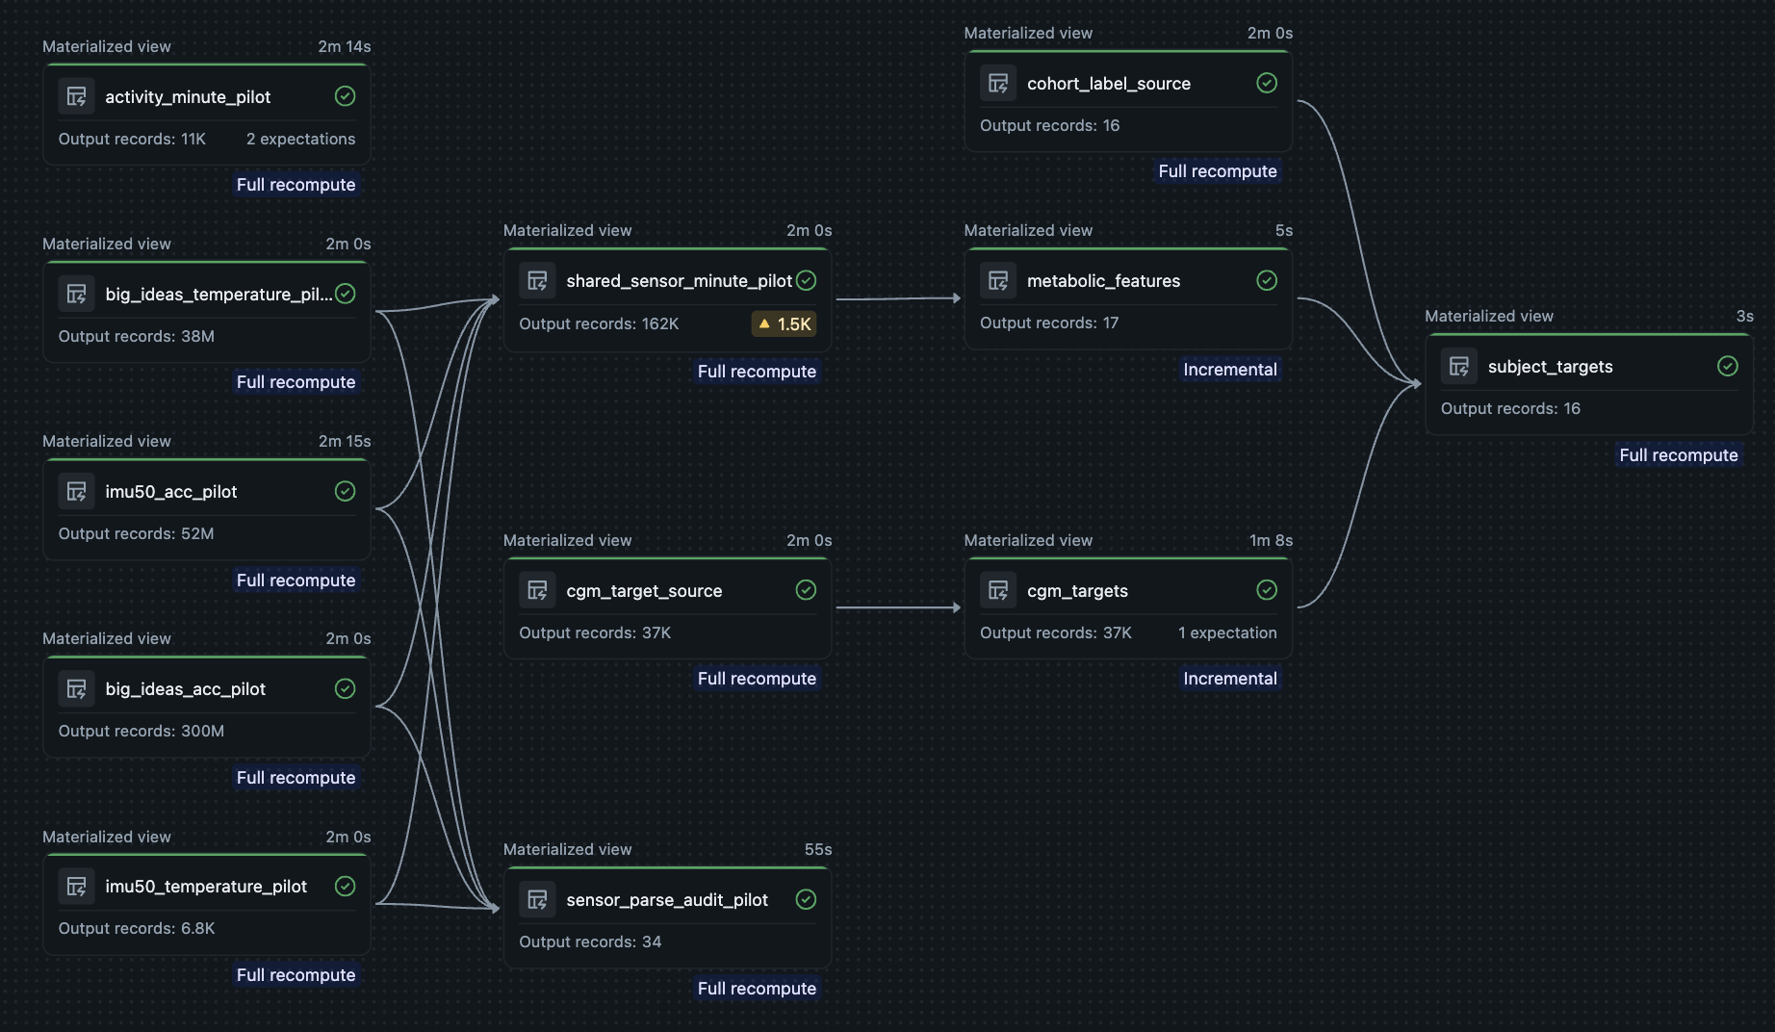
Data at research scale
Two independent studies. One shared wearable feature pipeline.
3.03B
IMU50 acceleration
rows prepared
66
Demo participants
16 BIG IDEAs + 50 IMU50
02
Historical pilot shown. Expanded cohort includes local preparation.
Notes:
This is our actual Databricks pilot pipeline. Expanded local preparation processed over three billion acceleration samples into compact summaries. Our demo includes all sixty-six participants from two independent studies, without matching people across datasets.
Image provenance: user-provided UI screenshot, original image unchanged. The shown pipeline processed 300M BIG IDEAs ACC rows and 52M IMU50 pilot ACC rows into 162K shared minute records. The image retains its 1.5K warning indicator; its meaning was not inspected. Node runtimes are not live latency benchmarks. The exact expanded IMU50 ACC manifest sum is 3,031,935,104. Prepared demo minutes: 855,360 (66 × 12,960). Fixtures span nine days including labeled synthetic extensions.
Sources: user-provided Databricks historical-pilot UI image; databricks/DATA_FLOW.md; databricks/tiger/rolling_risk_evaluation.json; complete IMU50 preparation manifests; verified Tiger snapshot October 4, 2026, 10:09 a.m. Eastern. Datasets: https://physionet.org/content/big-ideas-glycemic-wearable/1.1.3/ and https://zenodo.org/records/21468410. Runtime counts are project evidence, not claims inferred from the linked dataset pages.

Slide 3
System architecture
Live readings and rolling analytics share one serving database
HISTORICAL PREPARATION
Study files
Databricks Volumes
Replay bank
BIG IDEAs + IMU50
Lakeflow + local preparation
9 days per participant
Replay sender
Tiger Data
Backend API
Dashboard
66 participants
Current values + history
Read-only SQL
Cards + trends
Every second
gold.dashboard_live
HTTPS / JSON
Databricks Jobs
Minute events in. Metrics + risk out.
Versioned model
Real training data only
Every 5 minutes
24h features + model
03
Labeled synthetic demo values. Analytics cadence includes additional processing time.
Notes:
Databricks storage holds prepared history for the replay. The sender writes into Tiger Data, and the backend reads the same database directly. Databricks runs a separate analytics loop, reading minute events and publishing rolling features and scores every five minutes, plus processing time.
This architecture shows the requested demo configuration: five-minute analytics. Operational pre-demo cadence is omitted from the presentation. Historical preparation includes Lakeflow for pilot transformations and local preprocessing for the expanded IMU50 cohort. Compact artifacts and history reside in Volumes. Prepared history seeds rolling calculations separately. Tiger raw and gold schemas are the same PostgreSQL database. gold.sensor_latest stores latest interpolated one-second snapshots; raw.sensor_events retains canonical minute events. Databricks merges into Bronze, derives rolling features, scores a pinned model, then writes gold.dashboard_windows. gold.dashboard_live joins current snapshots with latest analytics. Backend requests read published outputs and never trigger compute. Real-only training and held-out models are versioned separately.
Sources: user-provided Databricks historical-pilot UI image; databricks/DATA_FLOW.md; databricks/tiger/rolling_risk_evaluation.json; complete IMU50 preparation manifests; verified Tiger snapshot October 4, 2026, 10:09 a.m. Eastern. Datasets: https://physionet.org/content/big-ideas-glycemic-wearable/1.1.3/ and https://zenodo.org/records/21468410. Runtime counts are project evidence, not claims inferred from the linked dataset pages.

Slide 4
Experimental metabolic score
24-hour movement and skin-temperature features
0–100
Similarity to the
higher-HbA1c cohort
15 real participants
660 real 24-hour windows
Random forest with 12 features
Whole-participant holdouts. Clinical and cross-device validation remain future work.
04
Notes:
Our random forest uses twelve movement and skin-temperature features. We held out whole participants across six hundred sixty real windows from fifteen people. Participant-weighted window accuracy reached sixty point four percent, versus fifty-three point three for the baseline. The score measures cohort similarity. Synthetic data stays out of training, and clinical validation is future work.
Percentages use participant-weighted held-out real-window evaluation, not random window splits. Final forest: 64 trees, depth 3, minimum leaf 20. Model selection used nested participant folds. Known participants use their held-out-person models, which may be logistic or forest. Final model applies to IMU50 with unvalidated device transfer. Heart rate is display-only, not an input. Participant 015 is excluded for inadequate coverage. Synthetic fixtures are excluded from fitting and evaluation. Score is cohort resemblance, not calibrated disease probability, glucose, or diagnosis.
Sources: user-provided Databricks historical-pilot UI image; databricks/DATA_FLOW.md; databricks/tiger/rolling_risk_evaluation.json; complete IMU50 preparation manifests; verified Tiger snapshot October 4, 2026, 10:09 a.m. Eastern. Datasets: https://physionet.org/content/big-ideas-glycemic-wearable/1.1.3/ and https://zenodo.org/records/21468410. Runtime counts are project evidence, not claims inferred from the linked dataset pages.

Slide 5
Streaming and agentic AI
Tiger Data serves live state. AI explains the computed results.
3.03B
LIVE DATA SERVING
Replay feed
Tiger Data
Backend API
Acceleration samples
prepared locally
Every second
PostgreSQL + Timescale
Read-only SQL
1s
Hypertables retain minute history. Latest views serve the dashboard.
Updates for 66 people
AGENTIC EXPLANATIONS
User + context
OpenAI Agents SDK
Gemini API
5 min
Tiger metrics + trends
Orchestration + guardrails
Response generation
Rolling analytics
Contextual explanation
05
Simulated sensor feed. Research insights require clinical validation.
Notes:
Tiger Data is our live serving layer. It refreshes current values every second for sixty-six people and keeps minute history in Timescale hypertables. The backend reads published metrics and trends without triggering analytics. For the AI explanation flow, the OpenAI Agents SDK coordinates the agent and guardrails, while the Gemini API generates a contextual response. That explanation uses the computed results. Databricks still produces the metabolic score.
Sources: databricks/tiger/README.md (expanded preparation totals); databricks/tiger/fast_sensor.py (one-second latest upserts, canonical minute events, joined dashboard view); databricks/tiger/schema.sql (Timescale hypertable); databricks/tiger/dashboard_queries.sql (read contract). Gemini API and OpenAI Agents SDK usage are confirmed by the product team in the presentation request. The diagram describes their high-level relationship and does not assert specific guardrail policies, agent counts, provider transport, or medical-safety guarantees. The current repository contains the data-serving implementation separately from the team’s API integration.
SDK capability references: https://developers.openai.com/api/docs/guides/agents/sdk and https://developers.openai.com/api/docs/guides/agents/guardrails-approvals. These support the general labels orchestration and guardrails, not verification of team-specific policies. Demo second-level values interpolate minute summaries. Durable history remains canonical minute data. Analytics target five minutes plus processing delay.

Slide 6
Glue4Glu
See it live
Continuous readings with a week of context
1s
5 min
7d
Sensor updates
Rolling analytics
Trend history
66 participants. 11,352 verified scored windows.
06
Verified 10:09 a.m. Eastern, Oct 4. Demo ticks interpolate minute summaries.
Notes:
Now we will show the live dashboard. Watch readings update each second, compare the score with its seven-day trend, and ask the AI to explain that participant’s recent context.
Live demo: select a participant, show the sensor publication timestamp advancing, point to the latest rolling score, and show the seven-day trend. Allow 15–20 seconds. The team has confirmed it will present its live dashboard. Demo sensor values are explicitly labeled interpolations and synthetic extensions. Analytics target five minutes plus Databricks processing delay. Scored count is the verified 10:09 snapshot, not a current recount.
Sources: user-provided Databricks historical-pilot UI image; databricks/DATA_FLOW.md; databricks/tiger/rolling_risk_evaluation.json; complete IMU50 preparation manifests; verified Tiger snapshot October 4, 2026, 10:09 a.m. Eastern. Datasets: https://physionet.org/content/big-ideas-glycemic-wearable/1.1.3/ and https://zenodo.org/records/21468410. Runtime counts are project evidence, not claims inferred from the linked dataset pages.

Slide 7
References
Data sources and supporting publications
BIG IDEAs
IMU50
Glycemic Variability and
Wearable Device Data
High-frequency wrist IMU
recordings from 50 subjects
Cho, P., Kim, J., Bent, B.,
and Dunn, J. (2026)
La Fratta, I., et al. (2026)
PhysioNet. Version 1.1.3
Zenodo. Version v1
doi.org/10.13026/aw6y-fc44
doi.org/10.5281/zenodo.21468410
Bent, B., et al. (2021)
Pollard, T., et al. (2026)
Engineering digital biomarkers of interstitial
glucose from noninvasive smartwatches
PhysioNet platform reference
Nature Health, 1, 792–795
npj Digital Medicine, 4, 89
doi.org/10.1038/s44360-026-00096-z
doi.org/10.1038/s41746-021-00465-w
07
Notes:
Reference appendix, outside the timed pitch. Dataset pages verified October 4, 2026. The BIG IDEAs v1.1.3 resource requests its dataset citation, original Bent study, and standard PhysioNet platform citation. IMU50 and BIG IDEAs contain independent participants. This bibliography attributes original measured datasets, not synthetic demo extensions.
Cho, P., Kim, J., Bent, B., & Dunn, J. (2026). BIG IDEAs Lab Glycemic Variability and Wearable Device Data (version 1.1.3). PhysioNet. https://doi.org/10.13026/aw6y-fc44
La Fratta, I., et al. (2026). IMU50: high-frequency wrist-worn IMU recordings from 50 subjects (v1). Zenodo. https://doi.org/10.5281/zenodo.21468410 (Title abbreviated; the DOI resolves the full dataset record.)
Bent, B., et al. (2021). Engineering digital biomarkers of interstitial glucose from noninvasive smartwatches. npj Digital Medicine, 4, 89. https://doi.org/10.1038/s41746-021-00465-w
Pollard, T., et al. (2026). PhysioNet platform reference. Nature Health, 1, 792–795. https://doi.org/10.1038/s44360-026-00096-z (Article title abbreviated.)
Primary metadata sources: https://physionet.org/content/big-ideas-glycemic-wearable/1.1.3/ and https://zenodo.org/records/21468410 .

